Slide 1
Symantec™ Endpoint Management
Mike Grueber
Product Management
Notes:
.

Slide 2
Agenda
1 | ITMS 8.0
2 | ITMS Roadmap
3 | Windows Patch Management

Slide 3
ITMS 8.0

Slide 4
IT Management Suite 8.0
Release Objective
Introduce SUEP capabilities to ITMS customers
Doubled product scalability
Release Highlights
Endpoint management convergence
Symantec Unified Endpoint Protection integration
User self-enrollment
Mobile inventory
Security configuration visibility
User-centric search and filter
Enhance core value
New SW licensing compliance tracking
FIPS support
Doubled nodes per SMP server
New report save option
Agent plugin version tracking in Agent Health
Increased filtering options
SW install reboot control
Application metering – UEFI secure boot support
Internet-based help system
Platforms Windows 10, OS X 10.11, RHEL 6.6, 7, 7.1, SLES 11 SP3, 12, Android, iOS
Ship Date: March 7, 2016
Value Proposition
Gain unified view of all devices being used to access corporate resources
Target
Customers managing traditional and modern OS devices
Customers with BYOD use cases
Release Status
Shipped
Execution

Slide 5
Unifies visibility across
all endpoints
ITMS
8.0
SOLVES
KEY
CHALLENGES
Optimizes software
license costs
Enhances reporting, patch and software management, platform support
Gives organizations room to grow and is easier to use
Increases protection of information

Slide 6
ITMS 8.0 UNIFIES VISIBILITY ACROSS ALL ENDPOINTS
Symantec
Endpoint Protection
ITMS Implementation
Remote Branch / Affiliate
Infrastructure or expertise limitations
ITMS
BYOD/CYOD
ITMS agent not an option
Mobile Device
Non-traditional management
Traditional ITMS boundary

Slide 7
Unifies visibility across
all endpoints
ITMS
8.0
SOLVES
KEY
CHALLENGES
Optimizes software
license costs
Enhances reporting, patch and software management, platform support
Gives organizations room to grow and is easier to use
Increases protection of information

Slide 8
ITMS 8.0 OPTIMIZE SOFTWARE LICENSE COSTS
Correlation
Collection
Remediation
License models:
Per device
Per user
Per CPU / processor
A
Remove Unused / Unauthorized Software
25% of licenses not used
Software
Inventory
SW License
Compliance Posture
Software
Metering
B
Deploy SW to Correct User or Device
Reallocate licenses properly
SW Contract
Management
C
Purchase Additional Licenses
Avoid penalty fees
Common misalignment:
Over-deployed licenses
Underutilized licenses
SW used by unintended user or device

Slide 9
Unifies visibility across
all endpoints
ITMS
8.0
SOLVES
KEY
CHALLENGES
Optimizes software
license costs
Enhances reporting, patch and software management, platform support
Gives organizations room to grow and is easier to use
Increases protection of information

Slide 10
ITMS 8.0 GIVES ORGANIZATIONS ROOM TO GROW AND IS EASIER TO USE
..
..
..
..
..
15K
17K
10K
42K
42K
..
..
..
15K
17K
10K
200K
200K
100K
100K
35K
35K
35K
35K
35K
25K
20K
20K
20K
20K
20K
20K
20K
20K
20K
20K

Slide 11
Unifies visibility across
all endpoints
ITMS
8.0
SOLVES
KEY
CHALLENGES
Optimizes software
license costs
Enhances reporting, patch and software management, platform support
Gives organizations room to grow and is easier to use
Increases protection of information
Notes:
ITMS 8.0

Slide 12
ITMS 8.0 INCREASES PROTECTION OF INFORMATION
New Device Security Status Summary View indicates secure, at risk, or compromised,
as reported by Unified Endpoint Protection
Also . . .
Stronger encryption (FIPS Compliant)
Updates to TLS support in CEM
Improved support for UEFI secure boot

Slide 13
Unifies visibility across
all endpoints
ITMS
8.0
SOLVES
KEY
CHALLENGES
Optimizes software
license costs
Enhances reporting, patch and software management, platform support
Gives organizations room to grow and is easier to use
Increases protection of information

Slide 14
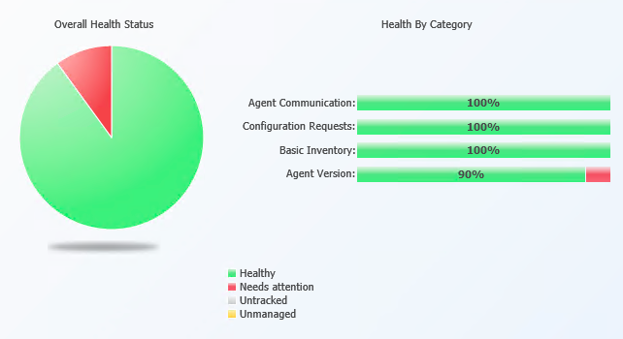
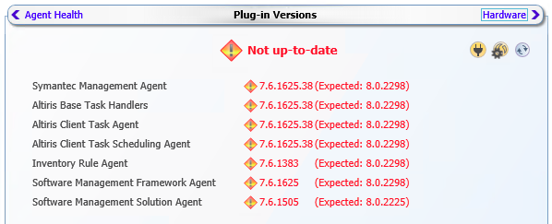
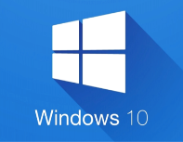
ITMS 8.0 ENHANCES REPORTING, PATCH & SOFTWARE MANAGEMENT, AND PLATFORM SUPPORT
Central agent health now reports plugin version status
Also . . .
Save results of filter view as a report
More granular control of system reboots
New SW compliance ITA cube
. . . and platform updates
Windows 10
OS X 10.11
Red Hat 6.6, 7, 7.1
SuSE 11 SP3, 12
SQL Srvr 2012 SP2

Slide 15
ITMS Roadmap

Slide 16
Safe Harbor Statement
Any information regarding pre-release Symantec offerings, future updates or other planned modifications is subject to ongoing evaluation by Symantec and therefore subject to change.
This information is provided without warranty of any kind, express or implied. Customers who purchase Symantec offerings should make their purchase decision based upon features that are currently available.

Slide 17
ITMS Roadmap
Calendar Year
1H 2016
1H 2015
2H 2015
2H 2016
1H 2016
1H 2017
2H 2017
1H 2018
2H 2018
2H 2016
1H 2017
2H 2017
ITMS
Endpoint management convergence
SEP Cloud integration
User self-enrollment, Mobile inventory, Security configuration visibility
Enhanced core value
New SW licensing compliance tracking
FIPS support
50k nodes per SMP server
1 x 6 x 35k hierarchy scalability
Easier to Use
New report save option
Agent plugin version tracking in Agent Health
Views-based filtering
Software install & patch reboot control
Application metering in UEFI secure boot
Internet-based help system
Platforms
Windows 10, OS X 10.11, RHEL 6.6, 7, 7.1, SLES 11 SP3, 12, Android, iOS
Key Customer Features
Win 10 feature and Office 365 updates
Win 10 cumulative updates enhancements
Mac management enhancements
CEM support in SW Portal
DS thin-client support
XFS, 4k sector drive
SNMP v3 network discovery (Cisco)
Smart card authentication
Off-box data migration
Symantec Licensing Framework upgrade
Additional remote control tools integration
Platform support
CentOS
Win Server 2016, Win 10 Redstone
Mac OSX Sierra
RHEL 6.7, 6.8 & 7.2, SLES 12 SP1
Solaris 11.3
SQL 2014 SP1, 2016
Modern OS Device/App Management
Patch of modern application
Peer-to-peer management
Software self-serve (app store)
imaging/provisioning enhancements
Managing from and on the Cloud
AWS/Azure-hosted & hybrid with on-prem
SEP Cloud, SAEP integration
Symantec cross-product integration
Remediation capabilities for CCS
ATP, Encryption, Deepsight integration
Console enhancements
Console technology modernization
Ease of use and integration
Platform support
Mac patch enhancements
Linux expansion
ITMS 8.0
ITMS 8.1 - Solitude
ITMS - Sundance
Ship date: March 7, 2016
Planned GA: CY Q1 2017
Planned GA: CY H1 2018
Release Status
Shipped
Execution
Planning
Concept

Slide 18
Windows Patch Management

Slide 19
Enhanced Support for Office 365 Updates
Description of capability introduced by Microsoft
Updates to Office 365 Professional Plus rely on the ‘Click to Run’ option, which uses incremental differencing to only download to the device the missing content needed to perform the update (using App-V streaming technology)
This contrasts with traditional updates, which require the entire install package to be downloaded
Description of enhancement in ITMS
Patch Management will be able to identify O365 installations that need updating and apply the update by transferring to the endpoint only the missing content needed to perform the update
To enable and control such distribution, ITMS will first download the O365 update to a central location and leverage Package Server infrastructure, where present, to get update content closer to the endpoints that need it

Slide 20
Enhanced Support for Office 365 Updates – continued
Technical Details
Configure
Redirect Click-to-Run Settings to point to package location
Update
Launch native O365 Update process
Policy
Standard Patch policy with DON’T_DOWNLOAD flag
Patch data
SMP Server
O365 Update bits
Management Agent
Staging
Office 365 package
Package Server
O365 Update bits
Management Agent
Benefit to customers
Communicate to endpoint only the information required to perform the update
Leverage Package Server infrastructure, where present, to reduce network bandwidth use
Single Patch framework and user experience to update all OS’es and applications in the environment

Slide 21
Support for Windows 7/8.1 Monthly Rollups & Security Updates
Description of capability introduced by Microsoft
Starting in October 2016 Microsoft is releasing monthly rollups and security updates for Win 7 & 8.1
Monthly rollups will be cumulative in nature and include security and non-security updates. Monthly security updates will not be cumulative
All updates in a monthly rollup/update are applied at once, no option to choose individual updates
Symantec KB Article with more information is available
Description of enhancement in ITMS
ITMS will download monthly rollups and security updates from Microsoft’s site
Detection and applicability rules of Win7/8.1 monthly rollups and security updates for intelligent targeting and compliance reports
Peer-to-peer distribution for data transfer efficiencies for remote sites without Package Servers*
* Estimated to be available in December 2016

Slide 22
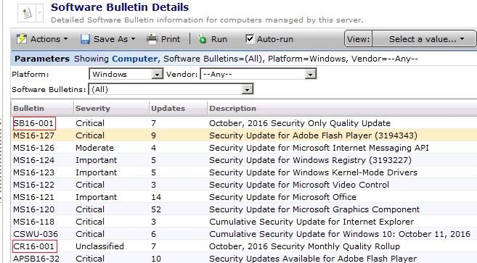
Support for Windows 7/8.1 Monthly Rollups & Security Updates
Available Today
Benefit to customers
Central control and tracking of Win7/8.1 monthly rollup and security updates rollouts
Single Patch framework and user experience to update all OS’es and applications in the environment
Optimized network utilization for remote sites without Package Servers
Alignment with industry trends to reduce the fragmentation of environments based on patch levels

Slide 23
Enhanced Support for Windows 10 Feature Updates
Description of capability introduced by Microsoft
Microsoft has been providing Win10 feature updates (3-4GB) every 4-8 months since Windows 10 GA in July’15
Win10 feature updates require manual step to download .ISO files from Microsoft site
Only encrypted ESD files for automated download and WSUS or direct internet access required to decrypt
Description of enhancement in ITMS
Detection and applicability rules of Win10 Feature Updates for intelligent targeting and compliance reports
Peer-to-peer distribution for data transfer efficiencies for remote sites without Package Servers
Benefit to customers
Central control and tracking of Win10 Feature Update rollouts
Single Patch framework and user experience to update all OS’es and applications in the environment

Slide 24
Enhanced Support for Windows 10 Cumulative Updates (CU)
Description of capabilities introduced by Microsoft
Cumulative security and reliability updates since edition’s GA or feature updates
CU-s are growing in size too fast (~300MB in April, 700MB in June, ~900MB in September)
Optimizations of the download size for future updates
Public communication from Microsoft is expected in October 2016
Description of enhancement in ITMS
ITMS will support download size optimizations from Microsoft
Detection and applicability rules for Cumulative Updates for intelligent targeting and compliance reports
Peer-to-peer content distribution for locations where Package Server deployment is not feasible*
* Estimated to be available in December 2016

Slide 25
Peer Download Optimization in ITMS – Technical Details
Local storage (packages and peer info)
Peer-to-Peer Overview
Peer-to-Peer Design on Management Agent
SMP or Package Server
⑩
Endpoint
Peers downloading packages
Commands to peers
Listen for & broadcast to peer info
Commands form peers
Update peer info
Download package
Share packages for download
Package info to/from peers
Peer Information
Store/retrieve packages
Package Delivery
Branch office
⑥
⑦
⑧
⑨
HTTP Server
④
DHT Engine
⑤
Peer Discovery
①
②
③
Endpoint
Endpoint
N e t w o r k
Copyright © 2016 Symantec Corporation

Slide 26
Enhanced Support for Windows 10 CU – Benefits to Customers
Benefit to customers
Significant reduction of file size for optimized bandwidth utilization
Scalable content distribution model at the endpoint, to supplement Package Server framework; doesn’t require changes to network and security configuration
Single Patch framework and user experience to update all OS’es and applications in the environment
Simplified way to ensure that environment is safe by following the OS vendor update posture
Example of Reduction in Network Traffic
Approach | Optimizes for | Traffic To Site*
Current | N/A | 30 GB
Current with Multicasting | network traffic | 12 GB
with Symantec optimization | # of downloads | 1 GB
and Integration of Symantec with Microsoft optimization | size of package | 300 - 500 MB**
* Estimations are based on
site with 30 computers
average Cumulative Update (CU) size 1 GB and
average size of Microsoft optimized package is 300-500 MB
multicasting efficiency 60%
** In case the site has endpoints which missed some monthly updates, the traffic to that subnet will increase to 1.3 – 1.5GB to include CU
Copyright © 2016 Symantec Corporation

Slide 27
Thank you!

