Slide 1
How Meridian Leverages Vontu DLP By Richard Tisdale

Slide 2
Meridian Health
Introduction
Challenges
Solution
Implementation
Results
Recommendations
Q & A

Slide 3
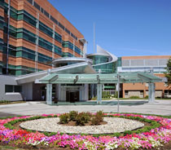
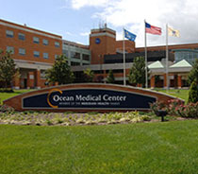
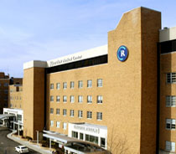
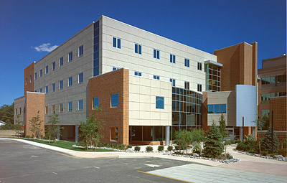
Introduction
Description of your company
Meridian Health
8,000 Employees and Physicians
4 Hospitals
Jersey Shore University Medical Center
Ocean Medical Center
Riverview Medical Center
K. Hovnanian Children’s Hospital
Southern Ocean County Hospital
Number of desktops, & servers?
4500 Workstations 1000
1000 Thin Clients
550 Servers

Slide 4
Introduction
Security Solution
Symantec Data Loss Prevention
Symantec IDS System Managed Security Services
Symantec Control Compliance Suite for IT Compliance & IT Governance
CheckPoint Firewall
Fortinet Firewall
WebSense Web Security
Bradford Networks NAC
ArcSight Log management and Event Log Compliance
McAfee ePolicy Orchestrator

Slide 5
Introduction
Current role & responsibilities
Senior IT Security Analyst
Enterprise Networking Perimeter Security
Hardware and Software Technical Regulation Standards Monitoring
PHI Data Regulation Protection
Policy Enforcement
Previous work experience
Technical Manager IT
Technical Advisor IT
Business Continuity Administrator IT

Slide 6
Challenges
DLP Product Concerns
Affordability
Scalability
User Ability
AD Integration
Workflow Intelligence
Enforcement Policy Intelligence
Product Support
DLP Business Concerns
Knowing WHO own the data
Knowing where the confidential data resides
Understanding data usages
Remote Users

Slide 7
Challenges
Open WiFi Users
Bi-Med Vendors Support
Email Communication
Incidents Response SLA
Resource
Manageable
Performance
DLP Business Impact
Users and Vendors Education
Data Classification
PHI Data Storage on and off Corporate Network
Control Data Transmissions
Control Web Communication

Slide 8
Solution
Vendors/solutions Considered to solve these challenges?
RSA Data Loss Prevention (Tablus)
Proof Point E-mail Encryption (Sigaba)
What were the pros & cons of each?
Centralized Console
AD Integration
Workflow Intelligence
Enforcement Policy Intelligence
Product Support
Endpoint Control

Slide 9
Solution
What was the decision process
POC
Bake-off
Analyst reports
Reference calls
Why did you choose Symantec?
Robust Policy Enforcement Engine
Fingerprinted Content Detection
Described Content Detection
Automated Enforcement
Policy Definition
Role-Based Access and Privacy Control
Incident Response Workflow
Reporting and Analytics

Slide 10
Solution
Network Discovery and Protection
Target Coverage
Data Protection
Actionable Incident details
Scan Management
Scale and Security
Endpoint
Coverage
User Action Coverage
Agent deployment and Management
Real Time Enforcement
Reporting and Analytics
Network Monitoring and Prevention
Multi-Protocol Monitoring capabilities

Slide 11
Implementation
Which specific products did you implement?
Security Products
Vontu Network Monitor
Vontu Network Prevent
Vontu Discover
Vontu Endpoint
Vontu Enforce
Vontu Email Prevent
Voltage E-mail Encryption
Symantec Consulting helped implemented the products
Describe the implementation process
How did it go
How long did it take

Slide 12
Results
Implementation Challenges
Multi-Network IP Filtering
SMTP Host Relay
Training
Knowledge Transfer
What are the most significant results you have achieved so far?
Users and Vendors Education
Have you been able to address the original challenges you wanted to solve?
Improved Incident Management and Resolution with Less Resources

Slide 13
Recommendations
What tips, tricks, best practices, etc can you share?
When making changes and or testing new policies turnoff email response notification rules

Slide 14
Q & A
Any questions?

