Slide 1
IT Analytics for Symantec Endpoint Protection
Presenter’s Name Here
Presenter’s Title Here

Slide 2
Agenda
1
What is IT Analytics?
2
Product Overview
3
Capability Comparison
4
Key Features
5
Summary of Benefits

Slide 3
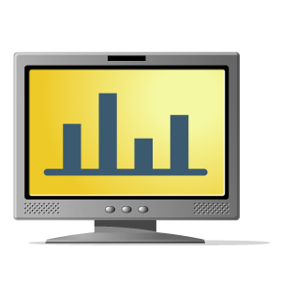
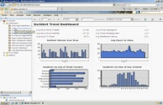
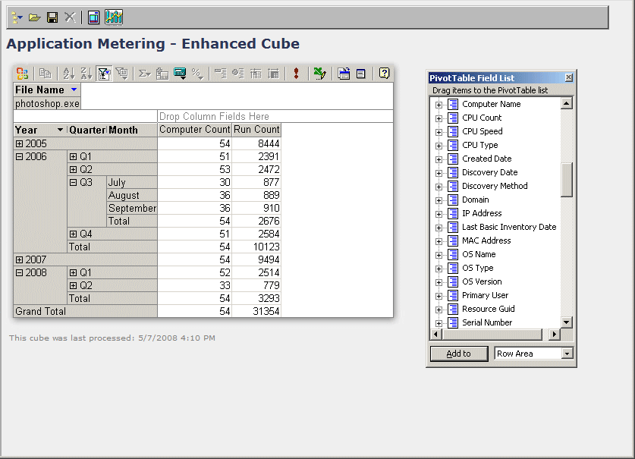
What is IT Analytics?
Leverages Business Intelligence
Expands on Traditional Reporting
Leverages OLAP Cubes
Utilizes Standard Technologies
Advanced ad-hoc data-mining
Analyze Trends and historical information
Graphical dashboards and easy reporting
User friendly custom reports
Export to multiple formats
Pivot tables and charts
Business intelligence via multi-dimensional data exploration
SQL 2005/2008 Analysis Services & Reporting Services

Slide 4
Product Overview
Traditional Reporting
Traditional Reporting
1
Multiple report requests can hinder server performance
Large databases or complicated queries may take a long time to run
Canned reports offer limited options for customization or data analysis
1
IT Analytics
2
Robust Graphical Dashboard
3
Multi-Dimensional Ad-hoc/Pivot Table Reporting
4
SEP
Database
Pivot Chart Functionality with Excel Export
5

Slide 5
Product Overview
Traditional Reporting
1
Flexible ad-hoc/custom reporting
Drill-down capabilities
Multi-dimensional analysis
Improved server performance
Seamlessly export to Excel & PDF
IT Analytics
2
Robust Graphical Dashboard
3
Multi-Dimensional Ad-hoc/Pivot Table Reporting
MS SQL
Reporting Services
Analysis Services
4
SEP
Database
CMDB
Pivot Chart Functionality with Excel Export
5

Slide 6
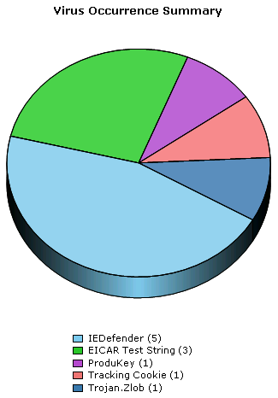
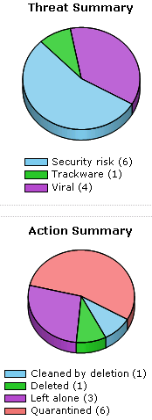
Product Overview
Traditional Reporting
1
IT Analytics
2
Robust Graphical Dashboard
3
Multi-Dimensional Ad-hoc/Pivot Table Reporting
4
Pivot Chart Functionality with Excel Export
5

Slide 7
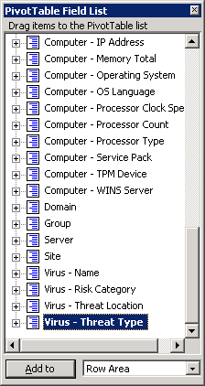
Product Overview
Alerts Cube
Traditional Reporting
1
IT Analytics
2
Robust Graphical Dashboard
3
Multi-Dimensional Ad-hoc/Pivot Table Reporting
4
Pivot Chart Functionality with Excel Export
5

Slide 8
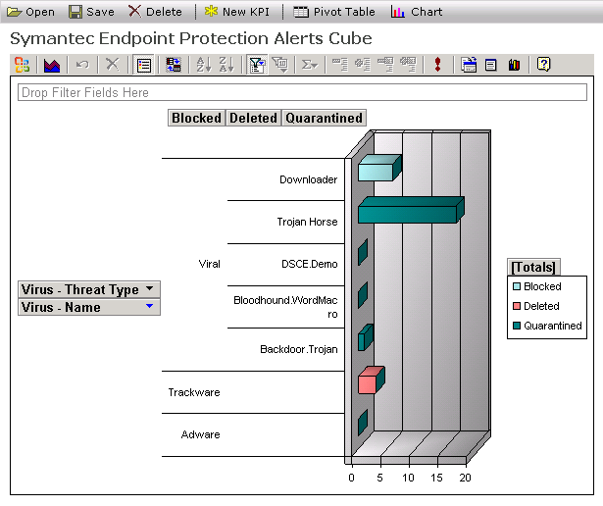
Product Overview
Alerts Cube
Traditional Reporting
1
IT Analytics
2
Robust Graphical Dashboard
3
Multi-Dimensional Ad-hoc/Pivot Table Reporting
4
Pivot Chart Functionality with Excel Export
5

Slide 9
What IT Analytics Enables You To Do
Continuously Improve IT Operations
Timeliness & quality of information
Observe compliance Standards and reduce costs
Top level summary of your essential Security data
Solve Existing Scalability Issues
Offload reporting burden from the SEP database
Alternative to previously long running queries
Resources & Time Savings
Replace time-consuming & complex custom reporting
Free-up technical resources with advanced SQL knowledge
9
Notes:
9

Slide 10
With the inclusion of IT Analytics, the Symantec [Endpoint Security] solution provides reporting and analysis capabilities far beyond what is available from McAfee.
IT Manager
Fortune 150 diversified manufacturing and technology company
Notes:
“Our decision to replace McAfee with Symantec Endpoint Protection was based on a thorough evaluation of features relevant to our large enterprise. In addition to its sharp look and feel, SEP 11 is superior in policy editing and network access control. With the inclusion of IT Analytics, the Symantec solution provides reporting and analysis capabilities far beyond what is available from McAfee. IT Analytics has given us the insight we need to effectively manage our migration from McAfee, and be confident we're in control of our SEP 11 implementation.”
IT Manager
Fortune 150 diversified manufacturing and technology company

Slide 11
Capability Comparison
 | Symantec |  | McAfee
Reporting and Analytics Capabilities | Endpoint Protection | IT Analytics | ePO
Pre-built SQL-based reports & dashboards | ● |  | ●
SQL-based custom report authoring |  |  | ●
Assemble multiple SQL-based reports into dashboards |  |  | ●
Fast OLAP based reports and dashboards |  | ●
Forensic Analysis through free form pivot tables |  | ●
Key Performance Indicators |  | ●
Ability to utilize reports in external portals & dashboards |  | ●
Drag-and-drop report and dashboard creation |  | ●
Granular data level security capabilities |  | ●
Actionable Intelligence that moves SEP ahead of ePO!
Notes:
11

Slide 12
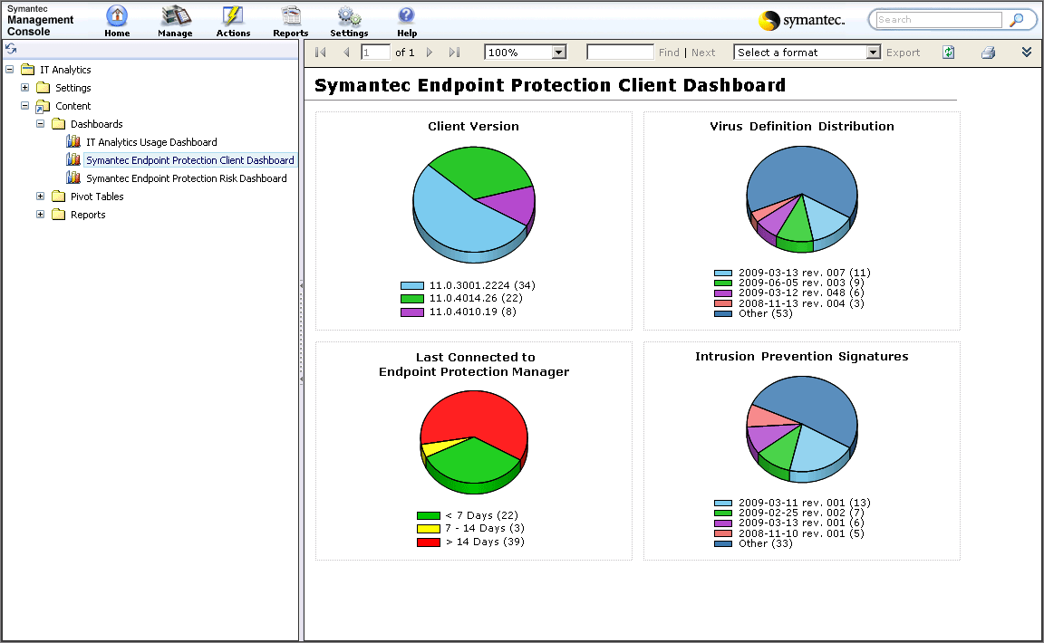
Client Dashboard
12

Slide 13
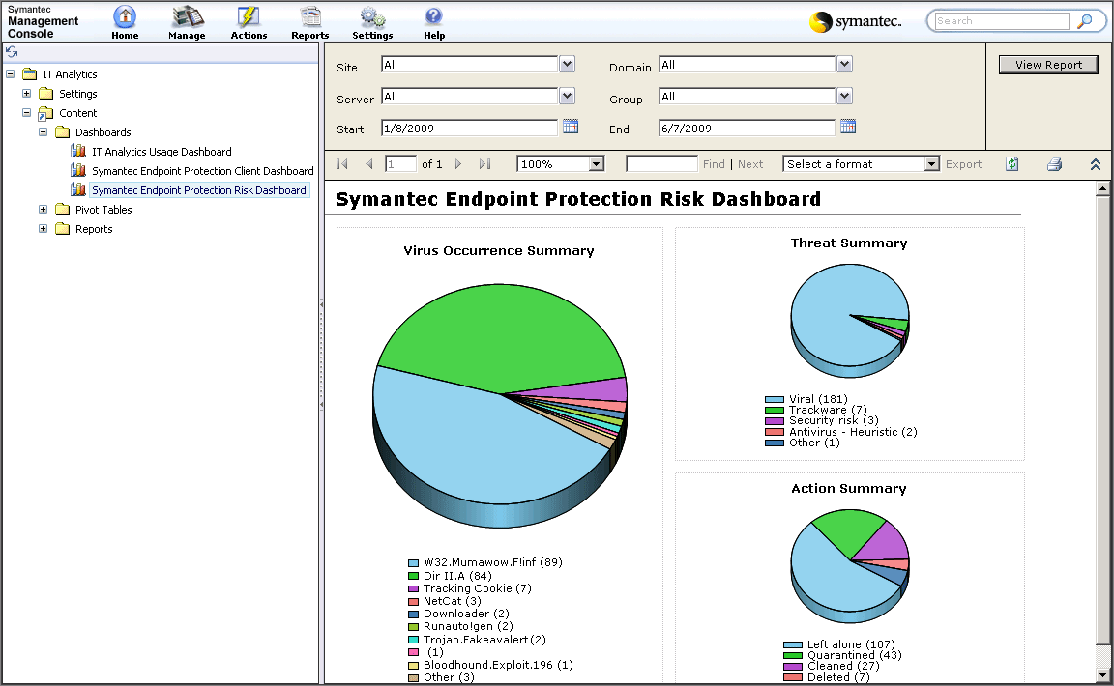
Risk Dashboard
13

Slide 14
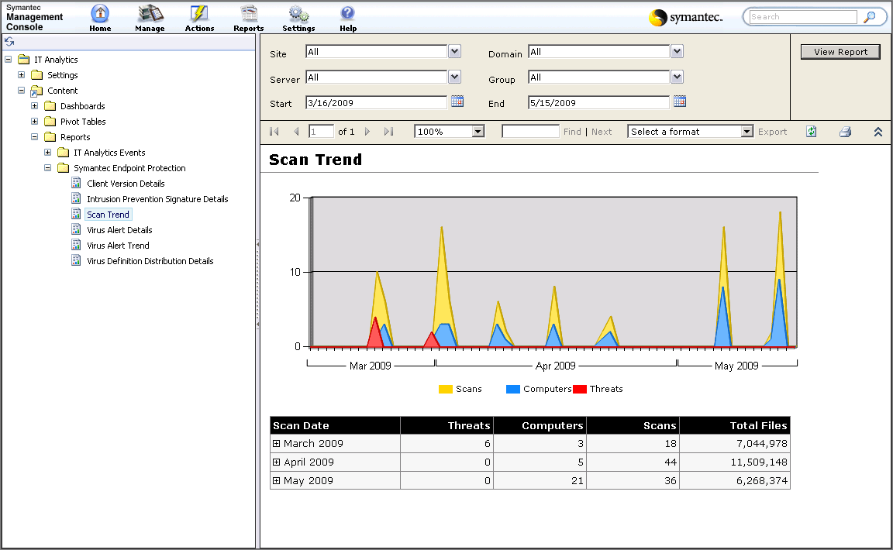
Scan Trend Report
14

Slide 15
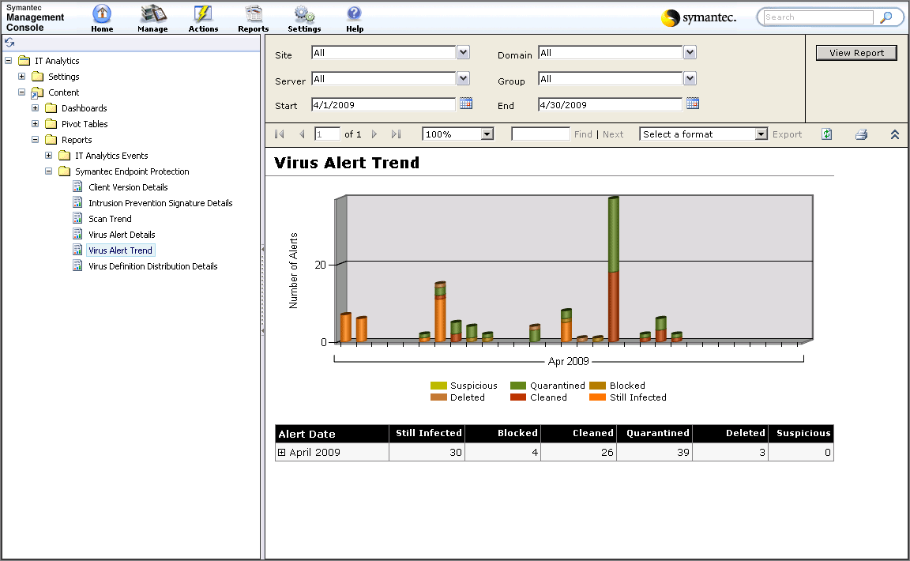
Virus Alert Trend Report
15

Slide 16
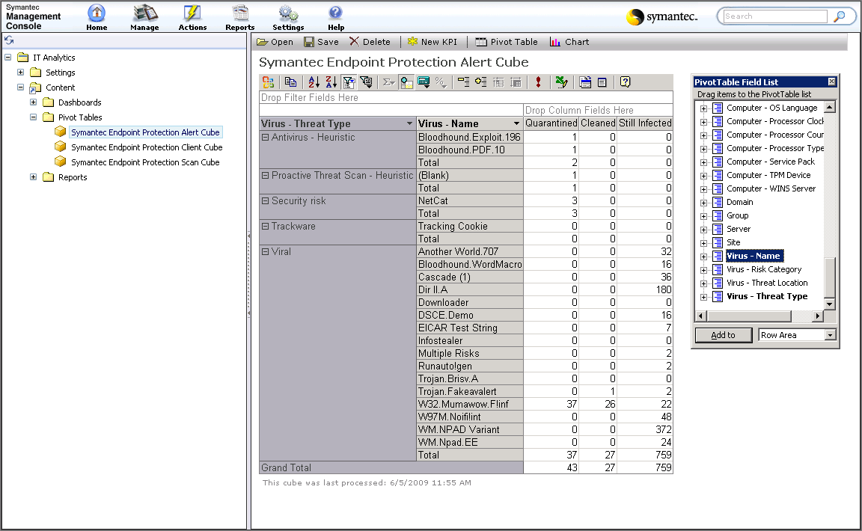
Alert Cube Pivot Table
16

Slide 17
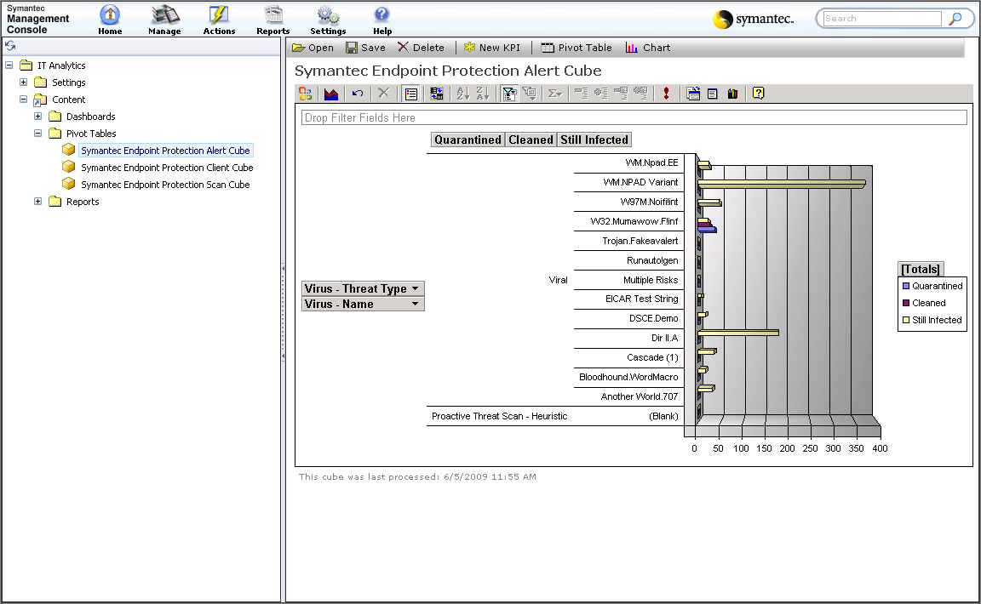
Alert Cube Pivot Chart
17

Slide 18
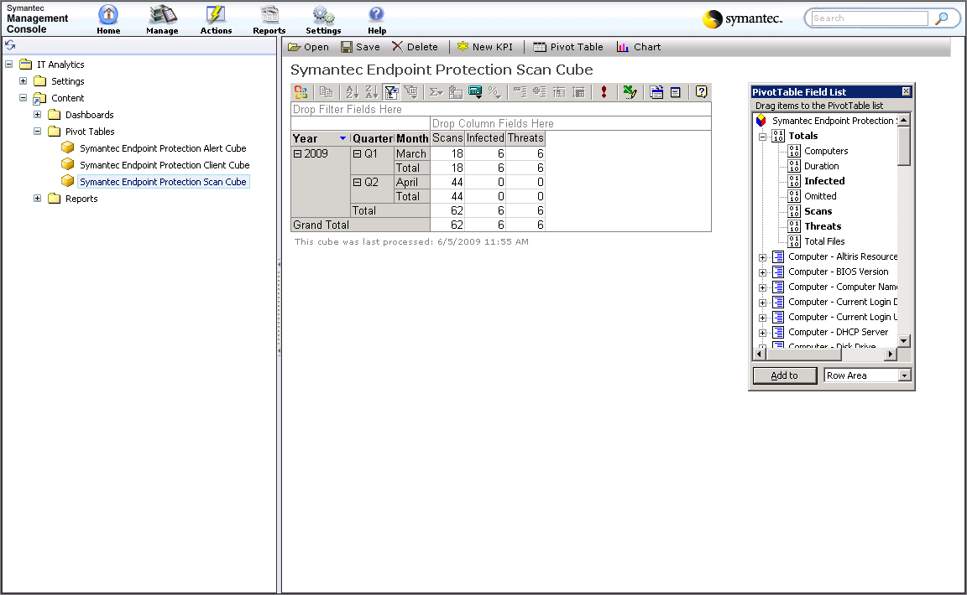
Scan Cube Pivot Table
18

Slide 19
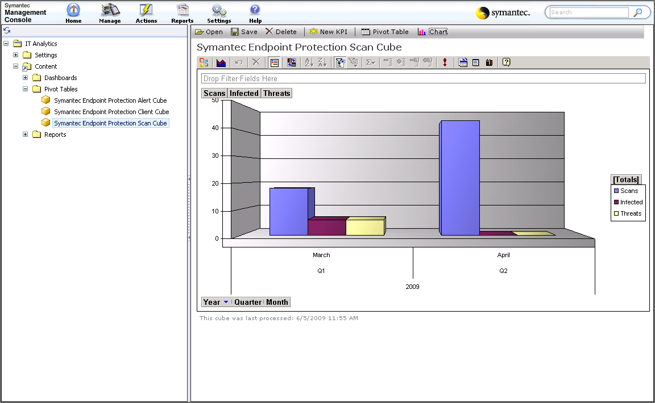
Scan Cube Pivot Chart
19

Slide 20
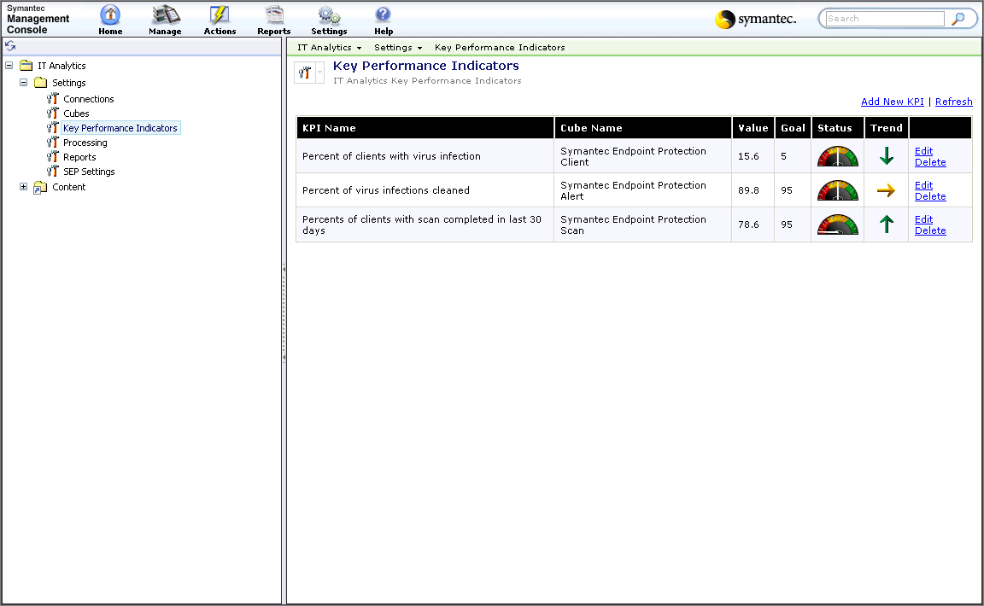
Key Performance Indicators
20

Slide 21
Summary
Optimize your Symantec investment
✓
Drill through Endpoint Protection data to mine the right information at the right time
✓
Make it easy for users to understand complex environments
✓
Identify trends and opportunities faster to accelerate the decision making process
✓
Make fully informed decisions about your organization’s performance
✓

Slide 22
Presenter
title
email

