Slide 1
21231182-1: CANNOT AUTHENTICATE FROM MEMBE

Slide 2
21231182-1: CANNOT AUTHENTICATE FROM MEMBE
AD server is not authenticating member server issue
Question 1 : seosd-eACSubAuth.Relationship between dll-susrauth.dll
The AC implemented sub authentication is based on SUSRAUTH.dll and eACSubSUSRAUTH.dll is the hooking DLL loaded by lsass.exe as a 'Sub authentication' HKLM\SYSTEM\CurrentControlSet\Control\Lsa\MSV1_0 value Auth0 and calling OS hook functions: Msv1_0SubAuthenticationRoutine() - for local authentication; Msv1_0SubAuthenticationFilter() - for DC authentication;

Slide 3
21231182-1: CANNOT AUTHENTICATE FROM MEMBE
AD server is not authenticating member server issue
It runs separate maintenance thread that on event set by starting SeOSEngine service dynamically loads eACSubAuth.dll and unloads it on another event set by stopping SeOSEngine service. The eACSubAuth.dll is responsible for connecting to the SeOSEngine for executing logon authorization and is where sub authentication logic is delegated to through the implemented hook functions.

Slide 4
21231182-1: CANNOT AUTHENTICATE FROM MEMBE
AD server is not authenticating member server issue
In the case of DC approval, the LSA receives the results from the AD, which is then eACSubAuth through Msv1_0SubAuthenticationFilter() hook.Deliver to dll. This sends an Authorization Request to SEOSEngine again and returns the result to the LSA.
In case of authentication on DC, the LSA gets result from AD and conveys it through Msv1_0SubAuthenticationFilter() hook to eACSubAuth.dll that creates and sends authorization request to SEOSEngine and returns received result back to LSA.

Slide 5
21231182-1: CANNOT AUTHENTICATE FROM MEMBE
AD server is not authenticating member server issue
The suserauth.dll called subauthentication package, implements Windows authentication customization extending standard OS authentication functionality
and the Windows authentication package calls suserauth.dll before returning the authentication result to the Local Security Authority (LSA).

Slide 6
21231182-1: CANNOT AUTHENTICATE FROM MEMBE
AD server is not authenticating member server issue
If AC is installed on DC the TERMINAL is the class responsible for authorization The symptoms described in the issue point on insufficient performance in serving authorization requests. We propose to improved performance by rule optimization and turning on the TERMINAL names internal cache reducing amount of authorization requests sent ot seosd: 1. Stop AC 2. Modifying rule to chres TERMINAL ("_default") defaccess(READ) owner('nobody') 3. Excluding authorization authorize- TERMINAL ("_default") uid('_undefined') 4. Setting registry value HKLM\SOFTWARE\ComputerAssociates\AccessControl\SeOSD EnableCachedLogonInfo = 1 5. Start AC

Slide 7
21231182-1: CANNOT AUTHENTICATE FROM MEMBE
AD server is not authenticating member server issue
Question 3: What effect does Bypassing lsass with SpecialPGM have?
Bypassing lsass.exe with SPECIALPGM has not any effect because AC ignores any access done by lsass.exe process to the system resources. In other word accesses of lsass process to e.g. files or registry values are bypassed because the lsass.exe is included into table of trusted processes
of seosdrv.sys driver and the driver ignores them without SPECIALPGM.

Slide 8
21231182-1: CANNOT AUTHENTICATE FROM MEMBE
AD server is not authenticating member server issue
In addition the LOGIN events are handled by OS (LSA) but not intercepted by th e AC driver. The LOGIN authorization is implemented through 'sub-authentication', thus byp assing it can be done as follows: 1. Stop AC 2. Rename eACSubAuth.dll in the %SystemRoot%\system32. 3. Start AC After that authorization with TERMINAL rules is not performed and "P LOGON" records are not written to audit log.

Slide 9
21231182-1: CANNOT AUTHENTICATE FROM MEMBE
AD server is not authenticating member server issue
Question 4: How to unload all AC modules performed by lsass.exe?
In order to avoid loading of all AC modules in lsass.exe process you need to add to (2.) renaming of eACPasswordFltr.dll in %SystemRoot%\system32 that is responsible for checking password quality during password reset.

Slide 10
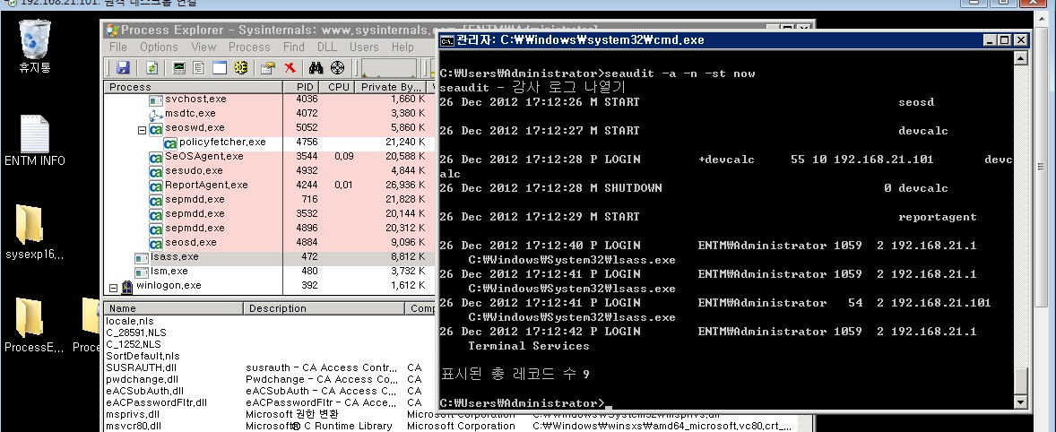
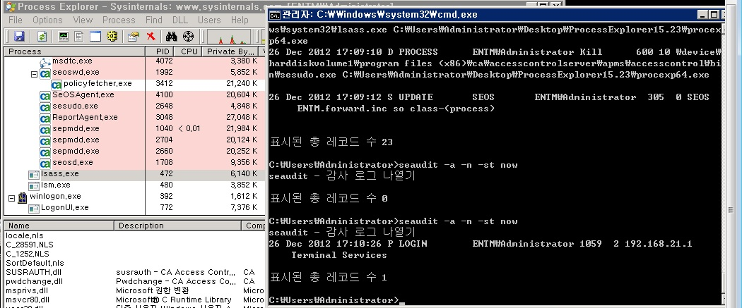
21231182-1: CANNOT AUTHENTICATE FROM MEMBE
AD server is not authenticating member server issue
Examples of use
eACPasswordFltr.dll, eACSubAuth.dll This is the test result before and after renaming the file.
No Lsass.exe logs were found, and one Terminal Services log was logged. 26 Dec 2012 17:10:26 P LOGIN ENTM\Administrator 1059 2 192.168.21.1 Terminal Services
<DLL 변경 전> <DLL 변경 후>

