Slide 1
Mainframe Automation Using Zowe Fast Track to Continuous Integration Tuesday, June 18, 2019
Hosted by

Slide 2
Presenter
Michael Bauer is a Sr. Product Owner at Broadcom responsible for the CA Brightside Command Line Interface (CLI) which was recognized as the Most Innovative DevOps Solution of the Year for 2018 by DevOps.com. He is also the squad lead for the Zowe CLI component of Zowe, the first open source project based on z/OS. Before transitioning into a product management role, Michael was a developer for traditional mainframe system applications. He is based in Pittsburgh, Pennsylvania.

Slide 3
Agenda
Zowe overview
Introductory webinar available on demand @ DevOps.com, 3/28, titled “Bridging Modern DevOps and the Mainframe”
API Mediation Layer & Command Line Interface demonstrations
Webinar available on demand @DevOps.com, 4/11, titled “Mainframe DevOps using Zowe Open Source”
Construct build, deploy, and test scripts using Zowe CLI
Demonstrate setup and execution of scripts from a Jenkins pipeline
Q & A

Slide 4
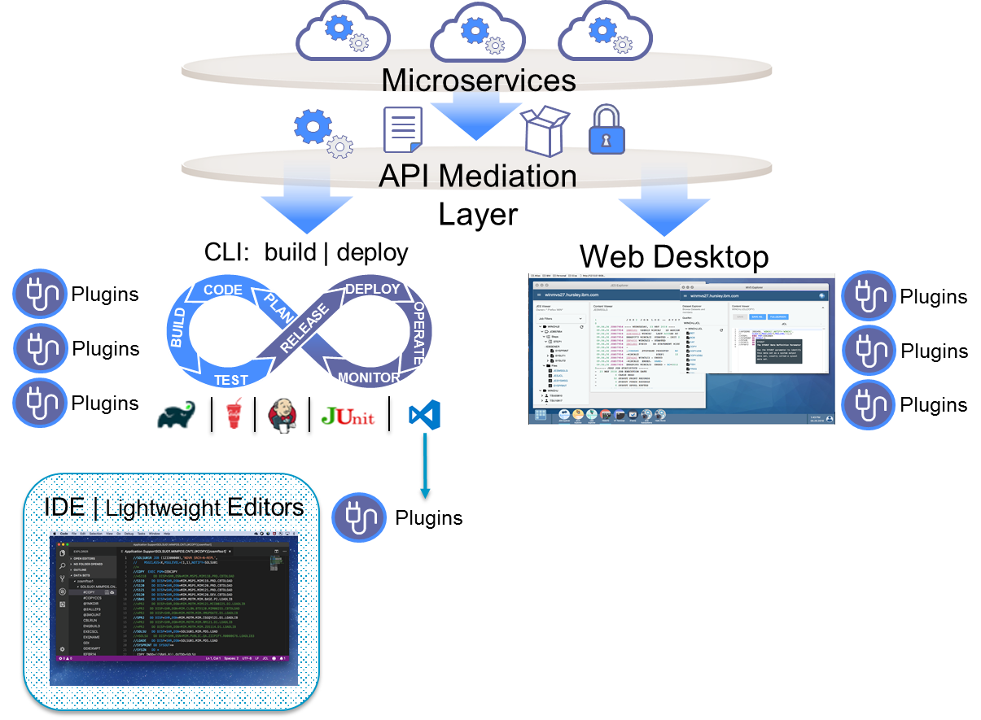
Zowe Framework and Ecosystem at a Glance
Core Zowe includes API Mediation Layer, CLI, and Web Desktop.
Vendors can build ‘Zowe Compliant’ plugins that will leverage this framework.

Slide 5
Zowe CLI
A robust, extensible, cloud-like Command Line Interface into the mainframe platform.
Enable developers and DevOps engineers to control, script and develop on the mainframe like any other cloud platform and allow them to make use of familiar, industry-standard, open-source tooling. By accomplishing this, Zowe CLI:
Addresses the skills gap by making mainframe development more attractive and accessible to next-generation developers
Improves the application delivery lifecycle by allowing mainframe applications to be integrated into enterprise DevOps pipelines

Slide 6
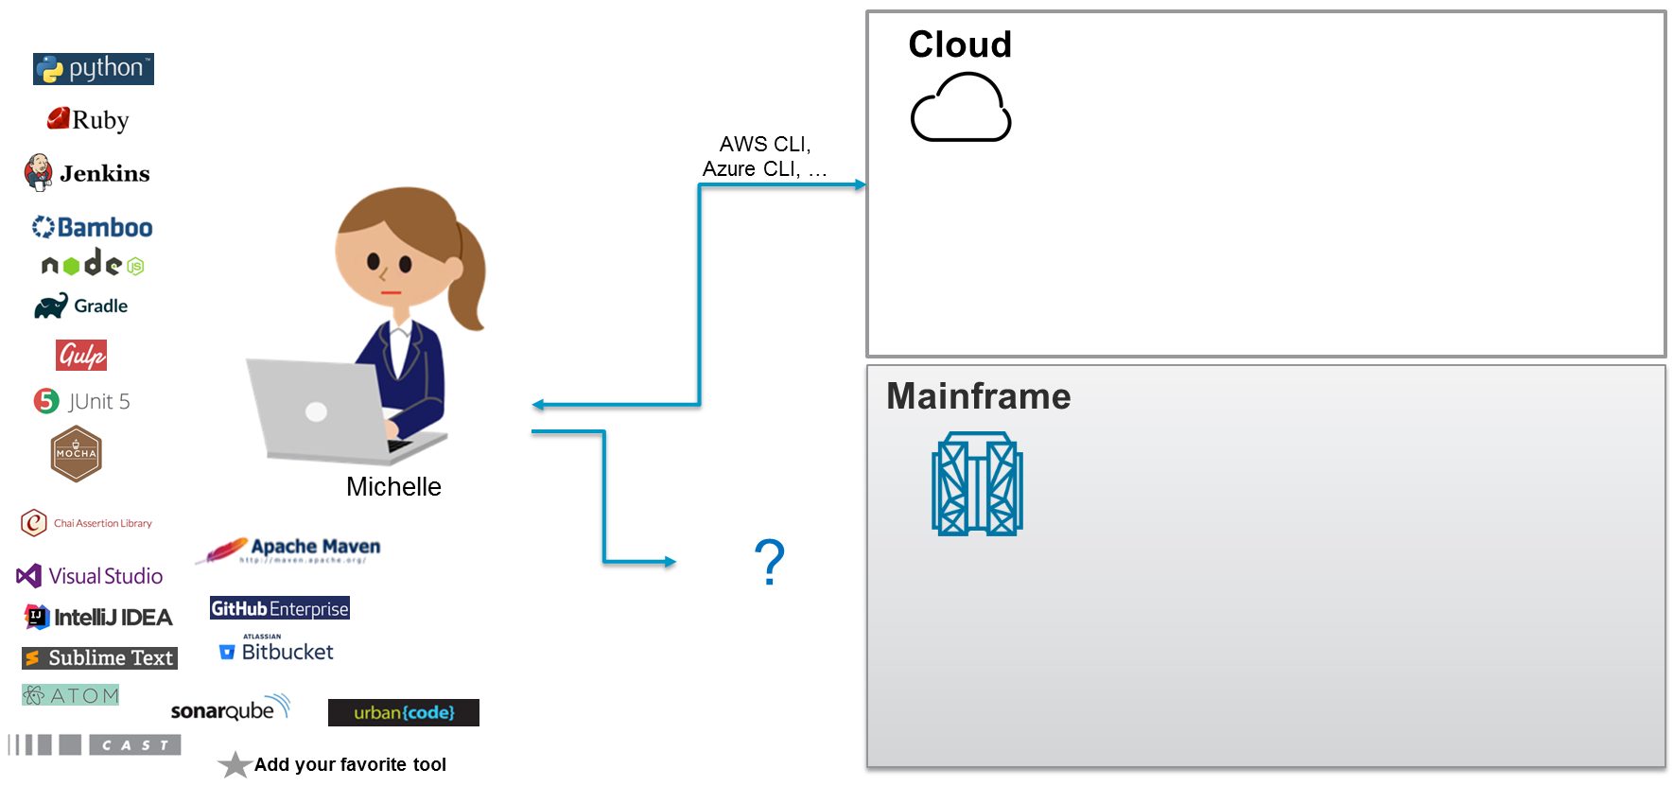
Challenge

Slide 7
CA Brightside
Open source, enterprise grade
CA Brightside
24x7 enterprise-class technical support
Full adoption lifecycle
Simplified & streamlined installation
Windows installer, Docker image
IP legal assurance
Subscription pricing
Quality & security tested
Distribution of Zowe
Early access to innovations
Secure Credential Store plugin
z/OS-Extended-Files, z/OS-Extended-Jobs plugins
Core command line interface (CLI)
w/ core plugins
Core web user interface (UI)
Core API mediation layer (APIML)
Microservices
Open source framework
For Broadcom designated distributions of Zowe
Enterprise support from a trusted mainframe partner
Notes:
Surround version

Slide 8
Demo
Introduce Zowe Command Line Interface and show interactive use
Demonstrate how commands can be used with modern scripting languages and frameworks to build automation for z/OS
Demonstrate how to set up a Jenkins pipeline for a z/OS application using the CLI to drive z/OS actions

Slide 9
Q&A
Michael Bauer: Michael.Bauer2@broadcom.com

