Slide 1
What's New in ITMS 7.5 SP1
Brian Sheedy, Sr. Principal Technical Education Consultant
Symantec Education Services
Notes:
Welcome to the What’s New in IT Management Suite 7.5 SP1 technical presentation, My name is Brian Sheedy and I am a Sr. Principal Education Consultant for Symantec Education Services

Slide 2
Agenda
Symantec Management Platform 7.5 SP1 Core
Symantec Management Console Views
ITMS 7.5 SP1 Solutions
Network Application Streaming Feature
Notes:
The following Agenda topics will be covered in today’s presentation:
Symantec Management Platform 7.5 SP1 Core
Symantec Management Console Views
ITMS 7.5 SP1 Solutions
Network Application Streaming Feature

Slide 3
Symantec Management Platform 7.5 SP1 Core

Slide 4
ITMS 7.5 SP1 Upgrade Scenarios
Supports the following upgrade scenarios:
From 7.1SP2MP1.1 with latest rollup (v9)
From 7.5 with latest hot-fix installed (HF6)
Supported upgrade paths:
On-box upgrade
Off-box upgrade
Upgrade through Database Settings page in Console
Note that unsupported upgrade paths are now blocked
Readiness Check allows navigation to page to install latest hot-fixes
Console page also implements check for SMP version after selecting DB
Notes:
ITMS 7.5 SP1 Core supports the following upgrade scenarios:
From 7.1SP2MP1.1 with latest rollup (v9)
From 7.5 with latest hot-fix installed (HF6)
ITMS 7.5 SP1 also Supports the following upgrade paths:
On-box upgrade
Off-box upgrade by selecting existing DB in SIM
both to Win2008R2 and Win2012R2 machine
Upgrade through Database Settings page in Console
Please Note that unsupported upgrade paths are now blocked through the SIM implemented readiness check allowing to navigate to corresponding page to install latest hot-fixes and the Console page also implements a check for SMP version after selecting DB

Slide 5
Operating Systems Support Has Been Expanded
SMP & ITMS Component Support:
Windows Server 2012 R2
Site Server Support:
Windows 8
Windows 8.1
Windows Server 2012
Windows Server 2012 R2
Support for IE 10 and 11 in the Symantec Management Console
For support statements and supported operating systems:
http://www.symantec.com/connect/articles/it-management-suite-os-platform-support
Notes:
Symantec has expanded its support for the Symantec Management Platform and ITMS 7.5 SP1 solutions.
The Windows Server 2012 R2 operating system is now supported for installation of Symantec Management Platform 7.5 SP1 and its solution components:
Also, The following operating systems are now supported for installation of package and task servers:
Windows 8
Windows 8.1
Windows Server 2012
Windows Server 2012 R2
The Symantec Management Console now has support for Internet Explorer 10 and 11
For support statements and supported operating systems:
http://www.symantec.com/connect/articles/it-management-suite-os-platform-support

Slide 6
Expanded Support For Client Operating Systems
Additional Symantec Management Agent Support:
Windows Server 2012 R2
Windows 8.1
Windows Embedded Standard 7 SP1
OS X 10.9
Red Hat Enterprise Linux 5.10
VMware ESXi 5.5
For support statements and other information on supported operating systems, see the following article:
http://www.symantec.com/connect/articles/it-management-suite-os-platform-support
Notes:
Symantec has expanded its support for the Symantec Management Agent and ITMS 7.5 SP1 solutions plug-ins
The following additional operating systems are now fully supported for the installation of Symantec Management Agent:
Windows Server 2012 R2
Windows 8.1
OS X 10.9
Windows Embedded Standard 7 SP1
Red Hat Enterprise Linux 5.10
VMware ESXi 5.5
For support statements and other information on supported operating systems, see the following article:
http://www.symantec.com/connect/articles/it-management-suite-os-platform-support

Slide 7
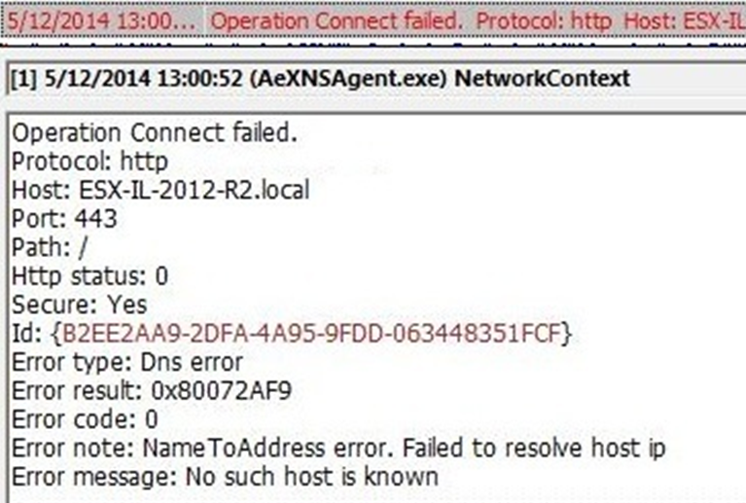
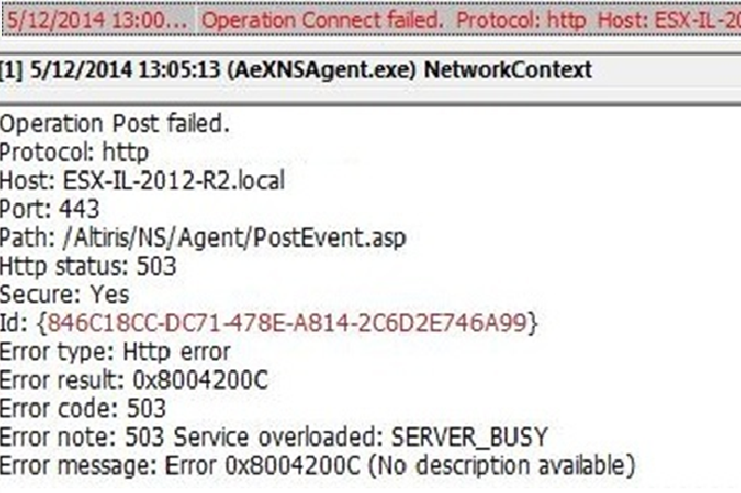
Expanded Reporting and Error handling
The following new reports have been introduced:
Legacy Agent Registration Requests
Package Status By Package Server
Error messages on Server or Client logs have been reworked.
Easier to understand – i.e., SERVER_BUSY
Notes:
The following new reports have been introduced: Legacy Agent Registration Requests and Package Status By Package Server to help in validating registrations and troubleshooting package server states
Error messages on Server or Client logs have been reworked. This enhancement improves error handling and deciphering on the client and server side. Now typical errors from the logs are comprehensible and can aid in improving the time required for the investigation of problems.

Slide 8
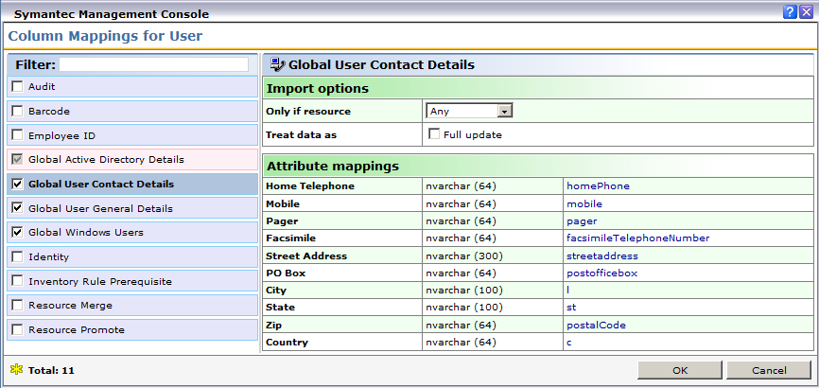
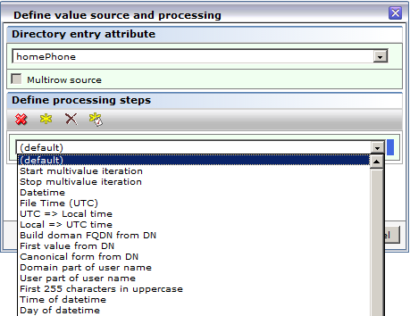
Microsoft Active Directory Import
Import Only if resource:
Any
Managed
Unmanaged
Treat Data As Full Update
Values for existing resources will be overwritten by the data from AD
Import of multiline attributes is now supported
Import from complex cross-domain scenarios
Can Import from different types of security groups from a trusted domain
Can Attempt to import from AD Forest Root
Improved import of resources containing special characters
New UI to Apply transformations before importing
Notes:
You can now choose to import data only if the source item is Managed or Unmanaged. You can also import all resources, regardless of their state.
The “Only if resource” choice has been added– in this drop-down you can select “Any”, “Managed” or “Unmanaged”. Based on this setting, the data class will be populated or updated only for the corresponding computers (managed by the NS, not managed by the NS or every computer regardless of it being managed or not)
There is also a New UI option to select partial or full update of specific data class values allows better synchronization with AD data
“Treat data as Full update” is selected then during an update the Import data class values for existing resources will be overwritten by the data from AD.
If the check-box is not ticked, then during an Update the Import of the AD data for existing resources will be preserved – this is the default behavior and the one present in previous ITMS releases.
Note that this only applies for Update Import as Data Class values will always be overwritten when Full Import is run
A new UI option has been added allowing you to apply transformations before importing data into the CMDB - It Defines various transformations for data imported from AD attributes. Note that processing steps are performed in the order from the top to the bottom in this UI
Better handling of multi-lined attributes during import. Now all the values from multi-valued attributes are imported, rather than the last one only
Importing for complex cross-domain scenarios has been improved. You can Import from different types of security groups from a trusted domain and can Import from Local/ Global and Universal groups
There is also Added funtionality to additionally attempt to import from AD forest root. This May slightly delay discovery, but provides more reliable data for import. This Functionality is “ON” by default and controllable through Core settings.
Improvements were made for the import of resources containing special characters from different Organizational Units , Security Groups or Distribution Groups
Also the Microsoft Active Directory Import webpage now contains information on last run time.

Slide 9
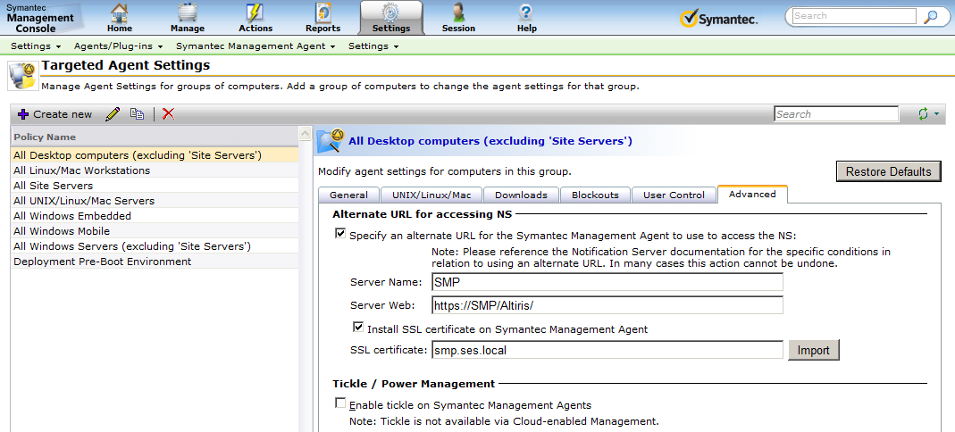
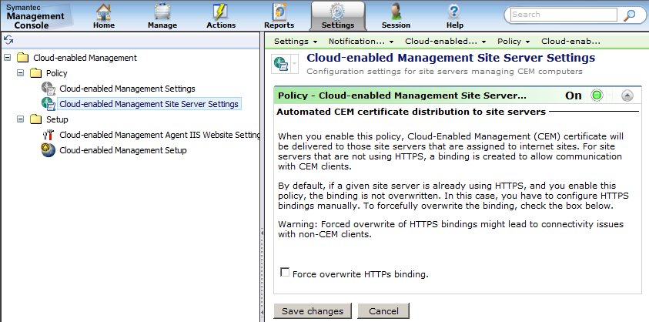
Installation Of SSL Certificates - Simplified.
Notes:
Under the Targeted Agent Settings webpage, there is a new checkbox that allows server SSL certificate inclusion within the policy. Certificate ‘Import’ functionality was also added to the page. This functionality gives the following benefits: It allows you to switch from HTTP to HTTPs communication without manual certificate distribution steps and allows for easier switching from one Notification Server to another along with the certificate import.
You can now import new certificates in a .pfx file format, that lets you reassign client computers to a different Notification Server when using HTTPS.
The Cloud-enabled Management Site Server Settings policy also allows you to distribute SSL certificates and create required HTTPS binding on the site server computers. The feature automates CEM certificate creation and distribution for Site Servers that service CEM Agents. Once assigned to Default Internet Site, the new policy will be sent to Package Server and certificate will be installed. The certificate will be processed depending on IIS configuration and whether policy setting “Force overwrite HTTPs binding” is ticked.
SSL trust is essential between CEM agents and the Site Servers that are on their service. Site Server Settings policy feature is beneficial in terms of automated SSL trust establishing between Site Servers that are assigned to Internet Sites and CEM Agents. Once the policy certificate is installed on a Site Server SSL site, because certificate is signed by CEM Site master certificate, it becomes automatically trusted by CEM agents. Once Site Server Settings policy is applied and certificate installed to Site Server, it is ready to service CEM clients right away, no additional configuration required, but adding Site Server to Gateway permitted server’s list.

Slide 10
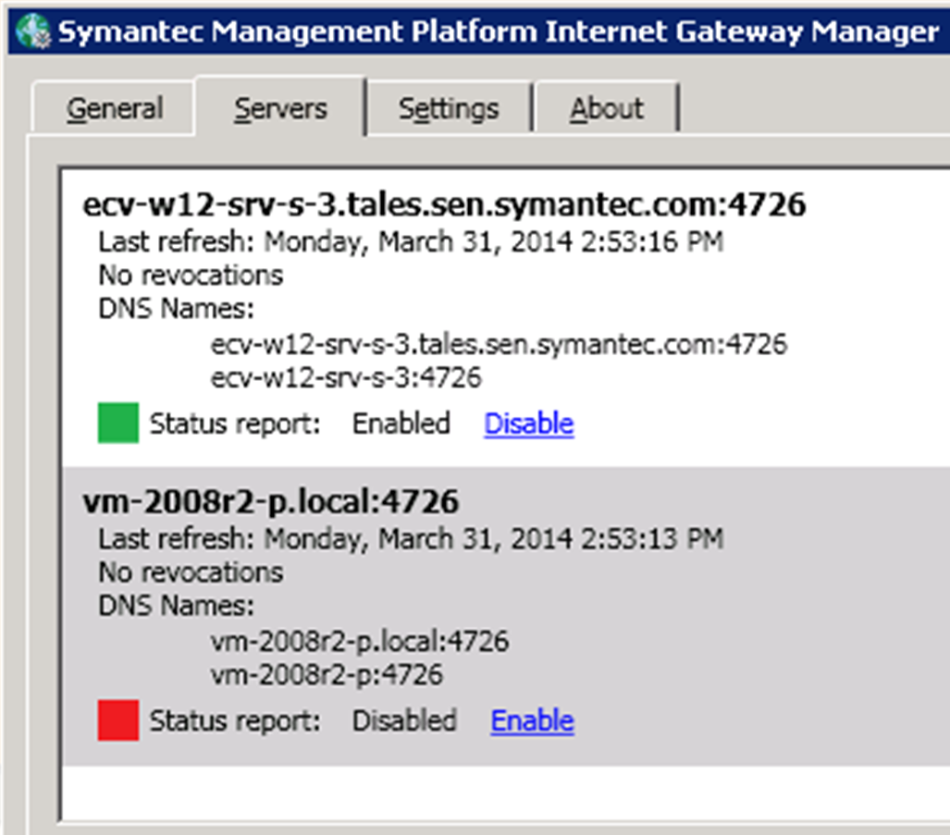
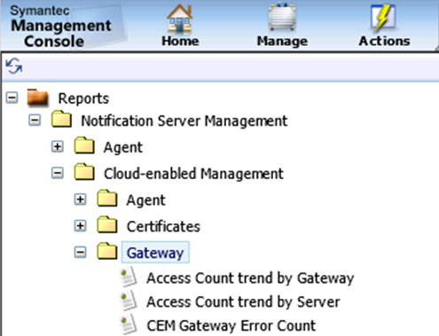
Internet Gateway Status Reporting Improvements
Feature enabled on Gateway
Monitors Status from NS
Sends status every 15 minutes
Configurable time
Results available in new reports:
Access Count trend by Gateway\Server
CEM Gateway Error Count
Transferred Data trend by Gateway\Server
Worker Status trend by Gateway
Notes:
Gateway status reporting allows you to monitor the Gateway status from the Symantec Management Console within in the Reports page. Status reporting is a controllable feature and can be enabled or disabled by administrator on Gateway side.
When enabled the gateway sends its status every 15 minutes - this and interval can be changed. The Received results are available in Console under the following new reports:
Access Count trend by Gateway\Server
CEM Gateway Error Count
Transferred Data trend by Gateway\Server
Worker Status trend by Gateway
All gateway reports have also been placed under the Notification Server Management node in the Gateway folder

Slide 11
Task Server Performance & Stability Improvements
A Windows Task “NS.Restore Task Servers” schedule was introduced.
You can restore Task Server definitions after NS reinstallation
You can add site server definition to a task server
A separate application pool in IIS for task servers is introduced.
IIS7 functionality is now supported in native mode.
Notes:
A Windows Task Scheduler Library task called NS.Restore Task Servers schedule has been introduced.
In the case of a Disaster Recovery situation, it allows you to restore Task Server definitions after a NS reinstallation or after a new NS database was created.
In another case, you can also add site server definitions to a task server that were manually installed using a distributable package.
A separate application pool in IIS specifically for task servers has been introduced and IIS7 functionality is now supported in native mode to improve performance & stability of Task Services.

Slide 12
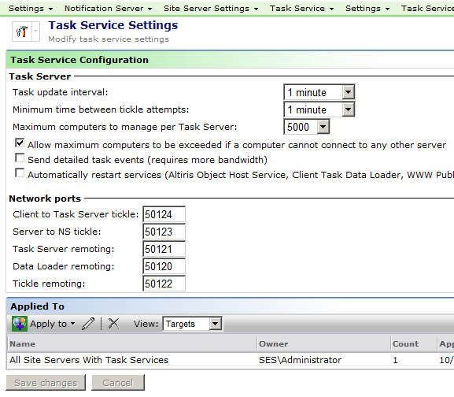
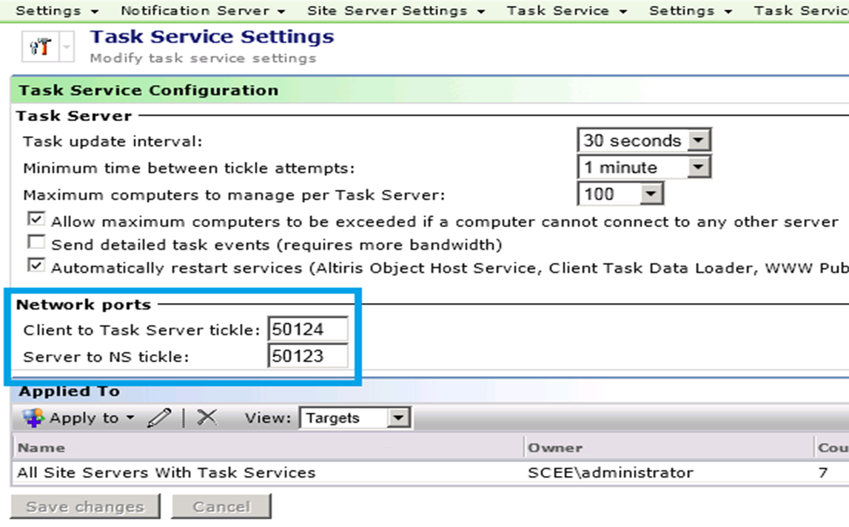
Task server performance and stability improvements
Windows Communication Foundation (WCF) has been implemented for inner processes communication for the Task Server components
All Remoting ports have been removed
Only two ports now needed to be opened for proper Task Server Operation
Notes:
Windows Communication Foundation (WCF) services have been implemented for inter-process communication for the Task Server components. This change was done as a part of resolving challenges with Task Server stability in 7.5 Hotfixes.
As a side-effect of these changes, only two ports are now required to be opened for proper NS Task Server operation (previously 5 ports were needed). As of 7.5 SP1 implementation of WCF is complete and the remoting ports have been removed from the Task Service Settings UI.

Slide 13
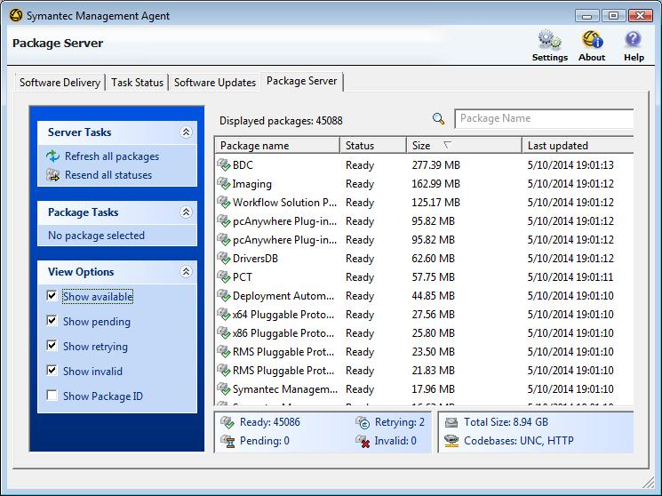
Package Server Tab UI Improvements
Added Filtering
Package Size
Extended Status View
Total Packages Size & Codebase Type
Notes:
A new Package Server Tab UI has been created to better viewing and handling of large amounts of packages. This UI update has added the following items:
Filtering and Search capabilities
Specific package tasks (force download, resend status)
Extended view options
Statistics about quantity of packages, type of codebases and total size.

Slide 14
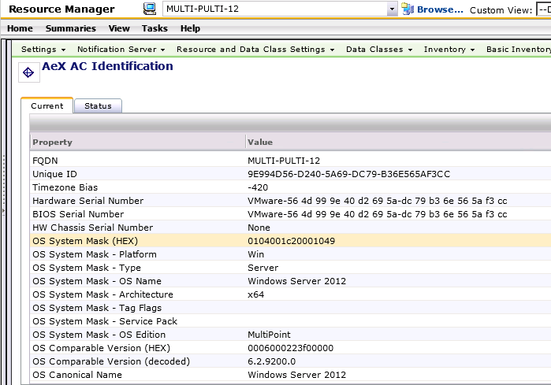
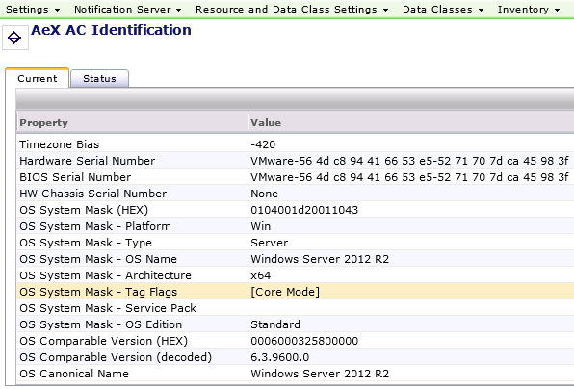
Operating System Detection Improvements
Basic Inventory Schema data class is extended by adding new property, named OS System Mask.
OS System mask is a set of bit fields
The mask value is decoded in the Resource Manager.
Windows Server 2012 Multi Point edition
Windows Server 2008 R2 installed in Core mode
Notes:
In an effort to improve Operating System Detection and classification of different versions of Windows, a Basic Inventory data classes have been extended by adding a new property, named OS System Mask.
The OS System mask is a set of bit fields containing various information like OS version and type, platform edition and name, etc. To make it more convenient and decipherable, the OS mask values are decoded in Resource manager.

Slide 15
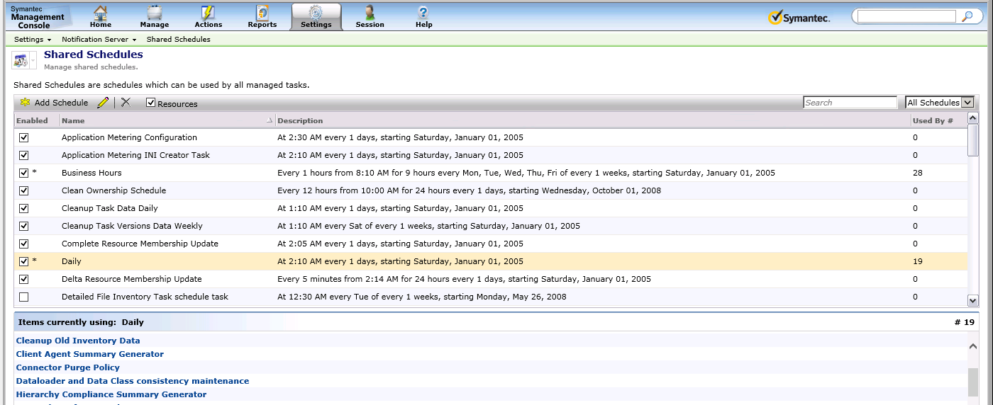
Shared Schedules
UI reworked to provide number dependent items
Can now see both Items and Resources
Can see Shared or All
Administrator can see R/O Schedules (*)
Deleted from Windows Task Scheduler
Can be Drilled Down for more Details
Notes:
The Shared Schedules UI has been reworked to provide an accurate number of items that are dependent on specific schedule.
This also provides us with the following abilities:
The Ability to see both Items (like policies) and Resources (like Software package) associated with schedule
The Ability to see either only shared schedules or all schedules on NS
The Administrator is also able to see read-only schedules (marked with “*” sign) and has the ability to disable them for troubleshooting
When disabling schedules in Console the specific schedule is deleted from Windows Task Scheduler and is re-created upon enabling. This allows to use NS as source of truth for any accidental changes in Windows Task Scheduler
Things to know
In the list of items and resources utilizing specific schedule it is possible to drill-down by opening item in separate IE window. Some items are not designed to be opened in such way, so new window will be closed

Slide 16
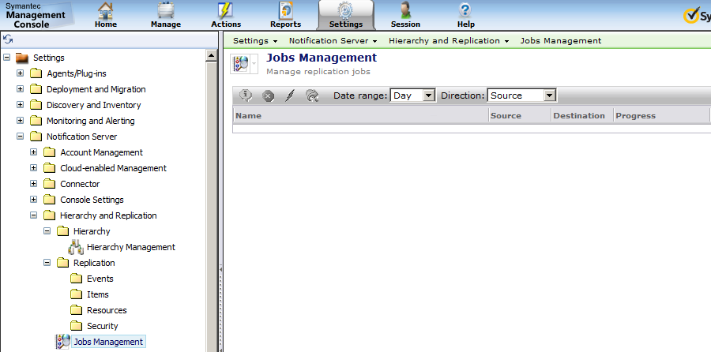
Hierarchy and replication improvements
Improved Hierarchy performance and scalability by 20%
Settings are now placed in single folder
Jobs Management View
Replicate Now
security privilege
Notes:
The following elements of hierarchy and replication functionalities are now improved:
Hierarchy performance and scalability has been reworked and Replication time decreased by up to 20% compared to 7.5 HF6
Hierarchy and Replication settings are now placed in single folder in Symantec Management Console for ease of configuration
The Jobs Management page is introduced to review and manage hierarchy and replication jobs. This page also lets you troubleshoot hierarchy and replication issues in an efficient way.
A new “Replicate Now” security privilege has been introduced. It allows the running replication of a given item from the context menu.

Slide 17
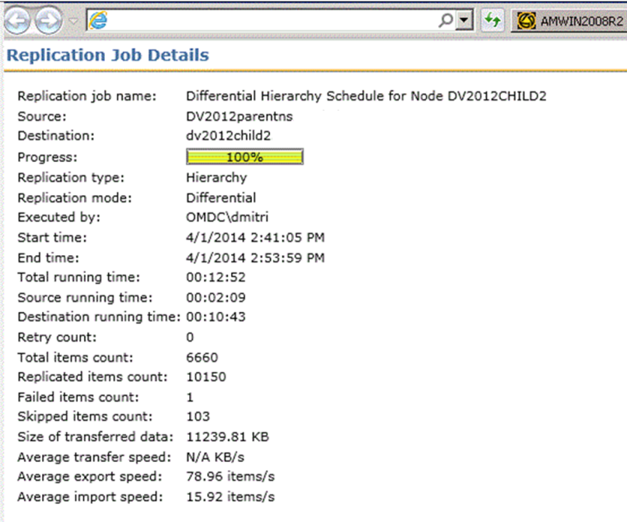
New Hierarchy and Replication Jobs View
Improves hierarchy visibility and is more informative
Covers jobs from both hierarchy and standalone replication rules
Provides insight into the next major action:
Jobs status and current progress
Running time separately for source and destination
Count for replicated/failed/skipped items
Average speed for data export, transfer and import operations
Drill down into job’s details from main page
Notes:
A New Hierarchy and Replication Jobs View has been developed and it offers the following benefits for Hierarchy status reporting and troubleshooting:
IT Improves hierarchy visibility and is more informative
It Covers jobs from both hierarchy and standalone replication rules
And it Provides insight into the next major actions like :
Job status and current progress
Separate running times for the source and destination
The Count of replicated/failed/skipped items
And finally, the average speed for data export, transfer and import operations

Slide 18
Hierarchy and replication improvements
Computers purged on the Parent when purged from the Child
A New hierarchy event is sent to Parent NS indicating specific resource purges
Non-replicable objects will no longer replicate
Decreased the size of the Evt_NS_Object_Replication_Status table by 50%
Can replicate folders and children via standalone replication
Event data tables are now replicated by default replication rule
Prevents missing data on target server
Can now check which user invoked a replication rule
New “Executed By” column in “Server hierarchy replication” Report
Notes:
Further improvements have been made to improve the performance and stability of Hierarchy and replication.
Replicated computer resources are also purged on Parent server if they are purged from a Child server. During purging a new hierarchy event is sent to Parent NS indicating that specific resource is subject for next local purge. A New core setting called “KeepRemotePurgedComputerData” was also created to allows you to preserve the Parent NS event data.
Non-replicatible objects will not be attempted to replicate, which helps to decrease size of problematic Evt_NS_Object_Replication_Status table for at least 50%. Non Replicable items will not be added into Evt_NS_Object_Replication_Status table. A new column called NotReplicableReason has been added into ReplicationItem table retain the reason why item is not replicable
The ability to replicate a folder and all its child objects via standalone replication rules has been added.
Also, Event data tables are now replicated by a default replication rule preventing missing data on the target server. Events like Evt_NS_Client_Config_Request and Evt_NS_Event_History are now replicated to allow a more complete picture of required event data.
It is now possible to check which user invoked replication rule this Data is available through the new “Executed By” column in existing “Server hierarchy replication” report and new hierarchy rules UI

Slide 19
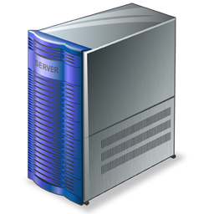
Notification Server Performance Improvements
Package Refresh internal task has been optimized
Runs up to 7 times faster than 7.5 GA Release
Expected to impact primarily Patch management and Software Management scenarios
Package share creation on IIS has been optimized
New API to create single UNC shares for thousands of patch packages
Improves to Package Refresh timings
Improves operations in Windows Explorer on IIS machine
NSE processing of some data times were further enhanced
NSE’s > 1 hour to process, now process < 7 minutes
Notes:
The following Notification Server Performance & Stability improvements have been made:
The Package Refresh internal task was optimized allowing to reach a significant performance improvement compared to 7.5. Package refresh task timing was improved by up to 7 times. This improvement is expected to impact primarily Patch management and Software scenarios.
Package Share creation on IIS optimized by providing a new API to create a single UNC share for thousands of patch packages or software packages as opposed to the original method of creating a separate share per package. This improves the Package Refresh timings and Operations in Windows Explorer on the Notification Server and package servers.
Also, NSE processing of some data times was further enhanced, in testing NSEs that took 1 hour to process 7.5 now process in less than 7 minutes

Slide 20
Symantec Management Console Views

Slide 21
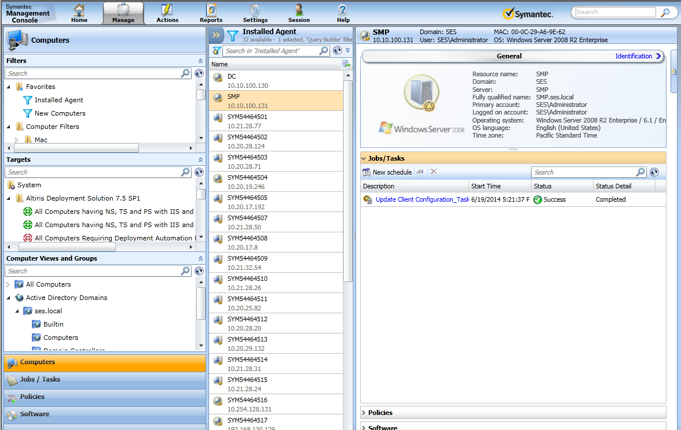
Management View Changes
Filters, Targets & Computer Views Exposed
Customizable page layout per user
Load on-demand feature
Improved drag and drop function and error handling
Availability of the Management Views
Notes:
The following improvements have been made to further increase the usability and efficiency of the management views in the Symantec Management Console.
The page layout is customizable for each user, and the user can choose which computer filters or computer targets to display or hide in the Filters and Targets lists. The list of custom filter criteria, the size of the panes, and the way the elements are displayed on the page can be configured. These settings are saved individually for each user.
A Load on-demand feature has been added. The items in the lists are displayed in chunks. The number of items to be displayed in one chunk can be customized. The rest of the list collapses and is loaded on demand. The load on-demand feature is enabled by default.
Improved drag and drop function and error handling has been added. For example, After an element is dragged and dropped, a dialog box appears that shows the results of the action.
Availability of the Management Views has been expanded. ITMS Management Views for Computers, Policies, and Jobs/Tasks are available to all users regardless of the installed solutions. Also, the Software view is available if there is Software Management Solution and Inventory Solution installed.

Slide 22
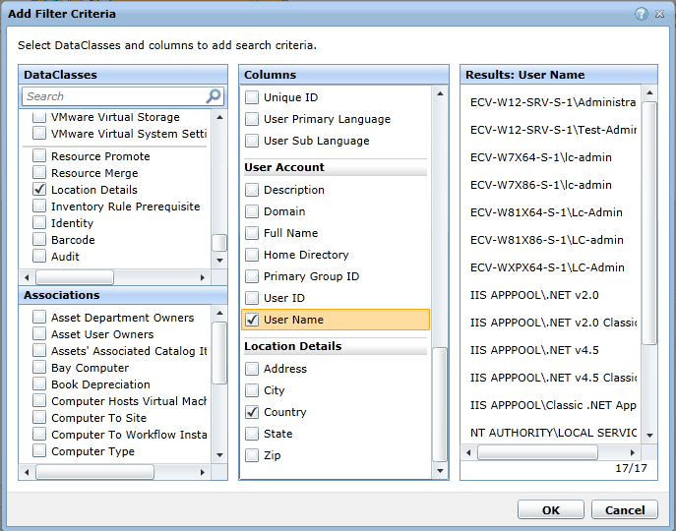
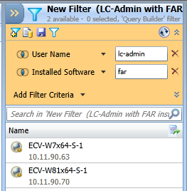
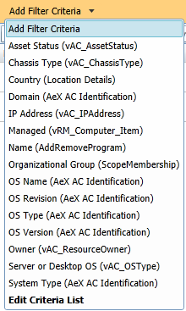
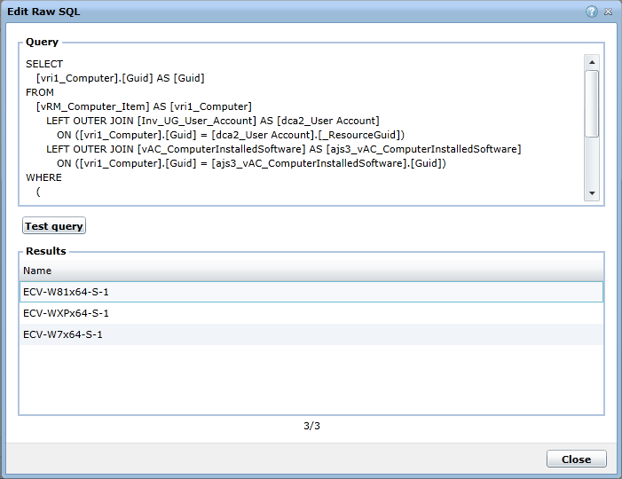
New Filter Tree & Builder View
Use filter criteria as a ‘power search’
Add & Validate custom criteria
New default criteria
Add new criteria
Validate Raw SQL queries & save them for reuse
Notes:
A filter tree view and filter builder has been created to further simplify information gathering.
The Filter tree shows the existing filters and are displayed in manage>computers view. Saved searches are included here and can also be used as filters. You are able to create new folders and filters in this view and Manage visibility and favorites on a per user basis
The Filter builder uses the saved search logic you are familiar with. You can use searches, and filter criteria and see the results in the computer list. Filters can be saved for reuse and the Results list can be saved to a CSV file with Computer Name and IP address included in the list. Any changes in the filter builder are global.
Additional default criteria have been added.
Some of the criteria have defined conditions and pre-populated values and custom criteria can be added and allows you to validate the values the right column.
Static list ‘explicit inclusions’ can be added in the builder as well as the use of the new Raw SQL editor.

Slide 23
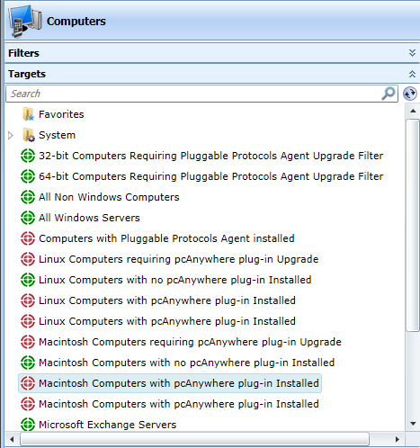
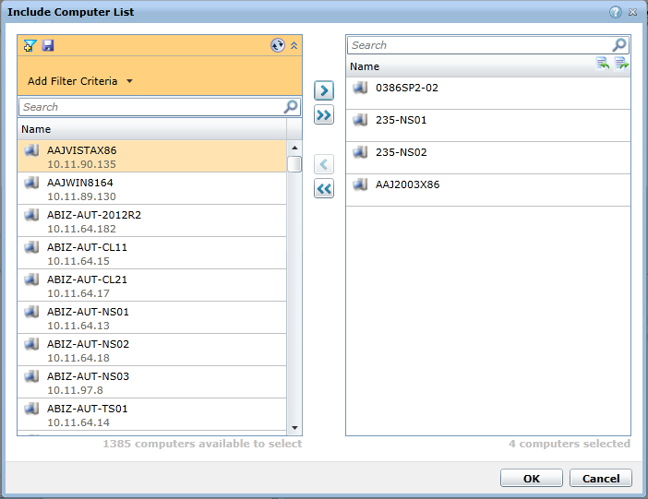
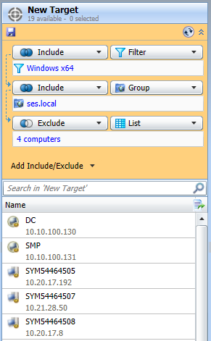
New Target Tree & Builder View
View & Edit Targets Directly!
Combine lists, filters, & groups with conditions
Create lists from filters, CSV import, and hand select
Notes:
A new Target Tree View and Target builder has been included in the management console to help with the reuse of targets for consistency in your organization
The Target tree exposes the targets as they are much easier to see and edit. It will define and show ad-hoc vs. managed targets and controls visibility and favorites per user. View scoping is instituted and only shows the results you are allowed to manage. You also now have the ability to delete targets you don’t need.
The Target builder allows you to view the target, target conditions, and results in easy to access manner. You can apply a static list, filter, or OV/G to the target. When assigning a target to a policy or task, you can now use saved targets from dropdown.
Conditions are now much easier to understand and evaluate and you can save the target or save a list of the results in a CSV file with the Computername and IP listed.

Slide 24
ITMS 7.5 SP1 Solutions

Slide 25
Deployment Solution Changes (CMS/SMS)
WinPE Distributable is not included in Deployment Solution
To use the WinPE as a preboot environment
Download and install the Windows ADK for Windows 8
Import the Windows ADK to install into Deployment Solution.
This activity consumes around 3 hours.
RapiDeploy tool no longer supported for imaging computers
You can still deploy any existing .img images created using RapiDeploy
Deployment Solution plug-in 64-bit Linux added
Deployment Solution plug-in for x64 bit for Linux is now added that lets you manage Linux 64-bit client computers.
Notes:
The following are changes made to the Deployment Solution 7.5 SP1 product included in ITMS, CMS and SMS.
WinPE Distributables are no longer included in Deployment Solution.
To use the WinPE as a preboot environment you can Download and install the Windows ADK for Windows 8 from Microsoft, then simply Import the Windows ADK to install into Deployment Solution. Please note that this activity consumes around 3 hours to complete.
With this release forward, Deployment Solution does not support the RapiDeploy imaging tool for the capturing of images. However you can deploy the existing .img images that were created using the RapiDeploy tool.
The Deployment Solution plug-in for x64 bit for Linux is now added that lets you manage Linux 64-bit client computers.
It is important to note that when you upgrade from IT Management Suite 7.1 SP1 MP1.1 or from IT Management Suite 7.5 HF6 to IT Management Suite 7.5 SP1, you must edit the tasks and jobs that contain the Create Image task using RapiDeploy imaging tool to Create Image task using the Ghost imaging tool. For more information refer to the Symantec™ IT Management Suite 7.5 SP1 powered by Altiris™ technology Installation and Upgrade Guide.

Slide 26
PCAnywhere Solution Changes
The list of supported platforms has been expanded.
Mac OS X 10.9
New policies added for Windows that contain the default filters.
PCAnywhere Plug-in for Windows – Install (Host Only)
This policy contains the default filter Windows Computers with no PCAnywhere plug-in Installed
PCAnywhere Plug-in for Windows – Upgrade (Host Only)
This policy contains the default filter Windows Computers requiring PCAnywhere plug-in upgrade
These default filters are not available in the following policies:
PCAnywhere Plug-in for Windows – Install
PCAnywhere Plug-in for Windows – Upgrade
New UI feature Add Caller button
Manually adds users for Authentication types
Add users, groups and domains for NT and Active Directory types.
Notes:
The following lists PCAnywhere Solution Changes within ITMS 7.5 SP1:
The list of supported platforms has been expanded to support Mac OS X 10.9
New policies have been added for Windows that contain the default filters.
pcAnywhere Plug-in for Windows – Install (Host Only) contains the default filter Windows Computers with no pcAnywhere plug-in Installed
pcAnywhere Plug-in for Windows – Upgrade (Host Only) contains the default filter Windows Computers requiring pcAnywhere plug-in upgrade
For more administrative control over the deployment of the pcAnywhere Quick Connect feature, the default filters listed above are not available in the following policies:
pcAnywhere Plug-in for Windows – Install
pcAnywhere Plug-in for Windows – Upgrade
Also, A new UI feature called the Add Caller button is introduced to manually add users or groups and domains for Authentication types NT and Active Directory.

Slide 27
Software Management Solution Changes
Improved Software Portal performance increased by over 50%
Improved Software Management Plug-in stability
Software Library packages are under one Virtual Directory (IIS)
Packages are marked and relocated based on the Nightly schedule.
Warning: The package relocation fails if the original software package location is a system folder not available during the initial upgrade procedure.
Agents and plug-ins can deploy during a maintenance window
Additional way to create/target Managed Software Delivery policies
Drag and drop the software release on the specific target
Drag and drop a Managed Delivery Policy on the specific target
Notes:
Significant improvements have been made to Software Portal performance by Multiple code optimizations that were implemented to speed up the loading the software resources. Administrators may notice a performance improvement by over 50%.
Improved Symantec Management Agent stability has been achieved by numerous fixes.
The Software Library packages are now located under one virtual directory in IIS. The packages are marked and relocated into one package share in IIS, based on the Nightly schedule. It is important to note that the package relocation process will fail if the original software package location folder is a system folder or is not available during the upgrade procedure.
Agents and plug-ins can now be configured to be installed during a maintenance window
There are now 2 additional ways to create and target Managed Software Delivery policies:
A Managed Software Delivery policy can be created for computers by dragging and dropping the software release on the target, which contains the corresponding computers. This will start a Managed Software Delivery policy wizard with prepopulated settings to target the corresponding computers.
By Dragging and dropping an existing Managed Software Delivery policy on the target, it will add the corresponding computers to the list of computers, targeted by the policy.

Slide 28
Network Application Streaming Feature

Slide 29
Updated Symantec Workspace Streaming Agent
Distributed as part of Software Management Solution.
Deliver the Symantec Workspace Streaming agent just as before
If SWS infrastructure utilized, you may update the client agent.
Delivers virtual layers to your clients regardless of SWS or ITMS
Notes:
A new package for the Symantec Workspace Streaming Agent is distributed as part of Software Management Solution. Just as before, you can use the software delivery capabilities of IT Management Suite to deliver the Symantec Workspace Streaming agent.
If you choose to install the Symantec Workspace Streaming infrastructure in the future, you can use Client Management Suite to update the client agent. You will still be able to deliver virtual layers to your managed clients regardless of which mode you use the Symantec Workspace Streaming agent.

Slide 30
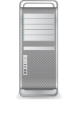
Network Streaming using SWS 7.5 SP1
How it works
New agent uses network share, DFS share, or package repository instead of Workspace Streaming back-end
What it applies to
Desktops, laptops, thin clients, VMware VDI, Citrix XenDesktop
Why it matters to ITMS
Much easier to integrate into software management because of its light weight and quick deployment/revocation.
External Package Repository File Share
External Package Repository File Share
Load Balancer
Load Balancer
Desktop / Laptop Users
Notes:
Network Application Streaming works by installation of the latest agent and the use of a network share, DFS share, or package repository instead of a Workspace Streaming back-end
It applies to Windows Desktops, laptops, thin clients, VMware VDI, Citrix XenDesktop systems. This process is much easier to integrate into software management because of its light weight and quick deployment/revocation.
This new ability to Stream applications from a file share with VHD support can also be used for customers who have already configured the Workspace Streaming Server and would like to try network application streaming.
This feature can be used in cases, where you need to upload and stream a large number of applications without the concern of uploading, configuring, and managing packages on Streaming Server.
For example, if you are logging to a new laptop or a Virtual Desktop, and you want to have all the applications available while roaming between office locations then you can configure application streaming with a file share and a Virtual Hard Disk (VHD).

Slide 31
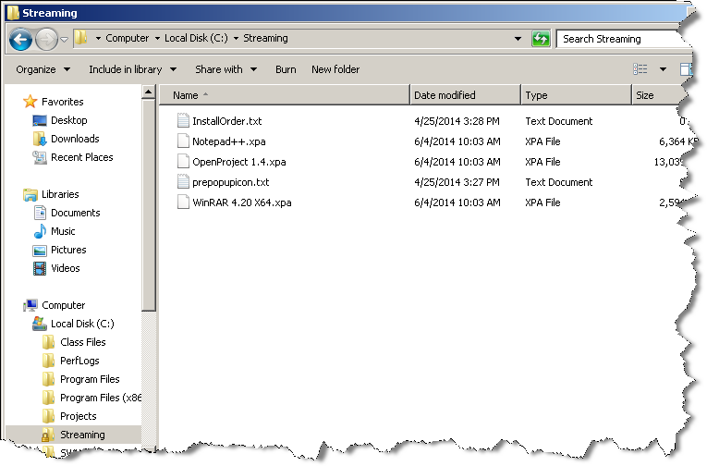
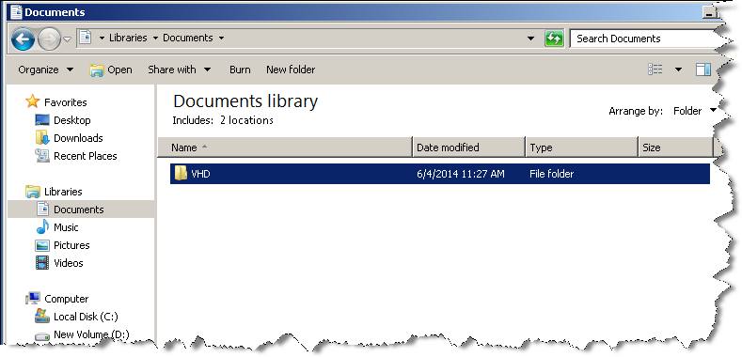
Configuring streaming from a file share
File share located on the streaming server or Converted XPF files from Virtual Composer System
VHD located on the client computer
Notes:
Application streaming from a file share does not require a Streaming Server. In this case, all the configuration required for managing the applications is done on the file share and on the client computers.
When a package is streamed, the Read Only (RO) layer is created locally but, the Read Write (RW) layer is created in the configured VHD. Each package will have its own VHD. With the help of the VHD, you can restore the user application settings at any time.
To manage application streaming from a file share and VHD support, you must perform the following tasks:
Create a file share to store the XPA application packages for streaming.
Create a VHD path in your local machine or on a network path.
Start and test the application streaming from a file share with VHD support.

Slide 32
Starting and Testing Network Application Streaming
Steaming Prerequisites
Install the latest SWS/SWV agent
Have a list of XPA packages to be streamed to client computer.
(You can use the XpfToXPA.exe from Virtual Composer to make XPA Files from XPF files)
Set-up a common file share accessible by all the users to store the XPA packages.
InstallOrder.txt and PrepopIcon.txt must be copied to the file share and they must contain the required .xpa file names
The AppStreamCfg.txt file in the client computer that contains all the required entries.
Network Application Streaming Process
Store the xpa packages for streaming on your file share
Place the updated InstallOrder.txt and PrepopIcon.txt in the file share
Create a VHD path in your local computer or on a network path.
Everyone must have the write access to this VHD path.
Restart the client and login as a domain user who has access to the packages.
After login, the applications are streamed and the VHD is created at the specified location.
Notes:
Before you start with network application streaming, ensure that the following prerequisites are met:
On your windows client computer, ensure that the latest SWS/SWV agent is running.
You have a list of XPA packages to be streamed into client computer. You can use the XpfToXPA.exe conversion utility on a Virtual Composer to make XPA Files from XPF files
You have a set-up a common file share accessible by all the users to store the XPA packages.
Two text files named InstallOrder.txt and PrepopIcon.txt must be copied to the file share and they must contain all of the required .xpa file names.
The AppStreamCfg.txt file in the client computer contains all the required entries.
To start network application streaming with a file share and VHD support
Store the xpa packages for streaming on your file share
Place the updated InstallOrder.txt and PrepopIcon.txt in the file share
Create a VHD path in your local computer or on a network path. - Everyone must have the write access to this VHD path.
Restart and login to the client as a domain user who has access to the packages.
After login, the applications are streamed and the VHD is created at the specified location.

Slide 33
Required AppStreamCfg.txt File Settings
ENABLE_VDI=true
VDI_PKG_REPO=\\<ip_address>\share_name\
VDI_MULTI_THREADED_STREAM=true
VDI_PKG_INSTALL_CONF_FILE=InstallOrder.txt
VDI_PREPOP_ICON_CONF_FILE=PrepopIcon.txt
VDI_DETACH_VHD_ONLOGOFF=true
Notes:
These settings should be added to the end of the AppStreamCfg.txt on the client computer to allow for network application streaming on a managed endpoint
ENABLE_VDI=true this Enables the VDI streaming from the file share.
VDI_PKG_REPO=\\<ip_address>\share_name\ this provides the Location of .xpa files on the file share. This key tells the agent to stream the packages from that particular location.
VDI_MULTI_THREADED_STREAM=true this will enable to stream applications concurrently.
VDI_PKG_INSTALL_CONF_FILE=InstallOrder.txt this file will be in the file share. This contains information about which applications should be streamed first. This will be useful if you have application that has dependent apps and the dependent apps should be streamed first.
VDI_PREPOP_ICON_CONF_FILE=PrepopIcon.txt This file should be present in the file share. This contains information about the packages whose icons should be published in user desktop. By default packages will be pre populated. If you want icons alone, then you have to mention the package names in this file.
VDI_DETACH_VHD_ONLOGOFF=true this setting will detach the VHD when user logs off. The default value is set to true. Change the value to false, if you are using Network apps without VHD. The VHD will not detach on log off, in case you set the value as false.

Slide 34
Creating a VHD to support application streaming
On the client computer, update the AppStreamCfg.txt file with the following settings:
VDI_RW_VHD_LOCATION= C:\temp\vhd
VDI_RW_VHD_SIZE=25
Now, when you logs on to a computer and starts streaming an application, a new VHD is created based on the specified location and size.
VHD located on the client computer
Notes:
Symantec Workspace Streaming allows users to create Virtual Hard Disk (VHD) with the help of few configuration settings. When you log on to a computer and start streaming an application, all changes that go into the RW layer like application settings and files saved on specific folders are saved to the VHD. There is one-to-one mapping between a particular user and a VHD. As part of creating a new VHD, you first need to create a VHD path.
To configure the AppstreamCFG.txt file to create a VHD path:
Go to the client computer and update the AppStreamCfg.txt file with the following settings:
VDI_RW_VHD_LOCATION= C:\temp\vhd This is the location where the vhd files will be created. It can be on the local drive or a network path. Everyone must have the write access to this VHD path.
VDI_RW_VHD_SIZE=25 this is the Size of the vhd in MB. If the value is 0, then the VHD will not get created.
When you log in to a computer and start streaming an application, a new VHD is created based on the specified location and size.

Slide 35
Removing Streamed Applications Based on User ACL’s
On the client computer, update the AppStreamCfg.txt file with the following entries:
VDI_REMOVE_UNPROVISIONED_APPLICATIONS=true
VDI_REFRESH_INTERVAL=240
The applications are automatically removed when a user logs on or after the specified interval that was set in the VDI_REFRESH_INTERVAL
Notes:
Symantec Workspace Streaming allows users to stream applications to a client computer with a file share and a VHD. On client computer, you can set the AppStreamCfg.txt file to automatically remove the applications when a user logs on or after the specified interval.
To configure for removal of applications based on the user's ACL:
Go to the client computer and update the AppStreamCfg.txt file with the following entries:
VDI_REMOVE_UNPROVISIONED_APPLICATIONS=true: this tag will remove or stream applications based on the user’s ACL permission. This will occur during logon and after the specified interval.
VDI_REFRESH_INTERVAL=240 is the interval in minutes. The default value is 240. Set the value to 0 for refresh to occur during logon alone.
The applications are automatically removed when a user logs on or after the specified interval set in the VDI_REFRESH_INTERVAL

Slide 36
Additional Resources
ITMS 7.5 SP1 Documentation Landing Page:
http://www.symantec.com/docs/DOC7440
ITMS Product Page:
http://www.symantec.com/it-management-suite
Endpoint Management Connect Community Page:
http://www.symantec.com/connect/endpoint-management
Platform and ITMS 7.5 Solutions Support Matrix
http://www.symantec.com/docs/HOWTO9965
ITMS 7.5 Migration Landing Page
http://go.symantec.com/altiris75/

Slide 38
End of Presentation

