Slide 1
Automic Automation V12
Beginner Developer Training
Integrations Team

Slide 2
Table Of Contents
What is the Automation Engine
AE System Architecture
AWI(Automic Web Interface)
Perspective
Object Orientation in AE
AE short form for Objects
Naming Conventions For Objects
Naming Conventions For Folders
General Rules To Create Folders
General Rules to Create Objects
JOBS Objects Win
JOBS Object UNIX
Executing a Job
Job Reports & Executions
JOBS Exercise
Filter Object and Error Handling
Call Object
JOBS Output Scan
Output Scan Filter/Call Exercise
Getting Ready For Production

Slide 3
What is the Automation Engine
Task Control
Tasks primarily refer to Jobs. A Job may consist of one or several OS commands or
several program calls. File Transfers are also tasks. It is possible to define dependencies
between these and other AE specific tasks and control them. There are logical and time based dependencies. For example, Job_B may only start if Job_A has ended successfully
(logical dependency) or FileTransfer_X may only start on the last workday of a month
(time-based dependency).
Event Handling
Another key feature of AE is the option of reacting to events. Events include:
• Positive or negative ends of tasks executions
• Achieving particular threshold values (e.g., 1 GB available disk space)
• The arrival of a particular file
Responses include:
• Starting (alternative) tasks
• Sending SNMP traps
• Dispatching e-mails
• Internal user alerts
• Restarting tasks

Slide 4
AE System Architecture
This had my architecture with IPs, so I had to remove it. Refer to Automic documentation for a general architecture drawing.
Notes:
peer to peer? agent to agent?

Slide 5
Getting Connected
AWI and Perspectives

Slide 6
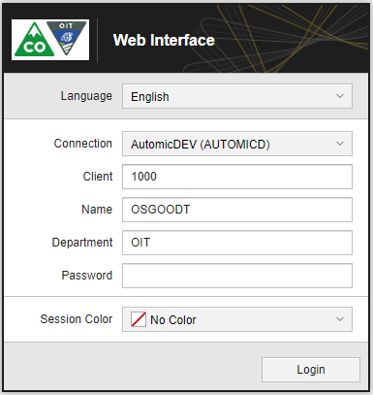
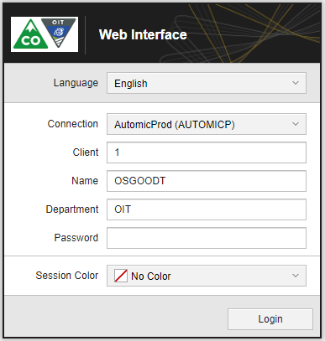
AWI(Automic Web Interface)
Prod URL:
Dev URL:
Client is based on user access.
Prod is always Client 1

Slide 7
Perspective
Perspectives are functional areas that give you access to the features and functions you have access to.
Although they serve different purposes and, therefore, provide different functions, they share many elements and common functions and their look and feeling is similar. Which ones are available to you depend on your installation and your user rights.
Perspective | Who will use it | What you can do
Administration | System administrators | Centrally manage users and user groups for all Automic products, perform administration activities regarding connections, agents, clients, etc. This functional area is visible and accessible only to users with administrator rights.
Process Assembly | Developers, object and workflow designers | Create and define Objects and Folders, design them, start executions, open execution data.
Process Monitoring | Operators (business users), developers and managers | Monitor, influence and analyze active and ended tasks. The tasks displayed in this perspective are not restricted to those assigned to the user via the User Catalog folder (as happens with the My Catalog), but to those the user is entitled to see and work with according to his/her common authorizations and privileges, no matter if these processes were started by themselves or by other users.

Slide 8
Perspective
My Catalog | Operators (business users), developers and managers | Provides an overview and access to the tasks, objects and folders that users are authorized to see and work with and that have been explicitly assigned to them via the Favorites folder. Users can start their executable objects, monitor their current tasks, review past runs and see the execution data and report.
Dashboards | Operators, managers | Open dashboards with one or more windows (widgets) with different kinds of information and links on one page. This gives you quick access to favorite overviews. Depending on your rights, you can also add dashboards of your own.

Slide 9
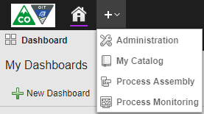
Perspective
To Open a Perspective
Click to the right of the Home button in the menu bar.
A dropdown menu opens that displays all the perspectives you are entitled to see. For example:
Select the one you are interested in; it is inserted in the menu bar. Click again to continue adding perspectives to your menu bar:

Slide 10
Perspective
To Close a Perspective
Hover over the name of the perspective on the menu bar.
The x to close it will be displayed

Slide 11
Perspective
Process Assembly Perspective
You are an automation architect. You create and configure objects and you write scripts to extend the object configuration options. You design Workflows and Schedules.
As a developer and object designer, the Process Assembly perspective is your main (although not only) working area.
The Process Assembly perspective has the following main elements:
Navigation Pane
The area on the left is the navigation pane. It contains the following tabs:
Explorer tab The Explorer shows the folders where objects are stored. Administrator users can grant or deny Users and User Groups permissions to objects at folder level. Some folders are created automatically during installation (for example, DASHBOARDS or <No Folder>). If you have the necessary permissions, you can create folders. <No Folder> is a security feature. It is the fallback in the following situations:
You import objects from a different Client or system and the target Client does not contain the same folders as the source Client. The objects for which there is not a corresponding folder are stored here.
You delete objects that contain other objects (a Workflow or a Schedule, for example). Those objects cannot be deleted and are stored here.

Slide 12
Perspective
Process Assembly Perspective
In the Explorer list, the following columns are displayed by default:
Name Folder or object name
Title Optional, descriptive title to help identify the purpose of the folder or object
Type
Platform You can only assign individual agents to a group if they all have the same platform. Note: This is not the operating system.
Last Modified
Opened by
Version
The following columns are also available but hidden by default:
Archive Key 1 and Archive Key 2 Archive keys are keywords you assign to the object. Later on you can perform searches or you can filter objects using them:
Archive Key 1 is limited to max. 60 characters
Archive Key 2 is limited to max. 20 characters

Slide 13
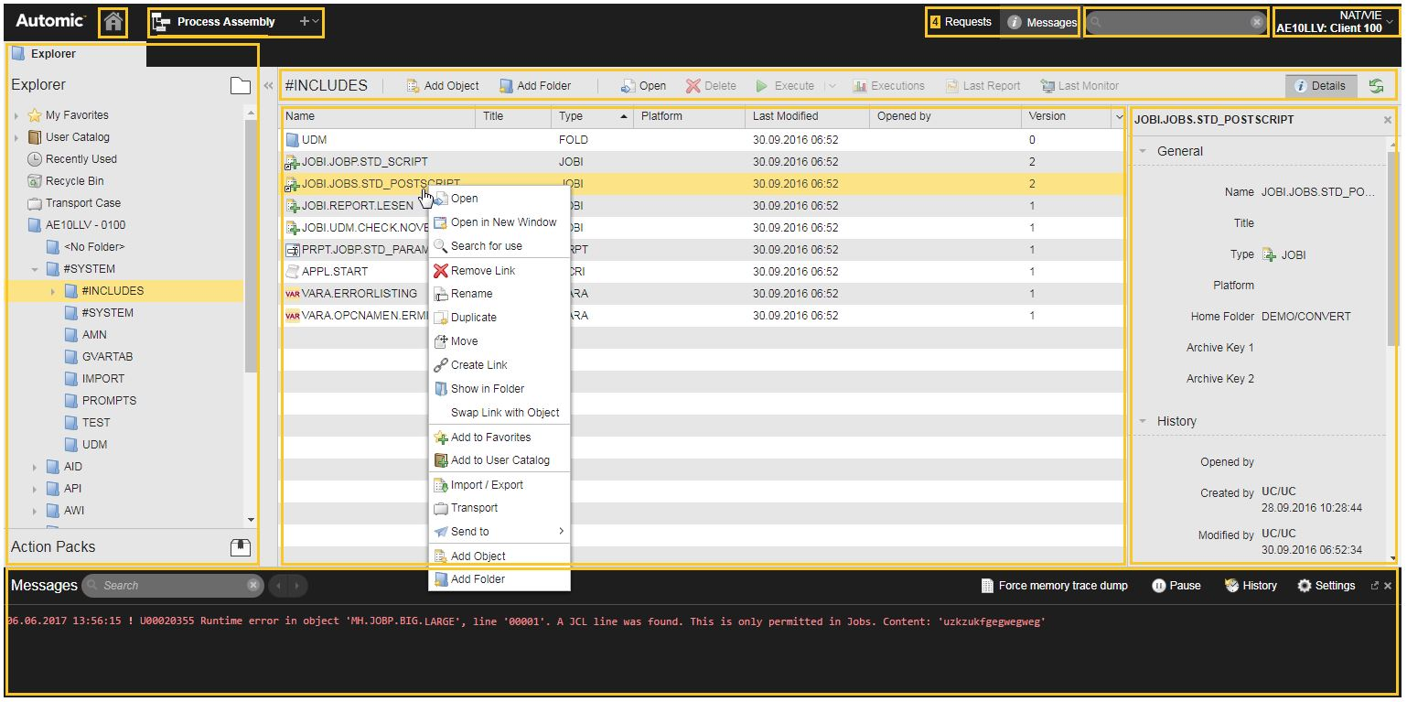
Perspective
Process Assembly Perspective -- Con’t

Slide 14
Perspective
Process Monitoring Perspective
You own the day-to-day business of running things. You keep an eye on processes and make sure that the workload gets processed every day, smoothly and without incidents. You identify problems and assume their ownership. To be able to remediate them, you perform basic root cause analysis, you determine the best course of action and the next steps. You react to failures either by involving other users, notifying the management team or by escalating to the owner of a process.
As an operator, the Process Monitoring perspective is you main working area. It displays comprehensive data on active and inactive tasks. The Process Monitoring perspective provides tools to filter and group tasks. In this perspective you can modify active tasks, open their reports and execution lists and troubleshoot.
The list of Tasks displays the tasks that correspond to the objects to which you have rights, no matter who has started them. Right-click one or more tasks to access the functions that are available to all those tasks. The functions that are displayed depend on the status of the selected task and of your user privileges.
The Process Monitoring perspective has the following main elements:
Navigation Pane
Task Bar
Status Bar
Toolbar
List of Tasks
Filter Pane

Slide 15
Perspective
Process Monitoring Perspective
Navigation Pane
The navigation pane on the left contains the following tabs:
Tasks The Quick Filter provides shortcuts to some of the filter criteria available on the Filter pane on the right side. Example: If you select Quick Filter: Queue and one of the Queues in the list below, the Tasks list shows the tasks processed by that Queue. If you use the Queue filter criterion in the Filter pane on the right and select the same Queue, you get the same result. For more information, see The Task List.
Services (SLO) The SLO Monitor is the control center of your SLO (Service Level Objectives) objects, the basis of the Service Level Management function. It provides timely information about whether the services meet the criteria stipulated in the Service Level Agreement they are subject to. For more information, see Monitoring Services.
Forecasts
Forecasts Information about the expected execution times and the estimated runtime of executable objects
Autoforecasts Information about which tasks will run in a certain time frame. This information can be used to plan the maintenance of your systems.
For more information, see Forecasting.

Slide 16
Perspective
Process Monitoring Perspective
Task Bar
The task bar indicates the number of tasks that are displayed on the list and whether the list is filtered. It allows you to switch the list view and to refresh the data in the list. For more information, see The Task List.
Status Bar
The status bar indicates how many tasks are on each of the available main statuses. For more information, see Task Status.
Toolbar
The toolbar provides shortcuts to perform the most important functions in the Process Monitoring perspective. It gives you access to the monitors and to historical data. The toolbar also contains the following buttons:
Export Table Exports the content of the list as comma-separated values in a CSV file
Custom Filter Lists your personal, customized filter criteria
Filter Opens the Filter pane
Details Opens the Details pane with information on the execution of the selected task

Slide 17
Perspective
Process Monitoring Perspective
List of Tasks
The main list is where you work with your tasks. It provides the most important task information at a glance. For more information, see The Task List.
Filter Pane
The Filter pane lets you restrict the number of tasks to be displayed. For more information, see Filtering Tasks.

Slide 18
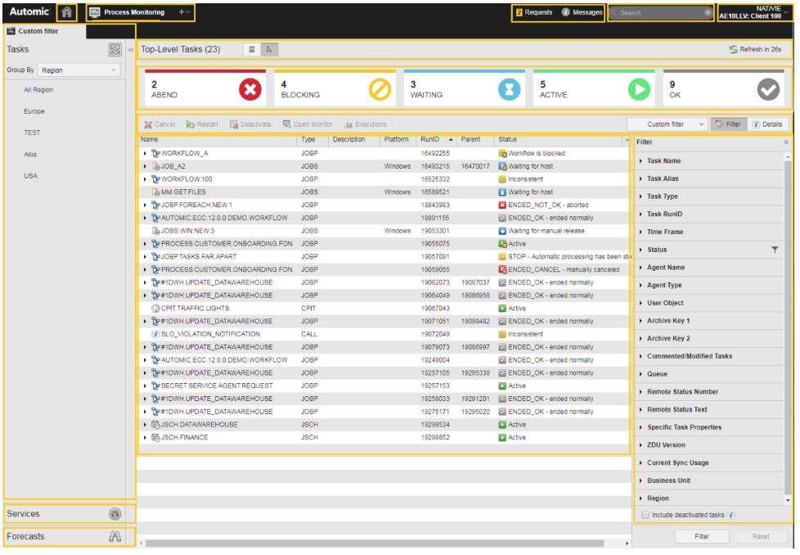
Perspective
Process Monitoring Perspective

Slide 19
AE Object Orientation
Benefits and Standards

Slide 20
Object Orientation in AE
Processes handled by AE are shown as objects. An object is a predefined mask in which
it is possible to specify various parameters. These parameters may vary depending on
the task to be solved. An individual object may be created for each task. You can create
modular process chains from these individual tasks. The individual components may
also be used repeatedly and simultaneously in any combination. This concept has huge
advantages compared to non-object-oriented programming:
• Clarity - All processes have a clear structure.
• Simple maintenance procedures - Modifications can easily be assumed.
• Expandability - New requirements are easily integrated.
• Distributed operations - Complex processes may be handled in simple individual steps.
• Reusability - Defined tasks may be integrated in various processes.

Slide 21
AE short form for Objects
Each object belongs to a particular object type. A short form exists for each object type.
It is shown in many places within the system. Below is a list of all objects that are discussed
in this training course:
• Job (JOBS): Determines the processing steps to be executed in a target system.
• Login (LOGIN): Stores login data for operating systems and applications.
• Queue (QUEUE): Works as a quantity limiter or prioritizer.
• Filter (FILTER): Contains Filter definitions for the contents of reports and external files.
• Filetransfer (JOBF): Transfers files of any kind between two computers.
• Workflow (JOBP): Comprises objects which form a process and executes them together.
• Calendar (CALE): Determines the days to be considered as start conditions for the execution of tasks.
• Schedule (JSCH): Starts executable objects recurrently.
• Notification (CALL): Notifies a user.
• PromptSet (PRPT): Used in dialogs to prompt users to enter values.
• Event (EVNT): Checks conditions and triggers an Automation Script.
• Include (JOBI): Contains commonly-used processing instructions from Automation Script for shared usage by
objects.
• AgentGroup (HOSTG): Combines Agents in order to execute a task on one particular or several Agents.
• Documentation (DOCU): Administers documentation not referring to a single object.
• Folder (FOLD): Help to keep your clients clearly arranged. Folders are also regarded as objects.
• Period (PERIOD): holds parameters for periodical object executions.

Slide 22
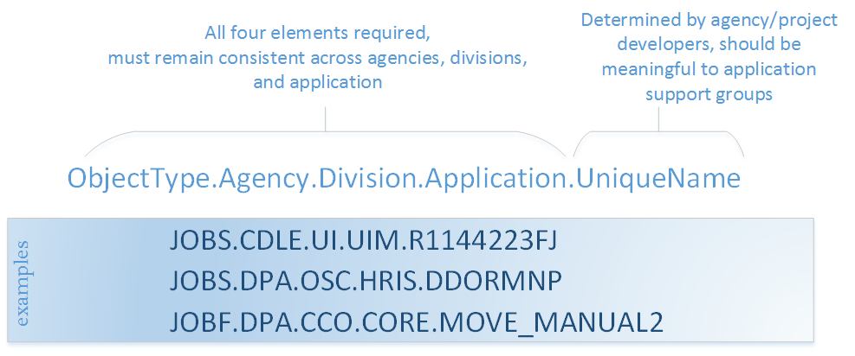
Naming conventions for Objects
An object name can be up to 200 characters long and may comprise the following characters:
A-Z, 0-9, $, @, _, . # and, from V11 on, the hyphen (-). TimeZone objects are exempted. Their names are limited to eight characters.
Object names must be unique across all folders.
Object naming convention:

Slide 23
Naming Conventions for Folders
While creating objects in the folder, it is better to follow folder structure which is created across departments, it makes it easier to maintain, easier to locate the objects and provides consistency across departments.
A typical folder structure: Agency/Division/Object or Agency/Division/Project/Object

Slide 24
Creating AE Folders and Objects

Slide 25
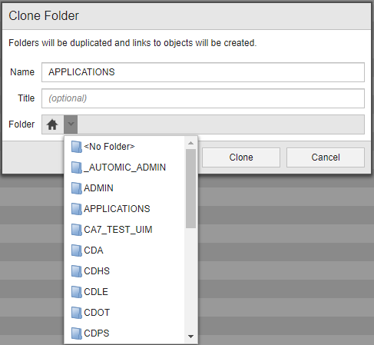
General Rules to Create Folders
AE folders are created in the AE Process Assembly Perspective
Though the basic folder structure is standard across agencies, there may be times you wish to create a personal folder in the development environment.
Creating Folders: Clone – Highlight a folder, right click, Clone
If you clone a folder that contains objects, they will become a link to the original objects in the original folder.
Using the folder dropdown, pick parent folder where you want it to go.
Add New – Highlight the parent folder, click on Add Folder

Slide 26
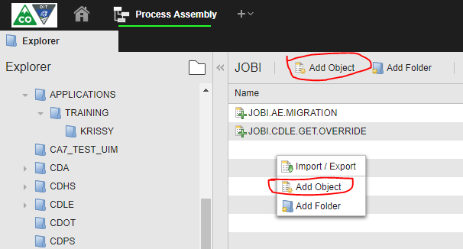
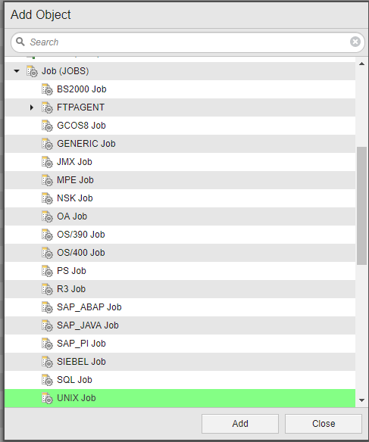
General Rules to Create Objects
AE objects are created in the AE Process Assembly Perspective
Objects are created in current highlighted folder. Make sure you
create your object in the corresponding folder.
Two ways:
Hit the Add Object icon at the top of the perspective
Right click inside the folder, Add Object
The Templates window appears at first. Various template objects are available for selection. A small black triangle appears in front of some objects. This indicates that the entry comprises further objects. Click the triangle to expand the entry. Select an object and click ADD to confirm or create an object by double-clicking it.
Immediately after creating your new object, you can change its name and give it a title. The title is displayed in the Explorer in the Title column. The title may be freely chosen and should contain a brief description of the object.

Slide 27
Automic Objects

Slide 28
JOBS
A Job is the central object of AE. There are 2 variants of Jobs:
Operating System Job
Application Job
Operating System Job
An Operating System Job interacts with the operating system on which an Agent is installed. Here, it may set operating system commands and start programs.
Application Job
The application Job interacts with applications. The most common usage is the combination of AE and SAP. Such a Job is able to execute particular tasks in the SAP system but it cannot interact with the operating system. Direct communication with SQL databases or systems such as PeopleSoft or Siebel also form part of the application Job.
For the purpose of this training, we will concentrate on the WIN and UNIX JOBS
One other note, no changes/edits are allowed in Production environment. Be aware that HOSTs, LOGINs and Connection objects need to be created to handle multiple environments. How to handle this will be discussed as needed throughout this course.

Slide 29
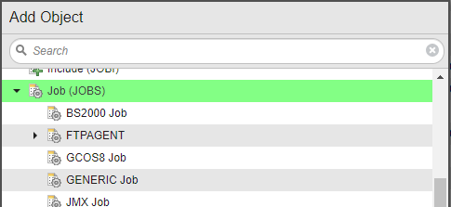
JOBS - WIN
Windows
While in the JOBS folder, Click on the Add Object button
Click on the Job (JOBS) and scroll down to WIN OIT Job and Win Job are interchangeable and you
can use either one.
Rename the object to follow naming standards

Slide 30
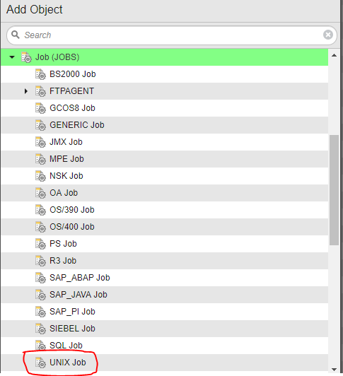
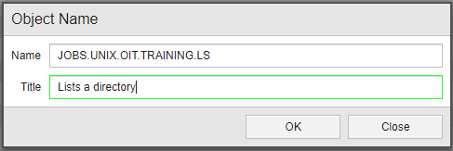
JOBS - UNIX
UNIX
While in the JOBS folder, Click on the Add Object button
Click on the Job (JOBS) and scroll down to UNIX OIT Job and Win Job are interchangeable and you
can use either one.
Rename the object to follow naming standards

Slide 31
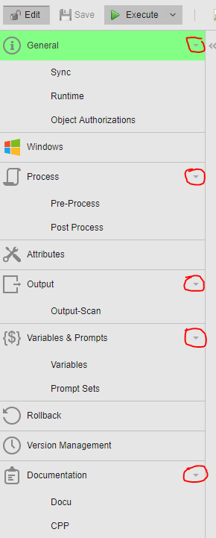
JOBS - WIN
Pages - Click on the triangle on the right to expand the page.
General - Gives object info, revision history and sets metadata.
Windows - Your Windows attributes
Process - Pre-Process - Executes an action before the Processing is run Process - The actions this job will take
Post-Process - Actions to take after Processing completes.
Attributes - Set your Host, Login, Queue and Deactivation setting
OutPut - Set external files and add Filters to the Output Scan
Variables & Prompts - Sets variables and prompt sets to be used with in the JOBS
Rollback - Enable/Disable Rollback of JOBS
Version Management - View and restore previous versions of the object
Documentation - Docu - Here you can paste in design text to support the object
CPP - Control Processing Procedure (CPP) This is the
instructions to the OCC as to when to schedule the job
and what to do if it breaks. This must be completed before
moving to Production

Slide 32
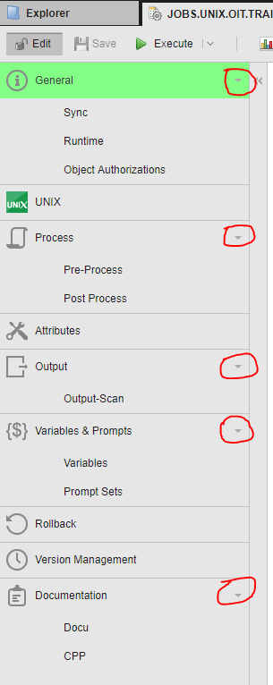
JOBS - UNIX
Pages - Click on the triangle on the right to expand the page.
General - Gives object info, revision history and sets metadata.
Windows - Your Windows attributes
Process - Pre-Process - Executes an action before the Processing is run Process - The actions this job will take
Post-Process - Actions to take after Processing completes.
Attributes - Set your Host, Login, Queue and Deactivation setting
OutPut - Set external files and add Filters to the Output Scan
Variables & Prompts - Sets variables and prompt sets to be used with in the JOBS
Rollback - Enable/Disable Rollback of JOBS
Version Management - View and restore previous versions of the object
Documentation - Docu - Here you can paste in design text to support the object
CPP - Control Processing Procedure (CPP) This is the
instructions to the OCC as to when to schedule the job
and what to do if it breaks. This must be completed before
moving to Production

Slide 33
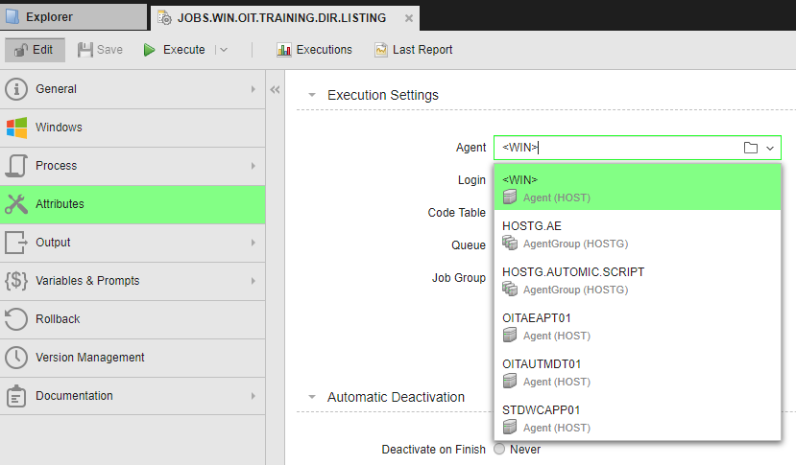
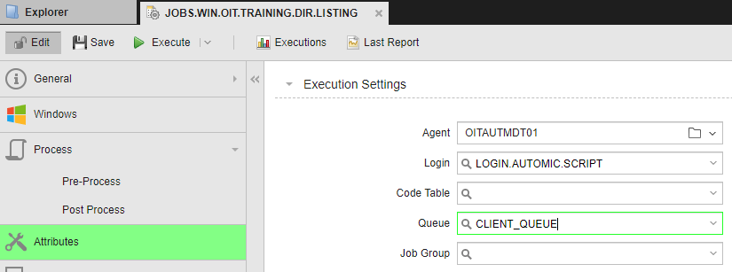
JOBS
The JOBS does not work if there is no Host or Login. The Job is ineffective if the command or program call is missing in the Process tab. We will concentrate on these two tabs. All other parameters are optional.
Attributes Page
Select the Agent
Select the Login
From the Agent dropdown box, select the Host on whose operating system or application the Job should run. If you know the name of the Agent, you can also enter the name directly in the field using the keyboard.
Host Groups (HOSTG) can be created that contain Hosts on
multiple environments. Automic tries each Host till it finds the one in the environment.
Login information is stored in a Login object. For OS Jobs,
it includes the OS users and their passwords. For application Jobs, it includes the users which have been defined within the application(s). Login objects pair with the Host

Slide 34
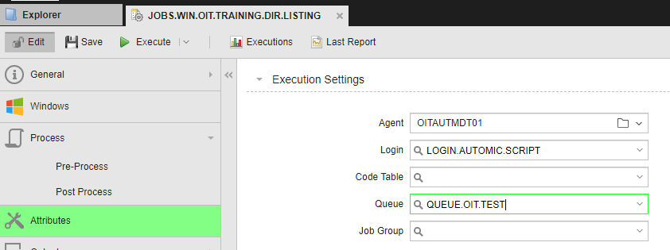
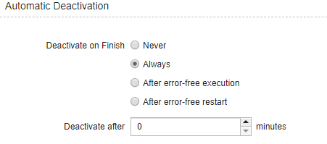
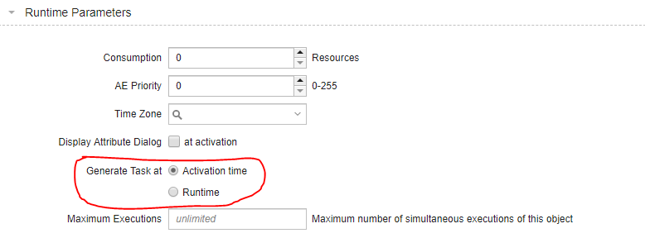
JOBS
Attributes Page
Queue
Automatic Deactivation
Runtime Parameters
By default all jobs are assigned to the Client_Queue. You can create and use a user defined queue to make it easier to find your running jobs in the Process Monitoring perspective
You can choose how you want the JOBS to deactivate after the JOBS executes. You will work with the OCC to determine the best method for your application.
By default the Task and its parameters are generated at activation. There are situations where the Task and parameters should be generated at runtime. You would set that parameter here.

Slide 35
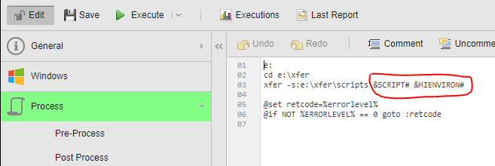
JOBS
Process Page - Commands or Program Calls
Process Page - Required for JOBS
The Process page is available in all executable objects. The script on this page is processed during the Generation stage.
For JMX, PeopleSoft, SAP, and SQL Jobs, the Process page provides two options to create scripts:
Writing code in the script editor This option is the standard one, available for all executable objects.
Adding predefined, ready-to-use commands available in the Forms view
Platform specific processing is available:
JCL for z/OS
Enabling an Interpreter for Windows and UNIX
Windows BAT and PowerShell Scripts
Using the variables set in Pre-Process, execute a command Some typical commands you can use.

Slide 36
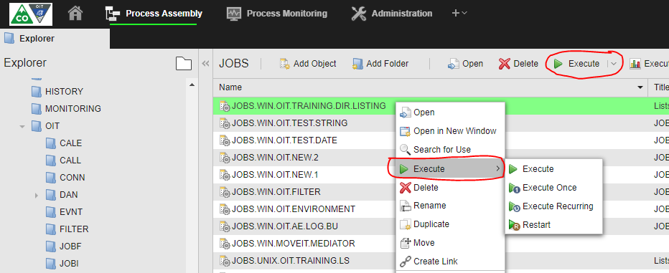
JOBS
How to execute a job
Click Execute on the Menu bar
Highlight the object, right click and select the execution type
Job Report & Executions - After execution, highlight the Job in the Explorer, right click and select Last Report. Or highlight the JOBS and select Last Report from the Menu Bar. Executions give you a list of the last 50 job reports.

Slide 37
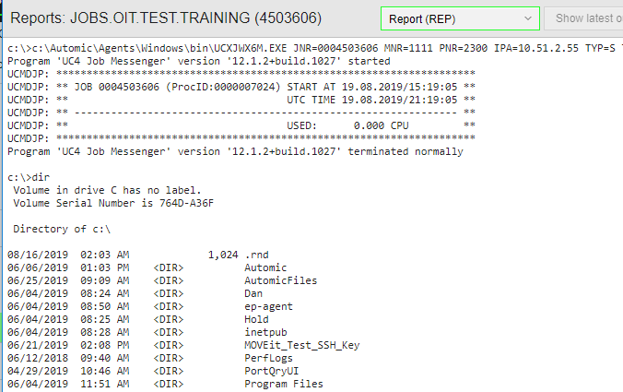
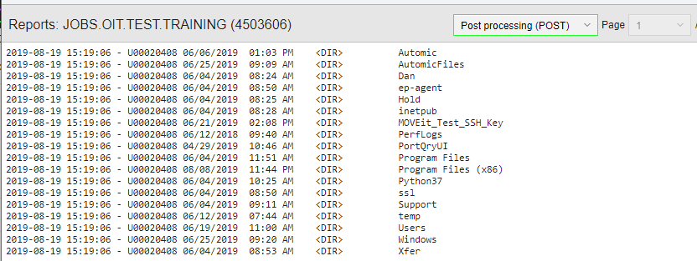
JOBS
Job Report
A Job report contains the information returned by the job, the most common are for Pre-Process (ACT), Process (REP) and Post-Process (POST). Using the dropdown (in red), you can choose which report to view.
TIP: FILTERS read job data including reports to look for errors in processing.

Slide 38
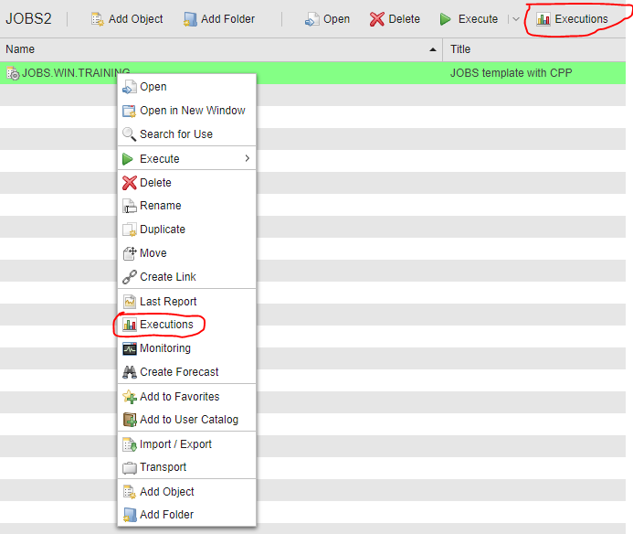
JOBS
Executions
The Executions window contains information on the task’s individual Job executions. The entries are sorted according to the time they were activated. You can change the order by clicking the respective column title. This changes the sorting sequence.
You can access the Executions window two ways:
Highlight the job name, right click and select Executions or by clicking Executions on the menu bar.
You can now right click on the specific execution and Open Report. Or you can click on Details in the upper right to see additional information.

Slide 39
JOBS
Exercise
Duration approx. 20 minutes
The following applies to all tasks: Execute the Jobs several times. Read
the corresponding reports, statistics and details for the execution. Familiarize
yourself with how Jobs are handled.
1. Task:
Create four Jobs. Select the commands from the following table:
2. Task
Create one Job where all 4 commands from task 1 are executed one
after the other and check the results.
3. Task:
Add an incorrect command like "eco error" as the first command to the
Job from task 2. What is different in the results? Move the incorrect
command to the end of the commands. What is different now?

Slide 40
FILTER - Error Handling
Filter objects search for a specific string or a combination of strings in one or more text files. Based on the results of the search, Filter objects return an overall true or false value. As a developer and object designer you create Filter objects and assign them to the Output-Scan Page of the following objects:
File Transfers (JOBF)
Jobs (JOBS)
Remote Task Manager (JOBQ)
The Filter object scans the output files of these objects.
Automic JOBS have built in error handling to deal with errors that happen based on JOBS attributes, variables, prompts and permissions to name a few. When these errors are found the JOBS terminates with a return code = 2, ENDED_NOT_OK_XX However, errors that happen in scripts, copy commands and any internal process of the JOBS get reported in a report but do not trigger job level errors.
Filters allow you to find the errors in internal components after JOBS execution and then act upon then.
OIT has created a standard Filter that can be used in any job. It reads the Report (REP) looking for connection related errors, Auth fail, wait time exceeded, permission denied and channel broken. You can add multiple filters to a JOBS and you should start by adding this one: FILTER.OIT.GENERAL.ERROR.HANDLING

Slide 41
FILTER - Error Handling
To Define a Filter Object
In the Process Assembly perspective click Add Object. On the Add Object dialog, select Filter.
In the Filter Logic section specify whether one or all the search criteria must be met for the overall result to be true.
Define the search criteria for the different types of file:
Report
Use this option to search for strings in reports
Reports that are generated by and stored in the Automation Engine database when a task is executed, for example logging (LOG) or activation (ACT) files
Registered Job Output
Use this option to search for strings in output files from external Jobs
Enter a file path and name.
File
Use this option to search for strings in any other kind of text file that you want to check
Enter a file path and name.
4. In the Condition dropdown list select the operator.
5. In Filter String enter a search string. Standard wildcard characters (*, ?) are allowed. You can also use
variables. This field is not case-sensitive.
6. Click Add. A search filter statement appears under the input fields.
To remove an added search criterion, click the x on the criteria box. To edit an added search criterion,
click on the search filter statement to activate it and modify its contents.
7. Repeat these steps for all the search criteria and save the object.
8. Assign the Filter object to the object in which you want to search for strings in their output files.

Slide 42
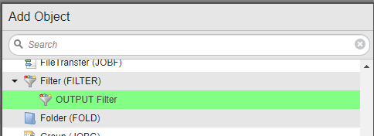
FILTER - Error Handling
Your Filter is set using an OR condition to look for multiple error messages in the JOB Report. Note: There are 20 report types you can choose and you can have your filter read multiple reports.

Slide 43
CALL - Notification
Notification (CALL)
Notification objects are customized messages and requests that can be assigned to other executable objects. When the execution of an object triggers a Notification, either an e-mail or an online message is sent. The Notification provides information or requires user interaction as a reaction to the execution of the object.
As an administrator or as a developer and object designer, you create Notifications and assign them to executable objects. There are four different templates for creating Notifications, depending on the type of content you need. For each template you can choose the message type
As an operator, you receive Notifications and react to them accordingly. They are either e-mails or online messages. You access the online messages through the Requests area in the menu bar or by clicking the link on the web notification sent by your browser. For more information, see Requests.
Example: A Job usually needs few minutes to finish. If it takes longer, something might have gone wrong. You want to be informed of this situation as soon as possible. For this purpose, you create a Notification object and assign it to the Job. You assign it in the Actions on Runtime Deviations section on the Runtime Page of the Job definition.
Notification Templates
When you create a Notification object, you must select a template. The following templates are available:
ALARM, MAIL, SLM & STANDARD
All templates except STANDARD come with some predefined settings and a template-specific script on the Process page. You can change the predefined settings. For this training we will use the Mail notification.

Slide 44
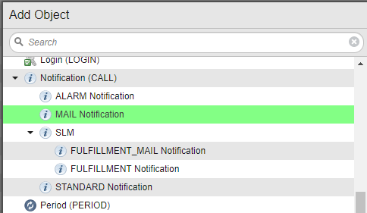
CALL - Notification

Slide 45
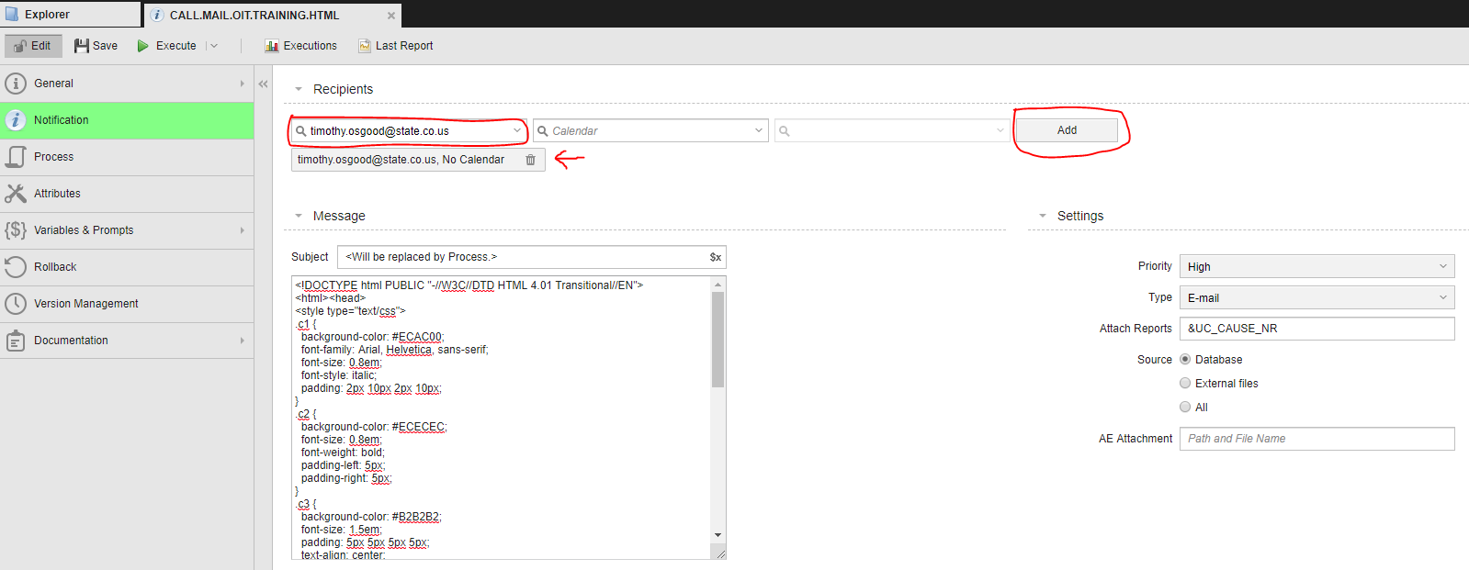
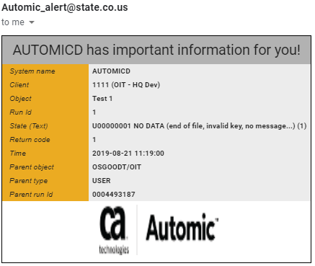
CALL - Notification
Add recipients by typing an email address then click Add or select an Automic user from the dropdown and click Add.
The Notification and Process tabs are pre-filled with variables and HTML. It reads the job information from the calling JOBS and sends the email to all recipients.
TIP: Editing the HTML line for &UC_CAUSE_NAME will add additional information about the job.
<tr><td class="c1">&c6#</td><td class="c2">General error exception has occurred - Please check &UC_CAUSE_NAME</td></tr>

Slide 46
JOBS - OUTPUT SCAN
After creating your FILTER and CALL objects, add them to the JOBS.
Using the drop down for Filter Object, select your filter. Then set your return code. 2 = Ended Not Ok. Lastly, choose your CALL object under Execution of.
You may also add Status Text to give a description of the error that is generated by the filter.

Slide 47
OutPut Scan
Exercise
Duration approx. 20 minutes
Create a FILTER object
Using the job report from previous exercise, choose some text value.
Add that value to your criteria
Create a CALL object
Add your email address as a recipient.
Edit your JOBS
Go to the Output Scan tab
Select your filter
Set your return code
Add your CALL object
Run your JOBS
Go to the Process Monitoring perspective to see the results of the job run
Check the Last Report
Bonus: Add some text to the Pre-Process tab. Edit your FILTER to read the Activation report and see the text as an error. Re-run your JOBS

Slide 48
Include (JOBI) & Scripting
Overview
Using Include objects ensures that your scripts are consistent, on the one hand, and saves you time, on the other, as they allow you to quickly and easily re-use code that you need often.
If your Include object also includes variables, ensure that these variables are also defined and initialized in the calling object. Otherwise, you cannot pass the variable from the Include object to the calling object.
You can also add the Include object in the calling object with the :INCLUDE statement. The script of the Include object is then inserted in the script of the calling object when the calling object is activated.
You can add JCL lines (if it is used in Job objects) in an Include object's script. You can also nest Includes within Includes up to max. five levels.
Scripting Variables and Functions Exmaples
https://docs.automic.com/documentation/webhelp/english/AWA/12.1/DOCU/12.1/AWA%20Guides/help.htm#AE_AWA_Source/Script/ucaaee.htm%3FTocPath%3DAutomic%2520Scripting%2520Guide%7C_____2

Slide 49
Getting Ready for Production
As they say, the job’s not done until the paperwork is finished.
To promote your job to Production you have to complete a Design Document and a CPP (Control Processing Procedure).
Design Document
The design document tells what the current process is and what the new process will do. It includes object definitions and screenshots. It defines testing methods and shows results. It gives an overview of CI and repository information (as needed).
CPP
Automic jobs are monitored 7 x 24 by the Operations Control team. The CPP let’s them know a little about the job, the jobs run schedule, including holidays and what to do if the job has an error. Page one are the instructions and page two are the details.

Slide 50
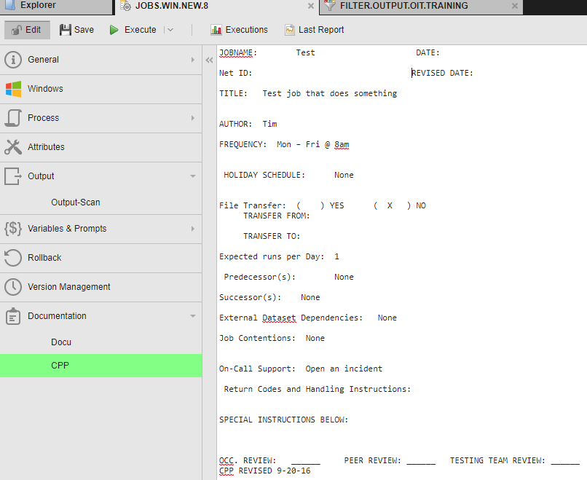
Getting Ready for Production
Adding the CPP to the executable object
All executable objects have a Documentation tab that contains a Docu and CPP sub-section.
After creating your CPP, copy Page two to the CPP tab in the executable object.
Save the object.
It is now ready to be promoted to Production.

Slide 51
Getting Ready for Production
The Promotion Process
Open a CA Change Order
Assign to the application.oit.integrations group
Summary = Promote Automic Jobs to Production
Description = Promote the following objects to 3333(QA/Test), 5555 (Prod Staging) and 1 Production
List Objects (provide details as necessary) + See schedule or Logic change
Attach the Design document and the CPP
The Integrations team will review the design document and compare to the actual objects. If all is in order, Integrations will re-assign to the Operations Control team. If adjustments need to be made, you will be notified to edit and re-attach design or CPP documents.
Operations team will run the job in 3333. If it runs without error, they will promote to 5555 and 1 and set your job schedule.
After promotion to production, monitor the first couple of runs to verify there are no issues.

