Slide 1
Michigan User Group

Slide 2
Segment 1
General Enhancements
Cloud Enabled Management
Agent Registration

Slide 3
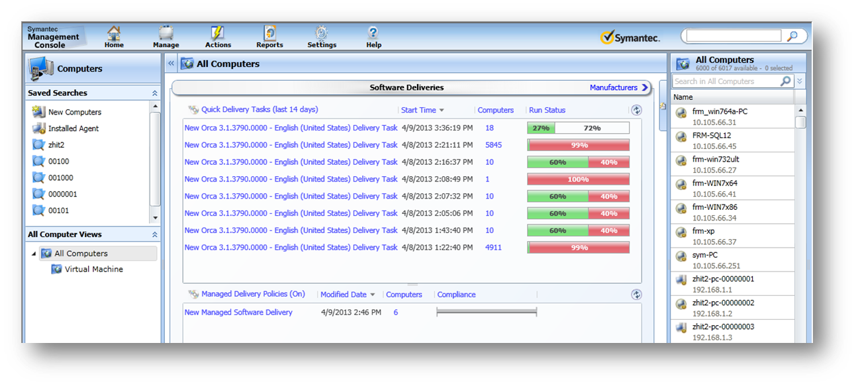
General Enhancements
Flipbooks

Slide 4
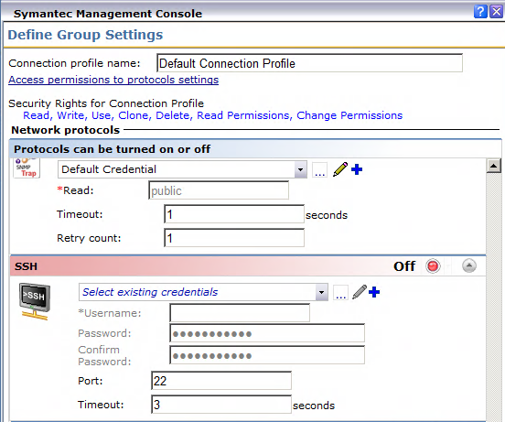
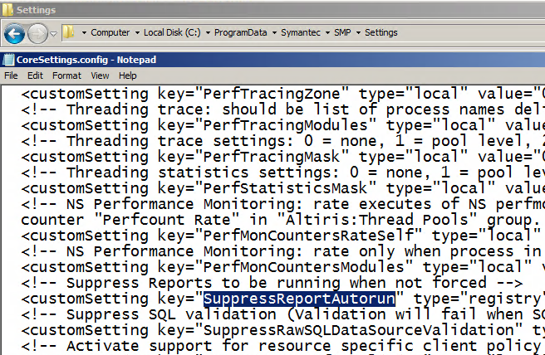
General Enhancements

Slide 5
Cloud Enabled Management (CEM)
Mobile Devices
Cloud Services
Mobile Workforce
Laptops are consistently outselling desktops since 2008
54% of businesses use SaaS
By 2015, over 37% of the global workforce will work outside the corporate firewall
Managing in the Cloud
5

Slide 6
CEM Introduction
According to a 2012 survey from Reuters, approximately one in five workers worldwide telecommute frequently.
Introducing Cloud-Enabled Management
Securely manage users anywhere on the internet
Eliminates the need for VPN
Agents automatically detect location
Internet Gateway can support multiple servers

Slide 7
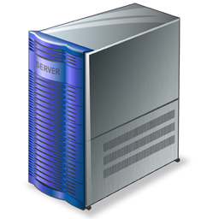
CEM Architecture
External
DMZ
Internal
Internet
Agent
External Firewall
Internet Gateway
Internal Firewall
Symantec Management Platform
Secure connection No VPN required
Gateway blocks un-trusted connections

Slide 8
CEM Scalability
Internet Gateway has been tested up to 3,000 concurrent connections:
Translates into up to 60,000 CEM-enabled nodes
Hardware requirements:
Preferably physical box, 8GB RAM, 40GB HDD and dual-core CPU
VM-based IG offers lower scalability, but still sufficient for a fully-loaded NS

Slide 9
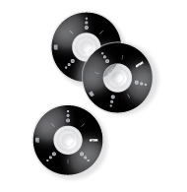
CEM Supported Solutions
Managed Software Delivery
Quick Delivery (non real-time)
Hardware Inventory
Software Inventory
Server Inventory
App Metering
Patch Inventory
Patch Management Policies
Basic Client Tasks
Managing in the Cloud
9

Slide 10
CEM Supported OS
Managed endpoints
Windows
No UNIX/Linux support now (Mac support upcoming)
SMP Internet Gateway
Windows Server 2008 R2 SP1 (64-bit)
.NET Framework 3.5 SP1
Two NICs
Managing in the Cloud
10

Slide 11
Agent Registration
The agent registration feature is added to ensure that only trusted endpoints can communicate with Notification Server.
The agent registration feature requires an endpoint to be allowed to communicate with Notification Server before it can be managed.

Slide 12
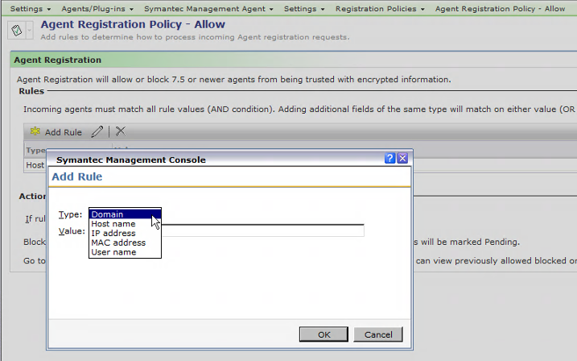
Agent Registration Policy

Slide 13
Agent Registration API
A registration API allows you to create your own customized process for registering agents.
Bulk Inputs
Self Service Portals
New Deployments
Other Business Process

Slide 14
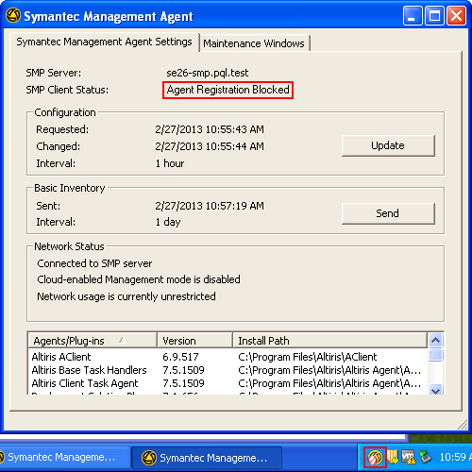
Agent Registration UI Status
Agent UI indicates:
GUID
Agent Registration Pending
Agent Registration Blocked
7.5 User Summit - Agent Registration
14

Slide 15
Segment 2
New Platforms
MAC Management
Patch, Inventory, & Software Management

Slide 16
New Supported Platforms

Slide 17
Macintosh Management
NTLMv2 support
Software install made easy
Detection Rules
Automatic creation of command lines
Introducing Mac Imaging
No Mac server required
Single console to manage Mac and Windows
According to Gartner, Mac sales to US businesses grew 50% in 2012

Slide 18
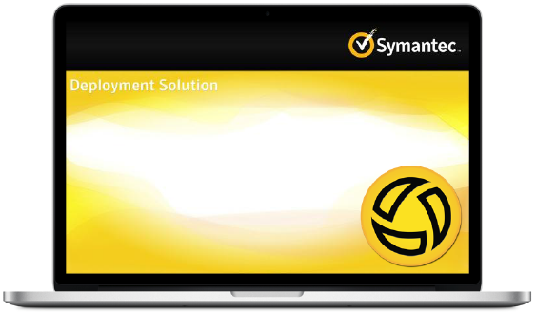
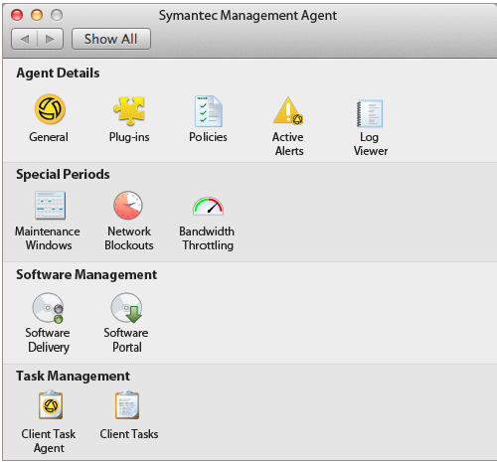
Macintosh Management
Mac Preboot
Mac SMA

Slide 19
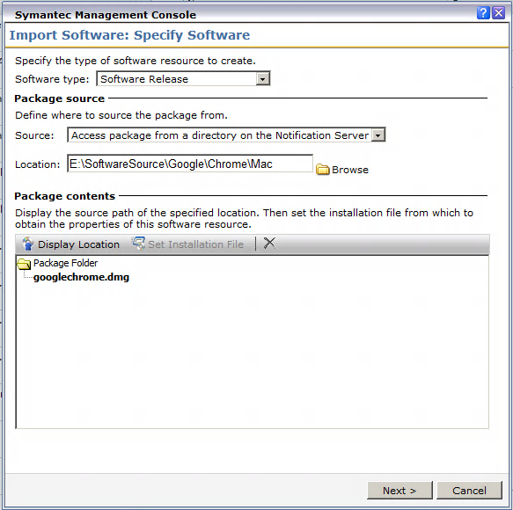
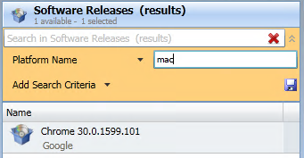
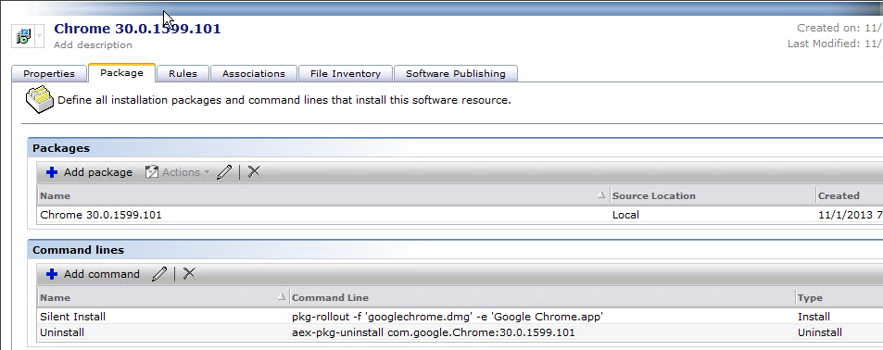
Macintosh Management
Platform Search
DMG Import
Command Line

Slide 20
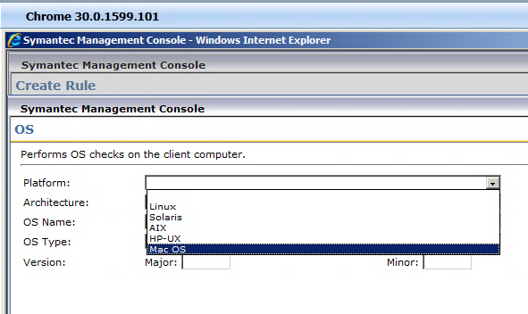
Macintosh Management
Detection Rule
Platform rule options

Slide 21
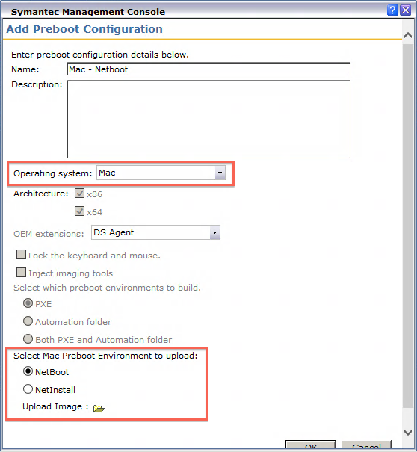
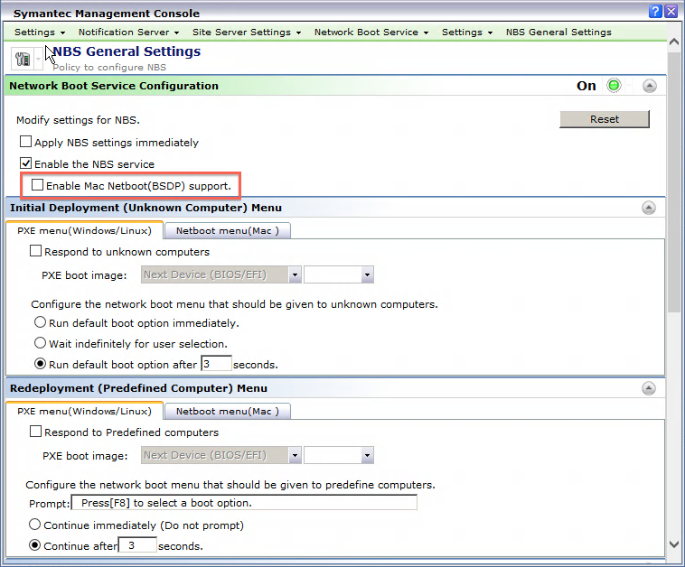
Macintosh Management

Slide 22
Out of Band Management (OOB)
The Out of Band Management (OOB) component is no longer available.
If you upgrade from earlier versions of IT Management Suite, the OOBRemover utility removes the Out of Band Management items from Notification Server, site servers, and client computers.
You should obtain the latest OOB component directly from Intel. This lets you to use the latest Intel services to simplify the provisioning process while providing the latest AMT feature support.

Slide 23
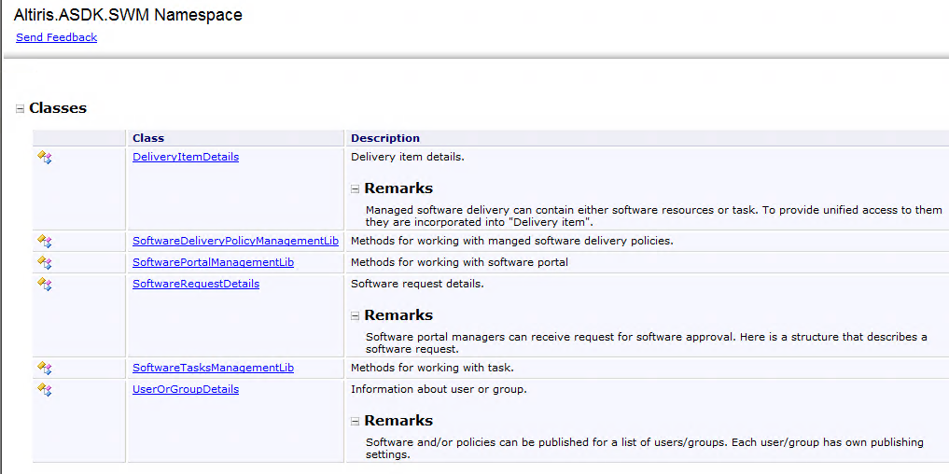
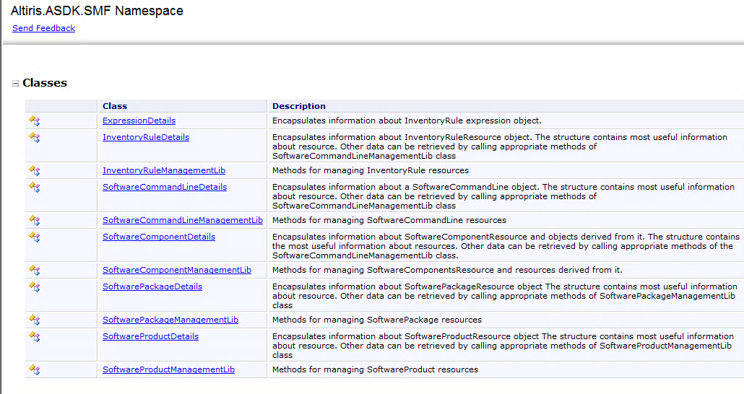
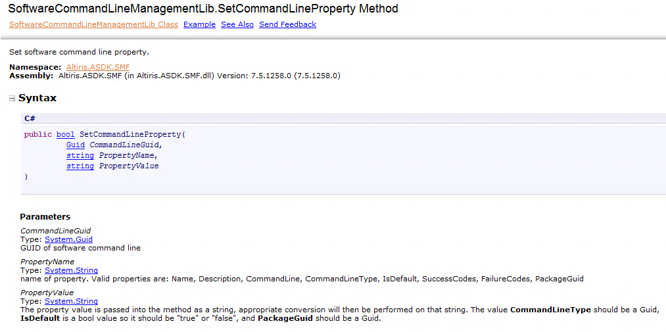
Software Management
Administrator Software Development Kit

Slide 24
Segment 3
Deployment

Slide 25
Deployment Solution
NetBoot options updated
Unknown, Pre-defined, Managed
Task Services
No longer required on Site Server with Deployment Components
Robust PXE services – No SBS Files
HTTPS
WinPE 4, LinuxPE 2.6
Close Match

Slide 26
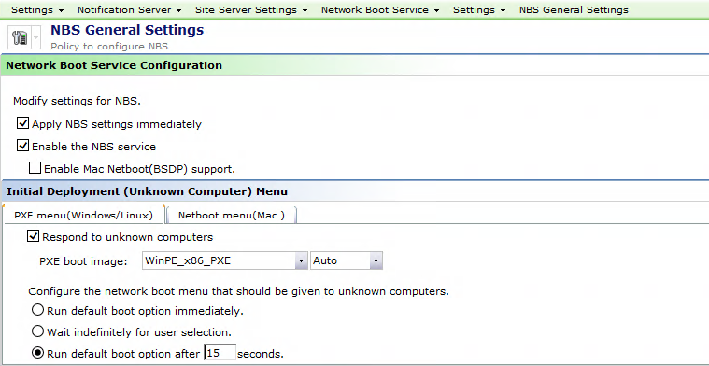
Deployment Solution - NBS

Slide 27
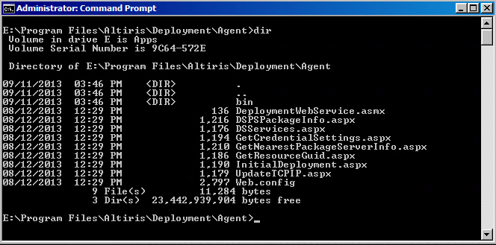
Deployment Solution – No SBS
7.5 Web Service on NS
7.1 SP2 SBS Files on SS

Slide 28
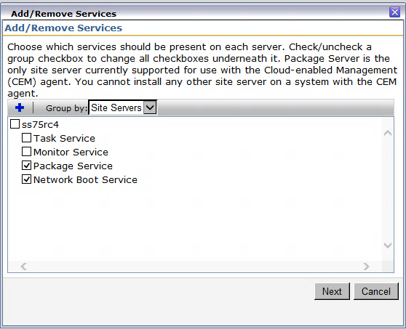
Deployment Solution – No Task Service
7.1 SP2 (4) netBoot Services
7.5 (2) netBoot Services (No Task Services!)
7.5

Slide 29
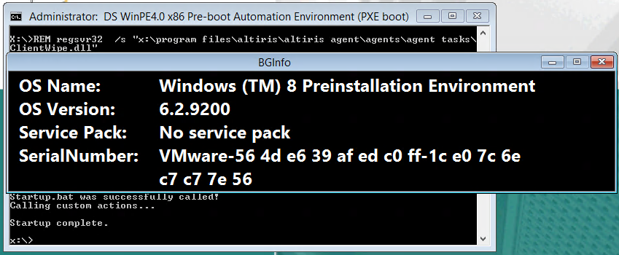
Deployment Solution - WinPE 4.0
7.1 SP2
7.5

Slide 30
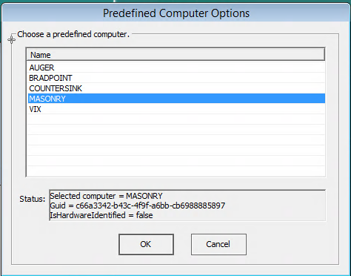
Deployment Solution – Close Match
In Preboot

Slide 31
Segment 4
Workflow
SEPIC & PCAnywhere
IT Analytics

Slide 32
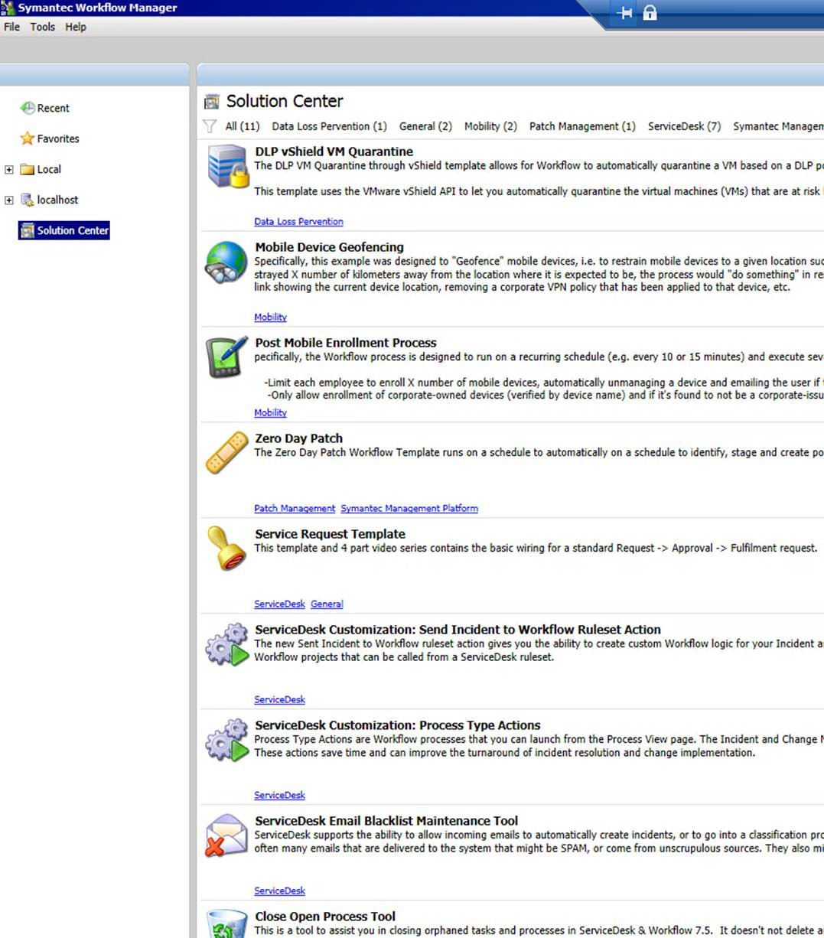
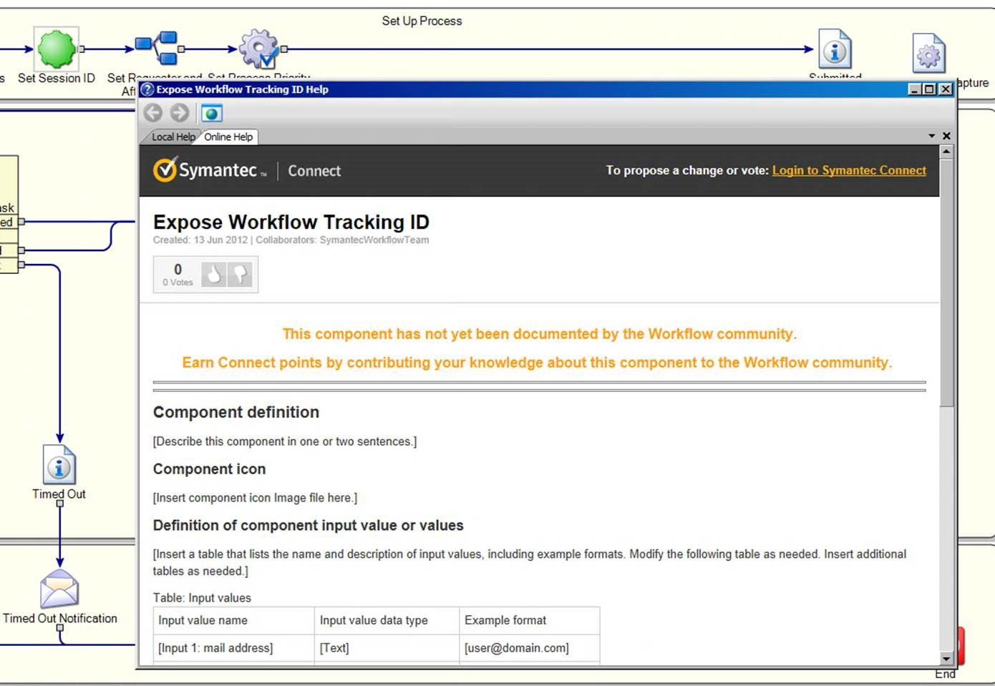
Workflow
Component Wiki

Slide 33
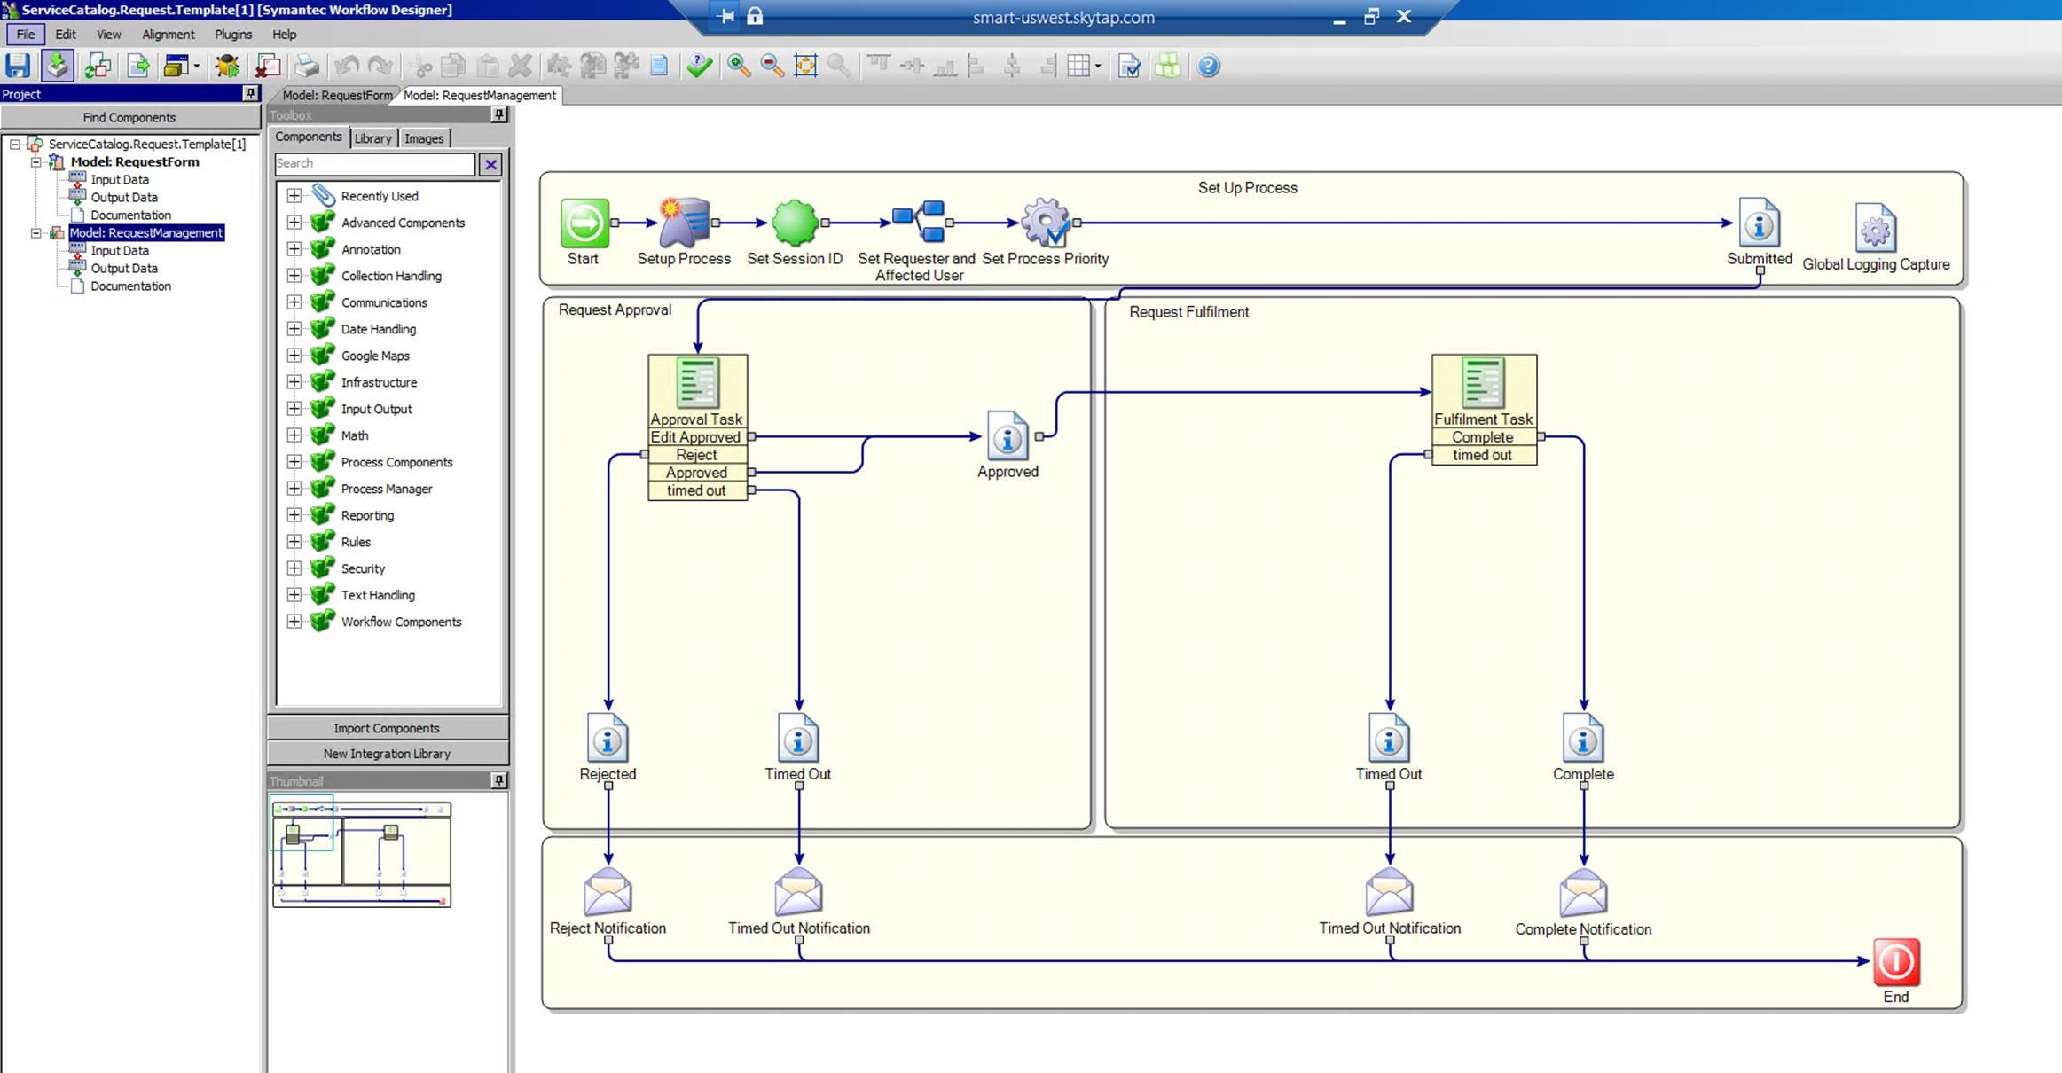
Workflow
Web Application Project Type

Slide 34
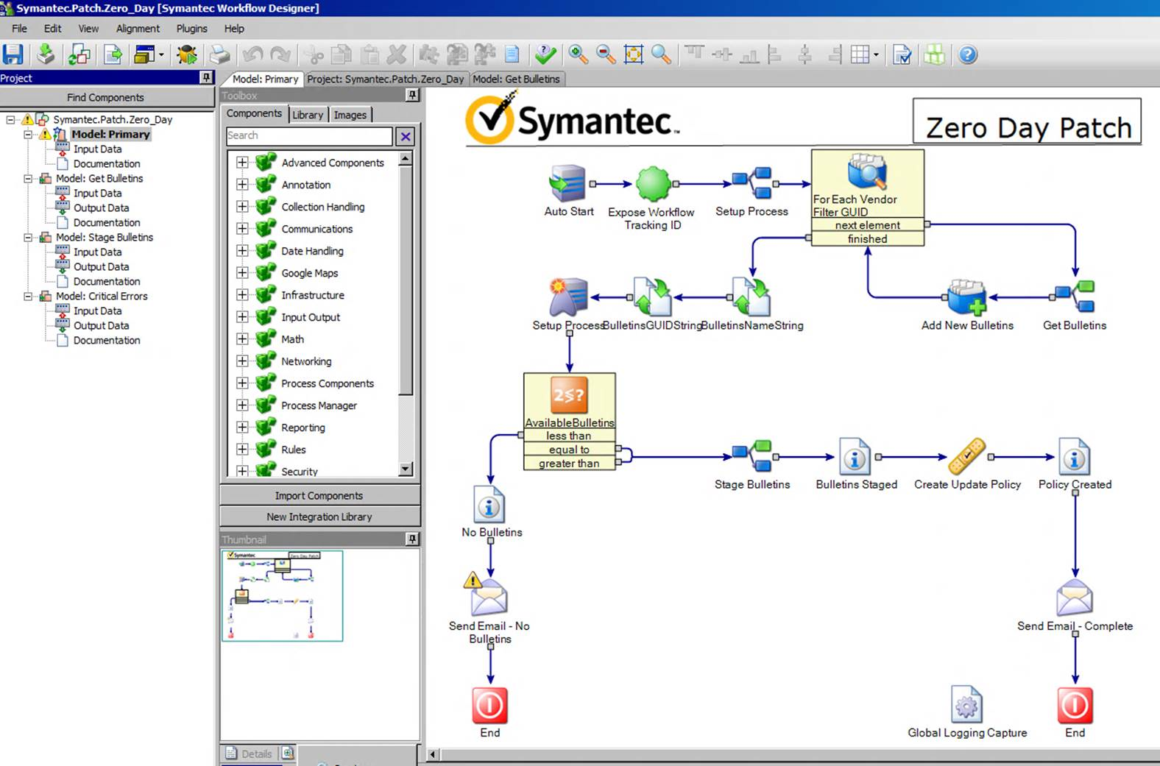
Workflow

Slide 35
IT Analytics (ITA) – Multi CMDB

Slide 36
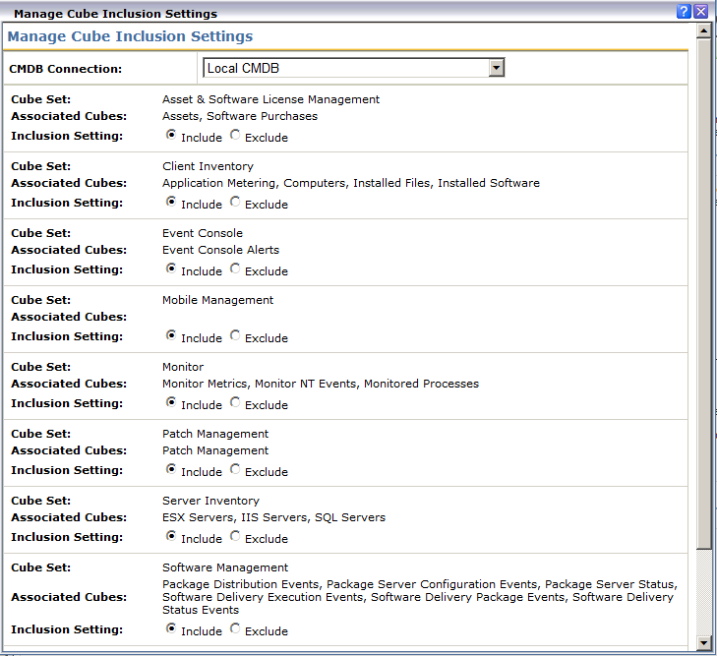
IT Analytics (ITA) – Multi CMDB
https://www-secure.symantec.com/connect/articles/adding-custom-data-class-it-analytics-cubes

Slide 37
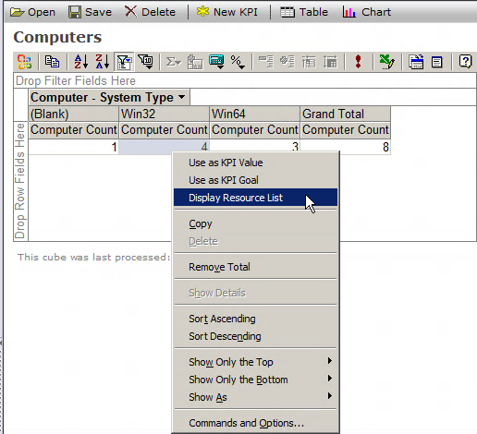
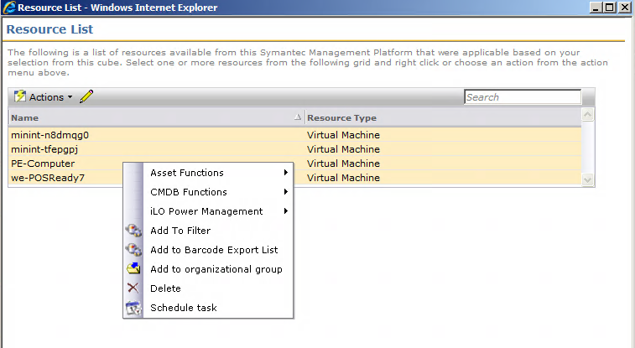
IT Analytics (ITA) – Cube Action
Taking action from cubes

Slide 38
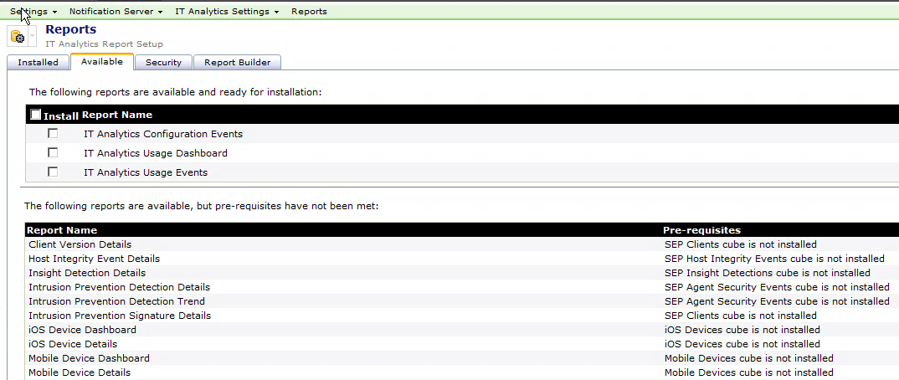
IT Analytics (ITA) - Mobile
Additions for Mobile

Slide 39
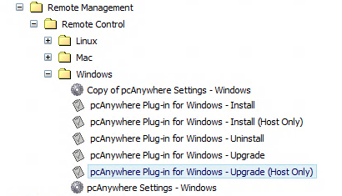
PCAnywhere Solution (PCA)
Upgrade to Host Only
Host by Version shows Host Only status

Slide 40
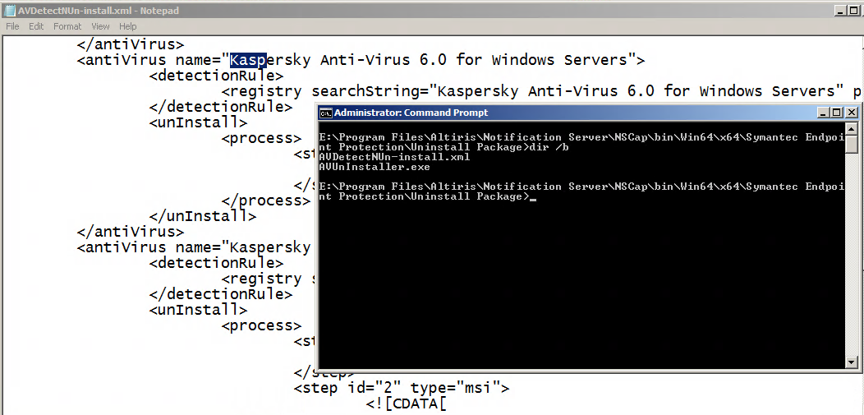
Endpoint Protection Integration (SEPIC)
Kaspersky Uninstall

Slide 41
Segment 5
IPAD App – “ITMSAdmin”
UI Pack (Q1)
Closing - Q&A

Slide 42
iPad App
Native iOS app
View dashboard reports and perform basic administrative actions
Delivered through the Apple App store subsequent to the release of 7.5

Slide 43
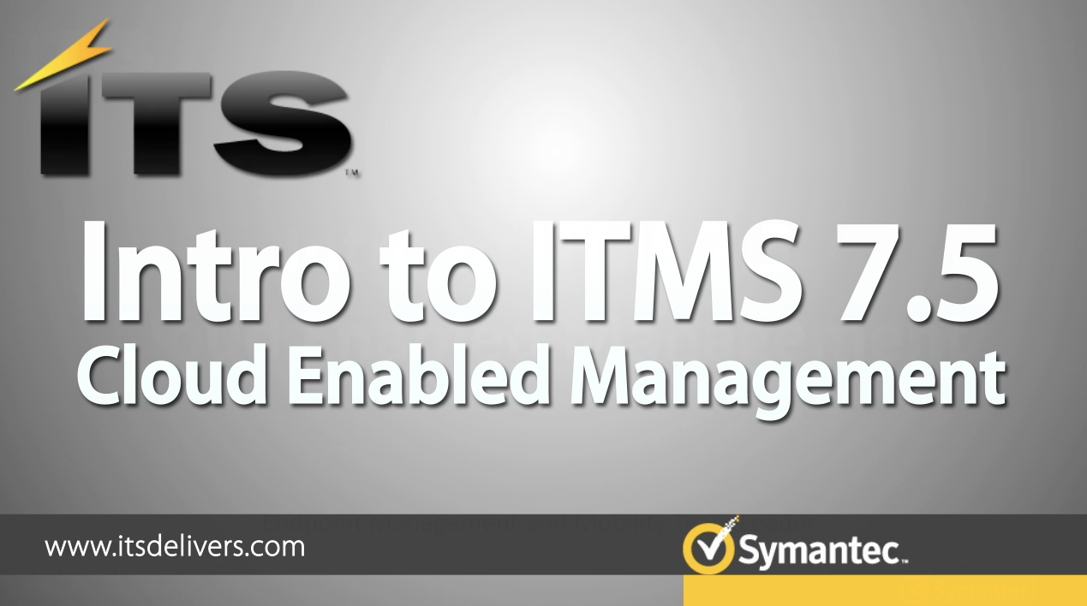
Thank You!
7.5 related videos

