Slide 1
Datacom™ Buffer Pools by Area
April 14, 2022
Joe Lynn
Software Engineer

Slide 2
Disclaimer
Certain information in this presentation may outline CA’s general product direction. This presentation shall not serve to (i) affect the rights and/or obligations of CA or its licensees under any existing or future license agreement or services agreement relating to any CA software product; or (ii) amend any product documentation or specifications for any CA software product. This presentation is based on current information and resource allocations as of April 14, 2022 and is subject to change or withdrawal by CA at any time without notice. The development, release and timing of any features or functionality described in this presentation remain at CA’s sole discretion.
Notwithstanding anything in this presentation to the contrary, upon the general availability of any future CA product release referenced in this presentation, CA may make such release available to new licensees in the form of a regularly scheduled major product release. Such release may be made available to licensees of the product who are active subscribers to CA maintenance and support, on a when and if-available basis. The information in this presentation is not deemed to be incorporated into any contract.
Copyright © 2022 Broadcom. All rights reserved. The term “Broadcom” refers to Broadcom Inc. and/or it’s subsidiaries. Broadcom, the pulse logo, Connecting everything, CA Technologies and the CA Technologies logo are among the trademarks of Broadcom.
THIS PRESENTATION IS FOR YOUR INFORMATIONAL PURPOSES ONLY. Broadcom assumes no responsibility for the accuracy or completeness of the information. TO THE EXTENT PERMITTED BY APPLICABLE LAW, BROADCOM PROVIDES THIS DOCUMENT “AS IS” WITHOUT WARRANTY OF ANY KIND, INCLUDING, WITHOUT LIMITATION, ANY IMPLIED WARRANTIES OF MERCHANTABILITY, FITNESS FOR A PARTICULAR PURPOSE, OR NONINFRINGEMENT. In no event will Broadcom be liable for any loss or damage, direct or indirect, in connection with this presentation, including, without limitation, lost profits, lost investment, business interruption, goodwill, or lost data, even if Broadcom is expressly advised in advance of the possibility of such damages.
Notes:
This is our standard Disclaimer slide which we are obligated to share stating that this presentation is for informational purposes only and is subject to change or withdrawal at any time without notice

Slide 3
Abstract
The recent GA publication of Buffer Pools by Area for index buffers completes the overall delivery of the Buffer Pools by Area feature. It is an improved method for allocating and managing Datacom buffers in the Multi-User Facility
This session will help you to understand the feature, how to configure it at MUF startup and why it has advantages over other buffer allocation methods available for Datacom
Buffer Pool by Area is a significant feature unto itself, but it is also the first part of a larger initiative of autonomic buffer tuning

Slide 4
Biography
Joe has worked on the Datacom/DB development team since 1975 in a variety of development roles and currently leads development for the database engine
Contact info: Joseph.Lynn@broadcom.com

Slide 5
Agenda
What’s new? Why would it provide value?
Defining the areas with Buffer Pools by Area
Dynamic adjustments
Reporting and Dynamic System Table
Messages

Slide 6
Poll question
1. What buffer management parameters do you use in your production MUF(s) today (check all that apply)?
a. SYSPOOL (System Buffers) and DATAPOOL (Data Buffers)
b. FLEXPOOL (Dynamic Buffers)
c. BUFFER_POOL_DEF (Alternate Buffer Pools)
d. BUFFER_POOL_DATA and/or BUFFER_POOL_INDEX (Buffer Pools by Area)

Slide 7
Poll question
2. If you specify FLEXPOOL at production MUF startup, do you actually use this feature to adjust buffer pools during the day or week?
a. Yes
b. No
c. Unsure

Slide 8
Poll question
3. What do you do to prioritize your highest priority applications (those that "pay the bills") in your organization? (check all that apply)
a. Prioritize in my scheduling system
b. Prioritize in Workload Manager
c. Prioritize in CICS
d. Set priority in the URTs I use for those applications
e. Use FLEXPOOL to add buffers while executing the applications
f. Other

Slide 9
What’s new?
Why would it provide value?

Slide 10
General feature Buffer pool for an index or data area
Provides a new way to have a private buffer pool for an index or data area
Available for when prioritizing an area outside of the common SYSPOOL/DATAPOOL.
Different than using the Memory Resident Data Facility COVERED
Different than using a common Alternate Buffer Pool with BUFFER_POOL_DEF
Provided for every MUF environment without a MUFPLEX Coupling Facility
New options BUFFER_POOL_INDEX and BUFFER_POOL_DATA with specific choices
Single area buffers not within SYSPOOL, DATAPOOL, or BUFFER_POOL_DEF memory
Not ‘redundant’ with COVERED

Slide 11
Buffer Pools by Area versus COVERED
Disadvantages with using COVERED being addressed
Covered memory is in addition to active blocks existing in other pools (SYSPOOL, DATAPOOL, BUFFER_POOL_DEF)
Active blocks are in other pools, can be few or many
Requires memory copy of blocks when written from other pools
Memory blocks restored to other pools when deleted as not active enough, then needed
With a large SYSPOOL, DATAPOOL, or BUFFER_POOL_DEF individual blocks may be rarely needed.
Are designed to be statically sized, not dynamically tuned
Does not support pipelined (deferred) DASD writes, so drives more write I/O

Slide 12
Buffer Pools by Area versus BUFFER_POOL_DEF
Disadvantages with using BUFFER_POOL_DEF being addressed
Data pools are built for multiple areas and not for joining with other Dynamic System Tables
Buffers can be added and deleted but not based upon active work for a data area
Not suited for favoring a single data area and automatically adjusting buffers

Slide 13
Buffer Pools by Area versus SYSPOOL or DATAPOOL
Disadvantages with using SYSPOOL or DATAPOOL
The data buffers are not sized for exactly this one area. Similar for index
Buffers for this one area cannot be prioritized, Least Recently Used algorithm is used to manage all areas in DATAPOOL
Restriction of 99,999 maximum data buffers for DATAPOOL
Buffers can be added and deleted but not easy to actively tune to benefit an area

Slide 14
Buffer Pools by Area benefits
Advantages over SYSPOOL, DATAPOOL, BUFFER_POOL_DEF and COVERED
Buffers are sized for the specific data area
Blocks are in memory once and not redundant like COVERED
Large quantity of buffers allowed, similar to COVERED and not other pools
Allows an important area to have priority and control of memory and thus reduce I/O
Easy to tune either actively by a DBA or by automation
Five strategies for defining area sizing

Slide 15
Index areas combine high level IXX and low level DXX
This is similar to how COVERED works, not how SYSPOOL and BUFFER_POOL_DEF separates
Having all index blocks in memory in one pool is more efficient
Blocks need not be deleted and reread to move between IXX and DXX
Allows the proper sizing as it is hard to manage if one pool for IXX and another for DXX.
The percent of IXX blocks varies between databases
The number of IXX blocks versus DXX blocks is not constant

Slide 16
Recap: Why another buffer pool?
Cost of MUF execution
Benchmarking has shown CPU cost of moves from COVERED buffer to prior types of buffers can be measurable, depending on your environment. Buffer Pools by Area eliminates these moves and should have “better” performance.
Direction for the future as MUF automates more to reduce DBA efforts
This is much easier with the new Buffer Pool by Area than using either COVERED or BUFFER_POOL_DEF

Slide 17
Defining the areas
Buffer Pools by Area

Slide 18
Defining the areas
BUFFER_POOL_DATA dbid,area-name,BYTES,number
Definition for one area providing the number of bytes for the memory of the buffers
1 to 9 billion using just number or number with ‘K’, ‘M’, or ‘G’, except using ‘G’ may be up to 19 billion (19G)
BUFFER_POOL_DATA dbid,area-name,BLOCKS,number
Definition for one area providing the number of blocks (sized at open) for the memory of the buffers
1 to 9 billion using just number or number with ‘K’, ‘M’, or ‘G’, except using ‘G’ may be up to 19 billion (19G)
BUFFER_POOL_DATA dbid,area-name,INIT,number%
Blocks initialized at dataset open
1%-200%
BUFFER_POOL_DATA dbid,area-name,HIGH,number%
Blocks ever used, highest use
1%-200%
BUFFER_POOL_DATA dbid,area-name,ACTIVE,number%
Blocks actively in use containing rows at dataset open
1%-200%

Slide 19
Defining the areas, examples
Index
BUFFER_POOL_INDEX 002,IXX,ACTIVE,10%
BUFFER_POOL_INDEX 015,IXX,ACTIVE,100%
BUFFER_POOL_INDEX 360,,HIGH,200%
BUFFER_POOL_INDEX 1497,,HIGH,80%
BUFFER_POOL_INDEX 3310,,HIGH,50%,8192
BUFFER_POOL_INDEX 3311,,HIGH,50%,8192
BUFFER_POOL_INDEX 3314,,INIT,100%,8192
BUFFER_POOL_INDEX 3315,,HIGH,80%,8192
BUFFER_POOL_INDEX 3318,,BLOCKS,300,8192
BUFFER_POOL_INDEX 3319,,HIGH,80%,8192

Slide 20
Defining the areas, examples
Data
BUFFER_POOL_DATA 2,,ACTIVE,10%
BUFFER_POOL_DATA 15,DDD,ACTIVE,100%
BUFFER_POOL_DATA 3314,,HIGH,100%
BUFFER_POOL_DATA 3319,,ACTIVE,85%
BUFFER_POOL_DATA 3312,,HIGH,125%
BUFFER_POOL_DATA 3310,,BYTES,10M,32K
BUFFER_POOL_DATA 3318,,ACTIVE,75%,27998
BUFFER_POOL_DATA 3318,ARX,BYTES,200K,27998
BUFFER_POOL_DATA 3318,AR3,BLOCKS,230,27998
BUFFER_POOL_DATA 3318,AR4,BLOCKS,70,27998
BUFFER_POOL_DATA 3319,AR1,BYTES,4M,27998
BUFFER_POOL_DATA 3319,AR2,BLOCKS,50,27998

Slide 21
Defining the areas
Common at area open for all Buffer Pool by Area definitions
Data block counts less than 5 will be rounded up to provide minimum 5 blocks. (Not recommended)
Index block counts less than 99 will be rounded up to provide minimum 99 blocks. (Not recommended)
Large memory size over the MUF maximum (2G default or X_COVERED_MAX_SIZE) will be rounded down
Block counts more than blocks initialized at the time of the dataset open will be rounded down
Currently ‘gated’ to allow maximum 10 definition statements for data areas and 10 for index areas
Major new facility, learning period
Does use 31-bit memory for each buffer as a ‘directory’ for managing
If the definition statement omits the area name, it may allow more than 10 data and/or index areas
Important note: DBIDs and area names are not edited as currently existing

Slide 22
Dynamic adjustments
Buffer Pools by Area

Slide 23
Tuning after the area is open - New Size
Tuning commands may be used by any console-like API
BUFFER_POOL_NEW_SIZE DATA,dbid,area-name,class,new-size
Example: BUFFER_POOL_NEW_SIZE DATA,15,DDD,ACTIVE,50%
Example: BUFFER_POOL_NEW_SIZE DATA,2,DD1,INIT,110%
Example: BUFFER_POOL_NEW_SIZE DATA,100,ABC,BYTES,4G
Real testing examples:
SUBTASK_AUTO 161,BUFFER_POOL_NEW_SIZE DATA,2,DD1,ACTIVE,100%
SUBTASK_AUTO 149,BUFFER_POOL_NEW_SIZE DATA,2,DD1,ACTIVE,200%
SUBTASK_AUTO 138,BUFFER_POOL_NEW_SIZE DATA,2,DD1,ACTIVE,50%
SUBTASK_AUTO 161,BUFFER_POOL_NEW_SIZE DATA,15,DDD,ACTIVE,150%
SUBTASK_AUTO 149,BUFFER_POOL_NEW_SIZE DATA,15,DDD,ACTIVE,75%
SUBTASK_AUTO 138,BUFFER_POOL_NEW_SIZE DATA,15,DDD,ACTIVE,50%
DBUTLTY COMM OPTION=CONSOLE,
OPTION2=’BUFFER_POOL_NEW_SIZE DATA,2,DD1,ACTIVE,25%’

Slide 24
Tuning after the area is open - New Size
Example messages showing New Size changes:
DB01421I - BUFFER_POOL_DATA NEW_SIZE 15 DDD ACTIVE FROM 2,690 TO 1,345 BLOCKS
DB01421I - BUFFER_POOL_DATA NEW_SIZE 2 DD1 ACTIVE FROM 449 TO 2,248 BLOCKS
DB01421I - BUFFER_POOL_DATA NEW_SIZE 15 DDD ACTIVE FROM 1,345 TO 2,017 BLOCKS
DB01421I - BUFFER_POOL_DATA NEW_SIZE 2 DD1 ACTIVE FROM 2,248 TO 8,992 BLOCKS
DB01421I - BUFFER_POOL_DATA NEW_SIZE 15 DDD ACTIVE FROM 2,017 TO 4,035 BLOCKS
DB01421I - BUFFER_POOL_DATA NEW_SIZE 2 DD1 ACTIVE FROM 8,992 TO 4,496 BLOCKS
DB01421I - BUFFER_POOL_DATA NEW_SIZE 2 DD1 ACTIVE FROM 4,548 TO 2,274 BLOCKS
DB01421I - BUFFER_POOL_DATA NEW_SIZE 15 DDD ACTIVE FROM 4,018 TO 1,340 BLOCKS
DB01421I - BUFFER_POOL_DATA NEW_SIZE 15 DDD ACTIVE FROM 1,340 TO 2,010 BLOCKS
DB01421I - BUFFER_POOL_DATA NEW_SIZE 2 DD1 ACTIVE FROM 2,274 TO 9,068 BLOCKS
DB01421I - BUFFER_POOL_DATA NEW_SIZE 15 DDD ACTIVE FROM 2,010 TO 4,021 BLOCKS
DB01421I - BUFFER_POOL_DATA NEW_SIZE 2 DD1 ACTIVE FROM 9,068 TO 4,534 BLOCKS
DB01421I - BUFFER_POOL_DATA NEW_SIZE 15 DDD ACTIVE FROM 4,023 TO 1,341 BLOCKS
DB01421I - BUFFER_POOL_DATA NEW_SIZE 2 DD1 ACTIVE FROM 4,535 TO 2,267 BLOCKS
DB01421I - BUFFER_POOL_DATA NEW_SIZE 15 DDD ACTIVE FROM 1,341 TO 2,016 BLOCKS
DB01421I - BUFFER_POOL_DATA NEW_SIZE 2 DD1 ACTIVE FROM 2,267 TO 9,070 BLOCKS

Slide 25
Tuning after the area is open - Resize
BUFFER_POOL_RESIZE 1-5000
May be a single DBID or a range of DBIDs
Available with open areas using percentages, INIT/HIGH/ACTIVE
Each area in the DBID(s) buffers compared to the current INIT/HIGH/ACTIVE
Buffers are added or removed as needed to reach the set percent
Example: DB01421I - BUFFER_POOL_DATA RESIZE 3318 AR3 ACTIVE FROM 24 TO 209 BLOCKS

Slide 26
Tuning after the area is open - RESIZE
Example messages showing RESIZE changes:
DB01421I - BUFFER_POOL_DATA RESIZE 15 DDD ACTIVE FROM 4,033 TO 4,039 BLOCKS
DB01421I - BUFFER_POOL_DATA RESIZE 3312 AR1 HIGH FROM 662 TO 917 BLOCKS
DB01421I - BUFFER_POOL_DATA RESIZE 3314 AR1 HIGH FROM 669 TO 559 BLOCKS
DB01421I - BUFFER_POOL_DATA RESIZE 3319 AR3 ACTIVE FROM 51 TO 52 BLOCKS
DB01421I - BUFFER_POOL_INDEX RESIZE 15 IXX ACTIVE FROM 567 TO 568 BLOCKS
DB01421I - BUFFER_POOL_INDEX RESIZE 3310 IXX HIGH FROM 150 TO 180 BLOCKS
DB01421I - BUFFER_POOL_INDEX RESIZE 3313 IXX HIGH FROM 149 TO 174 BLOCKS
DB01421I - BUFFER_POOL_INDEX RESIZE 3315 IXX HIGH FROM 245 TO 268 BLOCKS
DB01421I - BUFFER_POOL_INDEX RESIZE 3319 IXX HIGH FROM 355 TO 369 BLOCKS
DB01421I - BUFFER_POOL_DATA RESIZE 15 DDD ACTIVE FROM 2,013 TO 2,008 BLOCKS
DB01421I - BUFFER_POOL_DATA RESIZE 3314 AR1 HIGH FROM 559 TO 720 BLOCKS
DB01421I - BUFFER_POOL_DATA RESIZE 3319 AR3 ACTIVE FROM 52 TO 51 BLOCKS
DB01421I - BUFFER_POOL_DATA RESIZE 3312 AR1 HIGH FROM 917 TO 918 BLOCKS
DB01421I - BUFFER_POOL_DATA RESIZE 3312 AR1 HIGH FROM 918 TO 1,007 BLOCKS
DB01421I - BUFFER_POOL_INDEX RESIZE 360 IXX HIGH FROM 348 TO 658 BLOCKS
DB01421I - BUFFER_POOL_INDEX RESIZE 3315 IXX HIGH FROM 268 TO 272 BLOCKS

Slide 27
Reporting and Dynamic System Table
Buffer Pools by Area

Slide 28
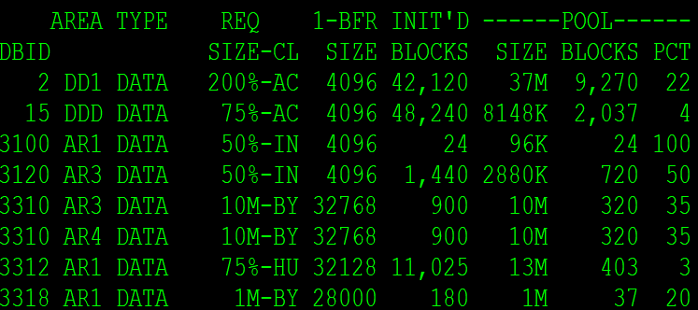
Reporting for areas that have been opened
MUF EOJ report (ALL_INFO_REPORT PXXDST)

Slide 29
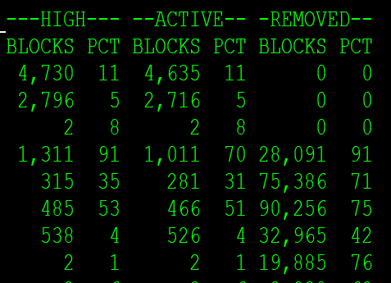
Reporting
MUF EOJ report (ALL_INFO_REPORT PXXDST)

Slide 30
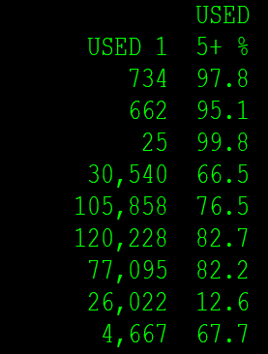
Reporting
MUF EOJ report (ALL_INFO_REPORT PXXDST)

Slide 31
Dynamic System Table
MUF_BFR_POOL_AREA (MPA)
DBID
AREA_NAME
TYPE (DATA)
REQ_SIZE size requested
CLASS (BYTES/BLOCKS/INIT/HIGH/ACTIVE)
BUFFER_SIZE
BLOCKS_INIT at time of query blocks initialized
POOL_SIZE memory pool size (buffer size * blocks in pool)
POOL_BLOCKS number of blocks in the pool
POOL_PCT percent of pool blocks to blocks initialized
HIGH_BLOCKS at time of query highest blocks used
HIGH_PCT percent of high blocks to blocks initialized
ACTIVE_BLOCKS at time of query actively blocks used
ACTIVE_PCT at time of query current active blocks
REMOVED_BLOCKS blocks removed not as oldest
REMOVED_PCT percent of blocks removed to reads
BUFFER_USED_1 (_2, _3, _4, _5) blocks used once, twice, etc.
GENERATION

Slide 32
Messages
Buffer Pools by Area

Slide 33
Messages: DB01420I, DB01421I
DB01420I - BUFFER_POOL_DATA OPENED 3318 AR2 BLOCKS-5 B_SIZE-28000 CL-ACTIVE
Provides the number of blocks allocated for the area at the dataset open
Provides the buffer size of each block for the area
Provides the class being used: BYTES/BLOCKS/INIT/HIGH/ACTIVE
DB01421I - BUFFER_POOL_DATA new_size/resize 2 DD1 ACTIVE FROM 2,303 TO 2,282 BLOCKS
Provides the adjustment from command NEW_SIZE
Provides the class of BYTES/BLOCKS/INIT/HIGH/ACTIVE
Provides the number of blocks at start of command and number after command

Slide 34
Questions

Slide 35
Poll question
4. Have you begun to test BUFFER_POOL_DATA and BUFFER_POOL_INDEX in your test/development/QA environment(s):
a. Yes
b. No

Slide 36
Poll question
5. I plan to implement BUFFER_POOL_DATA and/or BUFFER_POOL_INDEX in my production MUF(s) in about:
a. 0-3 months
b. 4-6 months
c. 7-12 months
d. >12 months
e. unsure
f. don't plan to implement

Slide 37
Poll question
If you would like someone to reach out to you individually to discuss further how Buffer Pool by Area might benefit your organization, please provide your name and email address:
______________________________________________________________

Slide 38
Keeping You Informed

Slide 39
Partnering with You – How you Can Get Involved
We’re Interested In Your Thoughts
Join us on our journey to achieve our ongoing vision, we are actively seeking feedback and suggestions from our customers. We want to hear your voice!
Submit your ideas on Datacom/CADRE community.broadcom.com
Vote and comment on ideas that are important to you
Join our validation program to influence our product direction
End-of-Sprint review meetings
Early access to new features and enhancements
Attend our monthly webcasts – check out the Communities site for upcoming sessions
2nd Thursday each month
NEW: Quarterly Office Hours

Slide 40
Database Webcast: Thursday, April 21 @ 11:00 (ET)
What is Design Thinking and Why Should I Care?
REGISTER HERE!

Slide 41
Communities – Ideas Update
Improving the Ideas program
A Broadcom mainframe-wide initiative announced in 2021
Datacom’s plan is underway
Regular checks for new ideas, posting to the Datacom CADRE Community
Broadcom review of Ideas regularly
Determining which Ideas are the most valuable
Closing others as “Not Top Priority” to let us focus on the ones that have more potential

Slide 42
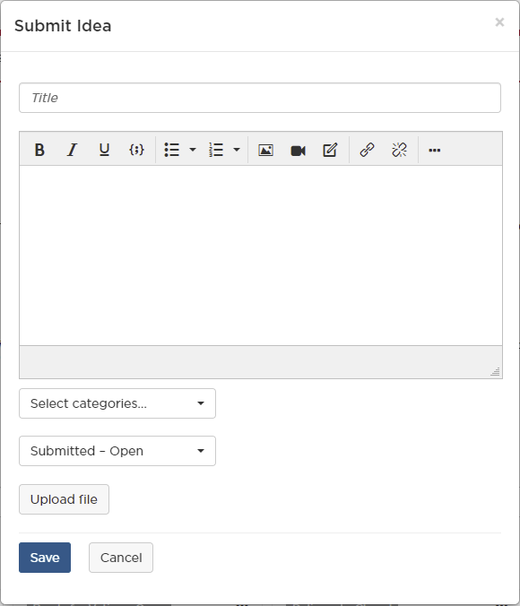
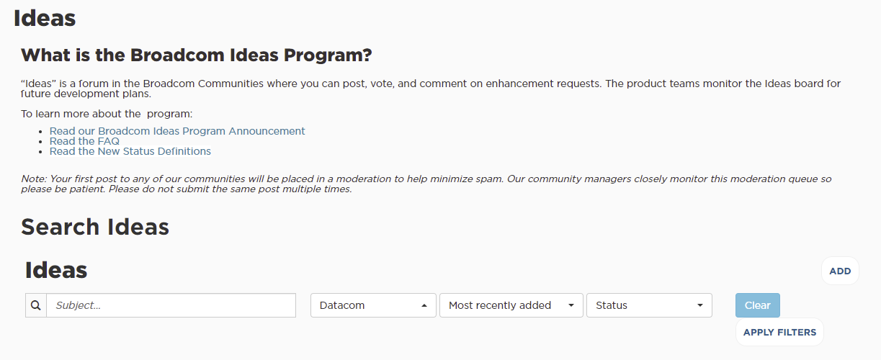
Ideas – Community Navigation
Sign-in required to access Ideas
community.broadcom.com

Slide 43
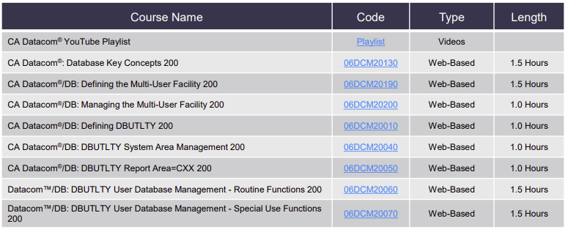
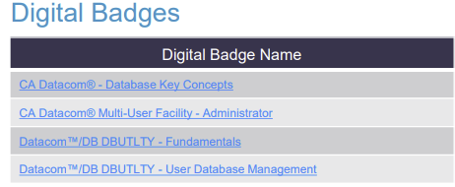
Education
Web-based training is provided at no cost for customers active on maintenance.
Customers: To learn more about the training options and to take web-based training, visit Mainframe Education and click TRAINING LOGIN. After logging in, search by course name or course code.

Slide 44
Mainframe Vitality Program We partner with you to resolve skill gaps
Attract talent, grow & retain skills for a long-term career in Mainframe
Multi-dimensional learning environment
Onsite and online instructor-led training
Your expert and our expert collaborating to train Mainframe talent
Low cost for Broadcom customers

Slide 45
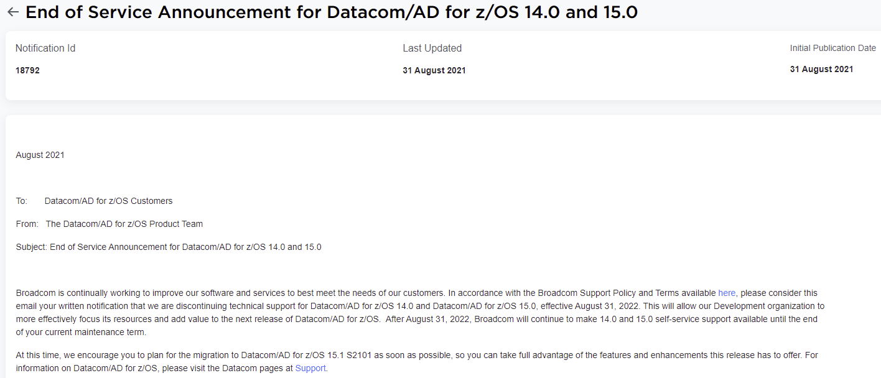
EOS Announcement: August 31, 2022

Slide 46
CSM EOL announcement in March 2022 +12 months support
z/OSMF new cross-vendor standard
Product acquisition & installation
z/OSMF Portable Software Instances
Product configuration
z/OSMF Workflows
Maintenance acquisition
SMP/E Internet Service Retrieval
Maintenance installation
Software Update module in z/OSMF
Care to learn more?
New training available on Learning@Broadcom!
Strategy Overview
Impact on CSM users
Process in z/OSMF demos
CSM to z/OSMF migration utility
Broadcom MF products using z/OSMF for Software Management
Questions? Reach out! jan.cihlar@broadcom.com
Broadcom blog
IBM statement of direction
Notes:
CSM announcement is now imminent, expected in March 2022. As per Broadcom policy, CSM end of life will be announced 12 months before it becomes effective
Our customers are being asked to start using IBM's z/OSMF for software management as part of the new cross vendor standard
New education site is available to provide details about:
Broadcom implementation of the new software management standard
Detailed walkthrough of the software management process in z/OSMF
Tools available to simplify transition from CSM to z/OSMF
Broadcom & IBM encourage all customers to transition to z/OSMF ASAP
“Starting January 2022, all mainframe software orderable as a ServerPac will be delivered in a portable software instance (PSWI) format and must be installed using z/OSMF Software Management. Broadcom supports this strategic direction and has already created PSWIs for several products with 35+ more planned during the remainder of 2021.”
SMP/E Internet Service Retrieval
https://techdocs.broadcom.com/us/en/ca-mainframe-software/traditional-management/mainframe-common-maintenance-procedures/1-0/configure-ca-smp-e-internet-service-retrieval.html
Software Update module in z/OSMF
https://www.ibm.com/support/z-content-solutions/software-update-zosmf/
CSM to z/OSMF migration utility
https://knowledge.broadcom.com/external/article?articleId=197545
YouTube education playlist
https://www.youtube.com/playlist?list=PLnylOi97j3vboAnq_gojrvKLmHsGj-p1p

Slide 47
THANK YOU

