Slide 1
San Francisco Endpoint Management April 3rd, 2013
Jon Sharp
Sr. Product Manager

Slide 2
Important Usage Information
This information is about pre-release software.
Any unreleased update to the product or other planned modification is subject to ongoing evaluation by Symantec and therefore subject to change.
This information is provided without warranty of any kind, express or implied.
Customers who purchase Symantec products should make their purchase decision based upon features that are currently available.

Slide 3
Deployment Solution

Slide 4
Architecture Changes

Slide 5
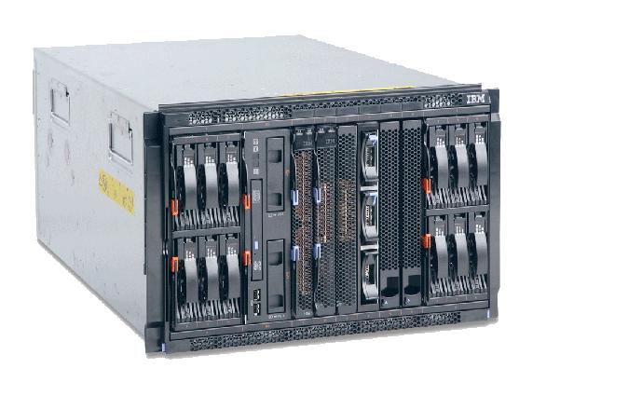
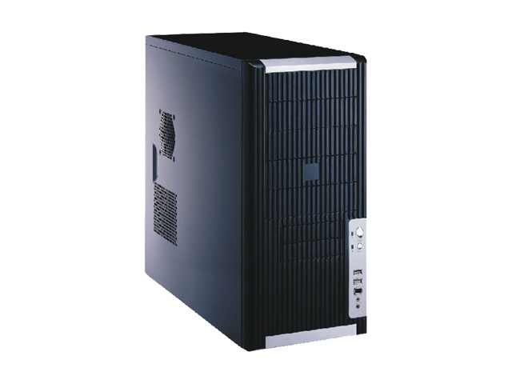
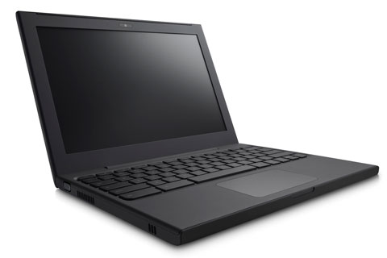
PXE: Architecture
7.1
7.5
SMP (NS)
Server
NBS (PXE)
Server
Request
Instructions
Reply with
Current data
NBS (PXE)
Server
Request
Instructions
Reply with old
Stored data
Request
Instructions
Reply with
Current data
Client
Client

Slide 6
7.1 Site Server Architecture
Network Boot Services require both Package and Task services be present on a Site Server
SMP (NS) Deployment Solution
Site Server
Package Service
Task Service
Network Boot Service (PXE)

Slide 7
7.5 Site Server Architecture
SMP (NS) Deployment Solution
Network Boot Services automatically detects and locates nearby Task and Package servers
Site Server: Package
Site Server: Task
Site Server: Network Boot (PXE)

Slide 8
New Features

Slide 9
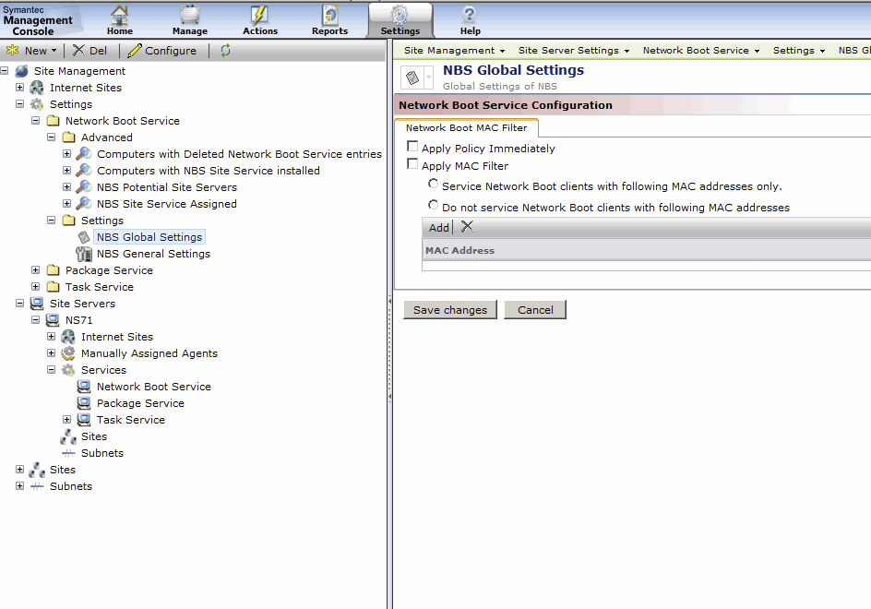
MAC Address Filtering
Specify to which computers PXE should respond
White or Black-list
Independent of managed or unmanaged, known or unknown

Slide 10
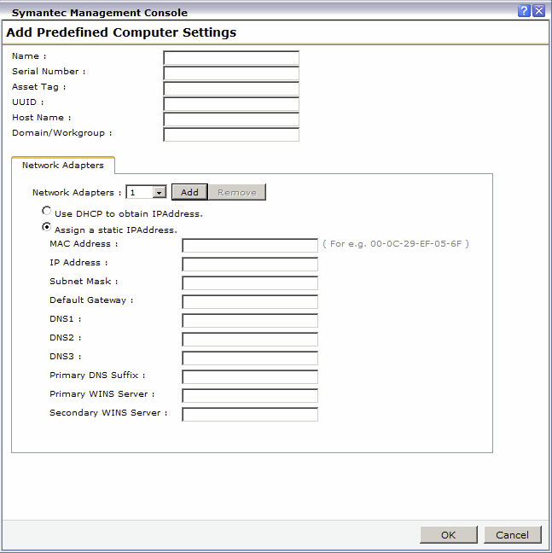
Predefined Computers
New UI for adding computers
Add computers one at a time
Simplify configuration of multiple NICs

Slide 11
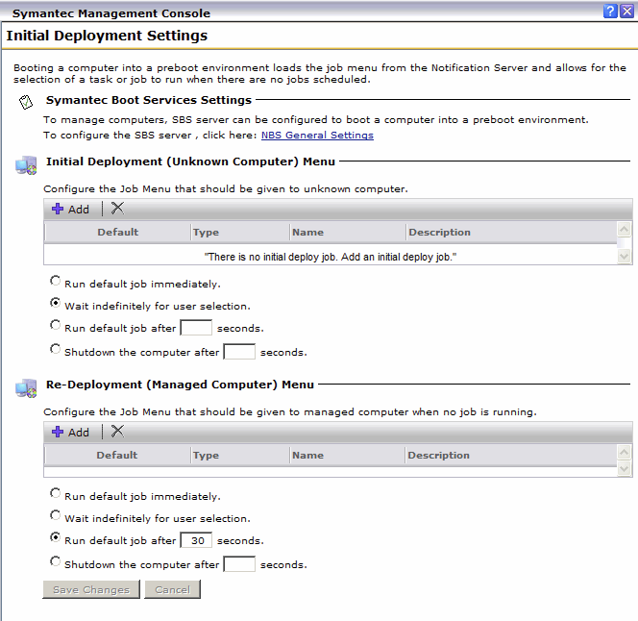
Managed PC Job List
Similar to unknown computers
Specify what image jobs are available to managed computers
A tech could then initiate a reimage job from the client with no need to enter the console

Slide 12
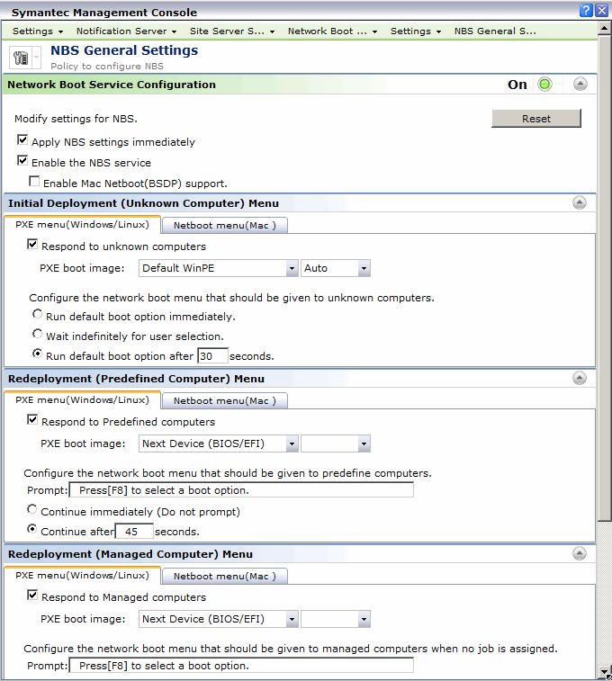
Greater PE Flexibility
Control timeouts
Set boot image (including the option for "Next Device")
Also available for Managed computers
Invoke with F8 on the local computer

Slide 13
New Platform Support

Slide 14
The Challenge of Mac Imaging
Unhappy data center team
Nonexistent Mac servers
Separate infrastructure to build up and maintain

Slide 15
Mac Imaging: Our Solution
Infrastructure
No Mac OS X Server required
Leverage existing Site Servers and infrastructure (Same HW as PXE)
Supported OS
Snow Leopard (10.6)
Lion (10.7)
Mountain Lion (10.8)

Slide 16
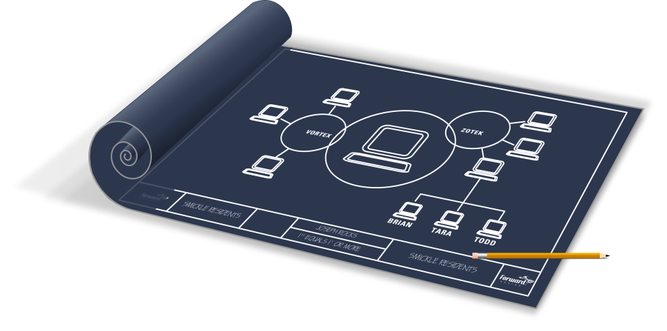
Other Platform Support
WinPE 3.1
SSL Preboot Agent
Windows 8
Windows Server 2012
UEFI
ESX, ESXi Provisioning
RHEL 5.5, 6.0
SLES 11
Updated LinuxPE Kernel

Slide 17
Mac Management in CMS

Slide 18
Software Management

Slide 19
Software Installation
Challenge
Unfamiliar formats
OS X Command-line knowledge required
Our Solution
Import your software DMG, we’ll do the rest
Automatically created install/uninstall command-lines

Slide 20
Software Enforcement on Macs
Challenge
Keep business critical apps installed
Enforce It software standards
Our Solution
Detection rules
Automatically created on SW import
Automatic remediation

Slide 21
Additional Features

Slide 22
OS X Support Matrix
Timely support of new OS’s is critical to our Mac customers. OS X 10.8 Mountain Lion was supported by CMS the day it was released.
OS X Version | CMS 6.x | CMS 7.0 SP4 | CMS 7.1 | Orion
10.4 |  |  | 
10.5 |  |  | 
10.6 |  |  |  | 
10.7 |  |  |  | 
10.8 |  |  |  | 
10.9 |  |  |  | TBD

Slide 23
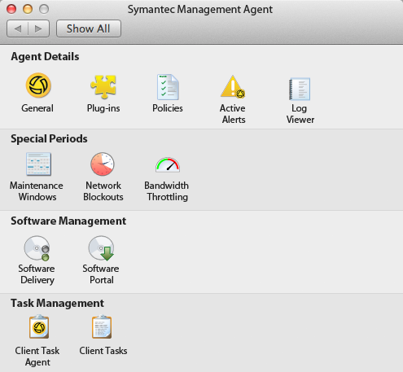
Additional Features
Updated Mac Agent
SW Catalog: Filter by Mac Platform
NTLMv2

Slide 24
Additional Mac Management Resources
Mac Admin Guide
http://www.symantec.com/connect/groups/mac-management
Online Mac Connect Group
Windows to Mac Migration: http://www.symantec.com/connect/blogs/deployment-solution-windows-mac-migration-script-tool
Sample scripts: http://www.symantec.com/docs/HOWTO51884
Add-on Scripts
http://www.symantec.com/docs/DOC4217

Slide 25
Cloud Enabled Management

Slide 26
The Digital Nomad
By 2015, over 37% of the global workforce will be mobile.¹ - IDC
Devices used by users with no connection to internal network or VPN present a challenge
Traveling employees
Employees working from home
Remote branch offices/sites
Devices managed remotely by Managed Service Providers (MSPs)
Travel
Home
Branch / Remote Office
¹ Worldwide Mobile Worker Population 2011–2015 Forecast, IDC Research, December 2011

Slide 27
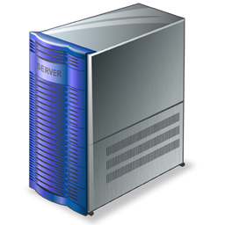
Cloud Enabled Management
External
DMZ
Internal
Internet
Agent
External Firewall
Internet Gateway
Internal Firewall
Symantec Management Platform
Secure connection No VPN required
Gateway blocks un-trusted connections

Slide 28
Altiris Agent: Automatic Connectivity Switching
Endpoint is on the internal network – Communicate to the SMP Server directly
Endpoint is on the Internet (no VPN) – Communicate to the SMP Server via Internet Gateway
Endpoint is on the VPN – Communicate to the SMP Server directly

Slide 29
Agent communication in CEM mode
Internet Gateway is listening on port 443
NS Agent site is configured on port 4726
External
DMZ
Internal
https://Gateway:443
https://NS:4726
Internet
https://NS:443 IG redirects requests to Agent Site port 4726
Agent certificate for IG
IG certificate
Agent certificate for NS
Agent
External Firewall
Internet Gateway
Internal Firewall
Symantec Management Platform

Slide 30
Internet Gateway
System requirements:
Preferably physical box, 8GB RAM, 40GB HDD, dual-core CPU and two NICs (VM-based Internet Gateway less scalable, but still sufficient for a fully-loaded NS)
Windows Server 2008 R2 SP1 (64-bit), .NET Framework 3.5 SP1
Scalability: Up to 3,000 concurrent connections – Translates into up to 60,000 CEM-enabled nodes

Slide 31
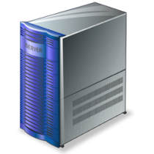
Supported architectures

Slide 32
Connectivity – Load Balancing
Agents can switch between gateways
Automatic load-balancing using round-robin algorithm
All gateways are treated equally
Automatic failover
Inaccessible gateways are marked as bad and skipped for a registry configurable timeout
At least two gateways are recommended for fault-tolerance

Slide 33
Security Hardening
Unnecessary Agent communication is disabled in CEM mode
Power management tickle is disabled
Multicast is disabled
Client Task Agent tickle is disabled
Secure Apache HTTP Server configuration
Certificate usage is enforced
Only manually added hosts and ports are allowed into internal network
Server Agent Trust – CEM Agent web site
Provides access to only agent web pages
Requires SSL and certificates
CMDB resource updates are restricted for events coming to CEM web site

Slide 34
ITMS – What is Supported?
Supported
Windows endpoints
Managed Software Delivery
Quick Delivery (non real-time)
Hardware and Software Inventory
Application Metering
Patch Management
Basic Client Tasks
Not Supported
UNIX/Linux (Mac support upcoming)
Monitor Solution
Deployment Solution
Software Portal
Remote and Agentless Management (OOB/RTSM)
Real-time tasks and jobs execution

