Slide 1
Resources
What is the ASDK?
PowerShell Learning
Intro to PoshAltiris (How to install, etc.)
How to run an Altiris task from PowerShell using the PoshAltiris PowerShell Module
GitHub Repository for PoshAltiris
My contact info:
Symantec Connect: tiberriver256
Twitter: @tiberriver256
Email: Micah.Rairdon@gmail.com

Slide 2
Altiris ASDK – PowerShell Module

Slide 3
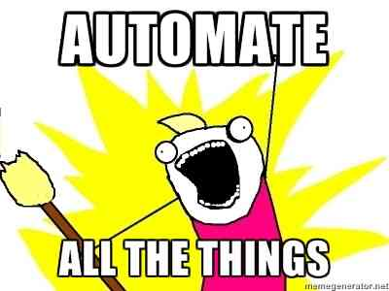
What is the ASDK?
“Target users are the IT personnel of NS customers, such as IT administrators (not solution developers), who want to automate or customize the functionality of NS.” – Symantec HOWTO9912

Slide 4
What is the ASDK?
Web Services (ASMX)
+
DLLs(Optional) or Executables (Deprecated)
+
Help Documentation
+
A little bit of developer foo
=
Automation Magic

Slide 5
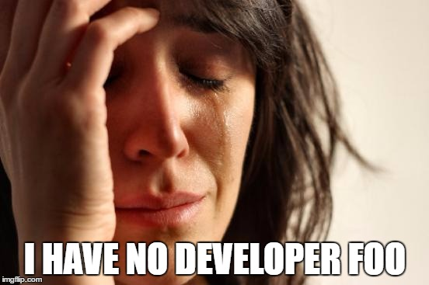
Problem

Slide 6
PowerShell to save the day!

Slide 7
What is PowerShell?
Get-Command
+
Get-Help
+
Get-Member
=
Set-AutomationAwesomeness –Identity “Me” –Rate “Fast”

Slide 8
PoshAltiris Demo

