Slide 1
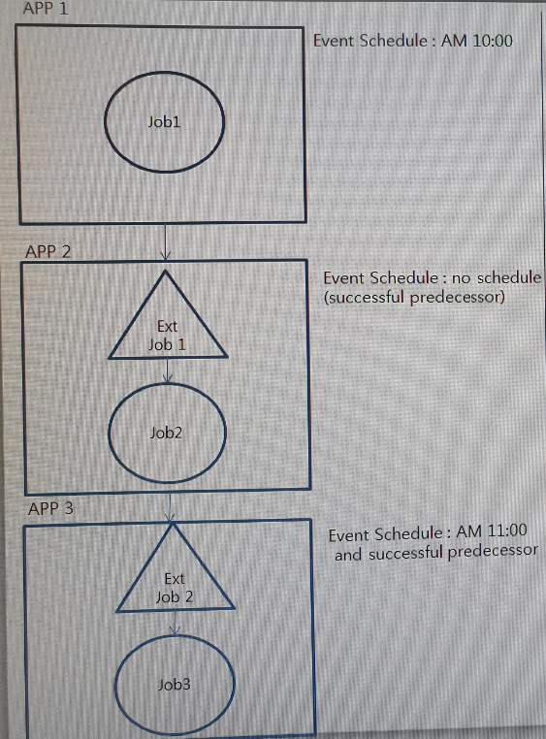
I want to set up the job to perform in the following order. (in the case of left flows)
APP1 - Perform JOB1 (JOB performed for 1 minute)
APP2 - As soon as JOB1 succeeds, JOB2 (JOB performed
for 5 minutes) is performed.
APP3 - After JOB2 succeeds, JOB3 waits until 11 o'clock
and executes.
However, in this case, the following phenomenon appears.
Did I misconfigure something?
APP1 – Performd at AM10:00
APP2 - Not performed
APP3 - WAIT (ExtJob2: EXTWAIT, Job3: PREDWAIT)
[My questions]
Q1] Is it possible to set APP2 and APP3 to be
executed sequentially after executing APP1?
Q2] Is it possible to set Schedule setting and
dependancy between APPs?
Q3] What does it use for APP / JOB Schedule and
Event Schedule?
If I set only APP / JOB schedule, then the APP /
JOB will not run at that time,
and if I set the event schedule without setting
APP / JOB schedule, no event schedule will be
performed.

