Slide 1
What’s New in Endpoint Management
Rene Kolga
Sr. Product Manager

Slide 2
Top 10 List
1
2
3
4
5
Intuitive Management Interface
Streamlined Software Management
Simplified License Management
Advanced Reporting and Analytics
Optimize Scalability and Performance
6
7
8
9
10
Expanded Mobile Support
Solving Windows 7 Application Compatibility
Built-In Process Automation
Migration and Deployment Enhancements
Expanded Patch Management
Notes:
The following presentation provides updates on key features being released in IT Management Suite 7.1 (including Management Suite 7.1, Server Management Suite 7.1, Asset Management Suite 7.1), Mobile Management 7.0 SP3, and Workspace Virtualization 6.1 SP6.
The release timing varies for each of the products, but listed below is the current schedule. Please note that all release dates are subject to change.
IT Management Suite 7.1 (and all supporting suites):
Beta: October 13th
GA: First week of March
Mobile Management 7.0 SP3
GA: First week of October
Workspace Virtualization 6.1 SP6
GA: released September

Slide 3
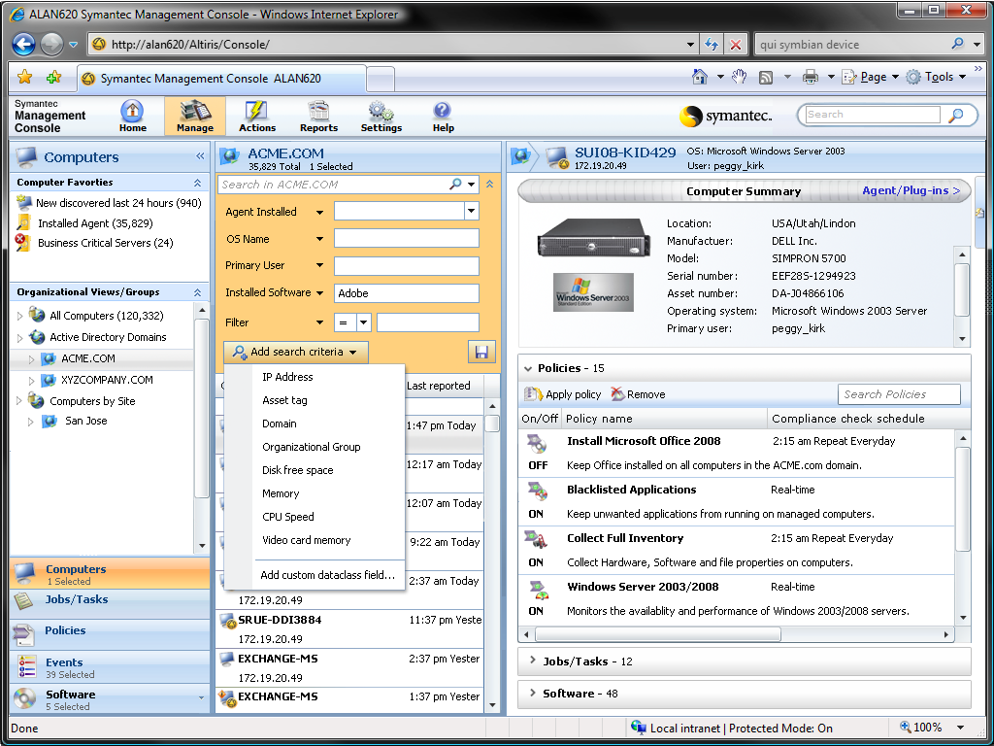
Intuitive Management Interface
1
At a Glance Resource Details
Powerful Search
Familiar Navigation Experience
Drag & Drop Functionality
Notes:
With the upcoming 7.1 releases for Client Management, Server Management and IT Asset Management, we are introducing a new and improved management interface for computers, tasks, policies and software. These improvements offer numerous advantages, such as a more intuitive design that gets you where you want to be faster, and the page loads are considerably shorter to improve responsiveness.
We’ve taken a lot of the common concepts around managing computers, delivering software, managing licenses and deployment and moved them into a consolidated, integrated experience. With this release we are able deliver a new interface that combines mobility in the browser experience and a familiar navigation experience. While we haven’t changed the entire user interface, this is just a first step in an overall transformation. But keep in mind that we aren’t getting rid of existing capabilities.
Some of the key highlights are:
Resource Management details are immediately visible when you click on a computer. You can still drill down to the traditional view, but we are putting those key details front and center.
Powerful Search features help you drill down and build filters in a shorter period of time. You can quickly save the searches for future use.
Drag and Drop functionality allows you to select tasks and drag onto one or more selected computers

Slide 4
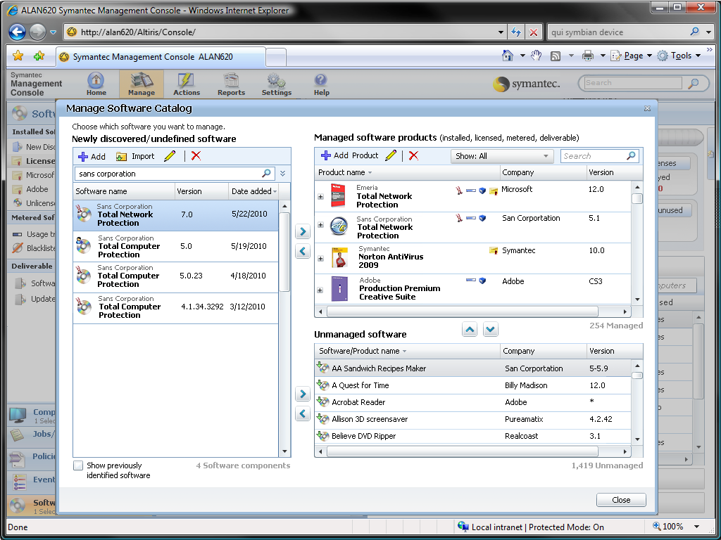
Streamlined Software Management
2
Choose What to Manage
Quickly make decisions about software in the environment
Manage in One Place
Notes:
Another new feature is a redesigned software catalog interface. You can still access the older version, but the newer version streamlines and improves the experience.
Any software that is found falls into a newly discovered list. From there you can determine whether you want to make the identified software as a manageable product or assign it as unmanaged software. Effectively what you are doing is taking the notion of components in 7.0 and assigning them to products.
Once software is assigned as a managed software product you can manage all elements of the software in a single interface. You’ll see that inventory, metering, delivery and license tracking is presented in a single interface.
By making these changes we are really reflecting how administrators and asset managers think about and manage software.
It is also important to mention that managed delivery will separate the schedule for delivery and execution. This means that 7.0 customers can now stage packages and then a few days later schedule delivery. This was an impediment for many customers and is now fixed in 7.1.

Slide 5
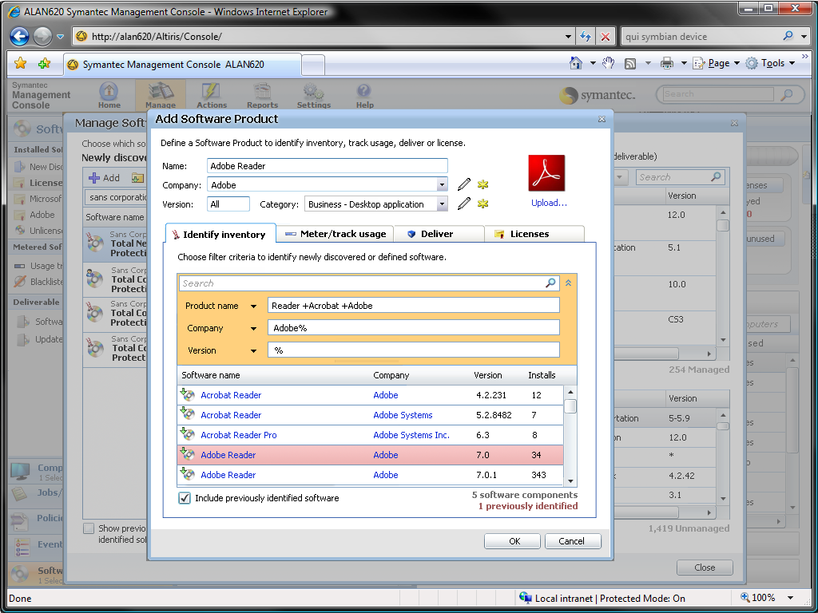
Streamlined Software Management
2
Choose What to Manage
All relevant details available in one place
Inventory, Metering, Delivery and License Management
Manage in One Place

Slide 6
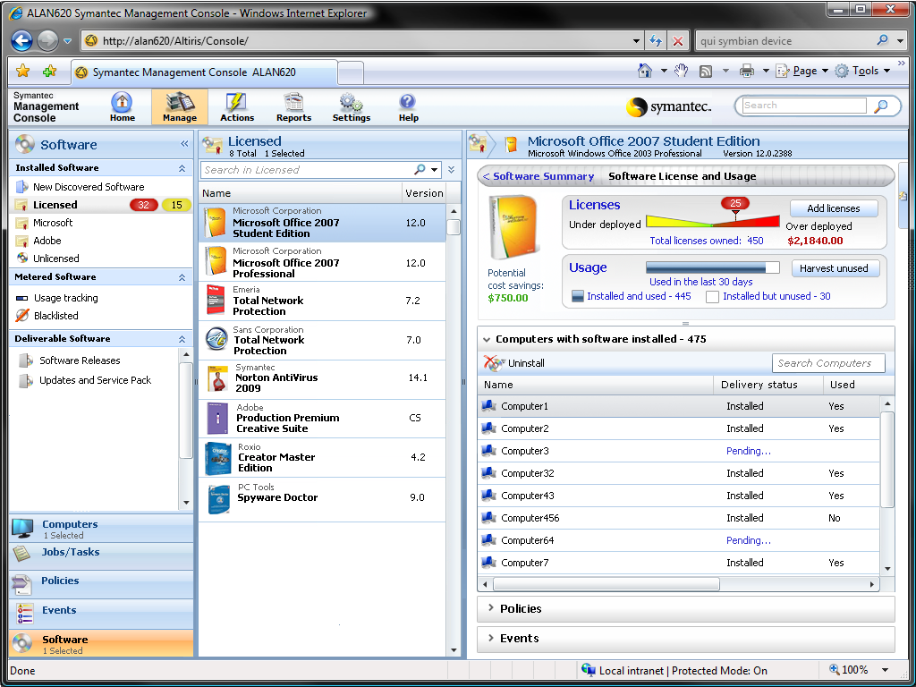
Simplified License Management
3
At-a-Glance Details
At-a-glance view displays usage and cost details
Impact & Action
Notes:
Extending the concepts of an improved software management experience, we are also tightly integrating details around license asset management and usage. Directly within the software view you will now see a single at a glance view that clearly shows current deployments and cost details based on current installations and purchasing details.
In the same view a easy graphic lets you immediately determine whether you are over or under-deployed for a given software product. When over deployed you can marry that information with current usage.
The last feature is providing insight into the financial impact for a given product. The same view presents potential savings from harvesting licenses and cost impact when over deployed.

Slide 7
Simplified License Management
3
At-a-Glance Details
Automatically calculates financial savings or impact
Take action by harvesting licenses or buying additional licenses
Impact & Action

Slide 8
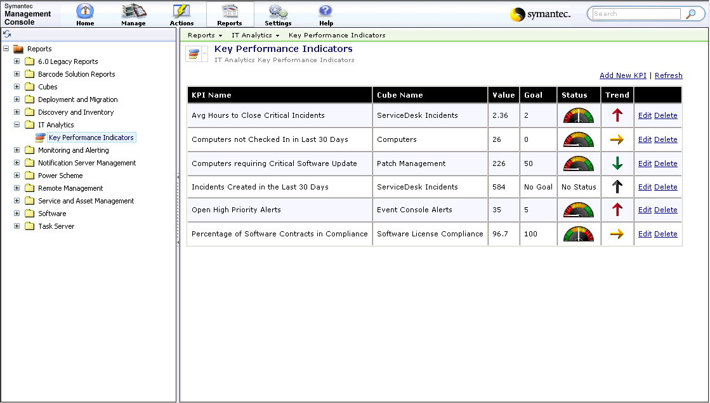
Advanced Analytics and Reporting
4
Measure Progress
Measure improvement with Key Performance Indicators (KPIs)
Analyze Trends
Ad Hoc Reports
Notes:
Another new addition is that we are also including our IT Analytics capabilities as part of all our product suites. This includes Client Management, Server Management, Asset Management and ServiceDesk reporting packs. Analytics provide a starting point for users to explore data and allow them to ask and answer their own questions. The advanced analytics capabilities help in three key areas.
Executive Dashboard and Trend Analysis – You can view reports that provide a representative view of your IT assets. You can leverage Key Performance Indicators to measure critical success factors for your organization, and quickly assess trends of how these measures are changing over time.
Ad Hoc Data Mining – You can use pivot tables to construct reports based on predefined measures and dimensions. You don’t have a to be SQL guru that understands the data schema since the functionality allows for easy manipulation of the data. If you’ve used Excel pivot tables then you are already trained to use our analytics.
Fast Reports and Trend Analysis - By incorporating multidimensional analysis and robust graphical reporting features you can arrive at your answers with little customization and without waiting.

Slide 9
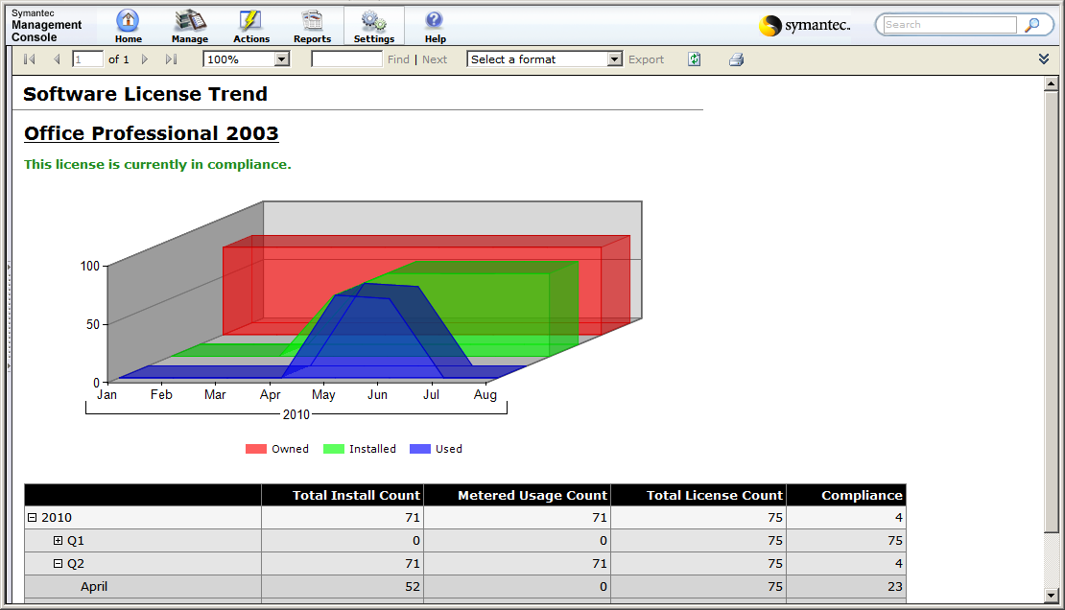
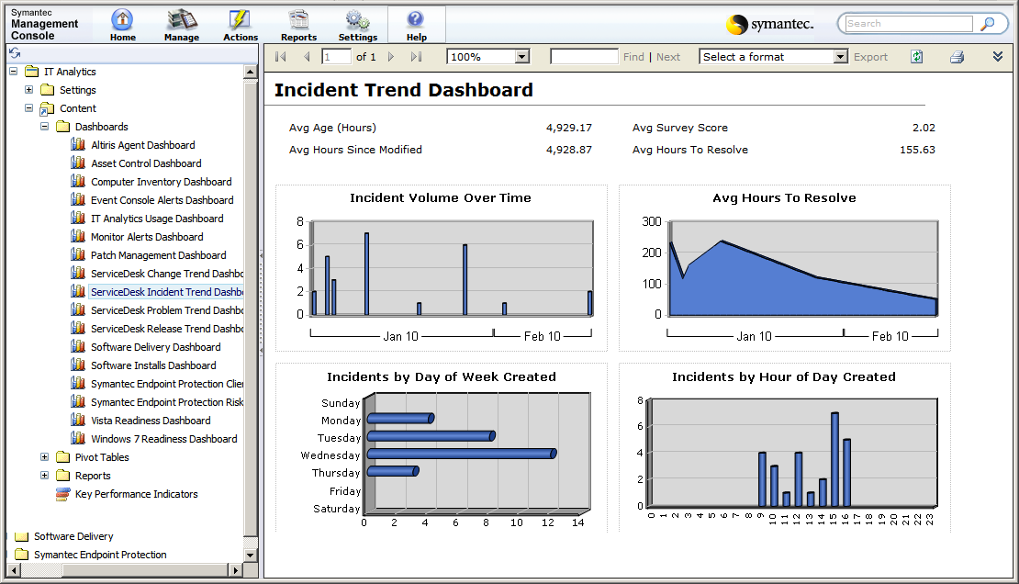
Advanced Analytics and Reporting
4
Measure Progress
Analyze trends over time
Analyze Trends
Ad Hoc Reports

Slide 10
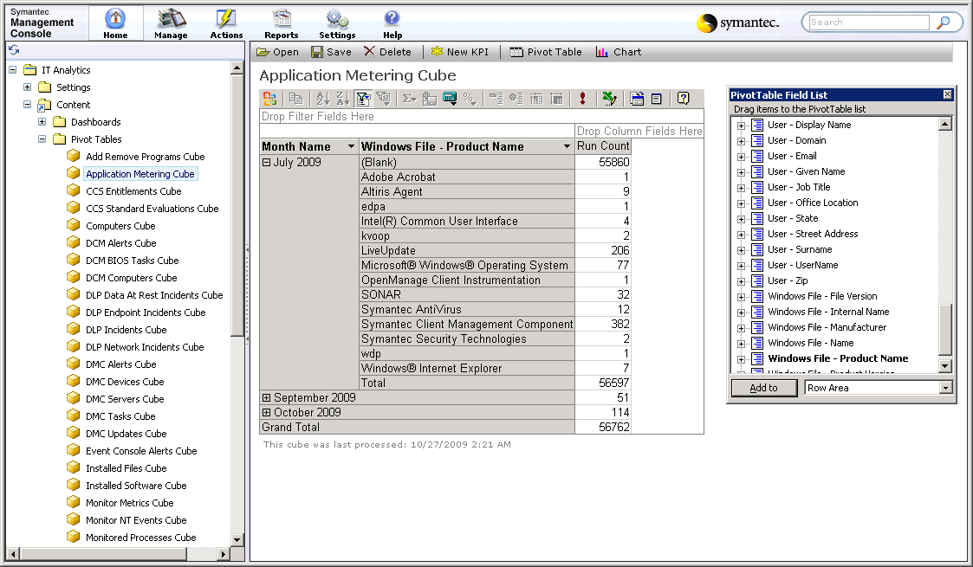
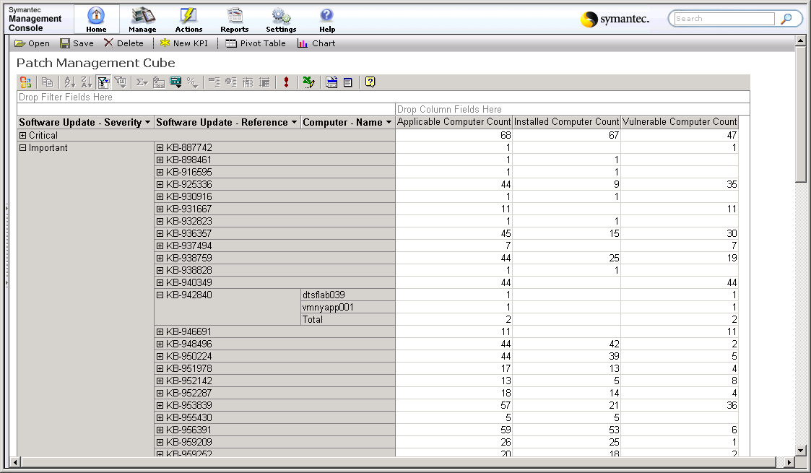
Advanced Analytics and Reporting
4
Measure Progress
Easily build ad hoc reports
Create and save role based views
Analyze Trends
Ad Hoc Reports

Slide 11
Optimize Scalability and Performance
5
Optimize
Scalability
Double the number of systems managed per Notification Server
Performance
Faster page loads with the new interface
Faster reporting with advanced analytics leveraging OLAP cubes
64-bit platform support
Notes:
A large focus has been on increasing the overall scalability of the platform. Additional testing has been done to optimize deployments and to ensure that each Notification Server will now scale to support twice as many endpoints as previous versions of 7. Scalability Testing is in progress and a final number will be available shortly. The overall goal is to streamline your implementations by using less hardware.
In addition to numerous improvements in overall performance, the two key changes are in the areas of user interaction and reporting. With the new management interface page loads are significantly improved and you’ll be spending more time managing systems. When leveraging the advanced analytics features you gain in the efficiency of OLAP cubes and offloading the operational database for faster reporting.
With the release of Notification Server 7.0 SP5, the ASDK (Administrator Software Development Kit) introduces Software Delivery automation. Using 3 types of abstraction layers, (CLI, COM, and Web Services) customers will be able to create, delete, schedule, and target jobs and tasks.
With the release of Notification Server 7.1, the ASDK (Administrator Software Development Kit) introduces Deployment Solution 7.1 and Deployment Solution for Solaris Automation. . Using 3 types of abstraction layers, (CLI, COM, and Web Services) customers will be able to create, delete, schedule, and target jobs and tasks.
ASDK Contributions are also available thru the Workflow Engine for added automation functionality.
Note: there is a lot more functionality that the ASDK introduces in these releases. For more information, go to the Knowledge Base at http://kb.altiris.com and search for the ASDK release notes.

Slide 12
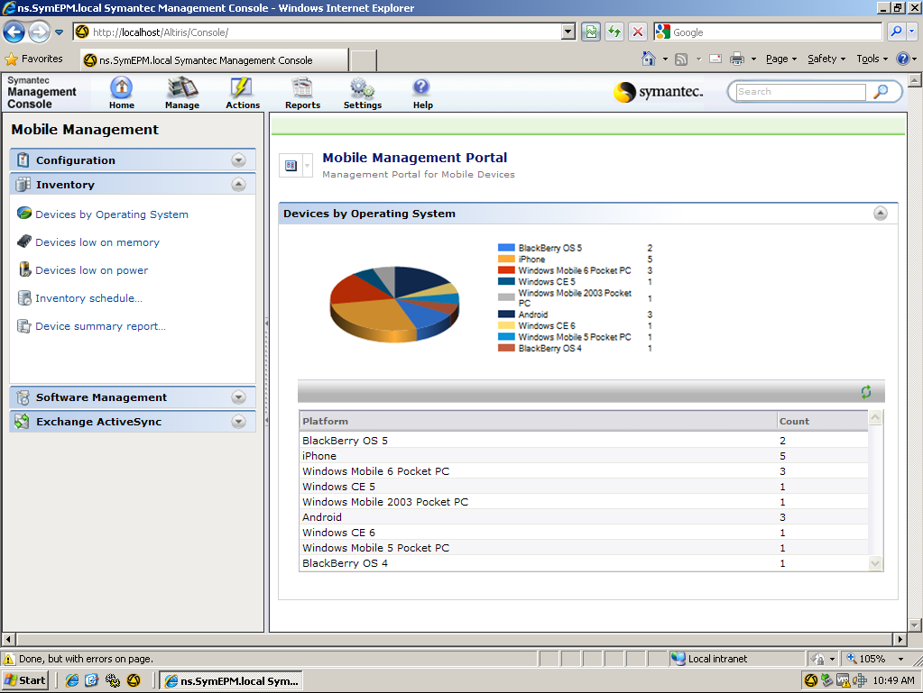
Expanded Mobile Support
6
Inventory
Basic inventory across numerous mobile devices
Now includes iPad, iPhone and Android
Security
Device Control
Notes:
Are your users smitten with the iPad, iPhone or a new Android device? Symantec Mobile Management is providing a service pack release to support the latest in mobile devices (iPad and iPhone) and a follow-on SP will provide Android support. Just a reminder the we’ve already released support for Blackberry devices in August.
List of policies and features supported on iOS versions 2.x, 3.x and 4.0
Basic Asset/Inventory
Device model, device OS, deviceID, device IMEI, phone number, email, email name, operator network, device OS language, last sync time, last update time, device wipe ack time, Exchange server name, Exchange server version, etc
Remote wipe
Enforce password on device
Minimum password length
Maximum failed password attempts (before local wipe)
Require both numbers and letters
Inactivity time in minutes (1 to 60 minutes)
Allow or prohibit simple password
Password expiration
Password history
Policy refresh interval
Minimum number of complex characters in password
Require manual syncing while roaming
Allow camera
Allow web browsing

Slide 13
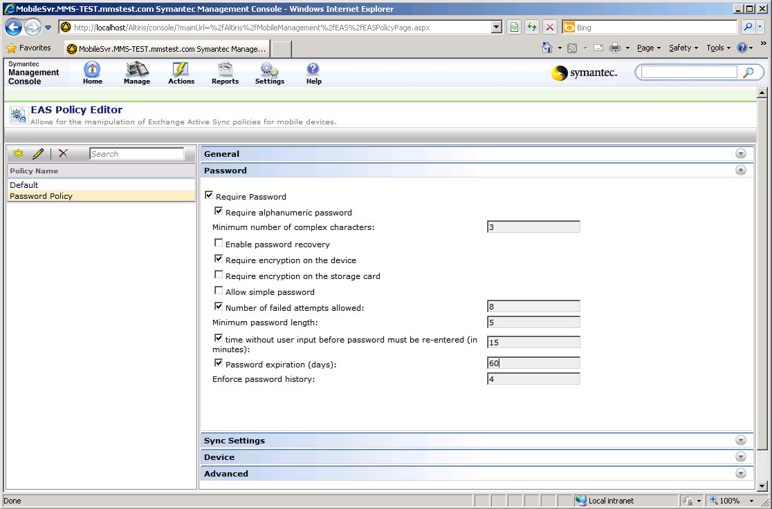
Expanded Mobile Support
6
Inventory
Enforce common security policies
Includes Password, Encryption and Remote Wipe Settings
Security
Device Control
Notes:
Mobile Mgmt functional areas:
Inventory and Reporting. Identify, discover, and catalog all deployed devices. Gather extensive details on device hardware, software, and status, which are collected and summarized centrally.
Device Configuration. Centralize distribution and maintenance of software settings, applications, and updates. Configure push email via Exchange ActiveSync. Distribute & apply pre-configured device settings to maintain common device configurations.
Software Management. Ensure the software remains installed and configured correctly on mobile devices. The self-healing capabilities can automatically detect and repair incorrect, corrupt, or missing applications.
Remote Assistance. Troubleshoot and fix mobile devices anywhere with flexible remote management capabilities including: Remote control, File system and registry access, Interactive access to services.
Summary of capabilities of Mobile OS/Device:
Windows Mobile Apple Blackberry Android Symbian
Inventory X X X X X
Config X X X X X
SWMgmt X X
Remote Assist X X

Slide 14
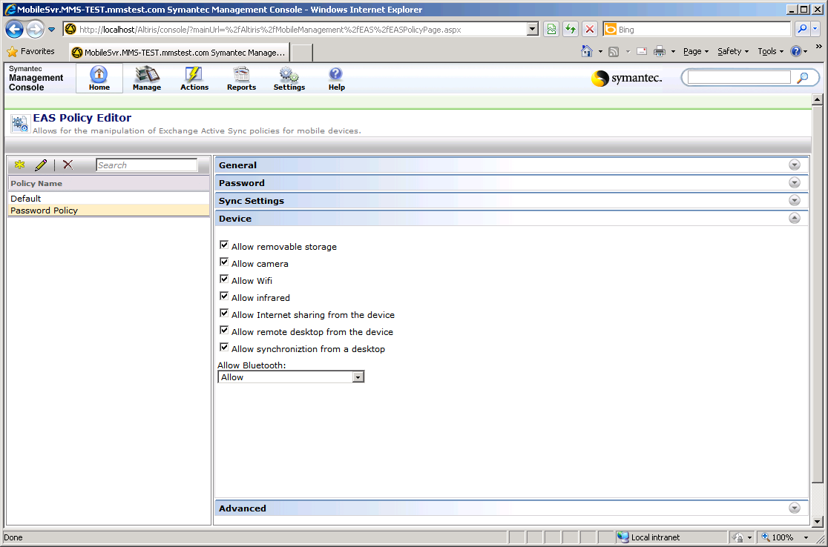
Expanded Mobile Support
6
Inventory
Control device functionality
Block use of removable storage, camera, web browsing …
Security
Device Control

Slide 15
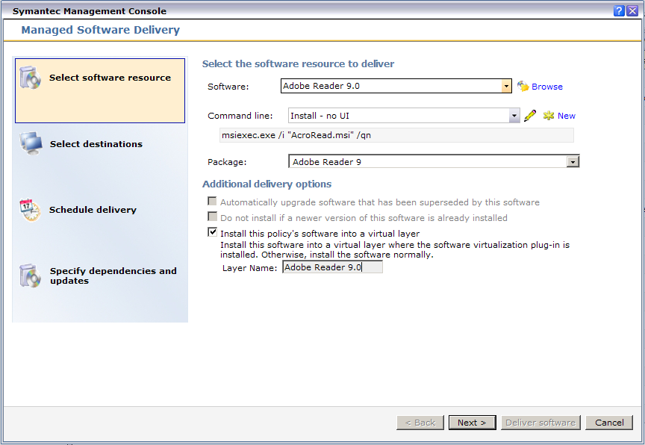
Solving Windows Application Compatibility
7
Virtualize on the Fly
Workspace Virtualization fully integrated
Quick check box to distribute as virtual layer
Manage Dependencies
IE6 on Windows 7
Notes:
One of the key challenges or potential impediments in moving to Windows 7 is the requirement of Internet Explorer 6 for many legacy web applications. The cost associated with updating these applications to support Internet Explorer 8 is often so high that maintaining support for an older operating system just makes financial sense. While Microsoft offers Med-V as an alternative, running a parallel OS and managing that extra support often isn’t feasible.
To solve this problem, Symantec’s application virtualization, also known as Workspace Virtualization, is releasing a new update that solves this challenge by virtualization IE6 directly in Windows 7. This allows organizations to concurrently run IE6, IE7, or IE8 concurrently – including running multiple JAVA versions - on the native OS to achieve normal visibility.
As a reminder Client Management Suite and IT Management Suite 7.0 customers are entitled to this capability since Workspace Virtualization is included with both products.
Our approach enables side by side usage, but more importantly offers a secure implementation that is invisible to the user. Administrators can determine which applications should have access to that specific browser – eliminating the use beyond the specified programs. End users are never prompted on which browser to use – the correct version automatically opens for them based on policy. This option will helps you move faster and more efficiently to Windows 7.
The solution supports the following technical considerations:
Browser plug-ins (Acrobat, Flash, etc.) can be installed in the base or in a virtual layer
Multiple Java versions can be installed in the base or in a layer and used by Virtual IE
Automatically supports any GPOs an enterprise may have in place for IE
Copy / paste
Links properly from email clients, documents, etc.
Printing

Slide 16
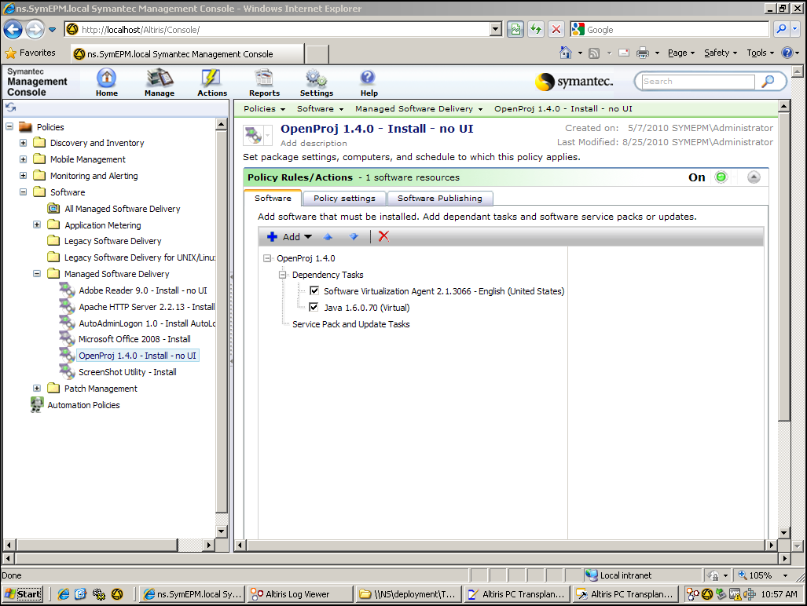
Solving Windows Application Compatibility
7
Virtualize on the Fly
Solve Java Run Time dependencies using virtualization
Manage Dependencies
IE6 on Windows 7

Slide 17
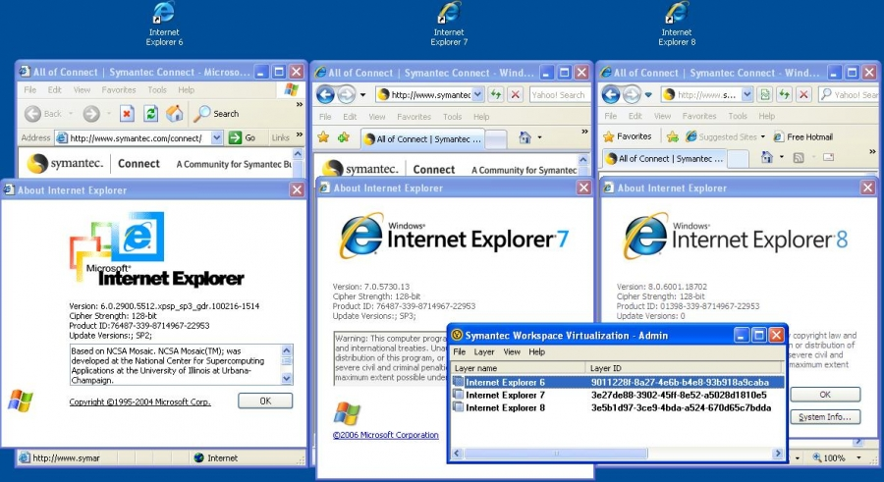
Solving Windows Application Compatibility
7
Virtualize on the Fly
Run IE6 alongside IE8 on Windows 7
Run multiple versions of Internet Explorer concurrently
Automatically launches the appropriate browser based on application
Manage Dependencies
IE6 on Windows 7

Slide 18
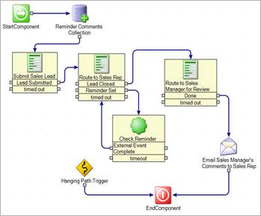
Built-In Process Automation
8
Fully Integrated
Workflow capabilities fully integrated with all products
Connect to Symantec and third party data and systems
Monitor and improve processes continually
Out of the Box Automation
Custom Automation
Notes:
As many of you know we have included our entire workflow capabilities into all of our product suites. The biggest technology change here is that in addition to forms builder and drag and drop process designer, customers are now able to take advantage of the full component generator that allows access to non-Symantec technologies, such as HR or finance systems, and the Workflow portal to track the overall process as it moves the various stages in order to improve the performance of implemented workflows.
We’ve already released 3 asset workflows with Asset Management Suite 7.0 and will be adding new workflows available in ServiceDesk, including a password reset process and fileshare access request process. The remaining template priorities will be rolled out over the next 4 to 5 months.
This change is really a huge a leap forward in customer efficiency gains. While the product management teams continue to work on providing out of the box workflows, especially in the areas of asset management and software management, the real gains come from automating processes core to your IT business. We have many customers to date that have created greater than 50+ internal processes per customer to tackle difficult problems and improve the end-user experience.
One such customer leveraged the process orchestration capabilities to save upwards of $2M and 18 months of project time using one workflow. They had a problem synchronizing end user data during onboarding and termination processes. They wanted a main entry screen that mapped to all locations and coordinated access across Lotus Notes, Active Directory and their various HR applications. When editing employee information they actually mimicked AD user properties to keep the experience a familiar one.
Other customers are using the tools to eliminate numerous access control requests, developing the front end service catalog for the organization, and cleaning up stale Active Directory accounts to minimize risk.

Slide 19
Built-In Process Automation
8
Fully Integrated
Out of the Box Templates included with the products
Windows 7 Migration
Automated Patch Rollout
Virtual Machine Provisioning
Ownership Validation
Hardware | Software Request
Lease Notification
Out of the Box Automation
Custom Automation
Notes:
Ownership Validation, Hardware/Software Request and Lease Notification all are available today with Asset
Automated Patch Rollout will release with Patch 7.1 SP1 (see the slide notes of the Patch slides at the end of this deck for details)
Windows 7 Migration and Virtual Machine Provisioning will be made available for download in the 7.1 timeframe.

Slide 20
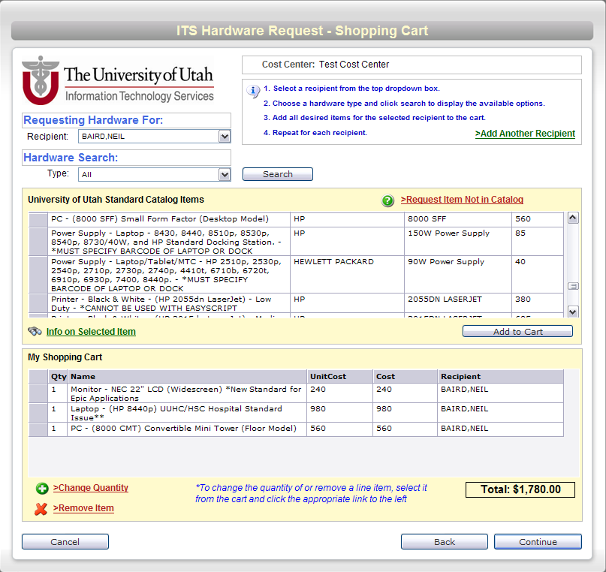
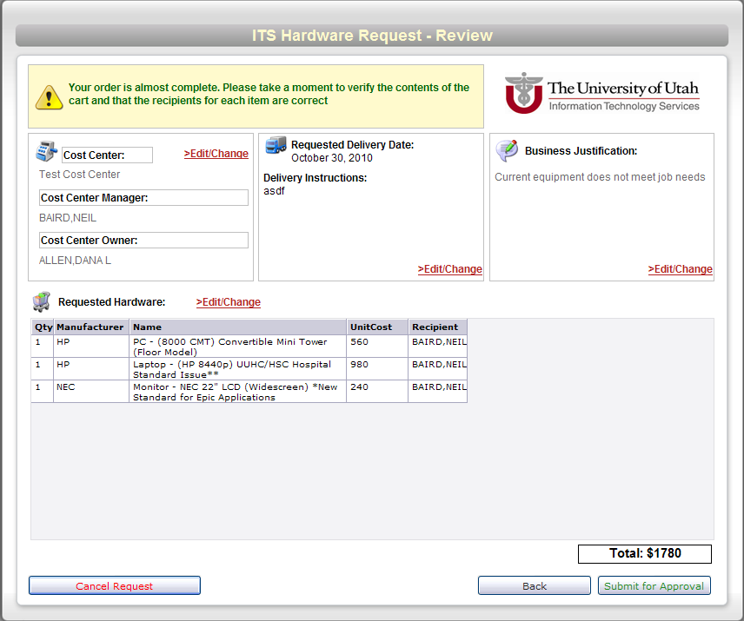
Built-In Process Automation
8
Fully Integrated
Extend to solve real-world business problems
Estimated savings of $2M and 18 months to implement onboarding/offboarding process alone (Autoliv)
Reduced time to receive assets from 3-4 hrs to 30 mins; time to edit assets from 1.5 hrs to 2-5 mins. (UofU Health)
Out of the Box Automation
Custom Automation
Notes:
University of Utah Health (hospital, medical research and services)
· Receiving process, quantity 40 assets. Reduced time to receive from 3-4 hours per each 40 assets to 30 minutes using Asset, Workflow, Barcode. Workflow does 90% of the receiving process. Processes hundreds of assets per week.
· Editing assets, reduced time spent from 1.5 hours to 2-5 minutes per 40 assets. Aids in ability to bulk edit.
· Stock level tracking, reduced time from 3 hours per week to about 5 minutes per week.
· Billing. Reduced time to assigned costs from 1.5-2.5 hours per each of the 40 assets to zero.
In Progress:
· Procurement. Bids come from vendors. Have to be created as POs in Altiris. New: get spreadsheet from vendor, workflow processes spreadsheet and creates PO. Also maintains the item in the catalog. Estimated savings of 2-5 hours per day. Takes an FTE right now.
· Master printer list. 8 teams that manage print servers on all platforms. Manual coordination for break/fix/config. Very convoluted. Workflow in progress, estimated resource savings to be huge.

Slide 21
Migration and Deployment Enhancements
9
DS on the Platform (7.x)
DS on the platform answers long standing requests
Centralized management of Computers, Jobs, Scripts, Security, System Configurations, Drivers, Images
Enhanced management of multiple PXE servers
Better security roles with global scoping
Integrated reporting capabilities across ALL solutions (DS, Inventory, Patch, SWD, Asset, etc.)
Windows 7 Migration
Expanded OS Support
Tight VM Integration

Slide 22
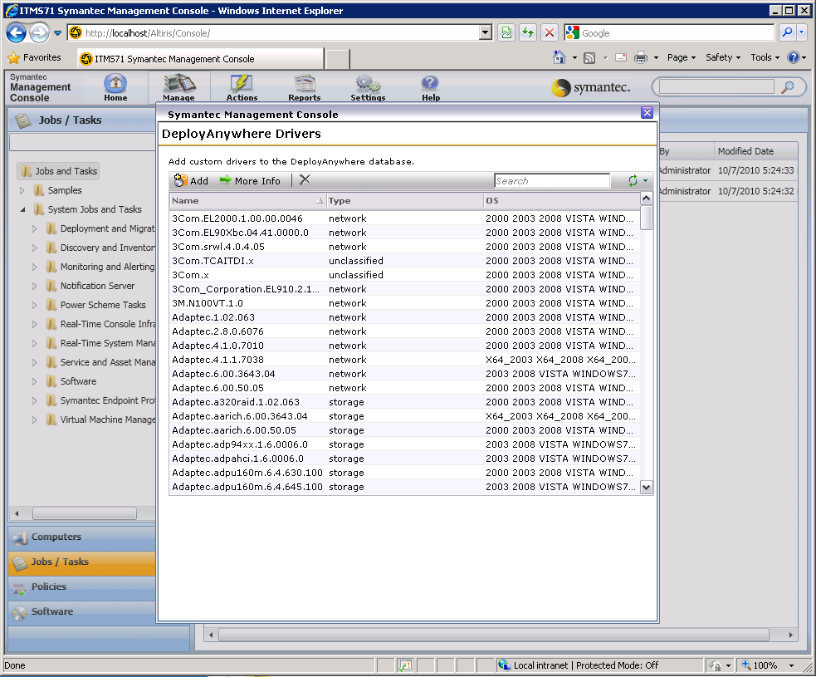
Migration and Deployment Enhancements
9
DS on the Platform (7.x)
Support for all PnP drivers
Driver management for imaging & scripted OS installs
Rapideploy style multicasting with Ghost
Personality support for Office 2010 (32 & 64-bit)
Windows 7 Migration
Expanded OS Support
Tight VM Integration
Notes:
There are a lot of exciting changes and enhancements to our core Migration and Deployment capabilities.
First, quick reminder that that Deployment Solution is now natively integrated with the Symantec Management Platform; which means one CMDB, one Console, and one agent for DS and the rest of ITMS. ITMS 7.1 provides many enhancements to the DS Silverlight console that was introduced in March.
Furthermore, we’ve improved the DeployAnywhere capability to support all plug-and-play driver types for hardware independent imaging. This complements the support we already had for HAL, NIC and mass storage drivers to provide a complete HII solution. Management for the driver database is now available through the Console; no need to run a separate application anymore.
By the way, the drivers in the DeployAnywhere database are consumed both by imaging and scripted OS installations, allowing our users to consolidate driver management.
In this version Ghost imaging now supports familiar rapideploy style multicasting; many of our customers have told us they needed that feature before they could take advantage of the other many benefits of the Ghost engine.
PCTransplant supports MS Office 2010 (32 and 64-bit).

Slide 23
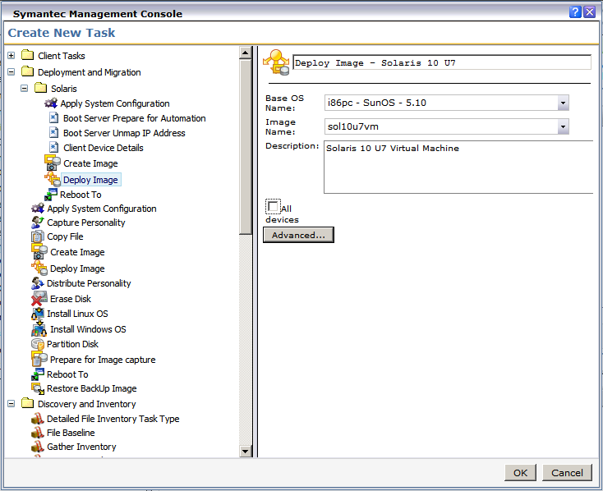
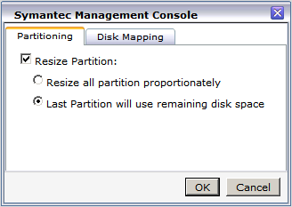
Migration and Deployment Enhancements
9
DS on the Platform (7.x)
Solaris Support
SPARC imaging and scripted OS install
x86 imaging
Windows 7 Migration
Expanded OS Support
Tight VM Integration
Notes:
A long-standing request for Deployment Solution is native support for Solaris deployment. This feature is now supported in a recently released update to DS 7.0. We support Solaris running on SPARC and x86 systems. The ability to do Solaris imaging is unique in the industry, and goes a long way to realize an objective many customers have to standardize their build images. Solaris Imaging is a separate purchase.
It’s important to note that the ability to deploy Solaris boxes does not rely or require an external system such as Kickstart. All the functionality to do Solaris bare metal deployments is part of ITMS 7.1.

Slide 24
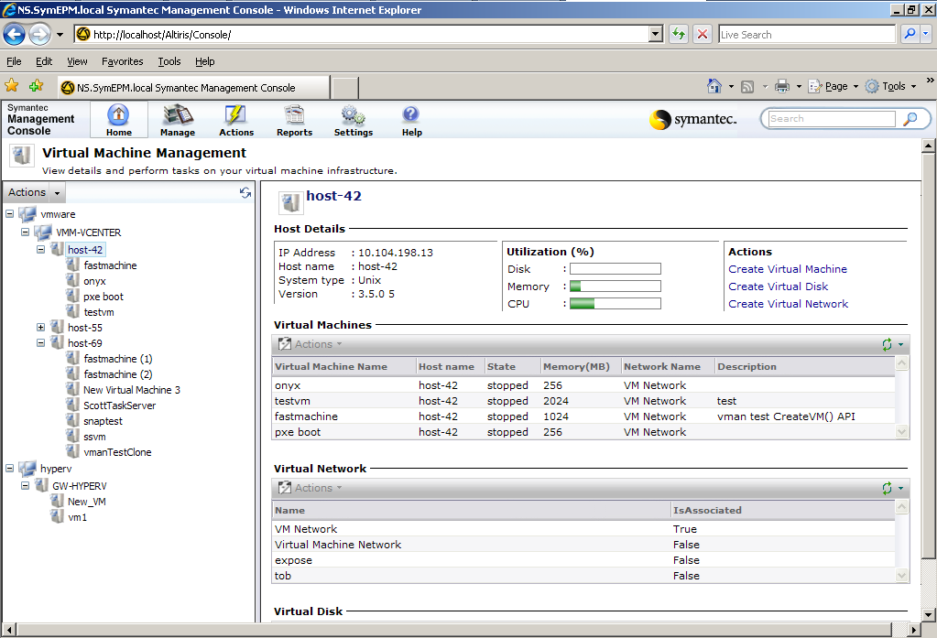
Migration and Deployment Enhancements
9
DS on the Platform (7.x)
Virtual Machine Manager
Dashboard of VM activity and resource consumption
Ability to kick-off deployment jobs within the VM creation wizard
Windows 7 Migration
Expanded OS Support
Tight VM Integration
Notes:
Lastly, we have enhanced the Virtual Machine Management capability by
streamlining its configurations and
by extending the VM creation wizard to execute any DS job as part of the VM creation process This allows users to leverage existing server provisioning jobs by applying them to virtual server provisioning.

Slide 25
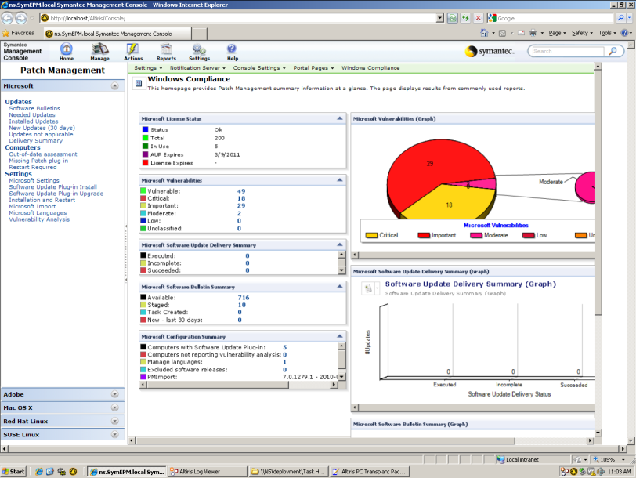
Expanded Patch Management
10
More Coverage
Substantially increased application coverage
Microsoft updates
Adobe apps
All common browsers
Java Runtime
Common browser plugins
More
Automated Process
Notes:
The capabilities described in this slide and the next slide are being implemented in a parallel project to ITMS 7.1 and will be released in a special Patch 7.1 SP1 3-4 weeks after ITMS 7.1 is released. These features, therefore, will not be in the ITMS 7.1 beta.
The key features consist of Microsoft coverage = to WSUS. Currently, our Microsoft coverage includes primarily patches for security vulnerabilities. Our expanded coverage will include all Microsoft updates, including Service Packs. The only exception is drivers.
We will also be adding additional support for non-Microsoft Windows applications as noted on the slide. Note that we already support in 7.0 patching Mac OS and Apple applications (anything that is updatable through the Mac Software Update function).

Slide 26
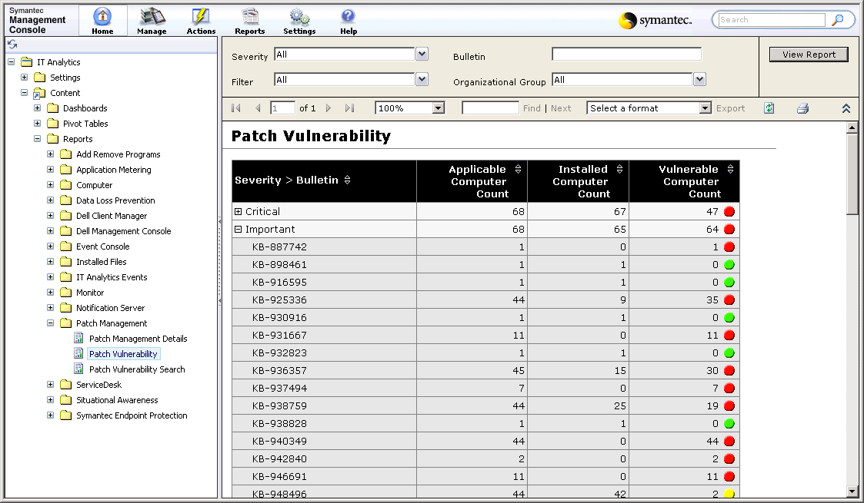
Expanded Patch Management
10
More Coverage
Predefined workflow automates staged rollouts to reduce risk of unintended consequences
Adapts to different use cases from multi-stage processes to set-and-forget it automation
Ability to take action through email and mobile devices
Automated Process
Notes:
The Patch 7.1 SP1 will contain two built in workflows: the first workflow is for organizations that prefer a set and forget model to patching. Basically, once you’ve approved the proposed patches, everything happens automatically—from staging, to distribution, to compliance reporting. It removes most of the human involvement.
The second workflow is designed to help orchestrate a staged rollout. Staged rollouts are a common means to reduce the risk associated with changing the configuration on an endpoint. If problems are encountered in an early stage, the adverse impact can be contained and further rollout can be halted until a resolution is found. The stages can include lab testing, pilot groups and full production (as well as multiple stages in production rollout).

Slide 27
Experience the Value of Version 7
Altiris ITMS 7.1
Workspace Virtualization
Mobile Management
More automation, deeper integration, greater intelligence
Beta underway now
Request beta access:
altirisbeta@symantec.com
Drive out incompatibility
Part of CMS and ITMS 7!
Get the latest:
http://www.symantec.com/business/workspace-virtualization
Get a handle on those mobile devices
Additional purchase; fully integrated
Give it a try:
http://www.symantec.com/business/mobile-management
Notes:
If you haven’t already, we’d like to invite you to give 7 a try and experience the value for yourself.
Integrated workflow delivers a new level of automation. Deployment is now integrated, workflow is integrated, Ghost, pcAnywhere all integrated. The central catalog and software library and new user views deliver a deeper functional integration as well. IT analytics and the central software catalog provide greater intelligence.
Note that the latest WSV is 6.1 SP6 released in Sept. Though the version number is a six, 6.1 does work with the ITMS 7 products.

Slide 29
ServiceDesk Enhancements
11
Rules Engine
Configure Routing Rules and Prioritization directly from ServiceDesk portal
Changes made via the Rules Engine will survive upgrades
Rules engine will be expanded over time to include email notifications, SLAs and more.
Self-Service Processes
Notes:
The introduction of the Rules Engine is a huge leap forward in making ServiceDesk easier to configure and upgrade.
Currently, customers must thoroughly understand Workflow and the ServiceDesk workflow projects to make even the simplest configuration. In addition, any changes made at the workflow project level will not survive upgrades, meaning they will need to reimplement these configurations when they upgrade. For some customers, this can translate into weeks of effort. The Rules Engine will minimize the amount of Workflow training customers will need, and will minimize the amount of time they will need to spend in the Workflow Designer tool. As a bonus, any configuration made via the Rules Engine will survive upgrades.
We included Routing Rules and Prioritization in the first phase of the Rules Engine as these were the most common things all customers need to configure. We will continue to expand configurations available in the Rules Engine to include things such as email templates, email notifications and SLAs.

Slide 30
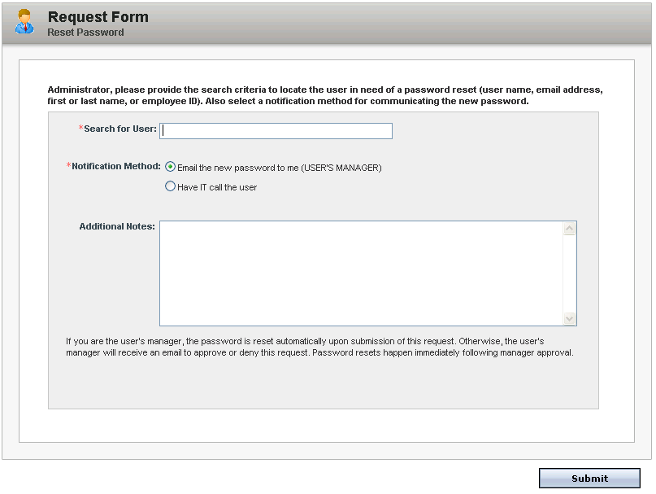
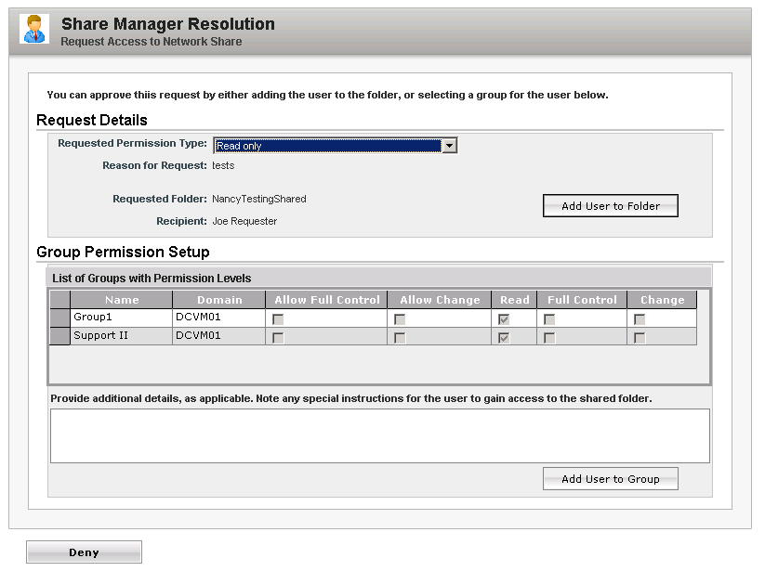
ServiceDesk Enhancements
11
Rules Engine
Password Reset
Fileshare Access Request
Self-Service Processes
Notes:
A couple of new self-service flows will be included in ServiceDesk 7.1. We picked Password Reset and Fileshare Access Request as these represent the top two processes customers do manually today. Both processes are fully integrated with AD.
The Password Reset process will allow a user’s manager to submit a request and have a temporary password emailed to the manager.
The Fileshare Access Request allows a user to request permission to a file share. The request is routed to the owner of the file share (or the AD admin) who can then determine the level of access to grant, all without ever leaving the ServiceDesk portal.
These processes also illustrate how customers can use Workflow to create a service catalog to help automate many of their manual processes.

