Slide 1
KCEPM JCCC Presentation “ITP in Altiris” Presentation by Ziggy Jarczyk
Wednesday, February 9, 2017

Slide 2
What is ITP
ITP is our in house application that is used:
By users to enter needs and wants for next fiscal year.
Centrally track orders for users and departments with Requisition, PO, Receive Date, purchase code.
To assist with tracking “buckets” per roll-up organization.
Not as a replacement for Banner or Purchasing department.

Slide 3
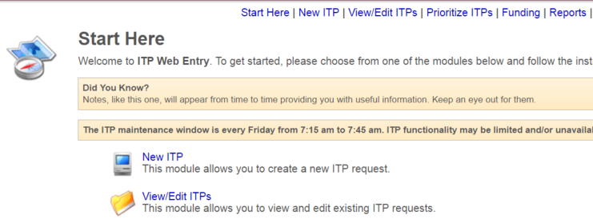
Example: Login

Slide 4
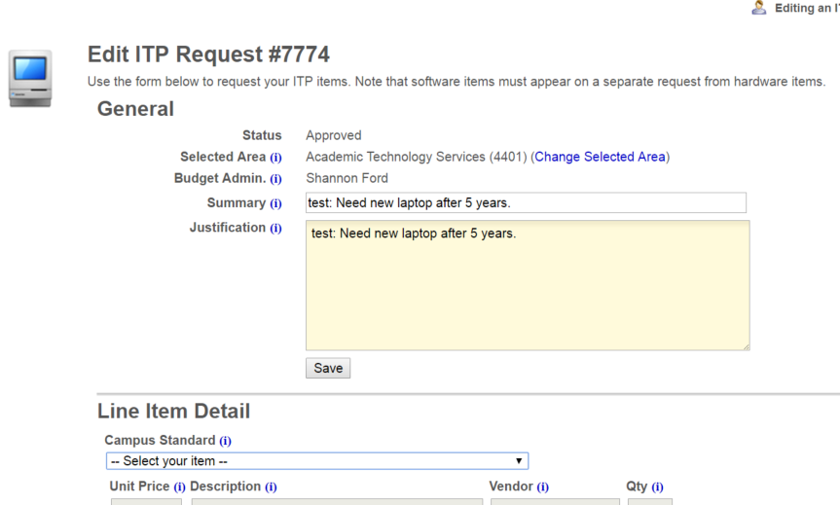
Example: New

Slide 5
Example: Ordering/Receiving

Slide 6
ITP Field in SMP: Asset Type
Create ITP field for Asset Type
This step was done so that all resource types have the ability to track ITP number associated to it.
Click Settings | All Settings.
Expand Settings | Notification Server | Resource Data Class settings | Data Classes.
Right-click CMDB Data Classes and select New | Editable Data Class Type
Name it JCCC ITP.

Slide 7
ITP Field in SMP: Why
There is no way to track which actual asset was ordered on which ITP number.
In order to quickly and accurately see which ITP an asset was requested, replaced, and ordered on.

Slide 8
ITP Field in SMP: Add Attribute
Click Add new attribute… and set it as:

Slide 9
ITP Field in SMP: Add to Data Class
Expand Settings | Notification Server | Resource Types | Asset Types | Generic Asset Types.
Click on Asset.
Click Add data classes in the lower pane.
Expand Data Classes | CMDB Data Classes.
Checkmark JCCC ITP.
Click Save Changes.
Click Save Changes again.

Slide 10
ITP Field in SMP: Finished Product
Edit asset record

Slide 11
Questions and Discussion
Open to all

