Slide 1
Programming Results Without Writing Code the Endevor Table Tool Demystified
Dan Walther, Client Services Consultant
joseph.walther@broadcom.com

Slide 2
Disclaimer
Certain information in this presentation may outline Broadcom’s general product direction. This presentation shall not serve to (i) affect the rights and/or obligations of Broadcom or its licensees under any existing or future license agreement or services agreement relating to any Broadcom software product; or (ii) amend any product documentation or specifications for any Broadcom software product. This presentation is based on current information and resource allocations as of May 22, 2023, and is subject to change or withdrawal by Broadcom at any time without notice. The development, release and timing of any features or functionality described in this presentation remain at Broadcom’s sole discretion.
Notwithstanding anything in this presentation to the contrary, upon the general availability of any future Broadcom product release referenced in this presentation, Broadcom may make such release available to new licensees in the form of a regularly scheduled major product release. Such release may be made available to licensees of the product who are active subscribers to Broadcom maintenance and support, on a when and if-available basis. The information in this presentation is not deemed to be incorporated into any contract.
Copyright © 2023 Broadcom. All rights reserved. The term “Broadcom” refers to Broadcom Inc. and/or it’s subsidiaries. Broadcom, the pulse logo, Connecting everything, CA Technologies and the CA Technologies logo are among the trademarks of Broadcom.
THIS PRESENTATION IS FOR YOUR INFORMATIONAL PURPOSES ONLY. Broadcom assumes no responsibility for the accuracy or completeness of the information. TO THE EXTENT PERMITTED BY APPLICABLE LAW, BROADCOM PROVIDES THIS DOCUMENT “AS IS” WITHOUT WARRANTY OF ANY KIND, INCLUDING, WITHOUT LIMITATION, ANY IMPLIED WARRANTIES OF MERCHANTABILITY, FITNESS FOR A PARTICULAR PURPOSE, OR NONINFRINGEMENT. In no event will Broadcom be liable for any loss or damage, direct or indirect, in connection with this presentation, including, without limitation, lost profits, lost investment, business interruption, goodwill, or lost data, even if Broadcom is expressly advised in advance of the possibility of such damages.

Slide 3
EXECUTIVE SUMMARY
This presentation provides an overview of Table Tool, a powerful but lesser known tool in the Endevor toolbox. Emphasis in this presentation:
Low levels of effort to gain valuable results
Building blocks become job steps
Comma Separated Value inputs
Not just an Endevor utility.

Slide 4
AGENDA
Introduction
Examples:
Output
Level of Effort involved
Variety of Features
https://github.com/BroadcomMFD/broadcom-product-scripts
Other examples beyond these
Where to get more information

Slide 5
Introduction Comparison to other technologies
Input processing similarities:
SAS, RPG, EasyTrieve, Telon
Optional Rexx processing
Python, java, config, JCL
Output processing – IBM’s File Tailoring
Notes:
Table Tool has features similar to those of some 4GL languages and a feature similar to IBM’s file tailoring. It optionally uses REXX to provide additional functionality.
REXX is big on the mainframe.
IBM allows you to code embedded REXX statements into your panels and skeletons. You run REXX in batch and do things that can be done in compilable languages, including making Restful API calls. Broadcom has several products that have a REXX interface, including JCLCheck and OPS/MVS. REXX comfortably runs in Endevor processors and sometimes as Endevor exits.

Slide 6
Introduction Table Tool reserved words
TABLE – input
MODEL – painted image for output
TBLOUT – output
OPTIONS – optional REXX statements
Executed once at initiation
Executed after each TABLE row is read
Notes:
DDnames for a Table Tool step
TABLE is the input file. In most of our examples today these are the files in the Comma Separated Value format.
MODEL is the painted output. MODELs are very much like IBM “skeletons”
TBLOUT is the output produced from a Table Tool step
OPTIONS are REXX statements executed once at initialization, and again after each read of the Table. Within OPTIONS, You can use variables to provide specialized processing.

Slide 7
Introduction Table Tool reserved words and more
OPTIONS
$Table_Type - “CSV” or ”Standard“ or "positions”
$row# - last row number read from the TABLE
$SkipRow - set to ‘Y’ to skip a row (do not write output)
$StripData - set to ‘N’ to keep spaces for formatting
BuildFromModel - use to produce immediate output
<your variables> make your own variables
<Rexx Statements> to do almost anything
Notes:
Table Tool has its own internal variables. Most begin with a dollar sign.
$row# tells you what row number from the table was the last one read.
$SkipRow. You can set to a value of ‘Y’ to skip a row
$StripData is ‘on’ by default, but you can change in order to keep spaces for formatting.
BuildFromModel tells Table tool to write output now from the named Model

Slide 8
Examples…..
Table Tool

Slide 9
List Elements Last touched by user Example
Table Tool

Slide 10
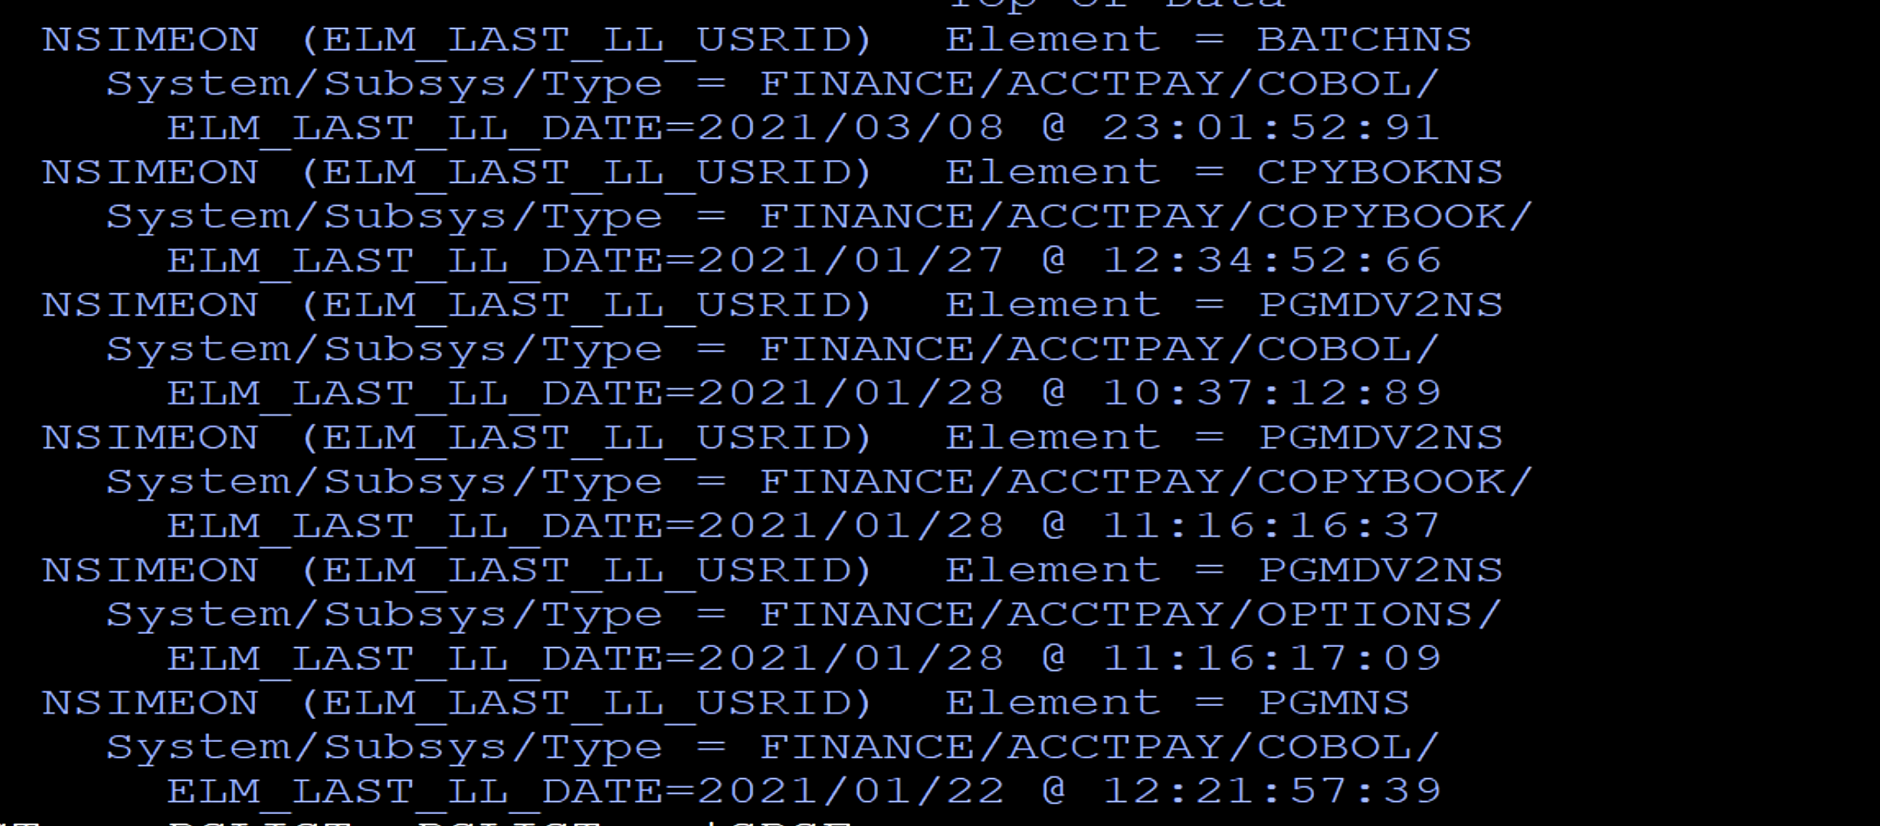
List Elements Last touched by user Example
Show report image
Notes:
SYSDE32.NDVR.TEAM.JCL.CSV(EXAMPL1A)
This is the output for our first example.
You might not like the format, but that’s OK.
We’ll show you how to change to make the change to get the format you like.
It shows a list of elements last changed by a certain Userid. Three lines are printed for each element found. The last changed Userid is one of several userids Endevor maintains on an element. Not all are available for printing from the standard reports. Here.
The first list shows the Userid and the element name
The second line shows the System, Subsystem and Type names
The third lines shows the date and time the element was chaged
.

Slide 11
List Elements Last touched by user Example
Two steps in 34 lines of JCL
CSV step
TableTool step
OPTION statement devoted to selecting records
Notes:
What kind of effort is needed to produce output like this?
Just 34 lines of JCL consisting of a comma separated value step and a table tool step.
If you already have a comma separated value step in another job you can copy it and to this job.
If you already have a table tool step you can it into a JCL for this process
In either case, only minor tailoring is needed to tailor you job to get what you want.
Job steps can become your building blocks

Slide 12
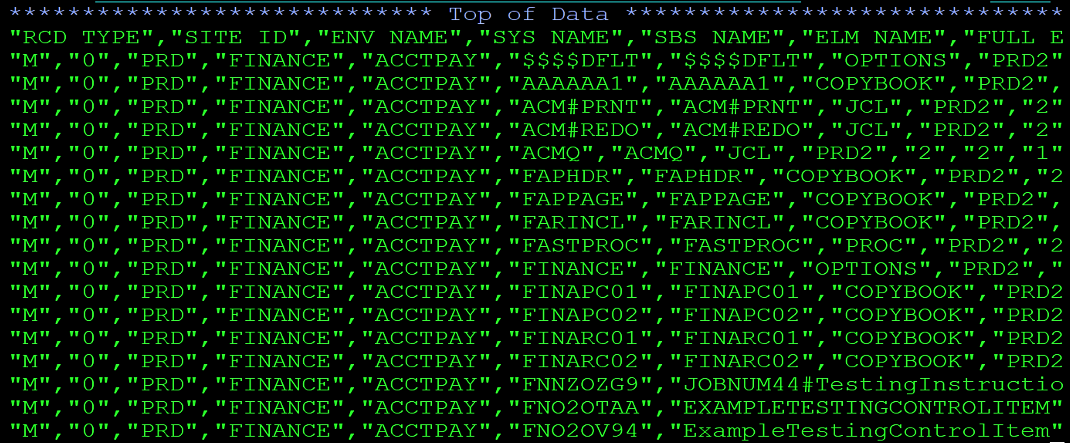
List Elements Last touched by user Example
Show the ttool step in the JCL
Notes:
SYSDE32.NDVR.TEAM.JCL.CSV(EXAMPL1A)
This is an example of what comma separated value data looks like
Each CSV output has a heading on the first line that describes the data on subsequent lines.
When Table Tool sees data like this, it makes variable names from each of the heading phrases. Then the variables are assigned values from each subsequent row of the table.

Slide 13
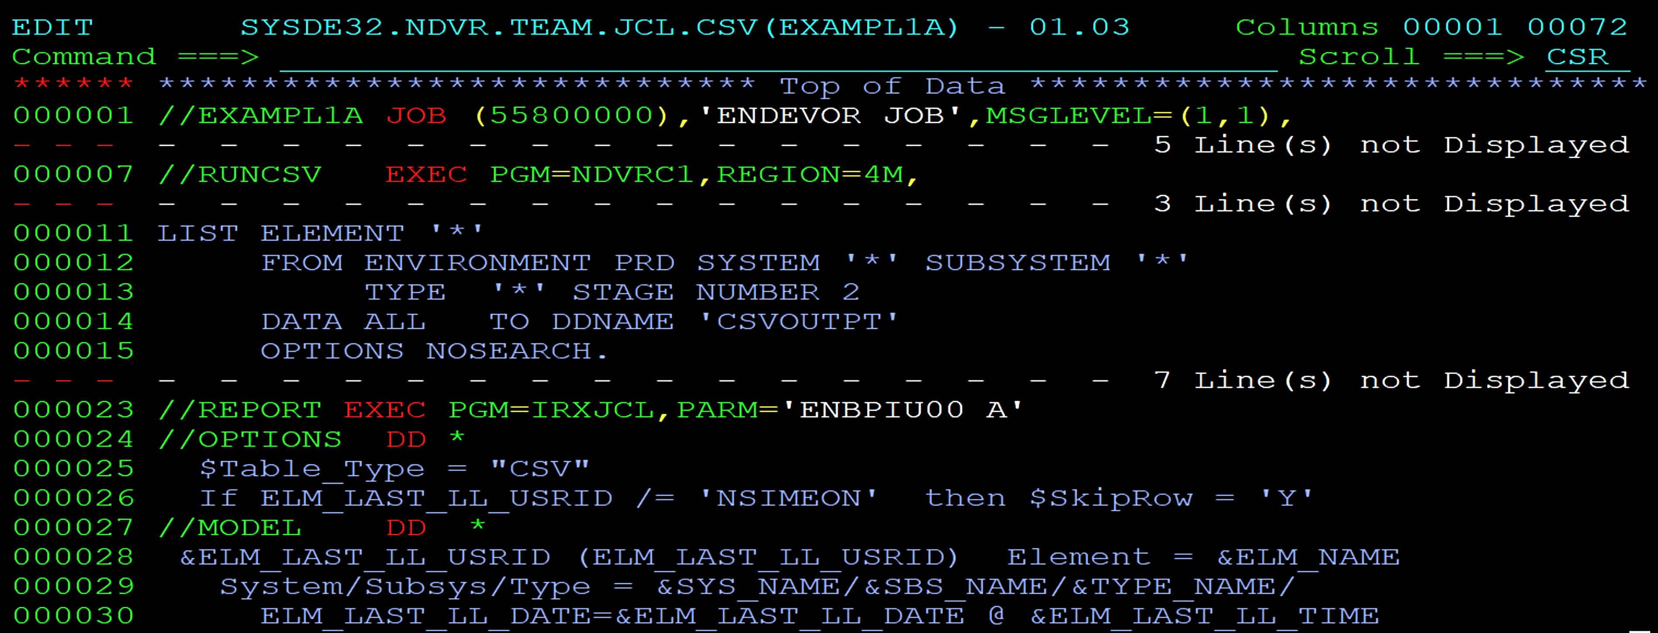
List Elements Last touched by user Example
Show the ttool step in the JCL
Notes:
SYSDE32.NDVR.TEAM.JCL.CSV(EXAMPL1A)
Here is the JCL.
The first step is an Endevor CSV utility step. We showed on the previous slide what the output from this step might look like. The Endevor CSV utility is covered in Broadcom’s Tech Docs documentation.
The second step, starting on line 23, is the Table Tool step, which produces the output from the CSV data. There is no additional code hidden anywhere.
Let’s look at what these two OPTIONS statements do?
TTool executes the OPTIONS once before reading the input table. The statement on line 25 tells TTool the format of the input table. (CSV is one of several input formats)
TTool knows the format of the heading and builds variable names from it.
After each row of the Table is read, the OPTIONS are executed again. Line 26 says….
If the value of one of the CSV variables is not ‘NSIMEON’ then bypass (or skip) the entire row.
Rows that are skipped produce no output.
For each row not skipped, values from the row cause an expansion of the ‘MODEL’, and the expanded output is written to the TBLOUT ddname.
If you prefer a different format for the output you can just simply arrange the text and variables in the MODEL to the way you want.
You might be wondering, where do the variable names and values come from? Variable names are provided on the CSV file header and values are given on each subsequent record of the CSV file. Do you have to already know the variable names for a CSV file, or analyze the heading yourself?
No.

Slide 14
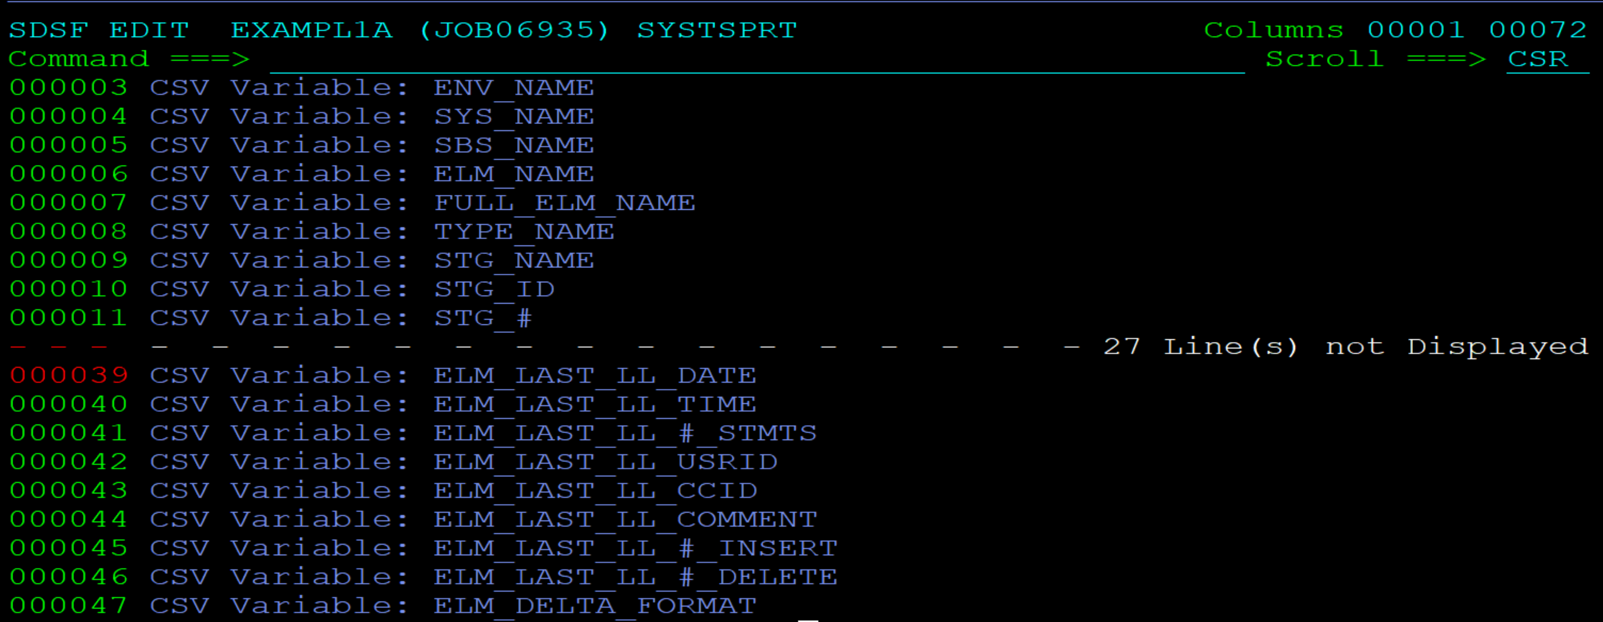
List Elements Last touched by user Example
Show report image
54 total variables
Four Userid fields:
SIGNOUT_ID
LAST_ACT_USRID
BASE_USRID
ELM_LAST_LL_USRID
A Table Tool output shows all the varaiable names found in a CSV intput.
Notes:
SYSDE32.NDVR.TEAM.JCL.CSV(EXAMPL1A)
For CSV files, Table tool lists all the variable names from the table heading. Here is an example. Variable names will differ from one kind of CSV request to another. However, the variable names are consistently the same for each kind of request. For example, the CSV file heading for package actions will consistently use the same variables, but they will be different from the variables related to elements as shown here.
So when you are running a certain CSV request for the first time, allow the table tool step to run – even with an empty model. Doing so will show you all the variables available for that kind of CSV extract.
I counted a total of 54 variables provided by the Endevor CSV utility for element information. The 54 variables contain the information found on the Endevor master display screen.
You could collect data like this, and download it into an excel spreadsheet, but then you would get 54 columns. You could, then, delete the unwanted columns, and use Excel’s filtering to select just the rows you want.
In contrast, using table tool you can use any of 54 variables as selection criteria, and you can limit the output to your chosen subset of the 54 variables in any order you want, and you do not have to download anything.

Slide 15
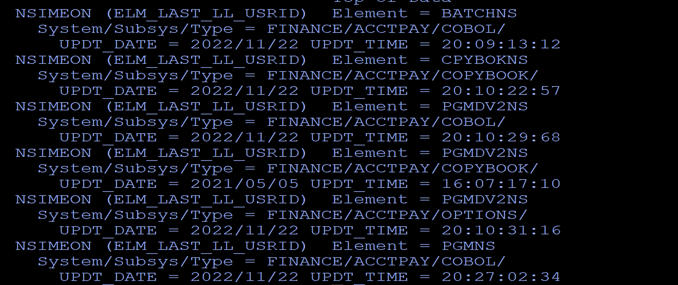
List Elements Last touched by user Example
Show report image
Notes:
SYSDE32.NDVR.TEAM.JCL.CSV(EXAMPL1A)
Once again this is what the output looks like for this first example The example model specifies that 3 lines of output are written for each selected table row, so if you like a different format, you can change the MODEL to format your output in any way you like.

Slide 16
Report of Inactive Elements Example
Table Tool
Notes:
PSP.ENDV.TEAM.JCL(EXAMPL1C)
This example starts with the first example, and goes a little further.

Slide 17
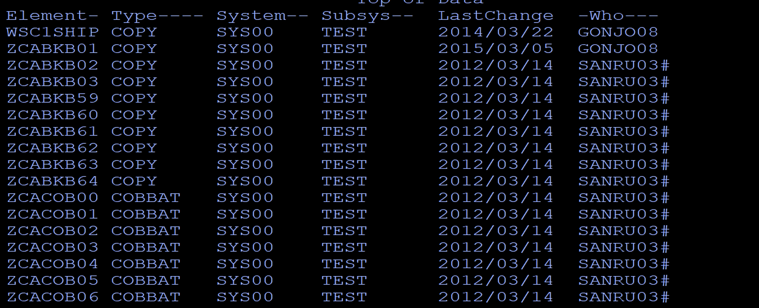
Report of Inactive Elements Example
Show report image
Notes:
PSP.ENDV.TEAM.JCL(EXAMPL1C)
This slide shows output for our second example.
This time the output is formatted as a standard report, and shows several columns of data the are derived from the CSV output.

Slide 18
Report of Inactive Elements Example
Two steps in 40 lines of JCL
CSV step
TableTool step
OPTION statements devoted to selecting records and formatting
Notes:
PSP.ENDV.TEAM.JCL(EXAMPL1C)
So what produces this report? Two steps in 40 lines of JCL.
The first step is a comma separated value step like the one from our first example.
The second step is a Table Tools step, like the one from our first example.
We could copy steps from the first example to build the JCL for this one.
The Option statements are used for selecting records and formatting.

Slide 19
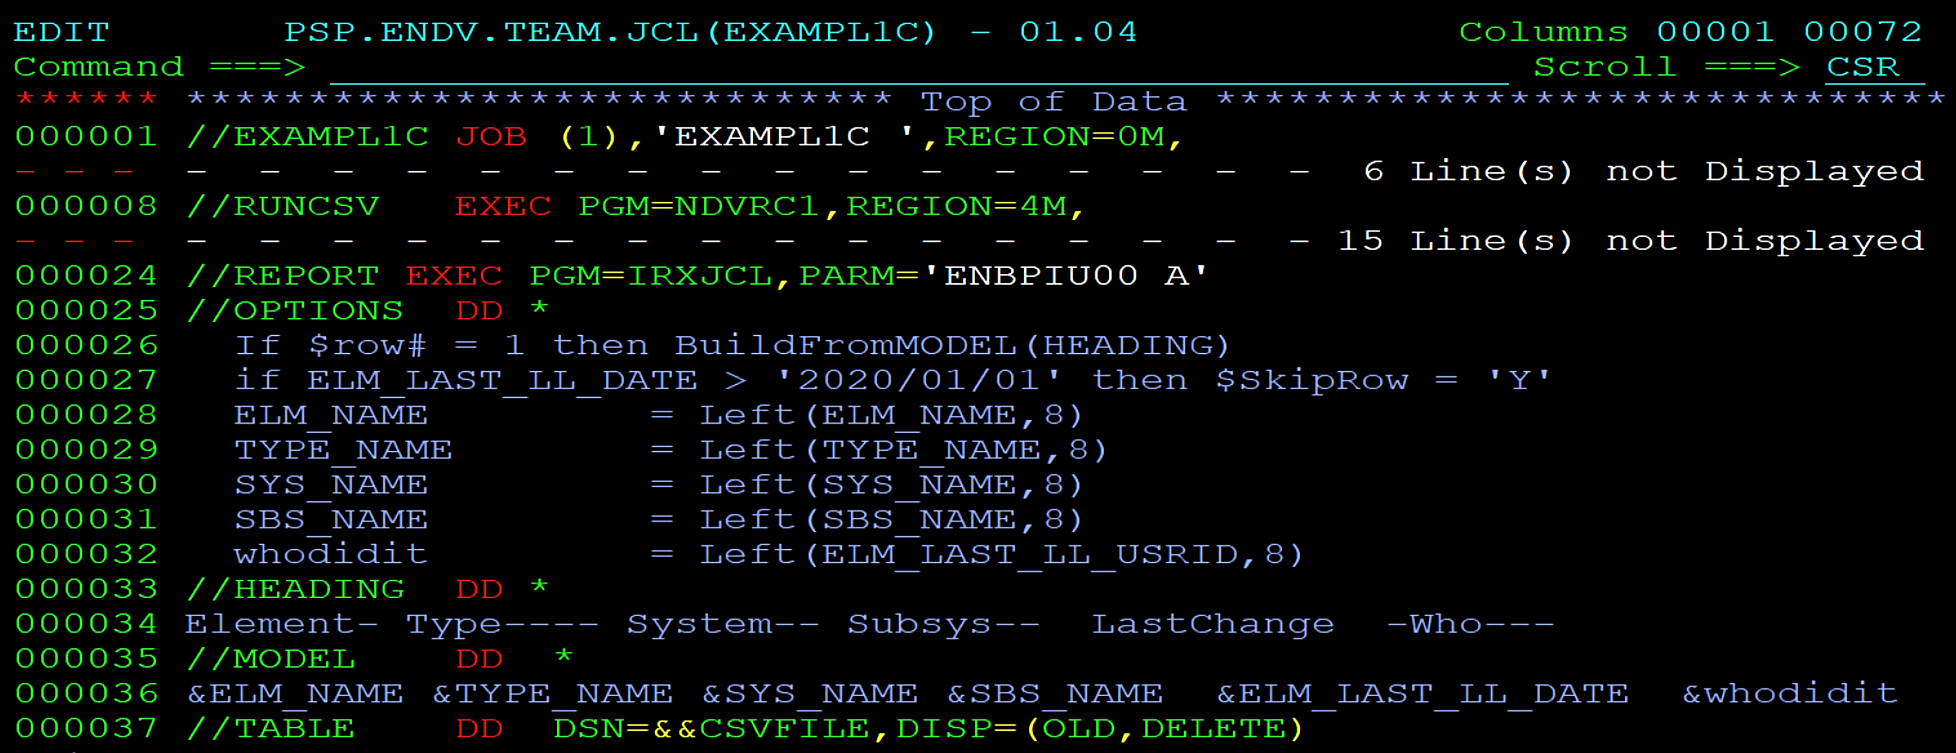
Report of Inactive Elements Example
Show the ttool step in the JCL
Notes:
PSP.ENDV.TEAM.JCL(EXAMPL1C)
The CSV step is the same….
The Table Tool step has more OPTIONS than before.
Line 26 looks at the number of the record just read, and if it is the first record, write the heading.
The heading is found on lines 33-34, and containing no variables is written as is.
Line 27 checks the value for one of the CSV Date variables. If the date is newer than Jan 1, 2020 then the Table row is skipped - in other words - it gets thrown out.
Lines 28-31 are using REXX statements to format variables to be consistently 8 characters in length. They are padded with blanks if necessary. Non-blank characters are shifted to the first position on left. The result compensates for the variations In lengths for the values from the CSV table. Then, each field is printed with a precise length – ideal for a report..
Line 32 introduces a new variable and assigns a value from one of the CSV variables.

Slide 20
Report of Inactive Elements Example
Show report image
Notes:
PSP.ENDV.TEAM.JCL(EXAMPL1C)
Once again this is what the output looks like for this example The example model specifies that 3 lines of output are written for each selected table row, so if you like a different format, you can change it in any way you like.

Slide 21
Report of Elements in DEV Example
Table Tool
Notes:
SYSDE32.NDVR.TEAM.JCL.CSV(EXAMPL1B)
The next example builds from the JCL steps from the first example.

Slide 22
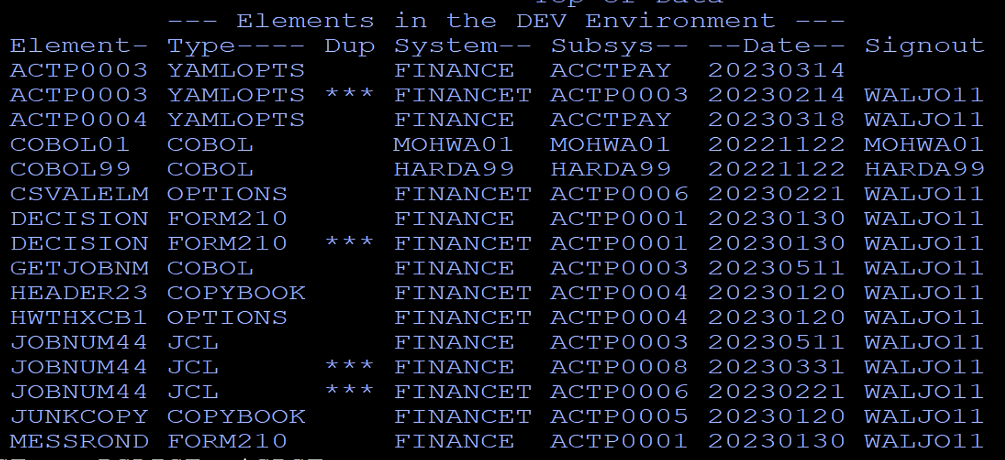
Report of Elements in DEV Example
Show report image
Notes:
SYSDE32.NDVR.TEAM.JCL.CSV(EXAMPL1B)
This slide shows output for our second example.
What you see is formatted a standard report, and show several columns of data the are derived from the CSV output, and a ‘DUP’ column that is constructed by the table tool step.
The output represents a list of elements, flagging in the ‘Dup’ column those elements that appear multiple times. This report highlights repeating elements, regardless of whether Sandboxes or Dynamic Envronments are configured for parallel development.

Slide 23
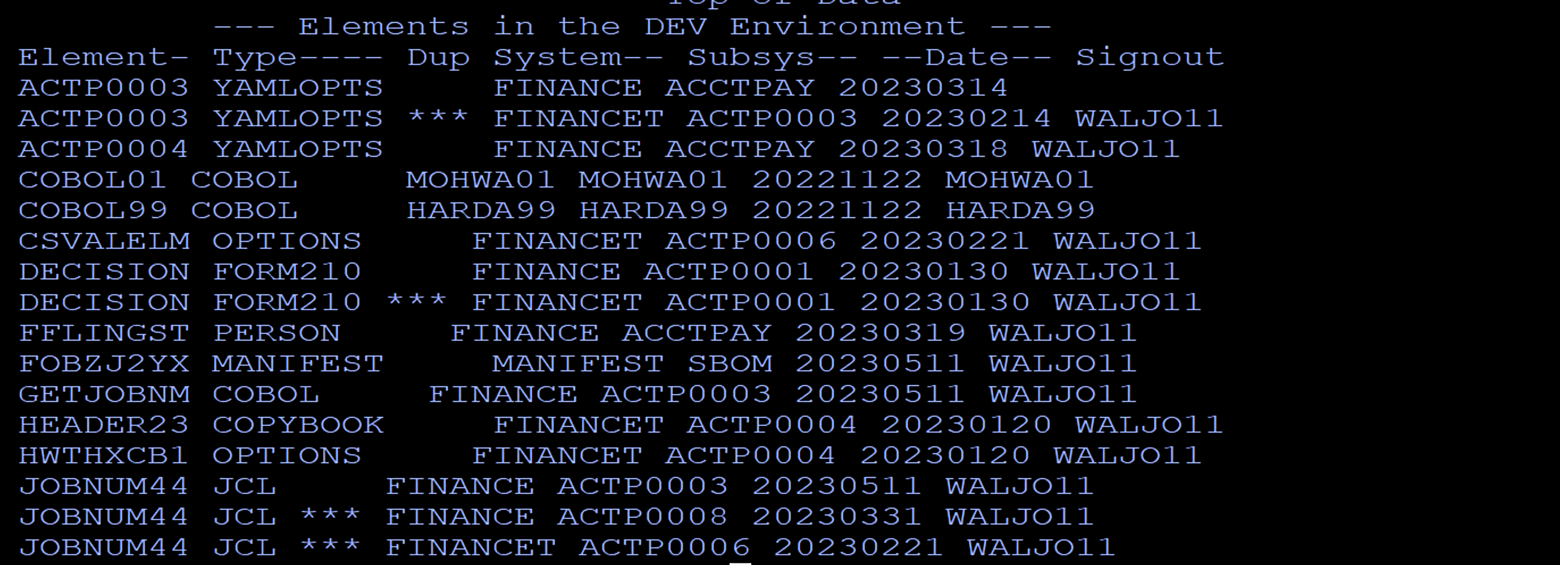
Report of Elements in DEV Example
Show report image
Notes:
SYSDE32.NDVR.TEAM.JCL.CSV(EXAMPL1B)

Slide 24
Report of Elements in DEV Example
Three steps in 58 lines of JCL
CSV step – with the NOCSV option
Sort step
TableTool step
OPTIONS devoted to formatting and assigning a value for the Dup variable
Notes:
SYSDE32.NDVR.TEAM.JCL.CSV(EXAMPL1B)
So what produces this report? 58 lines of JCL.
There are three steps that produce this output.
The first step is a comma separated value step like the one from our first example.
We could copy the CSV step from the first example to build the JCL for this one.
Because the data needs to be sorted for this report, the second step is a SORT step. If we already have a SORT step, we could copy it here.
The third step is a Table Tools step. We could copy the Table Tool step from the first example to build the JCL for this one.
The Option statements will be used for formatting, and deriving a value for the DUP column.

Slide 25
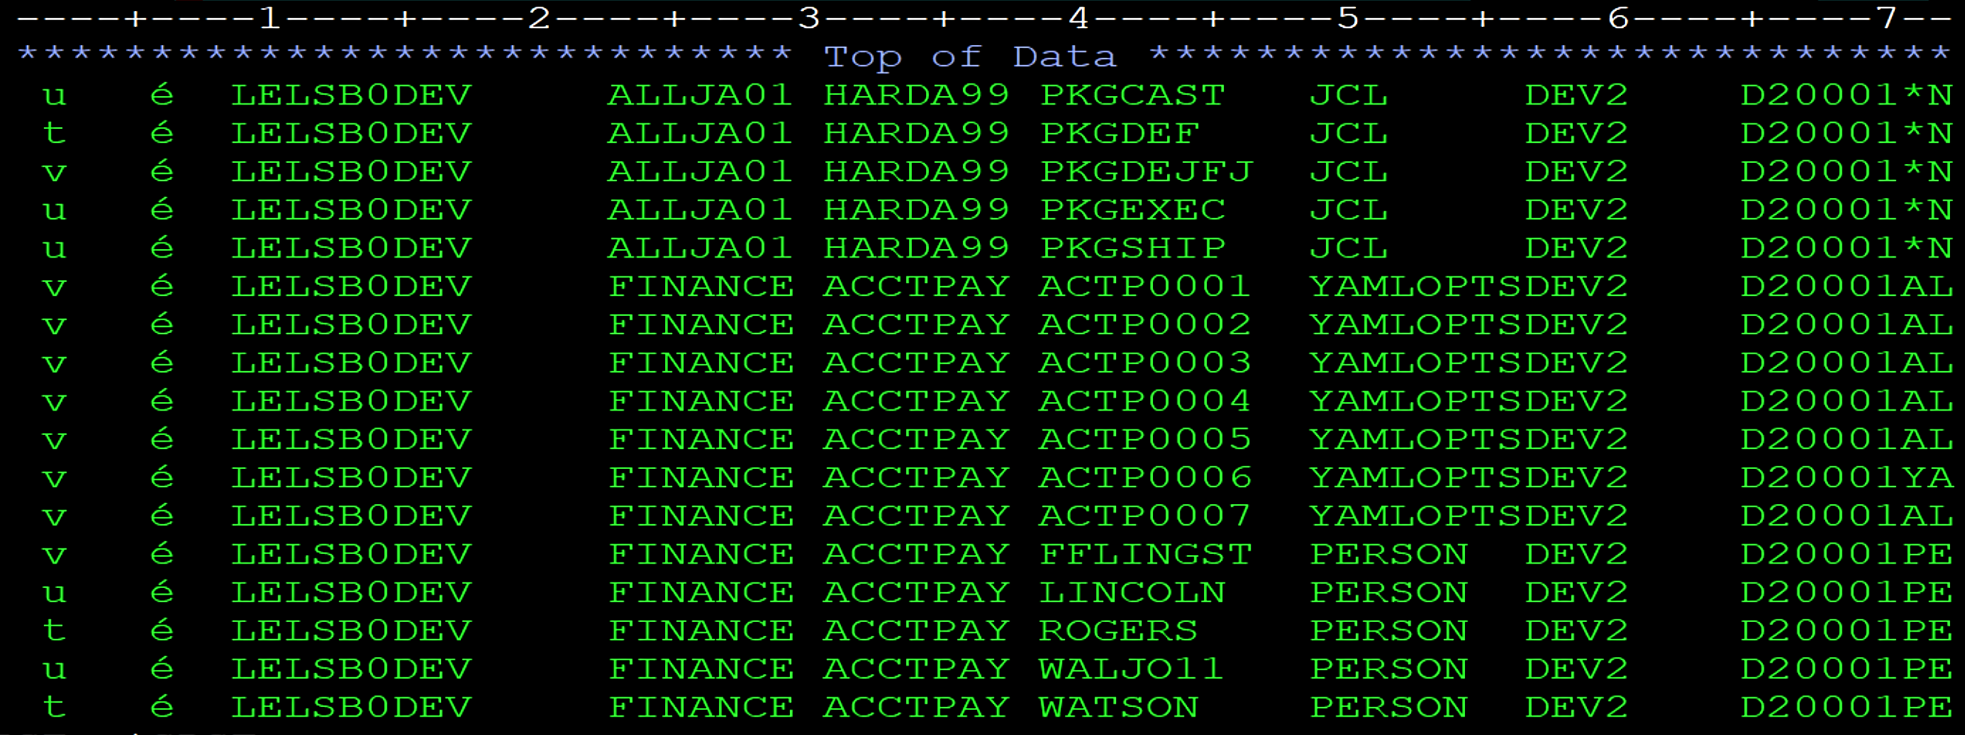
Report of Elements in DEV Example
Show the sorted CSV output (usning the NOCSV option) sorted.
Show Cols and how POSITION is created.
//POSITION DD *
System 23 30
Subsys 31 38
Element 39 46
Type 49 56
Userid 95 102
Date 79 86
//SYSIN DD * / sort by ele, typ, sys, sub
SORT FIELDS=(39,08,CH,A,49,08,CH,A,23,16,CH,A)
Notes:
SYSDE32.NDVR.TEAM.JCL.CSV(EXAMPL1B)
This is what the comma separated value data looks like when the NOCSV option is selected.
There are no commas separating values. In fact, all fields are in fixed positions, but there is no heading that provides useful information.
When you have data like this, a close examination can help make the data useful.
For example, I know that FINANCE is a system name, and I can see that it consistently appears in column 23. I recognize subsystem names as well, and that they consistently appear in column 31. Further to the right are recognized values for the element name, Type, Userid and date fields.
For fields that are needed on your report, List the names and their starting and ending positions. (No arithmetic is necessary ie for length calculations)
Then, to sort the data by Element and Type, we can build the Sort commands from the Positions of fields that we recognized.

Slide 26
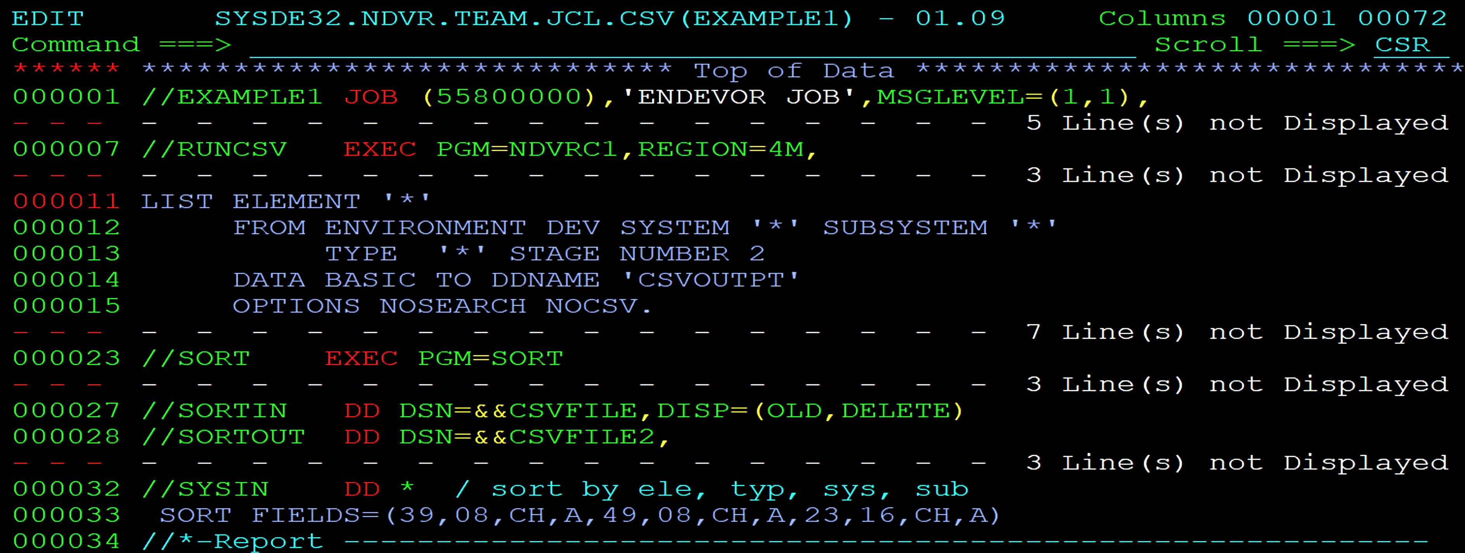
Report of Elements in DEV Example
Show the ttool step in the JCL
//SYSIN DD * / sort by ele, typ, sys, sub
SORT FIELDS=(39,08,CH,A,49,08,CH,A,23,16,CH,A)
Notes:
SYSDE32.NDVR.TEAM.JCL.CSV(EXAMPL1B)
Here you can see minor differences in the CSV step from the first example. The first example requested element information from PRD. This one requests information from the DEV environment. Also, since there is a necessary SORT in this job, it also includes the NOCSV option.
The second step sorts the data by Element, Type, System and subsystem.

Slide 27
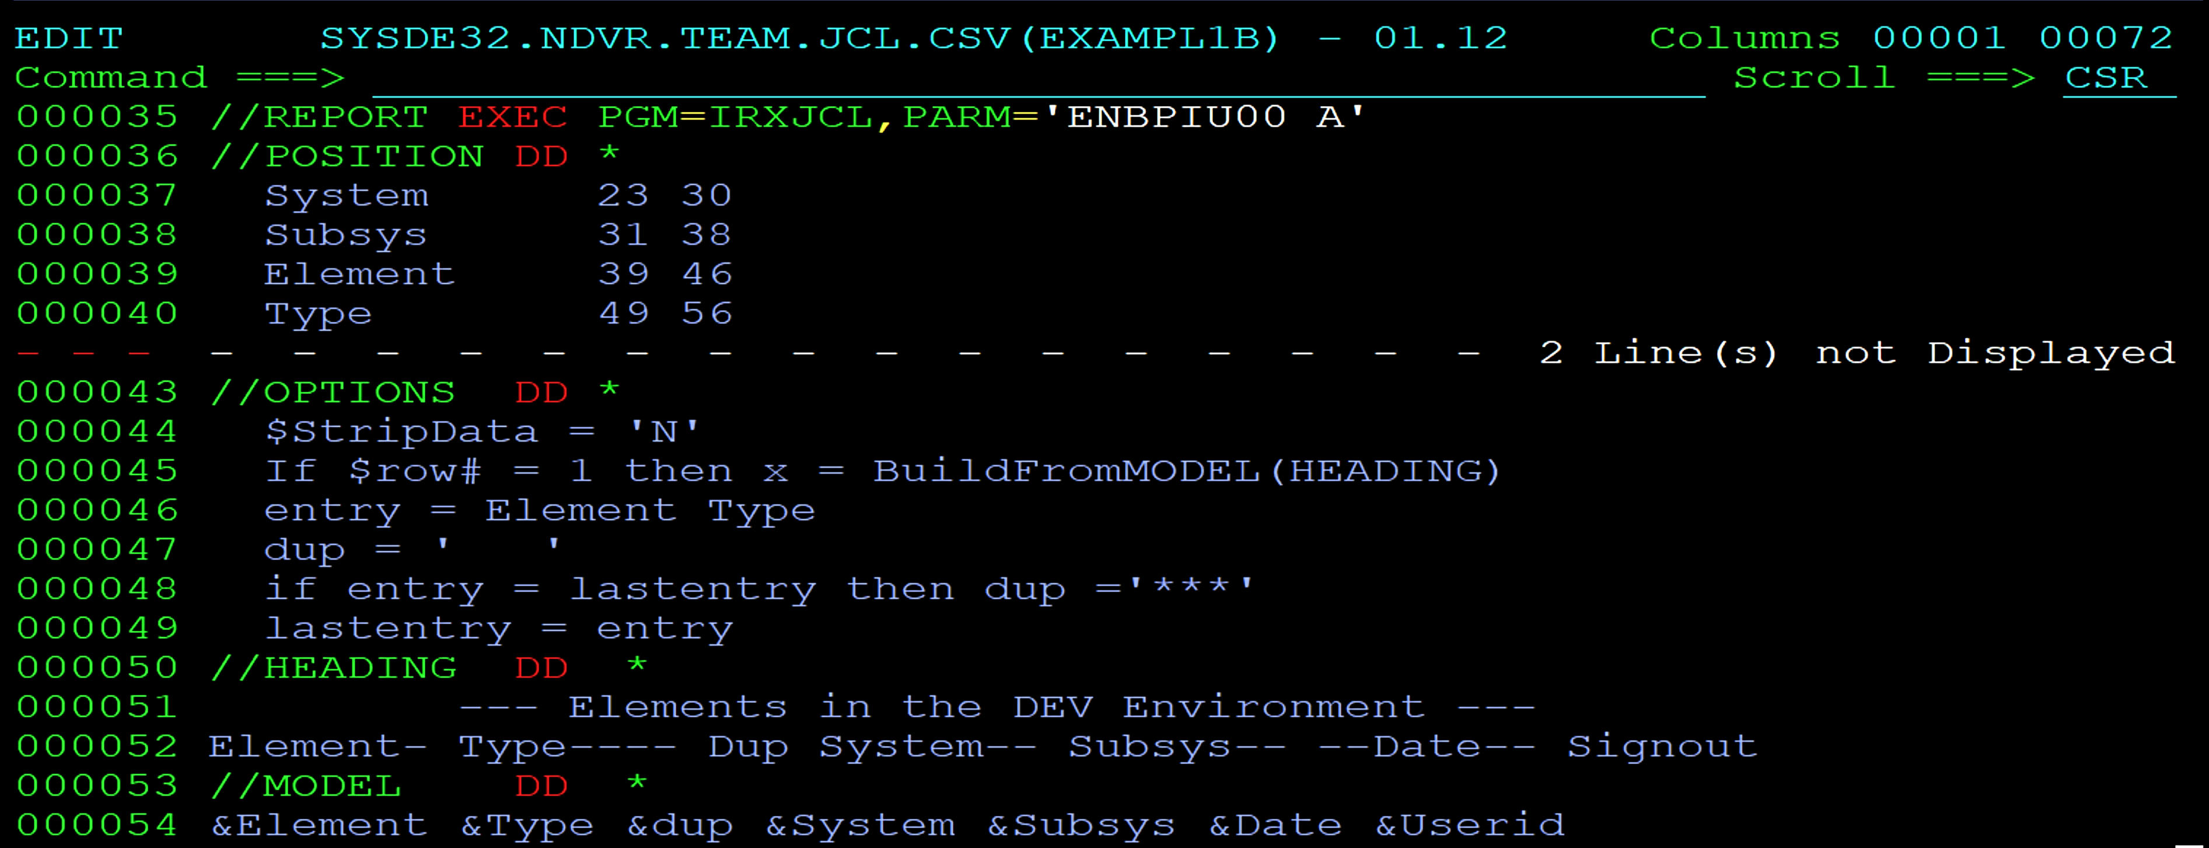
Report of Elements in DEV Example
Show the ttool step in the JCL
//POSITION DD *
System 23 30
Subsys 31 38
Element 39 46
Type 49 56
Userid 95 102
Date 79 86
Notes:
SYSDE32.NDVR.TEAM.JCL.CSV(EXAMPL1B)
The third step shows the Table Tool step.
The input table in this example does not contain a heading. There is nothing Table Tool can use to automatically identify the field names and their positions. However, when a “POSITION”input is provided, Table Tool can use your variable names and positions for processing. In this JCL, the POSITION input provides the kind of information that the CSV heading provides.
The options you see starting at line 44, are REXX statements that give Table Tool further instructions on what to do.
On-line 44, the $StripData tells Table tool to keep trailing spaces on each field as they are defined by POSITONS. Keeping the spaces improves the formatting when the output is a report.
Line 45 tells table tool to write the heading to the output when the $row# is 1. The $row# variable contains the row number just read from the input Table.
If our report did not require a ‘DUP’ column, then we would be done. No other options statements would be necessary.

Slide 28
Report of Elements in DEV Example
Show the ttool step in the JCL
//POSITION DD *
System 23 30
Subsys 31 38
Element 39 46
Type 49 56
Userid 95 102
Date 79 86
Assign a Value for Dup
Notes:
SYSDE32.NDVR.TEAM.JCL.CSV(EXAMPL1B)
However, since we are wanting to highlight elements that are found in multiple Endevor locations (Sandboxes or Dyn Envs), we have more to do. The next series of options statements are dedicated to assigning a value to the ‘Dup’ variable.
The variable name ‘Dup’ is your variable. You can name and define them on the fly as you see here.
Table has its own internal variables. Most begin with a dollar sign.
$row# tells you what row number from the table was the last one read.
$SkipRow. You can set to a value of ‘Y’ to skip a row
$StripData is ‘on’ by default, but you can change in order to keep spaces for formatting.
BuildFromModel tells Table tool to write output now from the named Model

Slide 29
Report of Elements in DEV Example
Show report image
Notes:
SYSDE32.NDVR.TEAM.JCL.CSV(EXAMPL1B)
Once again this is what the example output looks like.

Slide 30
Report of Elements in DEV Example opportunities
Report abandoned elements
Report/Count elements by CCID/ Sandbox/ Dyn Env / Userid / Type / Processor Group / . . .
Report anything you see on the Master Display
Report package information
Notes:
SYSDE32.NDVR.TEAM.JCL.CSV(EXAMPL1B)
From these first two examples, where could you go next?
You could report abandoned elements, for example, where you define what an abandoned element looks like – perhaps dependent on how long has it been sitting there untouched.
.
Report or count elements by CCID, sandbox, dynamic environment or userID.
Report anything you see on the master display screen.
Build reporting on package information as supposed to the element information reported by these two examples.

Slide 31
Report of Element Changes within date range Example
Table Tool

Slide 32
Report of Element Changes within date range Example
*** Report of Element Changes 2022/08/03 thru 2023/05/10 ******
ENV_NAME ELM_NAME SYS_NAME SBS_NAME TYPE_NAME Date------ Time------- Userid Package---------
PRD BINDTEST FINANCE ACCTPAY BIND 2022/08/30 12:50:37:44 WALJO11 2#WH4M0836186932
PRD BINDTST2 FINANCE ACCTPAY BIND 2022/08/31 11:49:51:81 WALJO11 2#WH4M0836186932
PRD CICSTEST FINANCE ACCTPAY CICSNEWC 2022/08/31 11:11:46:45 WALJO11 2#WH4M0836186932
PRD FINAPC01 FINANCE ACCTPAY COPYBOOK 2022/11/22 18:06:53:46 WALJO11 FINA#XC3N0822297
PRD FNO2OTAA FINANCE ACCTPAY YAMLOPTS 2022/12/14 20:51:21:23 WALJO11 FINA#WLNU1653486
PRD HEADER23 FINANCE ACCTPAY COPYBOOK 2022/12/06 16:10:01:64 WALJO11 FINA#WLFP1016782
PRD JOBNUM44 FINANCE ACCTPAY YAMLOPTS 2022/12/07 21:07:18:98 WALJO11 FINA#WLNT2322820
PRD PG000004 FINANCE ACCTPAY COBOL 2023/03/29 14:44:28:30 WALJO11 FINA#XC5O5806211
PRD PG000005 FINANCE ACCTPAY COBOL 2023/03/30 16:59:27:66 WALJO11 FINA#XC4Q0010266
PRD PG000006 FINANCE ACCTPAY COBOL 2023/03/30 16:59:46:56 WALJO11 FINA#XC4Q0010266
PRD PG000007 FINANCE ACCTPAY COBOL 2023/03/29 14:32:52:06 WALJO11 FINA#XDCN2523026
PRD PG000008 FINANCE ACCTPAY COBOL 2023/03/29 14:33:07:18 WALJO11 FINA#XDCN2523026
PRD PG000009 FINANCE ACCTPAY COBOL 2023/03/29 14:33:24:87 WALJO11 FINA#XDCN2523026
PRD PG000044 FINANCE ACCTPAY COBOL 2023/03/24 08:20:35:66 WALJO11 FINA#XC3P4719913
PRD PG000051 FINANCE ACCTPAY COBOL 2023/04/06 12:25:08:55 WALJO11 FINA#XDFM1753248
Notes:
SYSDE32.NDVR.TEAM.JCL.CSV(EXAMPL2A)

Slide 33
Report of Element Changes within date range Example
1 CSV step and 1 TableTool step in 76 lines of JCL
JCL parameters for
start and end dates
Environment and System (or wild-card)
OPTIONS devoted to formatting of fields
Notes:
SYSDE32.NDVR.TEAM.JCL.CSV(EXAMPL2A)
Rather than maintaining a REXX program as a separate member in another dataset, you can use Rexx statements in-stream to the job step.
You no longer need to swap back and forth between two or more screens to follow the processing. Instead, everything that runs is present in one display.

Slide 34
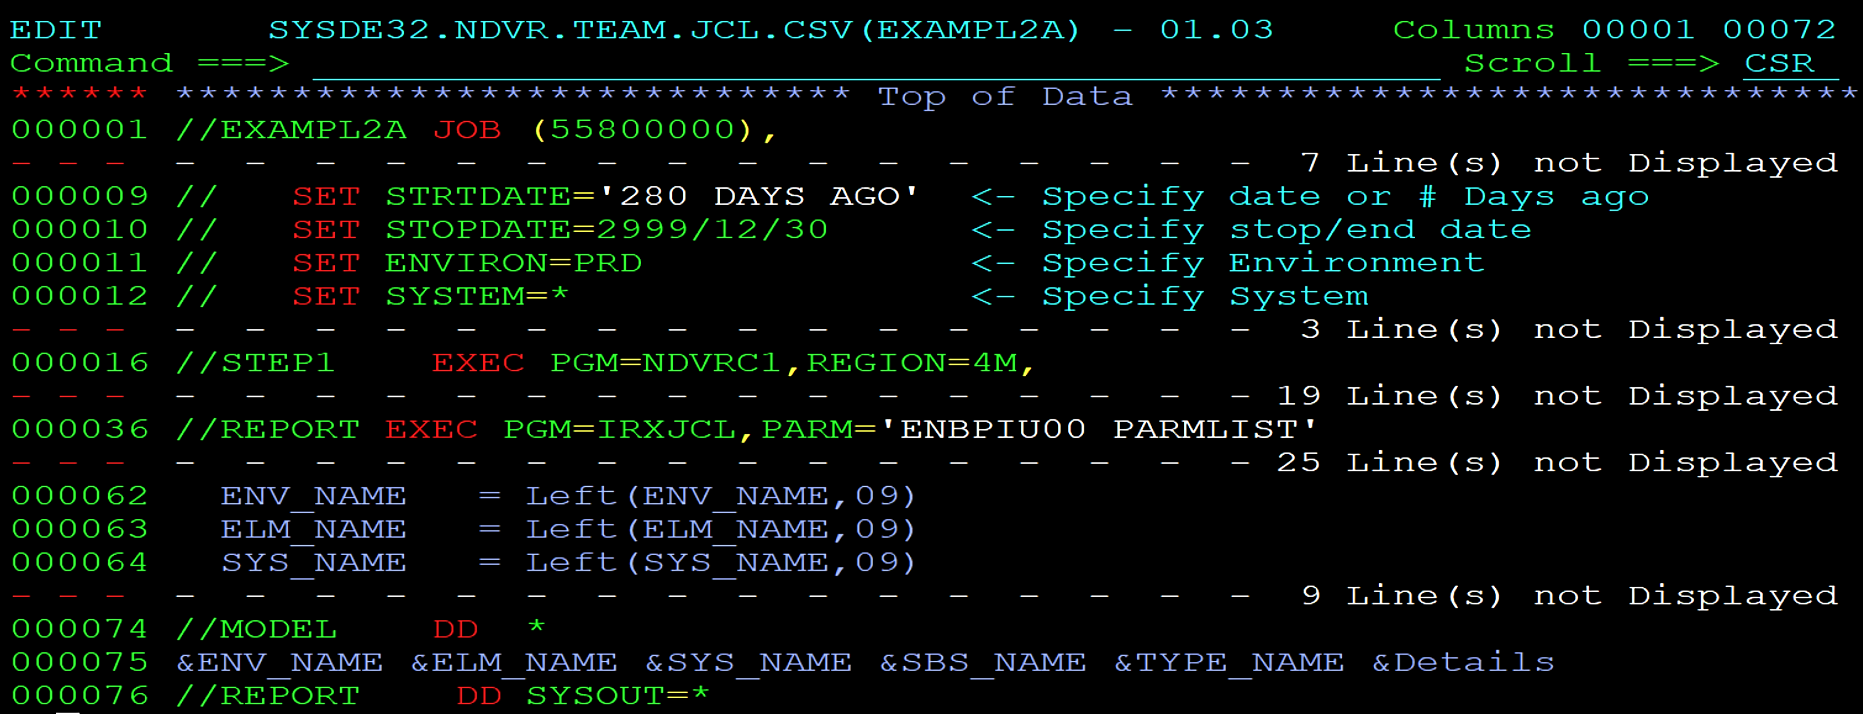
Report of Element Changes within date range Example
Notes:
SYSDE32.NDVR.TEAM.JCL.CSV(EXAMPL2A)

Slide 35
Managing processor group overrides Example
Table Tool
Notes:
SYSDE32.NDVR.TEAM.JCL.CSV(CLEANOVR
This next example iintroduces a way to expedite Endevor Administration tasks..

Slide 36
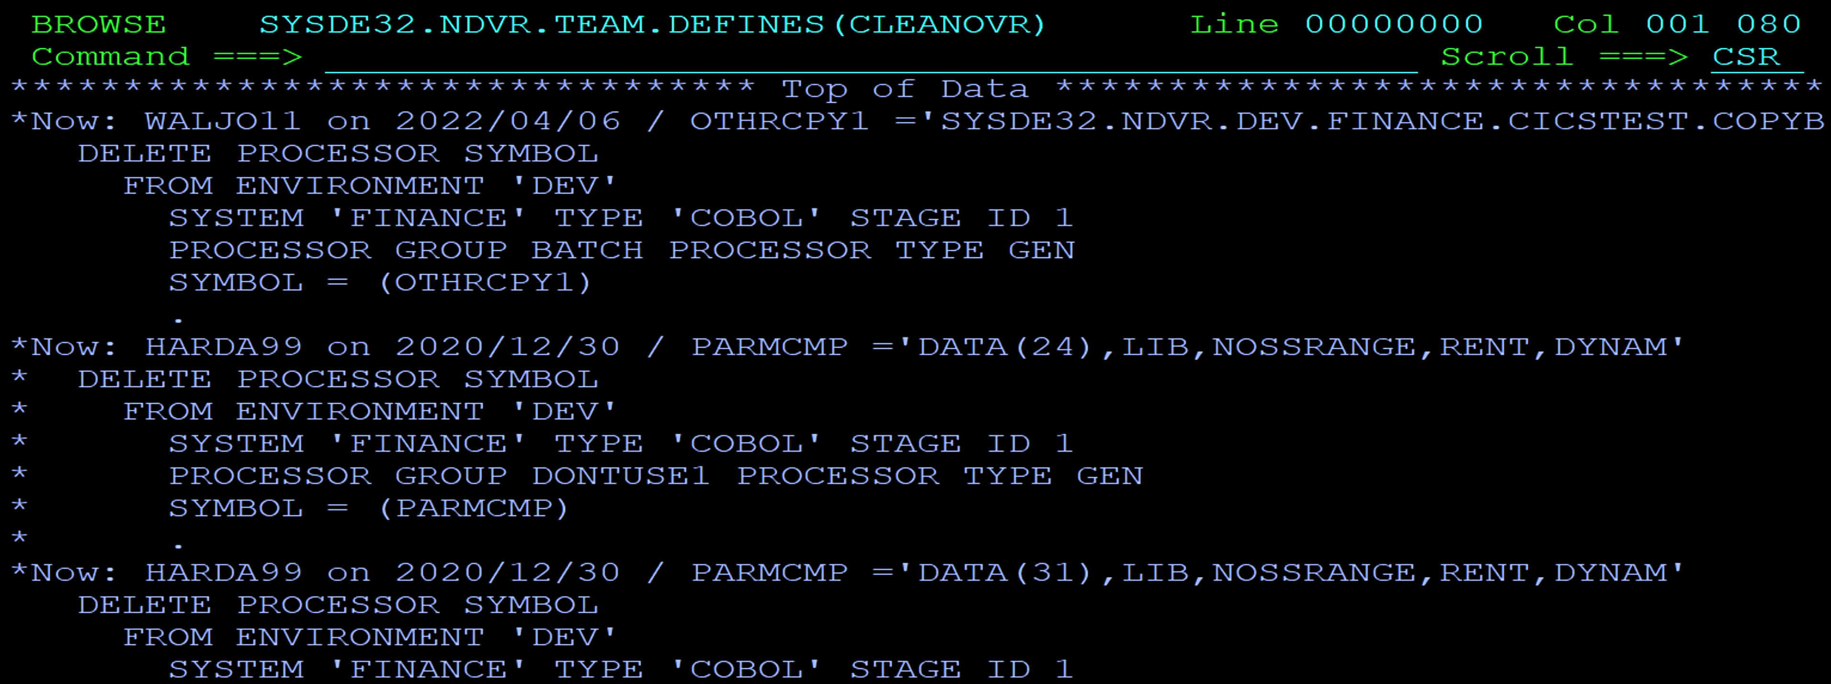
Managing processor group overrides Example
Notes:
SYSDE32.NDVR.TEAM.JCL.CSV(CLEANOVR)
Different from previous examples this example shows output being placed into a dataset. Output is formatted as Endevor commands. Those if you more Endevor administrators will recognize the syntax as batch administration SCL.
The data that you see is a representation of whole processor group overrides found within an Endevor and the environment. Some sites will have hundreds or thousands of overrides, and prefer to lean on them for if the diversity that they give. Other sites will allow only temporary use of processor group overrides to correct problems or for testing, but prefer to remove the override when the final solution is implemented.
The format of the output produced makes the removal of overrides subjected to a review before being removed. The person performing the review can examine the comment value before each DELETE statement to better assess whether the DELETE action should be included or excluded.
It also allows you to report overrides that you determine are to be “keepers”. An asterisk in the first column for each line within an entry renders the whole entry as just a comment.

Slide 37
Managing processor group overrides Example
Two steps in 47 lines of JCL
1 CSV step
1 Table Tool step
Output is generously commented and formatted for next stop - the Batch Environment Administration facility
OPTIONS determine whether to comment entries
Notes:
So what produces output like this ?
47 lines of JCL within two JCL steps.
The first step is an Endevor CSV utility step. If you already have the CSV utility in the job you can copy it to execute this job.
The second step is the table tool step. If you already have an example table tool step you could copy it into the JCL to produce this job.
OPTIOND introduce a new variable, not found on the CSV input. And assign a value to it.
.

Slide 38
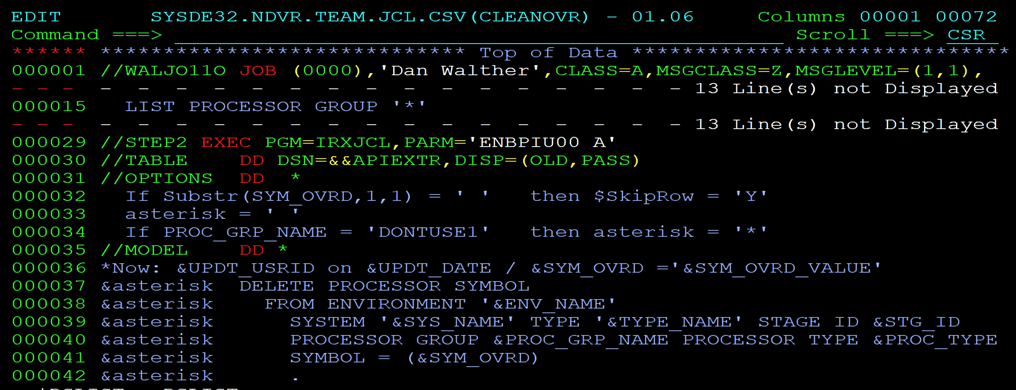
Managing processor group overrides Example
Notes:
SYSDE32.NDVR.TEAM.JCL.CSV(CLEANOVR)
The JCL is shown on this slide.
Line 15 shows that the LIST statement is different in this CSV example from the previous examples. So, the descriptive text on the header of the CSV file will be different from that of previous examples.
The options
Line 32 is a statement tells tools that table tool to bypass (or skip) any processor group record and has no processor group override.
Line 33 initializes a new variable to have a value of a space.
Line 34 is an example of the kind of code that can be used for a preexisting condition. When the CSV data finds an override that is to be kept, the statement assigns the value of variable named ‘asterisk’ to comment out the DELETE statement. The entry remains in the output for reporting only and not subject to an actual delete.
In the MODEL, each detail line of the model is preceeded with the Asterisk variable. When a keeper is identified by an OPTIONS statement, then entire statement for that entry appears only as commented SCL in the output. The method allows administrators to review the results.

Slide 39
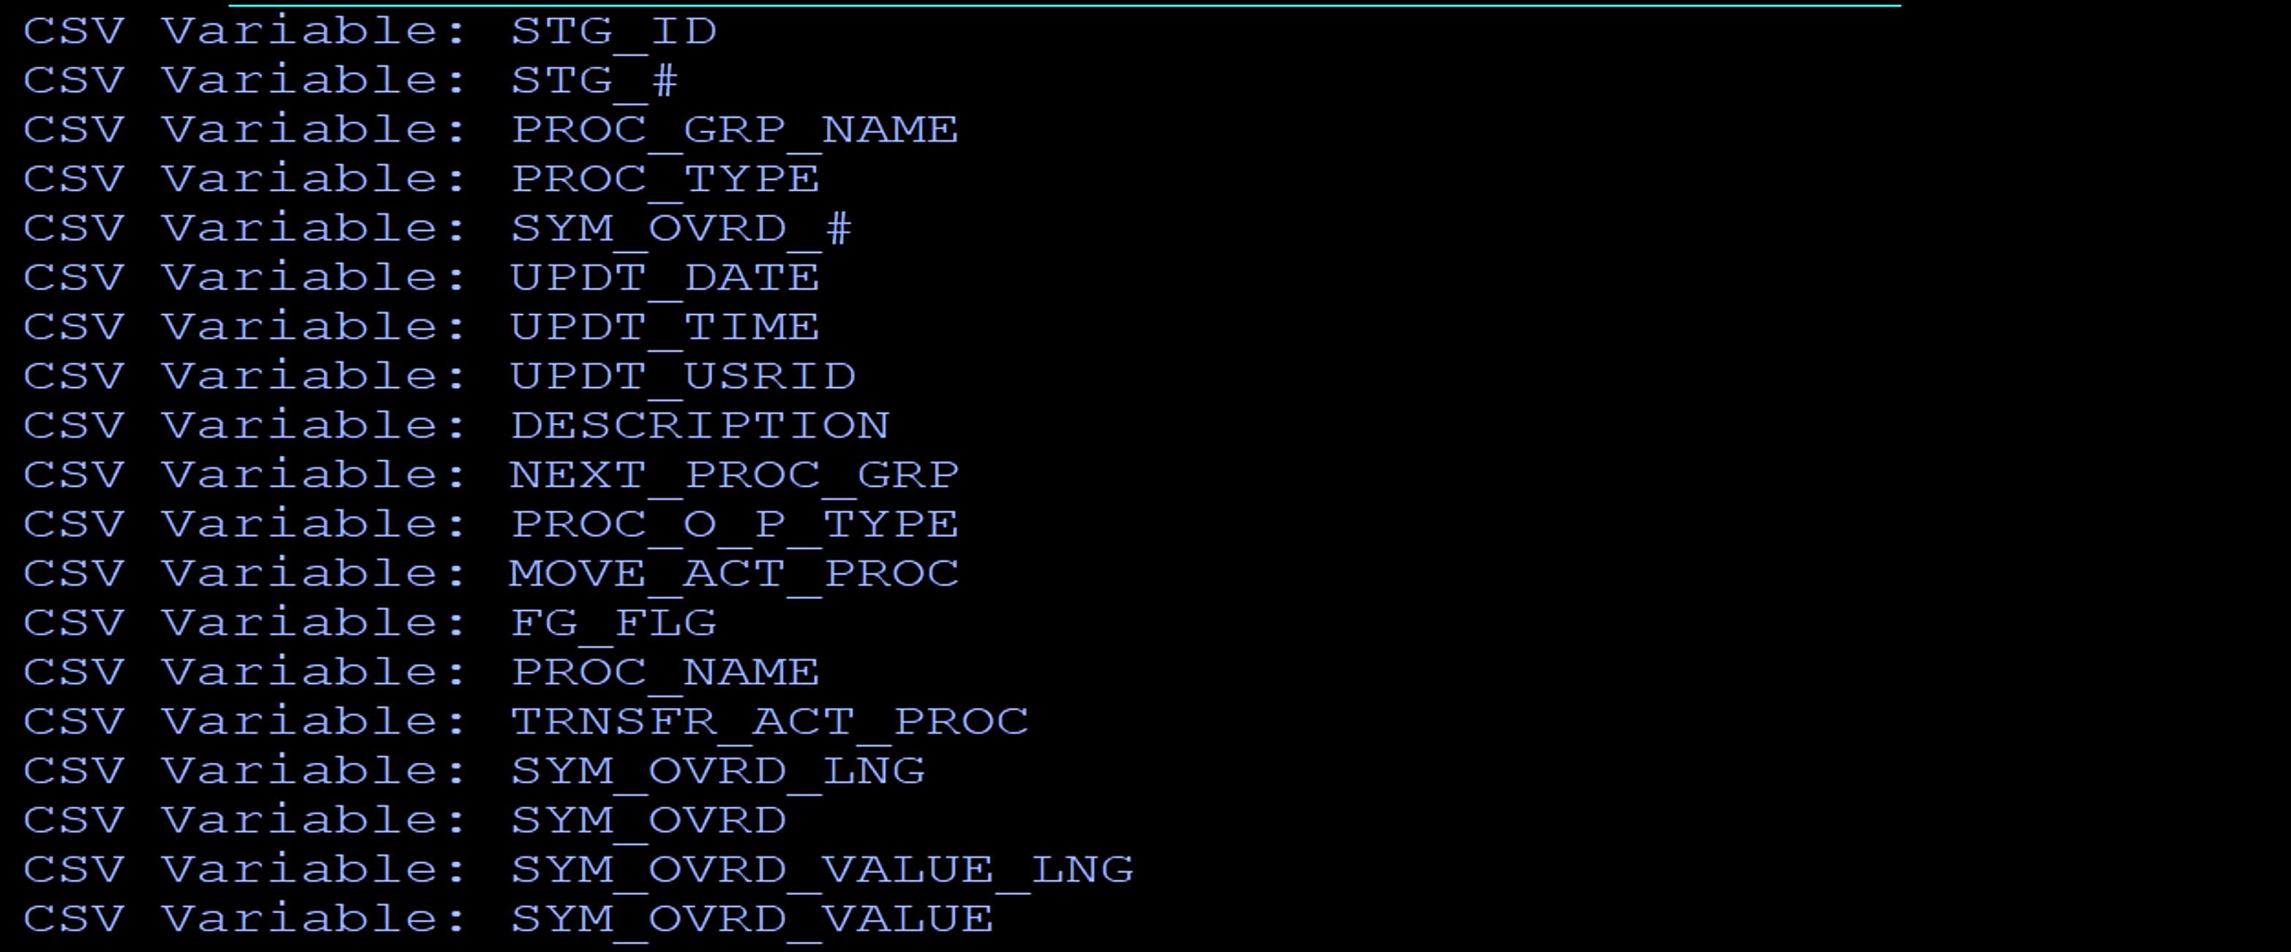
Managing processor group overrides Example
Notes:
SYSDE32.NDVR.TEAM.JCL.CSV(CLEANOVR)
the CSV variable names for this kind of CSV extract

Slide 40
Managing processor group overrides Example
Notes:
SYSDE32.NDVR.TEAM.JCL.CSV(CLEANOVR)

Slide 41
Managing processor group overrides Example opportunities
Batch Admin to BUILD SCL, Edit SCL, run DEFINE SCL
Foreground Panels for Type, processor Group, overrides
Define new Endevor objects from existing objects
Leverage existing Models in your Endevor CSIQSAMP library - formatted SCL
Produce outputs that are freely commented and available for review
Job steps become the building blocks
Notes:
Rather than maintaining a REXX program as a separate member in another dataset, you can use Rexx statements in-stream to the job step.
You no longer need to swap back and forth between two or more screens to follow the processing. Instead, everything that runs is present in one display.

Slide 42
Dataset Reporting Example
Table Tool
Notes:
This next example has nothing to do with Endevor, and uses another kind of TABLE input.
Not using CSV input this time.

Slide 43
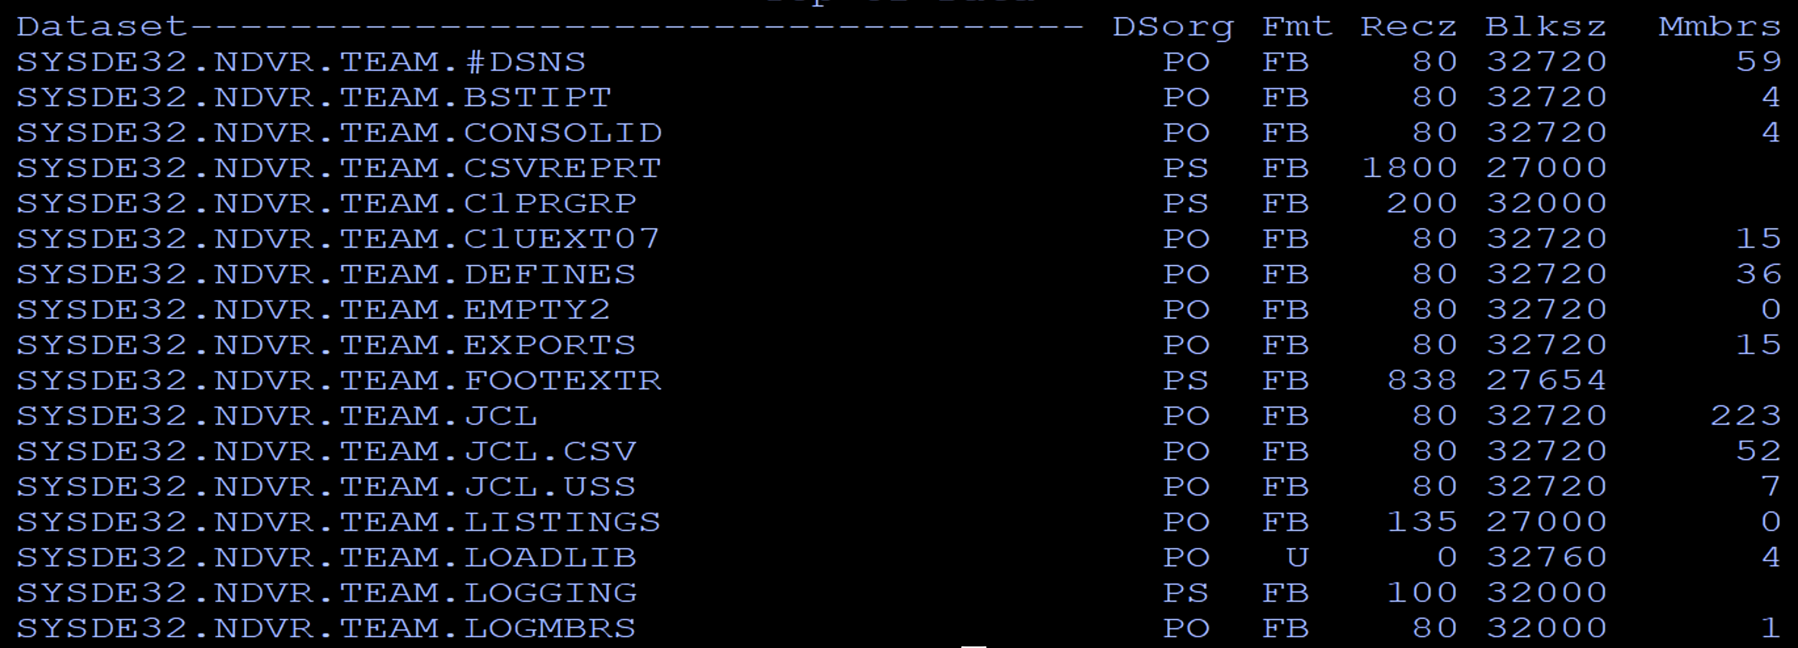
Dataset Reporting Example
Notes:
SYSDE32.NDVR.TEAM.JCL(LISTDSNS)
In this example, we are reporting a list of datasets given a common high-level qualifier.
For each dataset is reported the name and attribute information, including the number of members.

Slide 44
Dataset Reporting Example
Two steps in 36 lines of JCL
IDCAMS
Table Tool
Reports all datasets using a common high level qualifier
OPTIONS execute IBM’s LISTDSI command and provide for formatting
Notes:
SYSDE32.NDVR.TEAM.JCL(LISTDSNS)
What produces a report like this?
36 lines of JCL, using IDCAMS and a Table tool step.
Only the High-level qualifier is necessary as input.

Slide 45
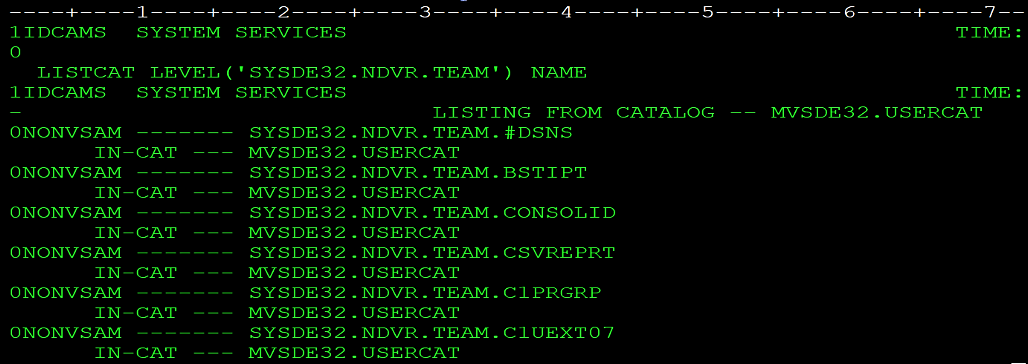
Dataset Reporting Example
Notes:
SYSDE32.NDVR.TEAM.JCL(LISTDSNS)
IDCAMS example output for a specified HLQ.
There is no heading. So there is nothing that has field definitions.
However, you can see that every line that has the text ‘NONVSAM’ in position 2, also has a dataset name.

Slide 46
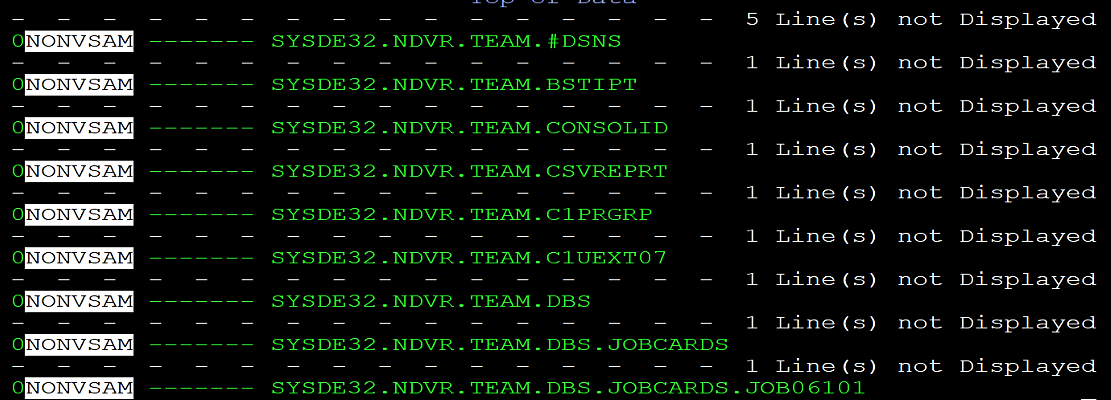
Dataset Reporting Example
F 'NONVSAM' 2 ALL
Notes:
SYSDE32.NDVR.TEAM.JCL(LISTDSNS)
Here is what you would see if you only looked at the lines that have the text string ‘NONVSAM’ in column 2.

Slide 47
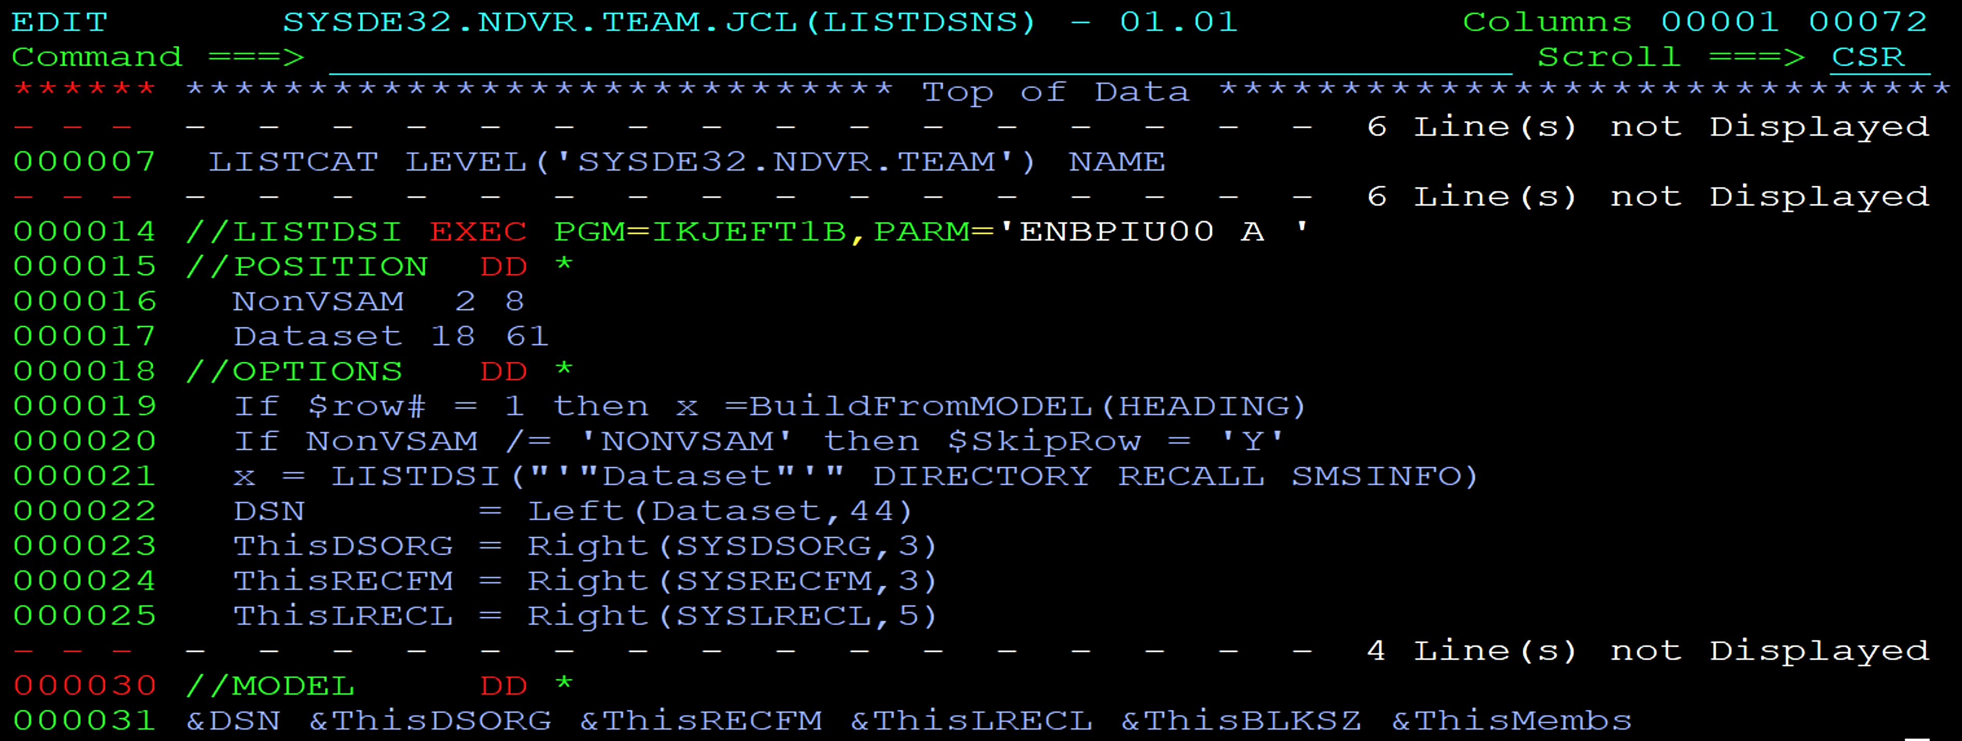
Dataset Reporting Example
Notes:
SYSDE32.NDVR.TEAM.JCL(LISTDSNS)
Here are the two steps in the JCL that produces this report.
Line 7 is the input to the IDCAMS step
Since the Table is not CSV, and does not contain any kind of heading, the Position data is used on the Table Tool step to define variable names and their positions. You can name the variables whatever you want. Just use the same names in your OPTIONS and MODEL as needed.
Line 19 writes the heading
Line 20 selects only those lines from the IDCAMS output that have the literal ‘NONVSAM’ and a dataset name.
Line 21 shows a REXX execution of IBM’s LISTDSI command. LISTDSI gives you back a list of variables with values for a dataset name. In Rexx, you can use a variable for the dataset name.
Lines 22 -25 are using REXX statements to shift left or right the non-blank characters within variable values to improve formatting.
Lines 30 + 31 contain the MODEL – painted output

Slide 48
Dataset Reporting Example
Notes:
SYSDE32.NDVR.TEAM.JCL(LISTDSNS)
A final look at the example report.
You can see the effects of the LEFT and RIGHT commands in the OPTIONS.
Dataset name is shifted LEFT
All the remaining items are shifted to the Right

Slide 49
Dataset Reporting Example opportunities
Find datasets
Empty / Not PDS-E / With wrong blocksizes
Take Action
Delete / Rename / Rebuild datasets
Calculate and Report
Counts / Totals / Averages / Smallest values / Largest values
Report from almost any kind of input
Notes:
SYSDE32.NDVR.TEAM.JCL(LISTDSNS)

Slide 50
Package Monitor Report Example
Table Tool

Slide 51
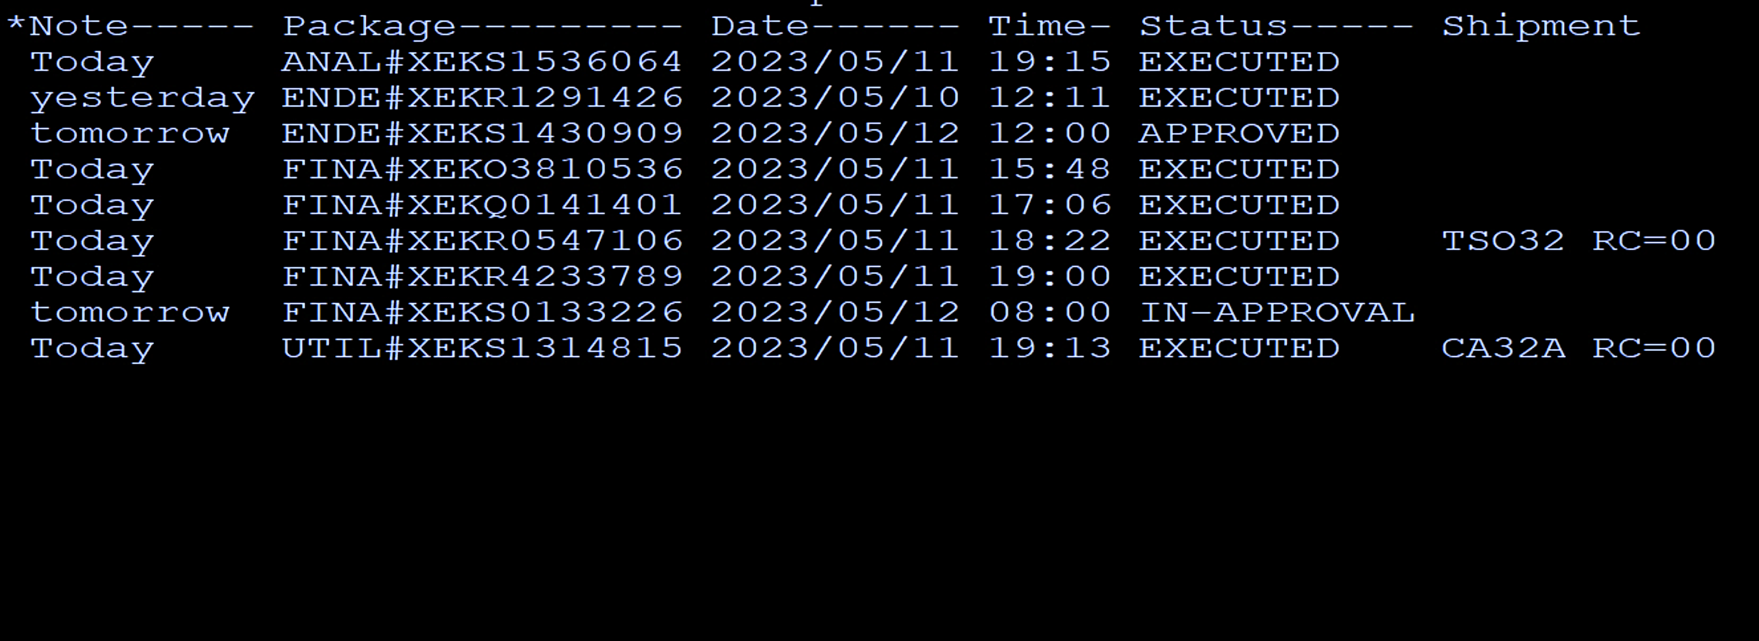
Package Monitor Report Example
Notes:
SYSDE32.NDVR.TEAM.JCL.CSV(PKGEMNTR)

Slide 52
Package Monitor Report Example
Multiple CSV and TblTool steps in 172 lines of JCL
Reported dates are most appropriate for the package status – date Executed or Window date
OPTIONS use
REXX stem arrays to merge data from one CSV step into another
REXX Date functions
Notes:
Rather than maintaining a REXX program as a separate member in another dataset, you can use Rexx statements in-stream to the job step.
You no longer need to swap back and forth between two or more screens to follow the processing. Instead, everything that runs is present in one display.

Slide 53
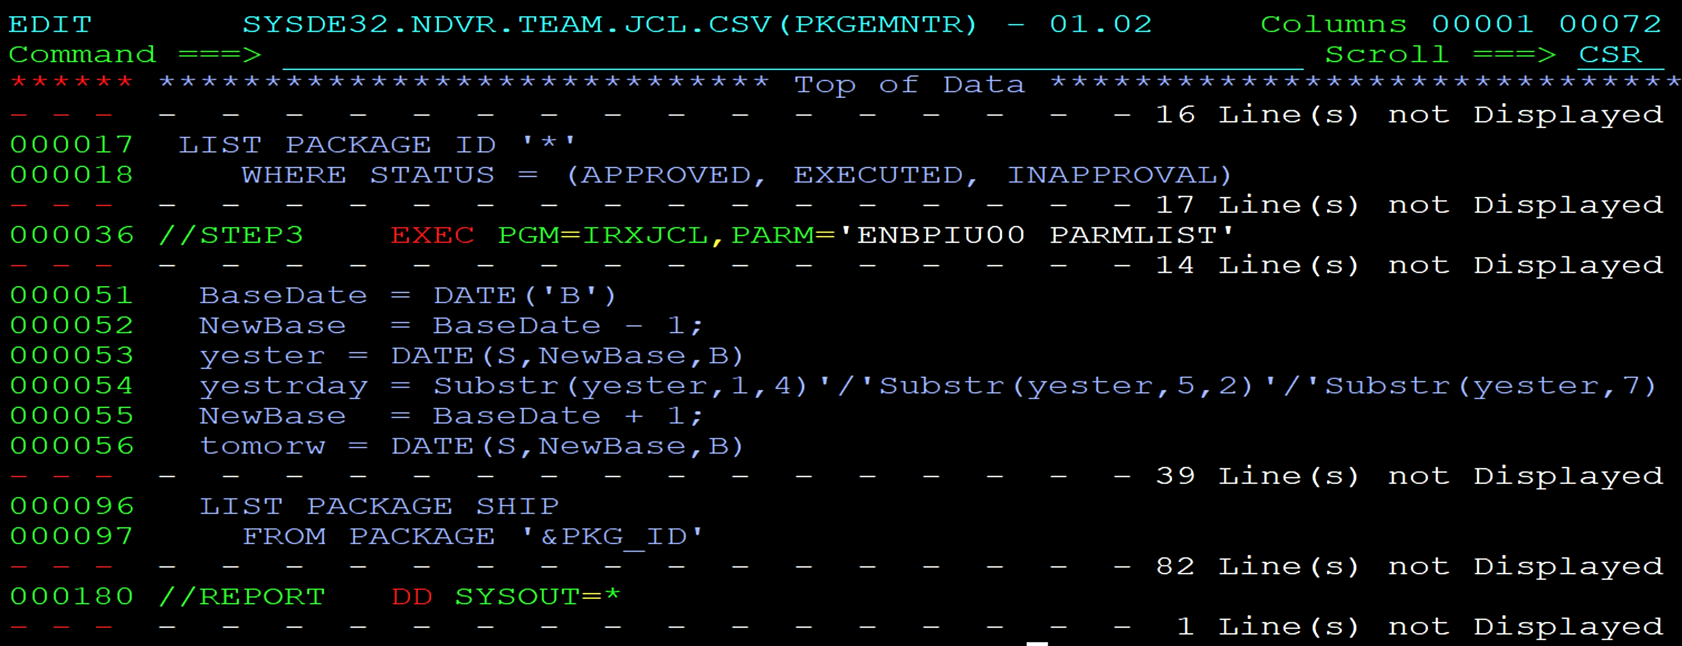
Package Monitor Report Example
Notes:
SYSDE32.NDVR.TEAM.JCL.CSV(PKGEMNTR)

Slide 54
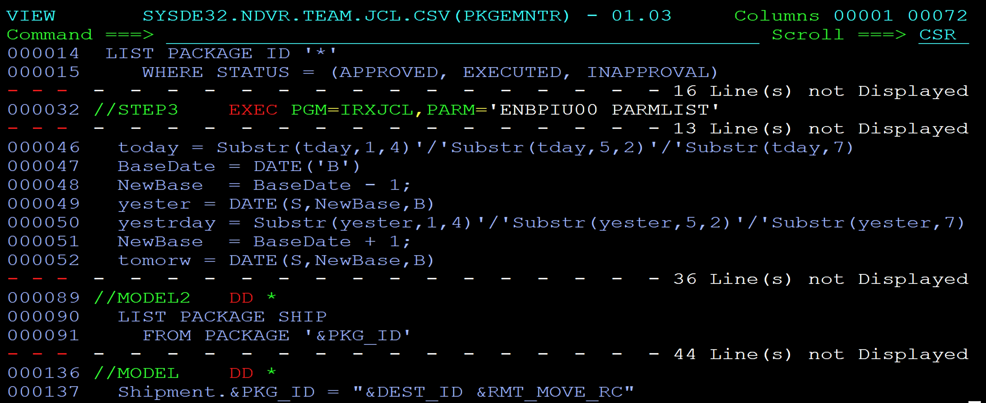
Package Monitor Report Example
Notes:
SYSDE32.NDVR.TEAM.JCL.CSV(PKGEMNTR)

Slide 55
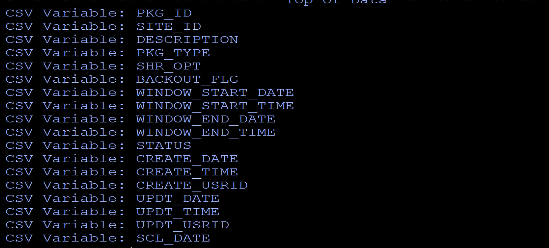
Package Monitor Report Example
Notes:
SYSDE32.NDVR.TEAM.JCL.CSV(PKGEMNTR)

Slide 56
Package Monitor Report Example
Notes:
SYSDE32.NDVR.TEAM.JCL.CSV(PKGEMNTR)

Slide 57
Use cases beyond the examples Additonal Table Tool Features
PARMLISTS
One step to make multiple passes though a table
Calculating totals, averages, counts etd
Merging content of one table with another
Parameter values for testing and Table searching
Multiple MODELs / Multiple TBLOUTs
Special considerations for Endevor processors
Notes:
Rather than maintaining a REXX program as a separate member in another dataset, you can use Rexx statements in-stream to the job step.
You no longer need to swap back and forth between two or more screens to follow the processing. Instead, everything that runs is present in one display.

Slide 58
Table TOOL PARMLIST building a Report with Summary
//STEP2 EXEC PGM=IRXJCL,PARM='ENBPIU00 PARMLIST'
//PARMLIST DD *
Model Tblout Options parm
Model Tblout Options parm
Model Tblout Options parm
Notes:
SYSDE32.NDVR.TEAM.JCL.CSV(CLEANOVR)

Slide 59
Table TOOL PARMLIST building a Report with Summary
//STEP2 EXEC PGM=IRXJCL,PARM='ENBPIU00 PARMLIST'
//PARMLIST DD *
MODEL1 REPORT1 OPTIONS1 A
MODEL2 REPORT2 OPTIONS2 A
MODEL3 REPORT3 OPTIONS3 A
Notes:
SYSDE32.NDVR.TEAM.JCL.CSV(CLEANOVR)

Slide 60
Table TOOL PARMLIST building a Report with Summary
//STEP2 EXEC PGM=IRXJCL,PARM='ENBPIU00 PARMLIST'
//PARMLIST DD *
Model Tblout Options parm
Model Tblout Options parm
Model Tblout Options parm
Notes:
SYSDE32.NDVR.TEAM.JCL.CSV(CLEANOVR)

Slide 61
Table TOOL PARMLIST building a Report with Summary
//STEP2 EXEC PGM=IRXJCL,PARM='ENBPIU00 PARMLIST'
//PARMLIST DD *
NOTHING NOTHING DEFAULTS 0
Model Tblout Options parm
Model Tblout Options parm
//NOTHING DD DUMMY
//DEFAULTS DD *
myCount = 0
myTotal = 0
Notes:
SYSDE32.NDVR.TEAM.JCL.CSV(CLEANOVR)

Slide 62
Table TOOL PARMLIST building a Report with Summary
//STEP2 EXEC PGM=IRXJCL,PARM='ENBPIU00 PARMLIST'
//PARMLIST DD *
NOTHING NOTHING DEFAULTS 0
MODEL REPORT COUNTEM A
Model Tblout Options parm
//COUNTEM DD *
If $row# = 0 then $SkipRow = 'Y'
myCount = myCount + 1
myTotal = myTotal + somenumber
//MODEL DD * <- MODEL for REPORT detail line
. . .
//REPORT DD SYSOUT=*
Notes:
SYSDE32.NDVR.TEAM.JCL.CSV(CLEANOVR)

Slide 63
Table TOOL PARMLIST building a Report with Summary
//STEP2 EXEC PGM=IRXJCL,PARM='ENBPIU00 PARMLIST'
//PARMLIST DD *
NOTHING NOTHING DEFAULTS 0
MODEL REPORT COUNTEM A
SUMMARY REPORT CALCS 1
//SUMMARY DD * <- MODEL for REPORT Summary
Count = &myCount
Total = &myTotal
Average = &myAverage
//CALCS DD *
If myCount = 0 then Exit(4)
myAverage = myTotal / myCount
//REPORT DD SYSOUT=*
Notes:
SYSDE32.NDVR.TEAM.JCL.CSV(CLEANOVR)

Slide 64
Table TOOL PARMLIST building a Report with Summary
Notes:
SYSDE32.NDVR.TEAM.JCL.CSV(CLEANOVR)

Slide 65
Use cases beyond the examples Endevor administration
System Approver definitions
Report Systems using the stage 1 processor library
Validate components across a list of packages
Report unused processors
Element counts by processor group
Build Site Symbols or ESMTPTBL source
Endevor processor examples (next slide)
Notes:
Rather than maintaining a REXX program as a separate member in another dataset, you can use Rexx statements in-stream to the job step.
You no longer need to swap back and forth between two or more screens to follow the processing. Instead, everything that runs is present in one display.

Slide 66
Use cases beyond the examples Endevor processors
Move processor to build BSTCOPY commands from the component list
Steps for CICS newcopy and DB2 Bind statements
Step to build ACM RELATES from a JCLCHECK “XREF” file.
Processor to Append an entry onto the CCID validation file
Automated Testing as a Generate or Move action
Notes:
Rather than maintaining a REXX program as a separate member in another dataset, you can use Rexx statements in-stream to the job step.
You no longer need to swap back and forth between two or more screens to follow the processing. Instead, everything that runs is present in one display.

Slide 67
WHERE TO GET MORE INFORMATION
INFO

Slide 68
WHERE TO GET MORE INFORMATION
Tech Docs Documentation
https://techdocs.broadcom.com/us/en/ca-mainframe-software/devops/ca-endevor-software-change-manager/18-1/administrating/table-tool.html
Broadcom Product Scripts (watch for updates here)
https://github.com/BroadcomMFD/broadcom-product-scripts
Table Tool Examples (Endevor community site)
https://community.broadcom.com/mainframesoftware/viewdocument/table-tool-examples-2020-june?CommunityKey=592eb6c9-73f7-460f-9aa9-e5194cdafcd2&tab=librarydocuments&LibraryFolderKey=&DefaultView=folder
Mainframe Tech Exchange (2022) https://gateway.on24.com/wcc/eh/3686843/lp/3895281/cim14-s-a-general-and-versatile-utility-for-endevor-users

Slide 69
Questions

