Slide 1
Endevor Eclipse Usage step-by-step
Bernie Beriau
July 2019
Notes:
<audio>
Welcome to the <Product>, <Topic> video.
</audio>

Slide 2
© 2019 Broadcom. All rights reserved. Broadcom confidential & proprietary information. The term “Broadcom” refers to Broadcom Inc. and/or its subsidiaries. For Broadcom, Broadcom Partner and Broadcom Customer use only. No unauthorized use, copying or distribution. All names of individuals or of companies referenced herein are fictitious names used for instructional purposes only. Any similarity to any real persons or businesses is purely coincidental. All trademarks, trade names, service marks and logos referenced herein belong to their respective companies. These Materials are for your informational purposes only, and do not form any type of warranty. The use of any software or product referenced in the Materials is governed by the end user’s applicable license agreement. Broadcom is the manufacturer of these Materials. Provided with “Restricted Rights.”
Yes
Select Yes to accept terms and begin the course, otherwise select Exit.

Slide 3
Questions to answer
I now have Endevor Eclipse and Endevor Web Services running, so how do I go about working with Endevor through the Eclipse Plug-in?
What are my first steps?
What is the difference between Repository and Project?
How do I tell if everything is working?
Notes:
Reading from left to right, Background/Problems were viewed, the developers made suggestions and requirements, proposed the solution items and outlined the benefits.

Slide 4
Agenda
REQUIRED SLIDE ~WBT ~ILT
Tasks
A module contains at least one task. A task defines a job activity that results in an observable end product. Typically, a task is composed of one or more procedures, which can be interactive demonstrations or demonstrations. A task is written in sentence case.
Add Repository
Add Project
View Elements
Add Element to project
Edit Element
Update Element into Endevor
This slide, listing the objectives for this module or course, lets the learner know what is covered in this training and why they need to know it. Use action words like ‘Explain’ or ‘Describe’ when listing the objectives as this provides the learner with concrete skills that can be measured. Avoid using words like ‘Understand’, for example.
<1> wbt nav tree
Notes:
<audio>
</audio>

Slide 5
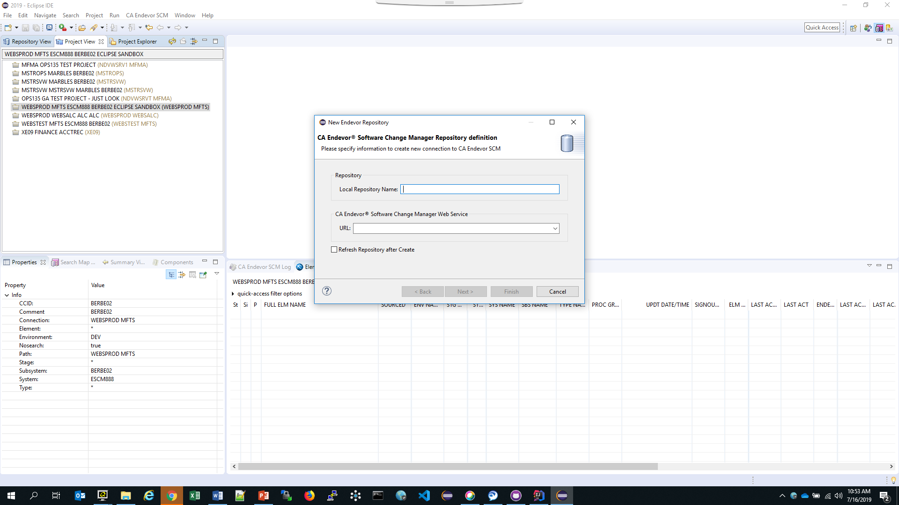
Add a Repository
Identify a repository
Click on NEW RESPOSITORY to invoke the wizard.
Notes:
Because CA purchased MANY software products over the years from multiple companies, their methodologies for source management and product delivery were very diverse. All had some pro’s and con’s, but after analysis and demonstrations by the experts, the best part of all the different utilities, tools and techniques were identified and marked for inclusion into the application to be used.

Slide 6
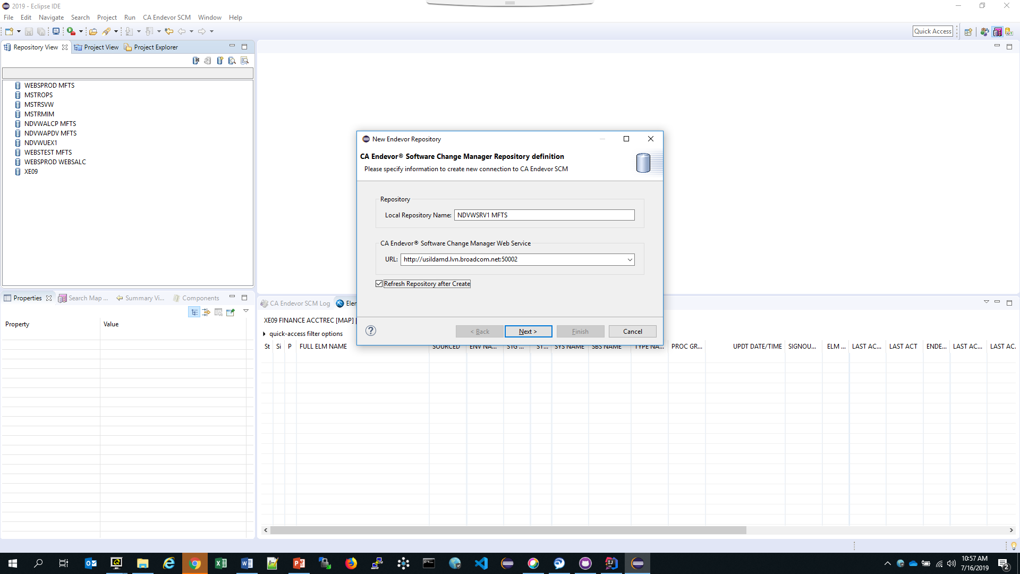
Add a Repository
Identify a repository
Supply a name that identifies the repository and provide URL of the Web Service and Port.
Notes:
Because CA purchased MANY software products over the years from multiple companies, their methodologies for source management and product delivery were very diverse. All had some pro’s and con’s, but after analysis and demonstrations by the experts, the best part of all the different utilities, tools and techniques were identified and marked for inclusion into the application to be used.

Slide 7
Add a Repository
Identify a repository
Supply a name that identifies the repository and provide URL of the Web Service and Port.
Click NEXT
Notes:
Because CA purchased MANY software products over the years from multiple companies, their methodologies for source management and product delivery were very diverse. All had some pro’s and con’s, but after analysis and demonstrations by the experts, the best part of all the different utilities, tools and techniques were identified and marked for inclusion into the application to be used.

Slide 8
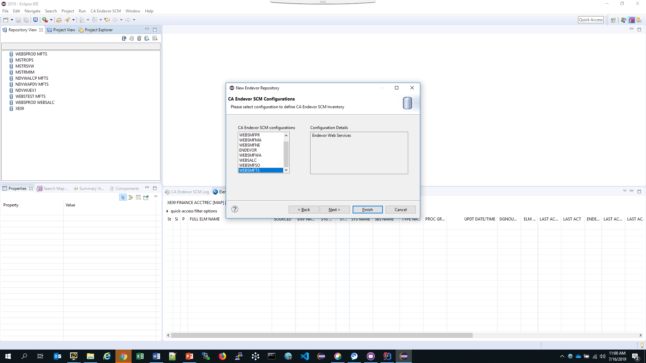
Add a Repository
Identify a repository
Select the Web Service (C1DEFLTS Table) that contains the inventory you desire
Click FINISH
Notes:
Because CA purchased MANY software products over the years from multiple companies, their methodologies for source management and product delivery were very diverse. All had some pro’s and con’s, but after analysis and demonstrations by the experts, the best part of all the different utilities, tools and techniques were identified and marked for inclusion into the application to be used.

Slide 9
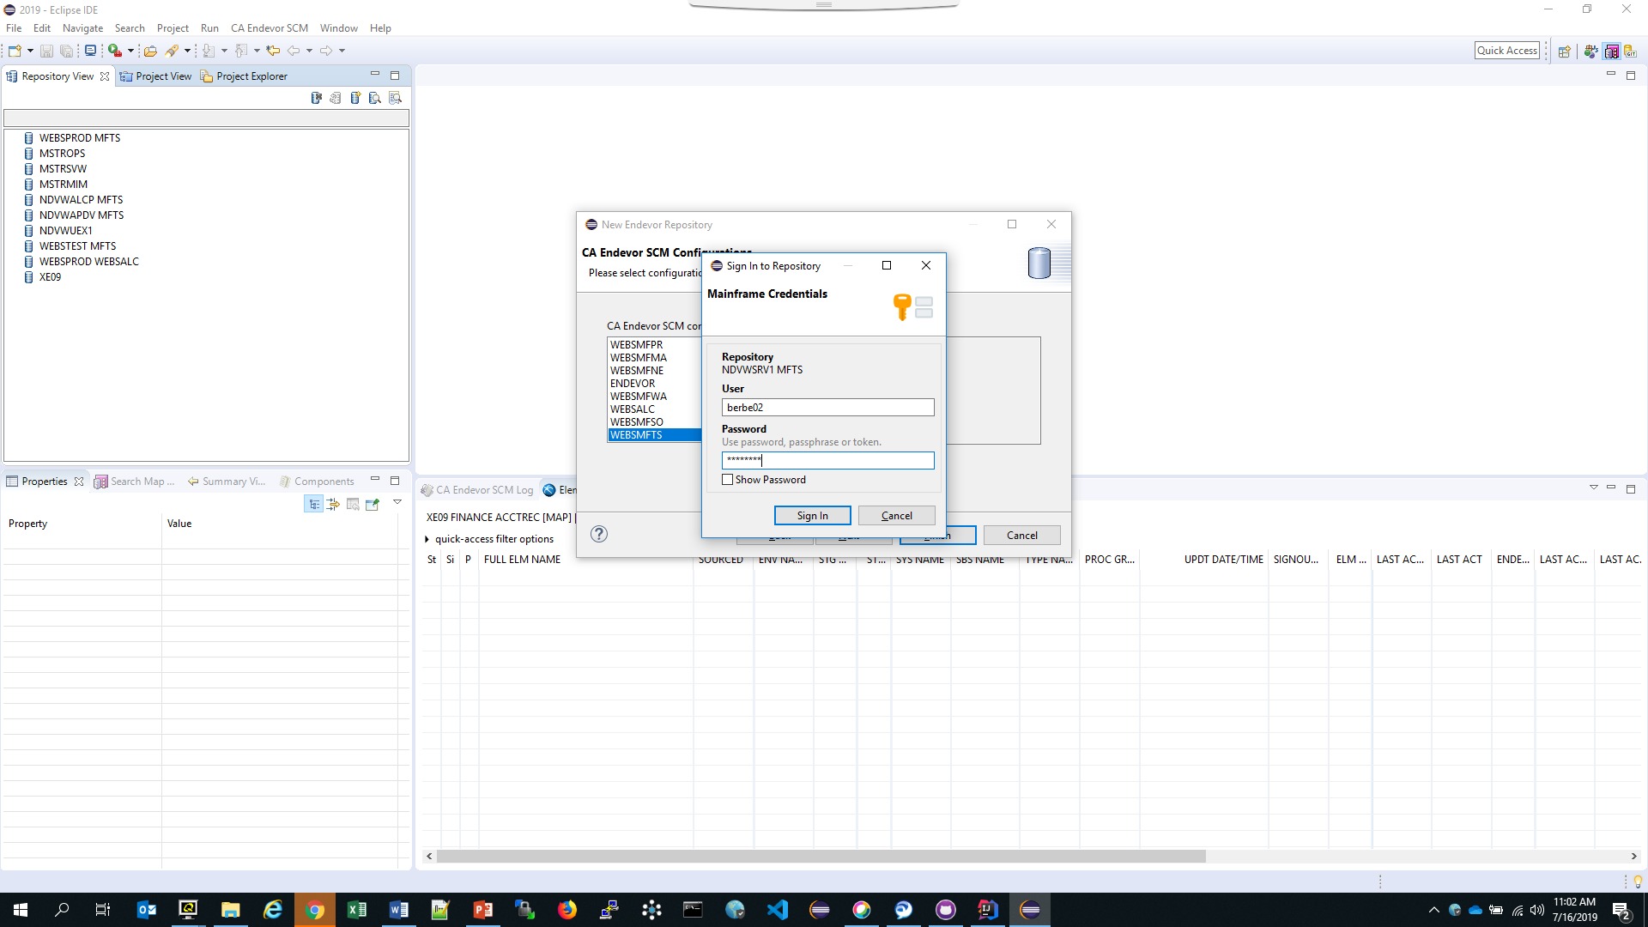
Add a Repository
Identify a repository
Supply the TSO Userid and Password
Click Sign In
Notes:
Because CA purchased MANY software products over the years from multiple companies, their methodologies for source management and product delivery were very diverse. All had some pro’s and con’s, but after analysis and demonstrations by the experts, the best part of all the different utilities, tools and techniques were identified and marked for inclusion into the application to be used.

Slide 10
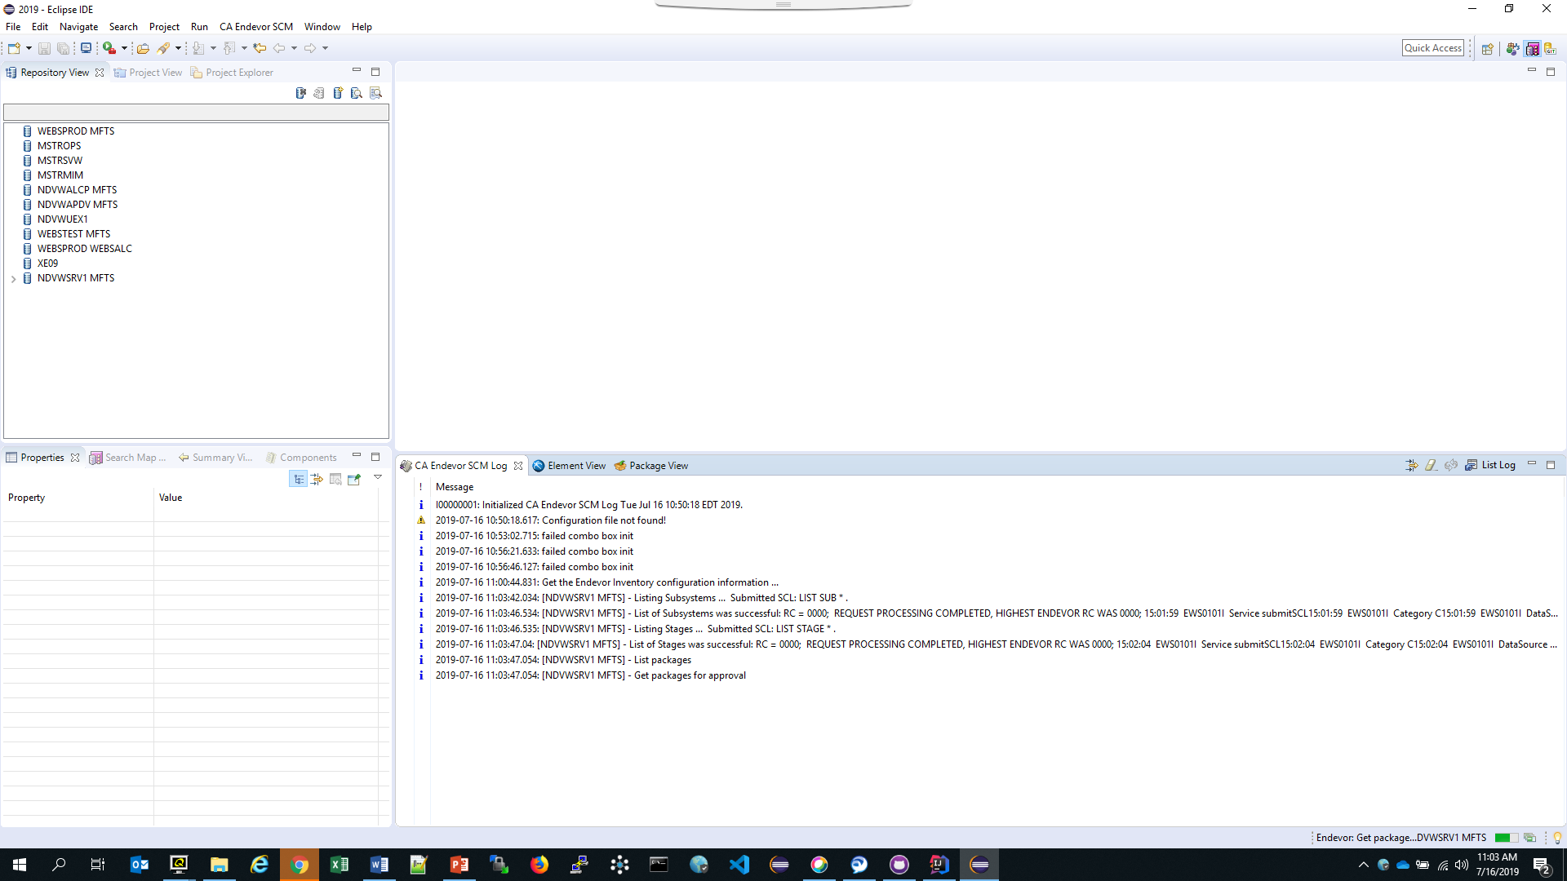
Add a Repository
Look at the SCM Log and Repository View for success
Note the Caret to the left of the repository
Notes:
Because CA purchased MANY software products over the years from multiple companies, their methodologies for source management and product delivery were very diverse. All had some pro’s and con’s, but after analysis and demonstrations by the experts, the best part of all the different utilities, tools and techniques were identified and marked for inclusion into the application to be used.

Slide 11
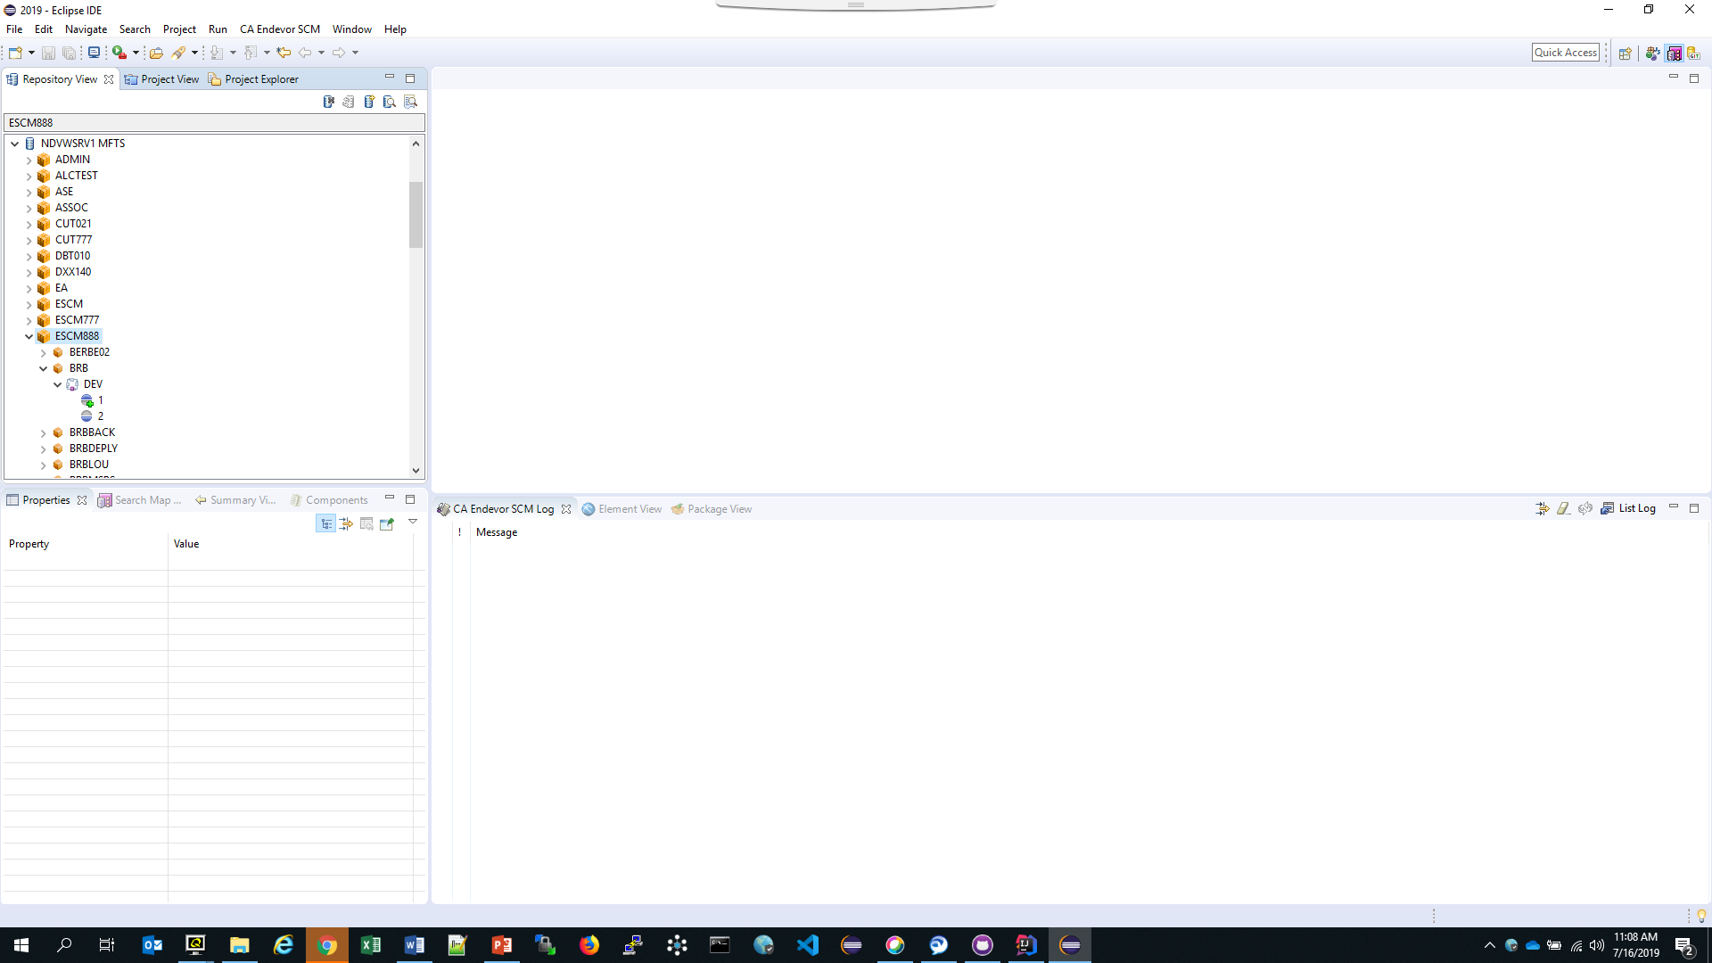
Add a Project
Obtain the list of Endevor Systems
Drill down to the Endevor inventory you want to work with
The inventory in this case is:
System: ESCM888
Subsystem: BRB
Environment: DEV
Note the + sign next to the Stage #1. This indicates the ENTRY stage.
Notes:
Because CA purchased MANY software products over the years from multiple companies, their methodologies for source management and product delivery were very diverse. All had some pro’s and con’s, but after analysis and demonstrations by the experts, the best part of all the different utilities, tools and techniques were identified and marked for inclusion into the application to be used.

Slide 12
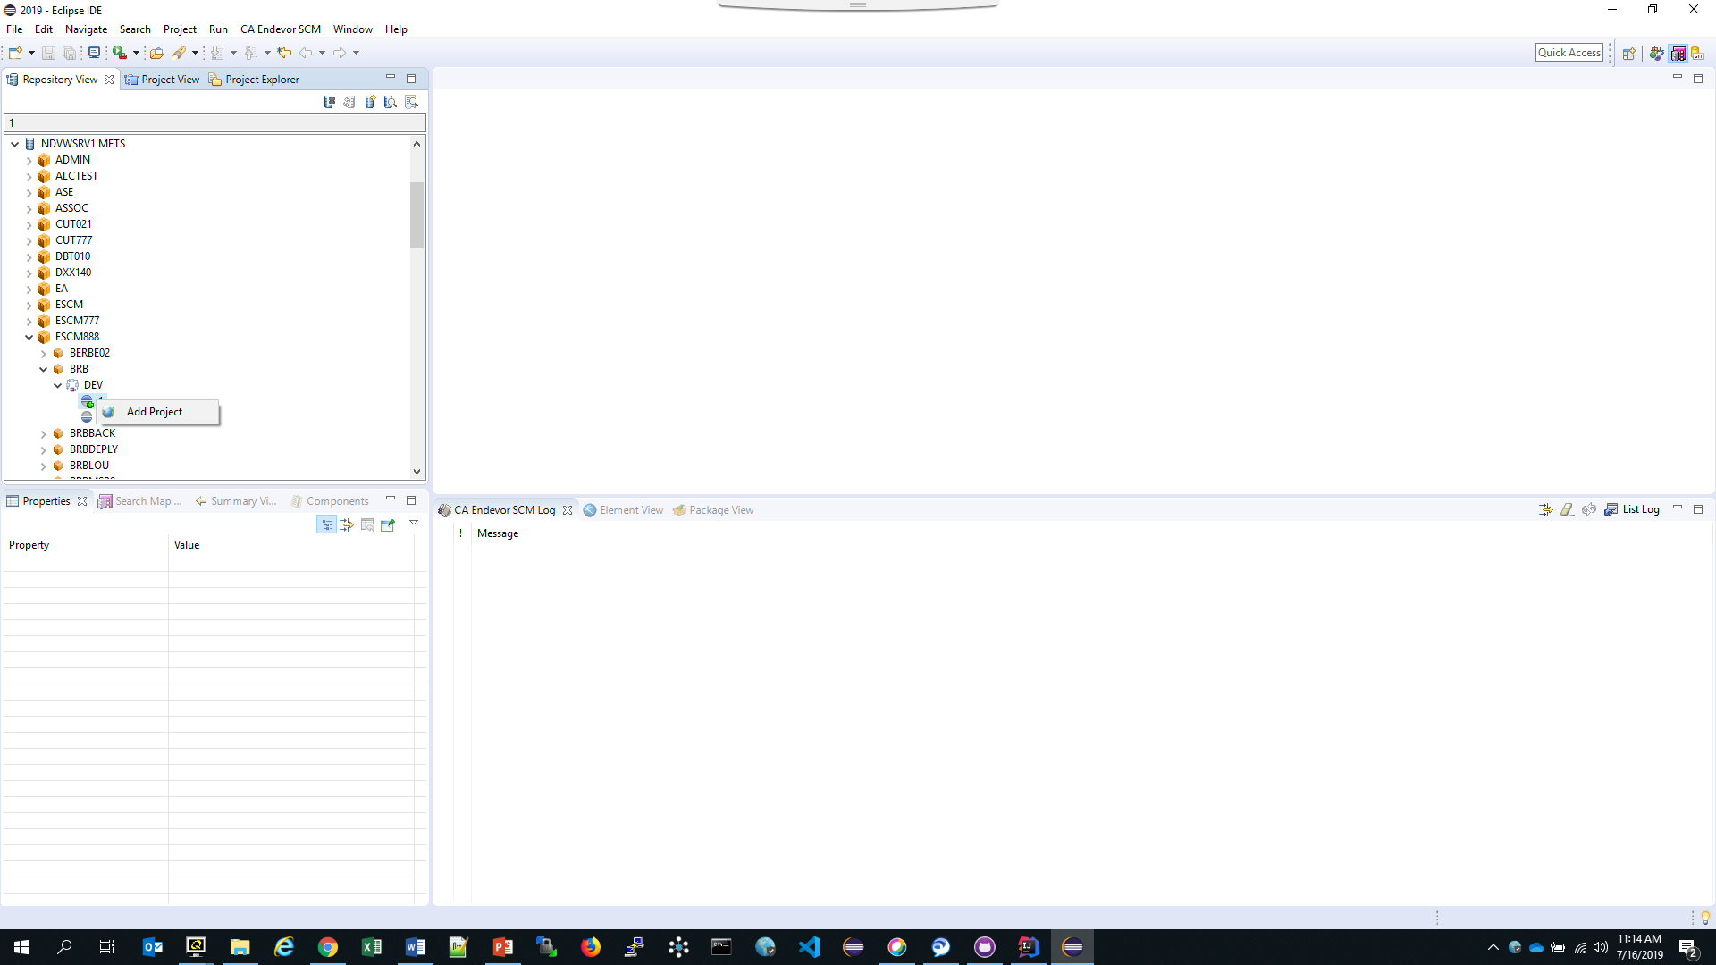
Add a Project
Add a Project
Right Mouse click the Entry Stage and see
ADD PROJECT
Then Left Mouse Click to invoke the wizard
Notes:
Because CA purchased MANY software products over the years from multiple companies, their methodologies for source management and product delivery were very diverse. All had some pro’s and con’s, but after analysis and demonstrations by the experts, the best part of all the different utilities, tools and techniques were identified and marked for inclusion into the application to be used.

Slide 13
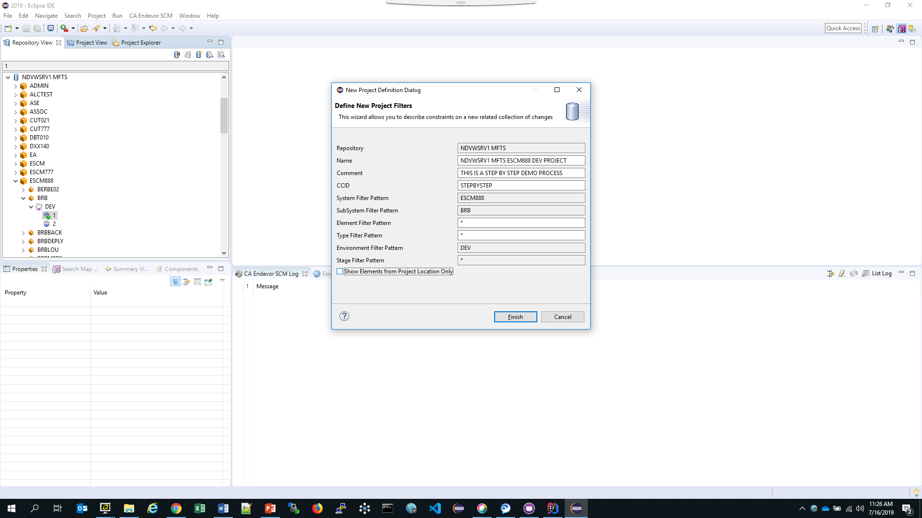
Add a Project
Define the Project Filters
Enter details about this project:
NAME: Something useful perhaps?
COMMENT: Used for ALL Endevor Actions
CCID: Denotes the Change Control ID
Make sure to uncheck the Show Elements from Project Location Only box
Click FINISH and watch the Log.
Notes:
Because CA purchased MANY software products over the years from multiple companies, their methodologies for source management and product delivery were very diverse. All had some pro’s and con’s, but after analysis and demonstrations by the experts, the best part of all the different utilities, tools and techniques were identified and marked for inclusion into the application to be used.

Slide 14
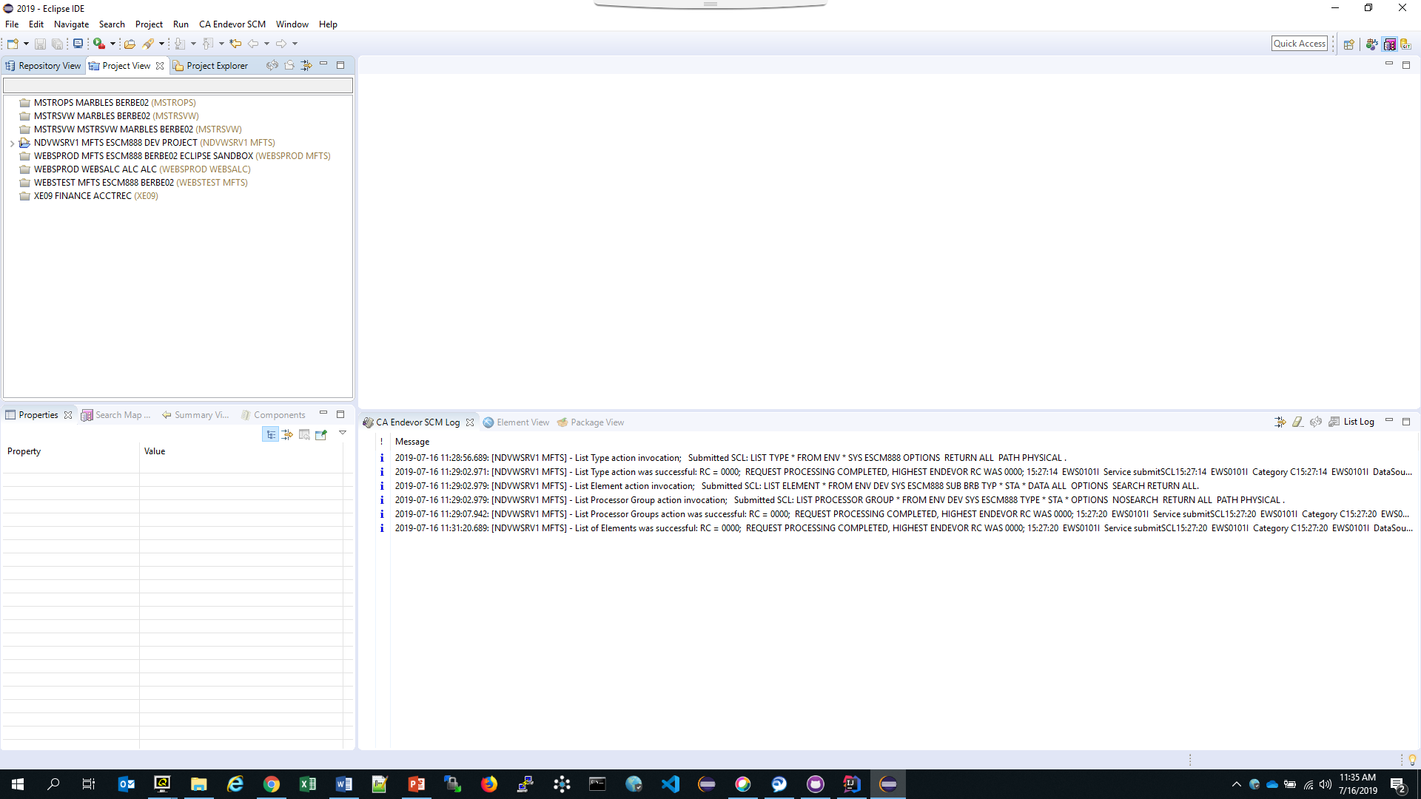
Add a Project
Success?
The Project will be defined and a caret to the left of the project will indicate a view will be available.
Left Mouse Click on the caret to expand the view.
Notes:
Because CA purchased MANY software products over the years from multiple companies, their methodologies for source management and product delivery were very diverse. All had some pro’s and con’s, but after analysis and demonstrations by the experts, the best part of all the different utilities, tools and techniques were identified and marked for inclusion into the application to be used.

Slide 15
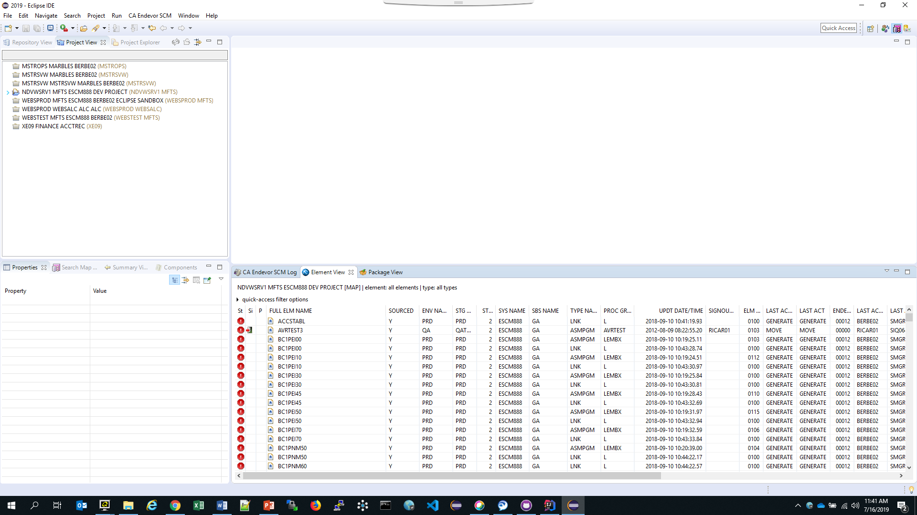
View Elements
Once Project defined, the elements will be displayed in the Element View
Click on the Element View
Tab to see the
Elements in the inventory
Notes:
Because CA purchased MANY software products over the years from multiple companies, their methodologies for source management and product delivery were very diverse. All had some pro’s and con’s, but after analysis and demonstrations by the experts, the best part of all the different utilities, tools and techniques were identified and marked for inclusion into the application to be used.

Slide 16
Add Elements to Project
Expand the Project
Click the caret to the left of the Project to view the folders to work in
Notes:
Because CA purchased MANY software products over the years from multiple companies, their methodologies for source management and product delivery were very diverse. All had some pro’s and con’s, but after analysis and demonstrations by the experts, the best part of all the different utilities, tools and techniques were identified and marked for inclusion into the application to be used.

Slide 17
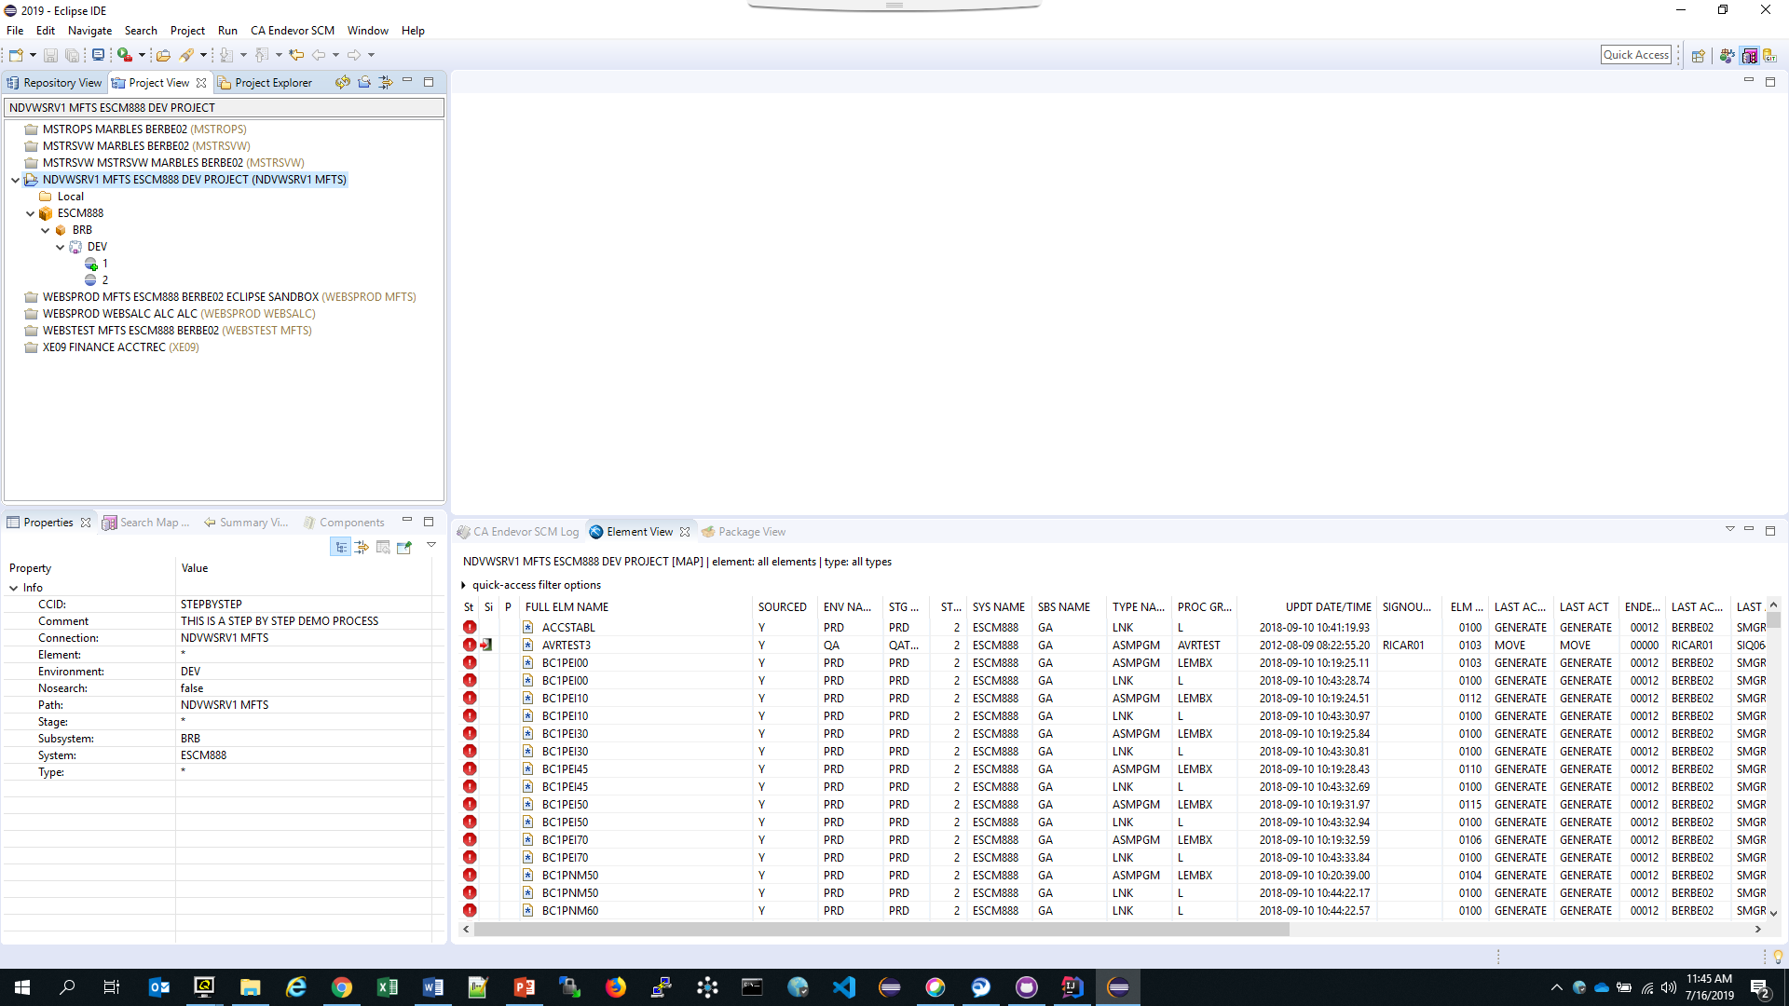
Add Elements to Project
Expand the Project
Note the LOCAL folder has no caret to the left of it.
This means that it is empty and ready for action.
The next step is to find the element to be modified for source change.
Notes:
Because CA purchased MANY software products over the years from multiple companies, their methodologies for source management and product delivery were very diverse. All had some pro’s and con’s, but after analysis and demonstrations by the experts, the best part of all the different utilities, tools and techniques were identified and marked for inclusion into the application to be used.

Slide 18
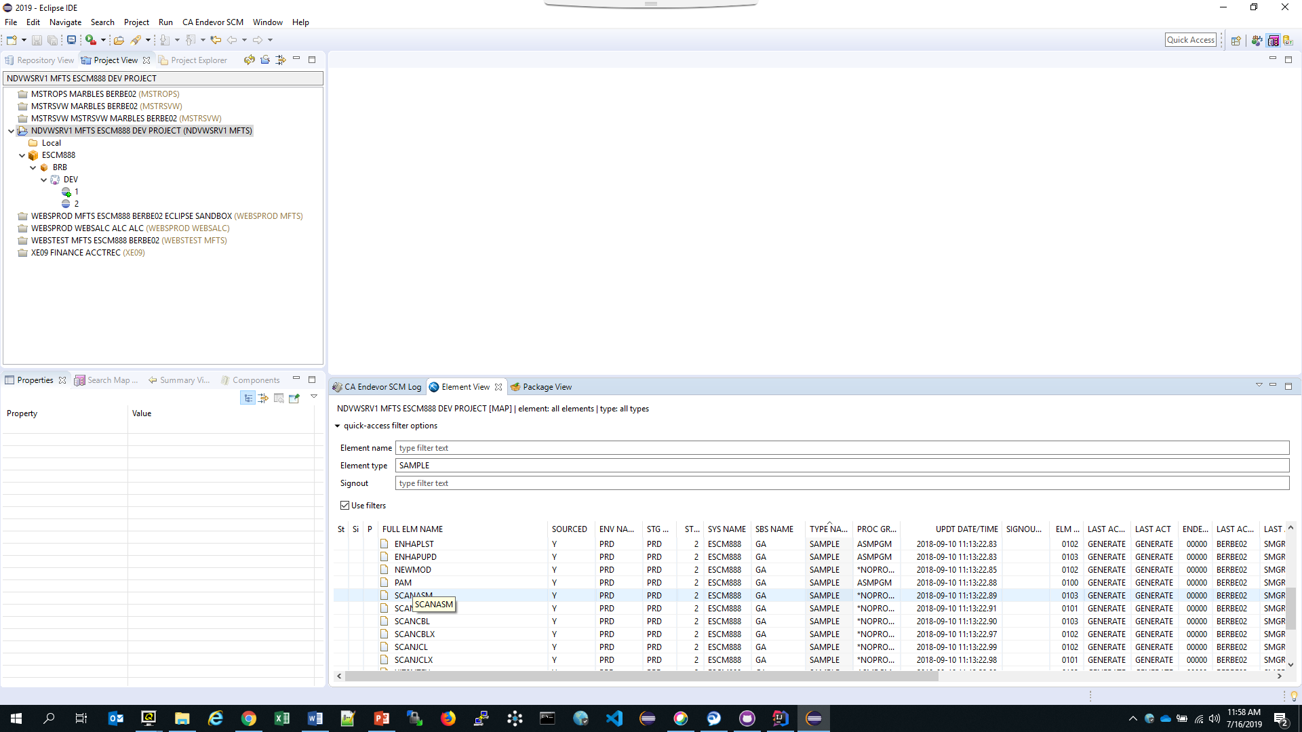
Add Elements to Project
The caret for Quick-Access filter options will display a filter.
This filter is set for TYPE SAMPLE.
The element list is only SAMPLE types.
Hovering over the element will display the name.
Right mouse click allows for ADD TO PROJECT.
Select the element
Notes:
Because CA purchased MANY software products over the years from multiple companies, their methodologies for source management and product delivery were very diverse. All had some pro’s and con’s, but after analysis and demonstrations by the experts, the best part of all the different utilities, tools and techniques were identified and marked for inclusion into the application to be used.

Slide 19
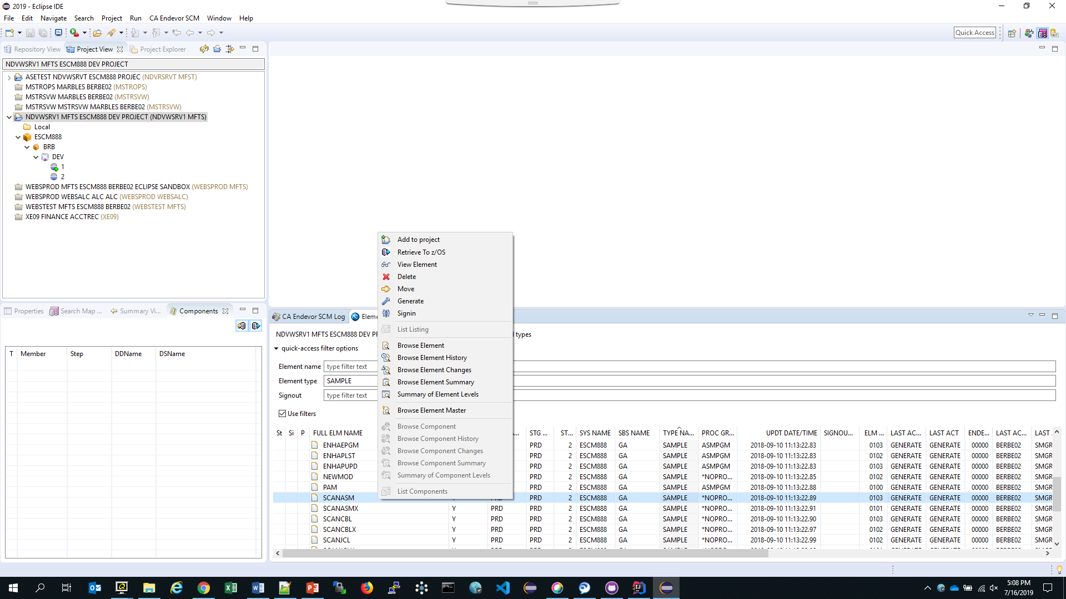
Add Elements to Project
The Right mouse click offers different options for manipulating elements, but the key one here is to add the element to your local directory.
Add to Project
Notes:
Because CA purchased MANY software products over the years from multiple companies, their methodologies for source management and product delivery were very diverse. All had some pro’s and con’s, but after analysis and demonstrations by the experts, the best part of all the different utilities, tools and techniques were identified and marked for inclusion into the application to be used.

Slide 20
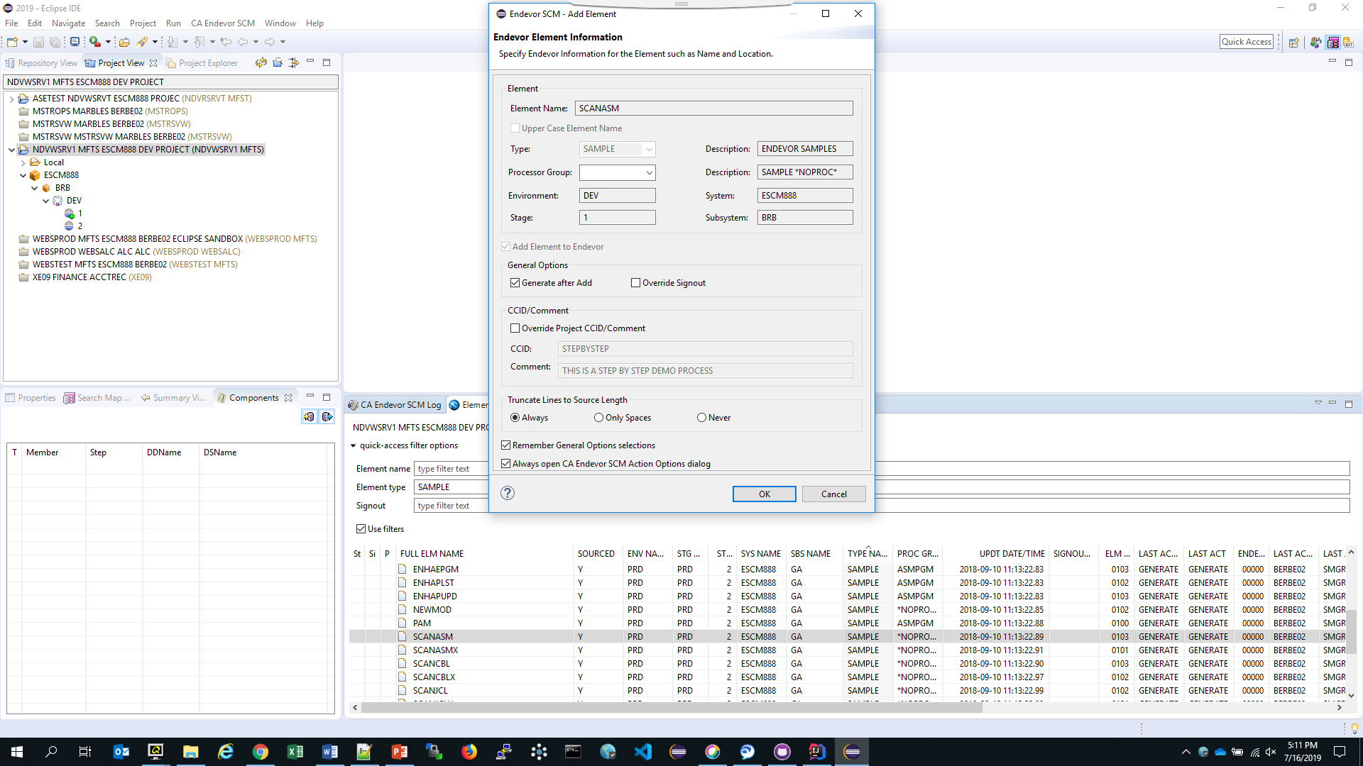
Add Elements to Project
The wizard will offer options.
Select ALWAYS TRUNCATE TO SOURCE LENGTH and
REMEMBER GENERAL OPTIONS.
Click OK
Add to Project
Notes:
Because CA purchased MANY software products over the years from multiple companies, their methodologies for source management and product delivery were very diverse. All had some pro’s and con’s, but after analysis and demonstrations by the experts, the best part of all the different utilities, tools and techniques were identified and marked for inclusion into the application to be used.

Slide 21
Add Elements to Project
The wizard will offer options.
Select ALWAYS TRUNCATE TO SOURCE LENGTH and
REMEMBER GENERAL OPTIONS.
Click OK
If the element is not signed out a prompt asking to signout.
Select YES.
Add to Project
Notes:
Because CA purchased MANY software products over the years from multiple companies, their methodologies for source management and product delivery were very diverse. All had some pro’s and con’s, but after analysis and demonstrations by the experts, the best part of all the different utilities, tools and techniques were identified and marked for inclusion into the application to be used.

Slide 22
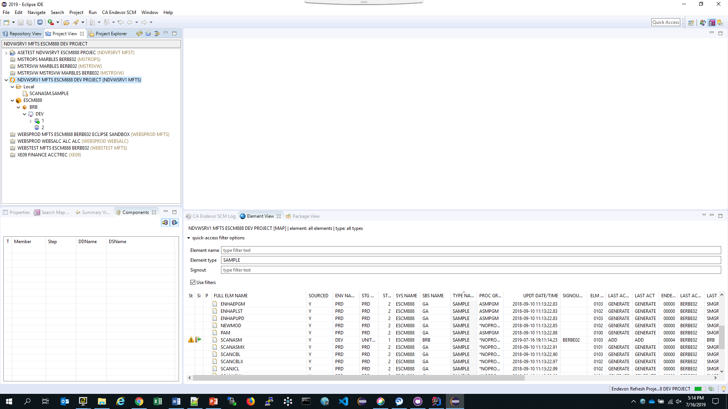
Edit Element
When the element is in the local directory, it is signified by the caret to the left of the local directory.
Expand the director to see the element in the local file.
Doubleclick to Edit the element.
Edit in LOCAL directory
Notes:
Because CA purchased MANY software products over the years from multiple companies, their methodologies for source management and product delivery were very diverse. All had some pro’s and con’s, but after analysis and demonstrations by the experts, the best part of all the different utilities, tools and techniques were identified and marked for inclusion into the application to be used.

Slide 23
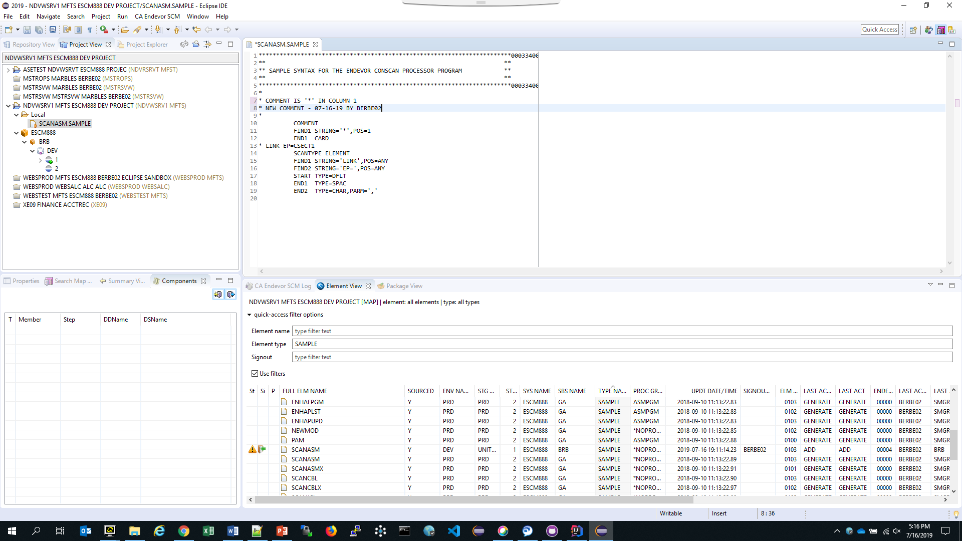
Edit Element
Line 8 was changed by comments.
Element must be saved now in local directory.
Edit in LOCAL directory
Notes:
Because CA purchased MANY software products over the years from multiple companies, their methodologies for source management and product delivery were very diverse. All had some pro’s and con’s, but after analysis and demonstrations by the experts, the best part of all the different utilities, tools and techniques were identified and marked for inclusion into the application to be used.

Slide 24
Edit Element
Once saved, there is a + sign next to the element in the local directory.
This means it was edited and must now be added back into Endevor.
Edit in LOCAL directory
Notes:
Because CA purchased MANY software products over the years from multiple companies, their methodologies for source management and product delivery were very diverse. All had some pro’s and con’s, but after analysis and demonstrations by the experts, the best part of all the different utilities, tools and techniques were identified and marked for inclusion into the application to be used.

Slide 25
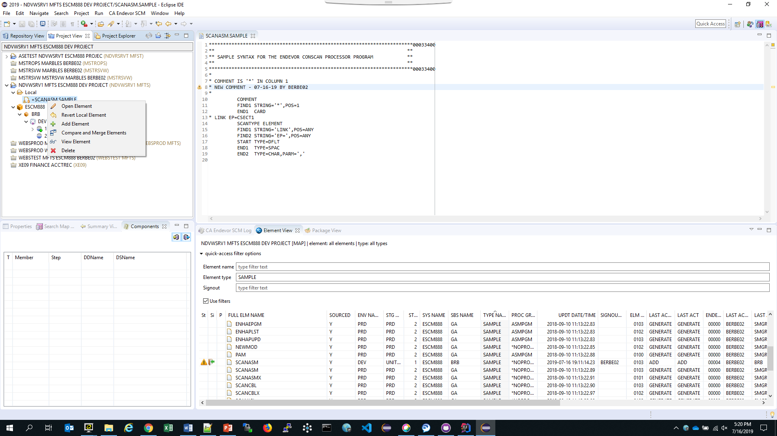
Update element back into Endevor
Right Mouse click element IN the local director for options available to the element.
Click on Add Element
Update Element
Notes:
Because CA purchased MANY software products over the years from multiple companies, their methodologies for source management and product delivery were very diverse. All had some pro’s and con’s, but after analysis and demonstrations by the experts, the best part of all the different utilities, tools and techniques were identified and marked for inclusion into the application to be used.

Slide 26
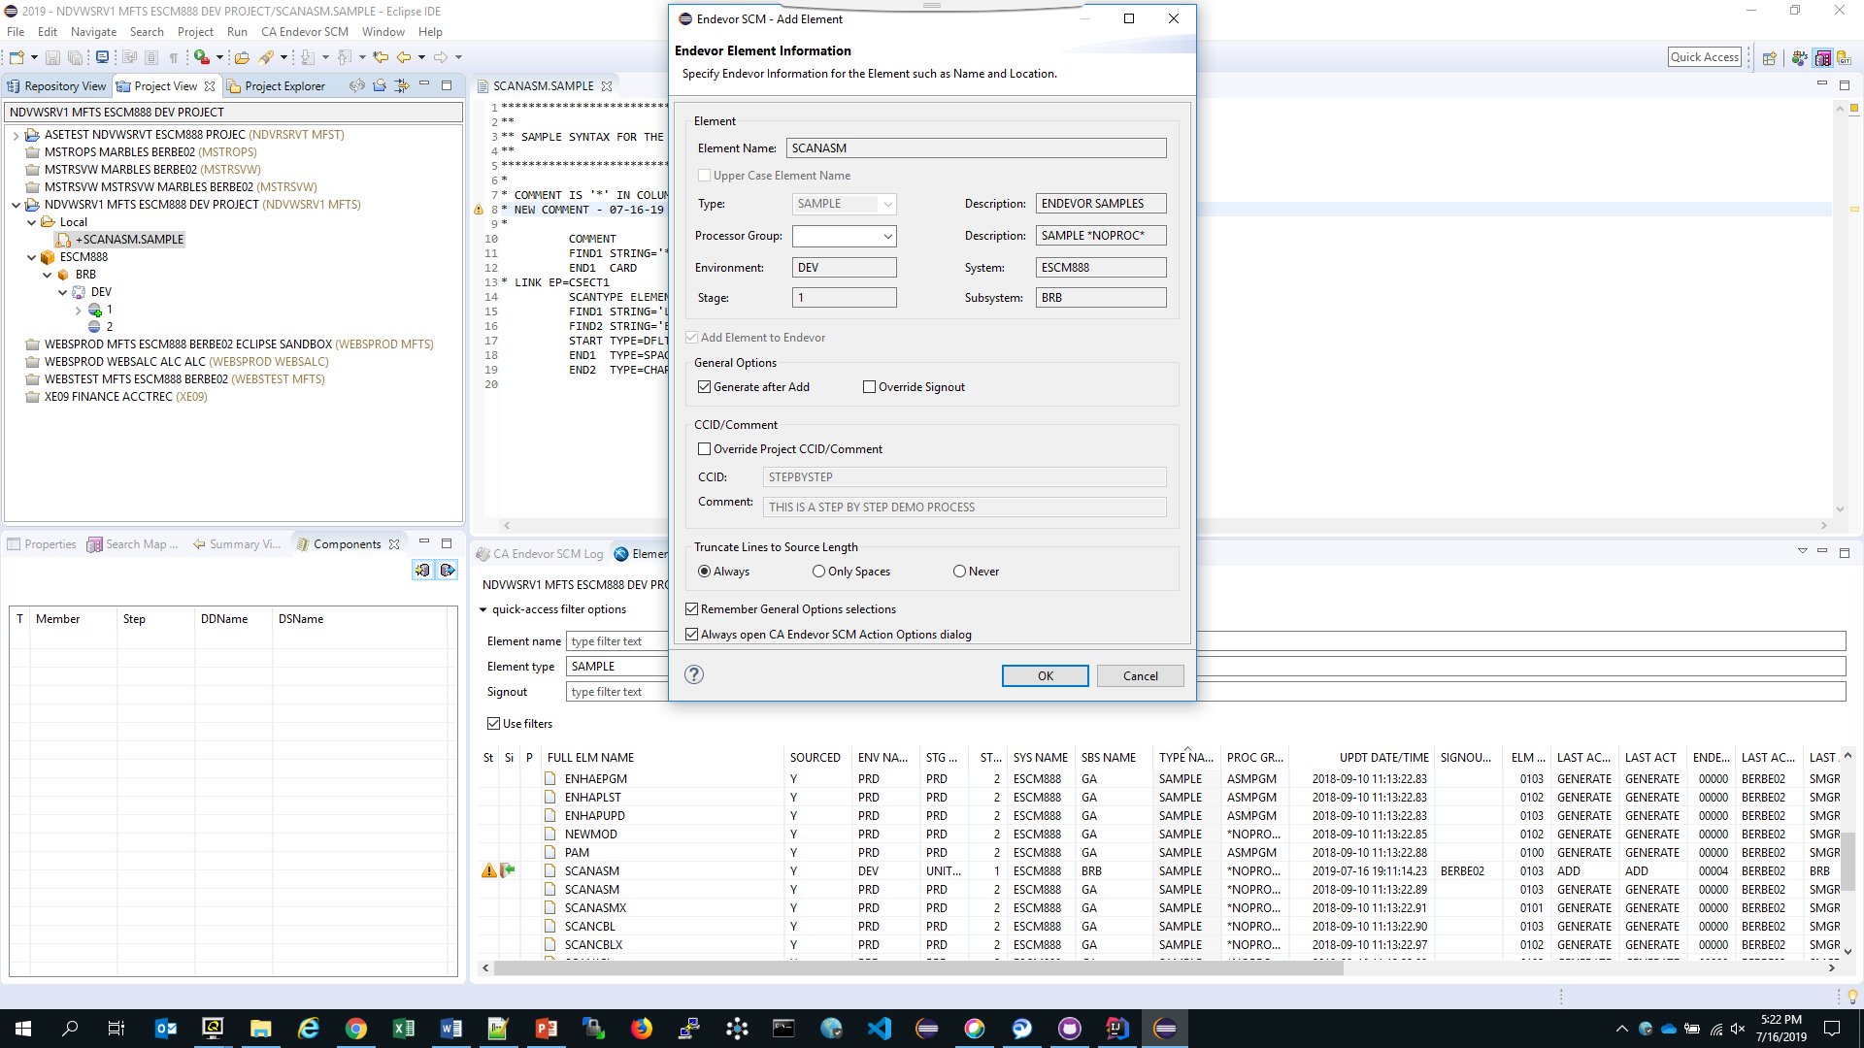
Update element back into Endevor
Satisfy the options.
Reminder:
ALWAYS TRUNCATE TO SOURCE LENGTH
Click OK
Update Element
Notes:
Because CA purchased MANY software products over the years from multiple companies, their methodologies for source management and product delivery were very diverse. All had some pro’s and con’s, but after analysis and demonstrations by the experts, the best part of all the different utilities, tools and techniques were identified and marked for inclusion into the application to be used.

Slide 27
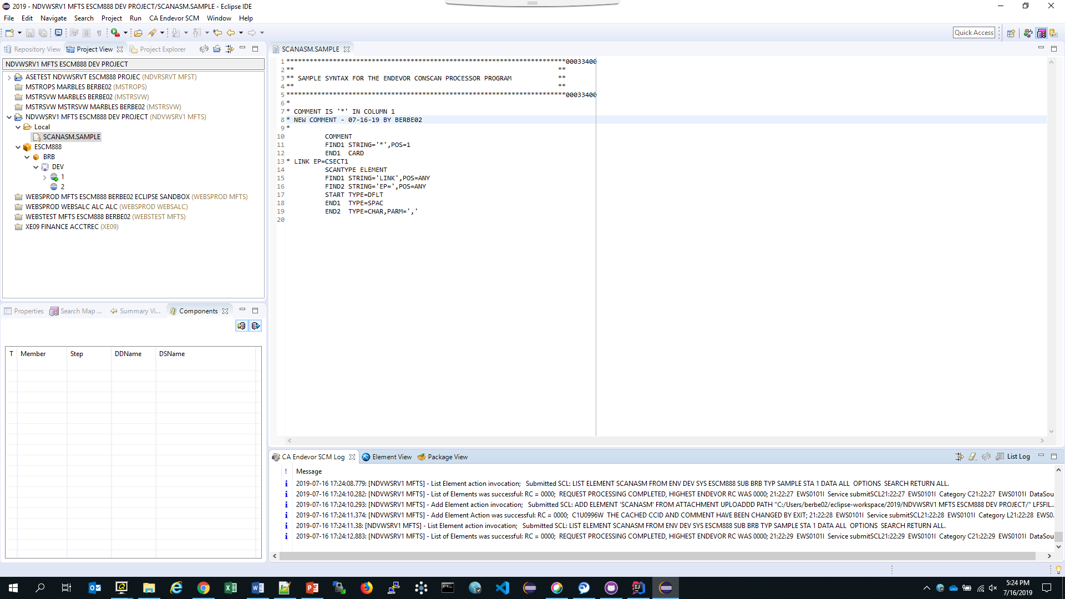
Update element back into Endevor
View the Endevor Log for activity and success.
The + sign is now missing from element in LOCAL Directory
Update Element
Notes:
Because CA purchased MANY software products over the years from multiple companies, their methodologies for source management and product delivery were very diverse. All had some pro’s and con’s, but after analysis and demonstrations by the experts, the best part of all the different utilities, tools and techniques were identified and marked for inclusion into the application to be used.

Slide 28
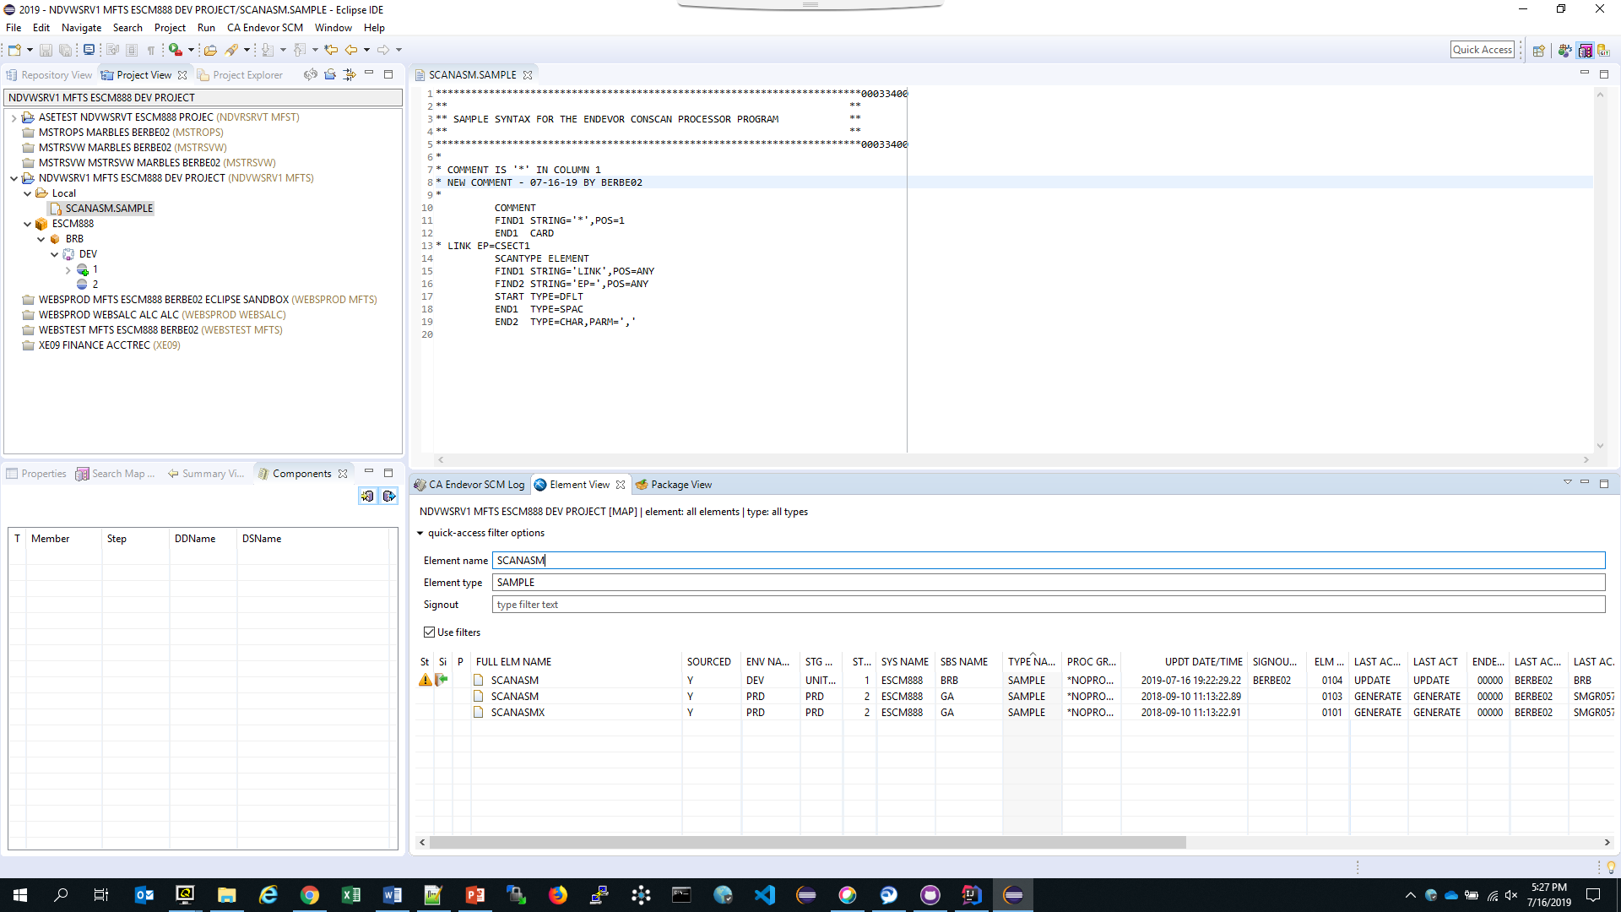
Update element back into Endevor
Element is now in DEV with an updated Version Level (from 0103 to 0104)
Update Element
Notes:
Because CA purchased MANY software products over the years from multiple companies, their methodologies for source management and product delivery were very diverse. All had some pro’s and con’s, but after analysis and demonstrations by the experts, the best part of all the different utilities, tools and techniques were identified and marked for inclusion into the application to be used.

