Slide 1
Symantec Security Information Manager and Symantec Data Loss Prevention
Curtis Carroll
Principal Product Manager Symantec Data Loss Prevention

Slide 2
Agenda
1
What is Security Information Manager?
2
SIM and DLP
Notes:
This is a sample Agenda/Preview slide. This slide is ideal for setting the scene at the beginning of your presentation by providing a big picture overview of what you plan to cover.
To Change Titles in Shapes (i.e.: “Text here”):
Select text. (Optional: Press Delete.) Begin typing desired text.
To Change Font Color/Size:
Select text, right-click and adjust the font setting on the Mini toolbar. Select desired attributes to change: font, size, boldness, color, etc. Note: many of the same commands can also be accessed from the Font group of the Home tab.
To Change a Shape’s Fill Color:
Select the desired object by clicking once on its edge. On the Home tab, click the Shape Fill button within the Drawing group to select a theme color from the Symantec color palette.
To Delete a Shape:
Select the desired object by clicking once on its edge. Press the Delete key on your keyboard.
To Copy a Text Box or Shape:
Select the text box or shape. Note: Make sure to select the entire object, not just the text, by clicking the edge of the text box or shape.
Type Ctrl C (copy), click outside object, then type Ctrl V (paste) to place the object. Click and drag the pasted object to desired location.

Slide 3
Security Management Challenges
Too much data – not enough information
Establishing Priorities - threats and resources
Supporting audit requirements – information requests
Limited IT Resources – increasing demands
Notes:
For years, IT Security has invested in numerous applications, appliances, and devices to address many of the evolving threats that pose risks to their operations.
Unfortunately, these investments yield a tremendous amount of what has become un-actionable data that is too large and complicated to analyze effectively with any manual based effort. The result is a lot of data, but not much in the way of useful information.
As such, most organizations are challenged to establish priority to the events that occur in their environments. This prioritization is both directed at the threats we seek to mitigate as well as the resources we have available to deploy. Equally challenging is maintaining any level of expertise as to what these threats are and what they can do to remediate them. This creates additional problems in establishing priority to remediation activities and managing the effectiveness of resources and the controls that are in place.
And a lot of time is wasted in manual analysis. The lack of being able to measure any level of compliance leads to inconsistent adherence to policies and procedures. And, audit pressures have created a need to disseminate the right information to the right people in a timely manner.
With what seems like limitless demands being placed on very limited and sometimes shrinking IT resources, many organizations are looking for a way to get a head of the curve and do more with less.

Slide 4
What is Security Information Manager?
Broad and customizable
High volume processing
Meaningful normalization
Assured reliability
Flexible capacity
Archive segmentations
Quick queries/searches
Retention Policy Automation
Collection
Storage
Security
Information
Manager
Pattern based rules
Global Intelligence Network integration
Asset groupings
Over 400 out of box queries
Customizable consoles
Web based portals
Raw event data viewer
Over 150 out of the box compliance reports
Correlation
Reporting
Notes:
The core competencies of Symantec’s SIM solution are represented here…
The process of collecting data from a wide variety of sources is critical. SSIM supports that process with out of the box collectors that are customizable, provides high volume and scalable processing of that data which includes meaningful normalization processes that start from the first point of collection. And an infrastructure that maintains operational integrity and assured reliability of the information the process will deliver.
SSIM also allows for storage capacities that are flexible to accommodate both budget and performance requirements. The data is stored in segmented archives in a flat file structure that will deliver quick queries and searches and the ability to automate retention of those archives based on policy.
SSIM’s correlation capabilities are delivered with pattern based rules to minimize the need for rules based development and maintenance in the face of an ever changing threat landscape. With its unique integration with Symantec’s Global Intelligence Network, SSIM offers a collaborative combination of internal events with global threat activities to deliver preemptive visibility to vulnerabilities that have not yet been exploited. SSIM’s correlation process is further supported with asset groupings to assist in segmenting critical activities as they occur and provides over 400 out of the box queries to facilitate quicker access to the critical information you need.
Since information is the ultimate goal, providing access to that information is a top priority. With customizable consoles and web based portal access, SSIM can deliver the right information to the right people via self service capabilities. For forensic needs, SSIM can also provide raw data views of original source data.
And finally, the reporting capabilities within SSIM are available in both in query-based customizable methods as well as via over 150 standardized out of the box reports.
These represent the critical components to delivering a world class log and event management solution.

Slide 5
Security Information Manager From Data to Actionable Intelligence
Security Information Manager
Prioritized
Incidents
Security Information Manager
Prioritization
Alerts
Reports
Remediation
Reduced impact of malicious activities
Quicker remediation with lower cost
Flexible and fast information exchange
Security Information Manager
Aggregation and Correlation
Events
Network Access Control
Firewall
Intrusion Prevention
Multiple Protection
Products
Device and Application
Control
Antivirus
Antispyware
Notes:
So we were just looking at advancing trends of malicious activity. But we know that in addition to the sheer number of malicious events, the complexity of those actions are increasing as well. In response to that, Symantec pioneered, some years ago, the concept of leveraging our end point position to provide a multi-layered protection strategy….<click> which I’ll represent with this…<click>
Now I’m going to use end point protection as my example as to how point solution data can be better leveraged to increase your advantage.
<click> - so without going into a detailed description of our end point solution…which could support its own stand alone session, these individual components or capabilities in our end point protection strategy are what provide you the means to better protect your environment in the face of increasing threat complexity. They each perform a unique function and are part of a collective, central process. And, they are each telling you something very specific about what a particular attack may be leveraging in its attempts to propagate itself.
<click> by providing an aggregation layer to consolidate, normalize, and correlate these different data points, we can <click> facilitate a process of prioritization and treat this as a common object on which we can centrally alert, report, and remediate.
So, <click> what we are doing is taking UNPRIORITIZED EVENTS and turning them into PRIORTIZED INCIDENTS that will <click> reduce the potential impact of these occurrences, allow for quicker remediation…and because the process has given us visibility to the most critical incidents, we increase our efficiency in responding and leverage ways to lower costs. And we also have the ability to work with intelligence that is conclusive and minimized instead of large amounts of raw data so we can be in a position to get critical information to the right stakeholders in a more timely manner.

Slide 6
SSIM + DLP Are Complementary
DLP defines where sensitive data is and can monitor that data
SSIM collects additional details regarding user, network, OS, apps, and even IPs that target sensitive data
DLP can help SSIM understand which of those elements are important by association to sensitive data
SSIM can help conduct comprehensive forensic analysis of a data breach incident
Notes:
DLP is a hot topic with a lot of customers and the key point to remember is that SSIM and DLP need each other. If you start by thinking about what DLP does, so, at a high level, it defines where sensitive data is and can monitor that data…and we know it does a ton more than that, but for the sake of making the point let’s start there.
SSIM obviously collects a very broad variety of other data points around the users, the OS, the applications, etc…that may be implicated around compromising that sensitive data in some way.
But, that DLP data point can be very instrumental in helping SSIM to focus on which of those other data points that are associated to sensitive data events.
And then SSIM can help in situations where a data breach may have occurred and forensic analysis needs to be done around that breach.
So, the point is that both solutions are valuable and can combine to provide very compelling capabilities around managing information around data breach events.

Slide 7
SSIM 4.7 DLP Collector
DLP Collector Features | Description/Benefits
Custom user action | Restricted workflow protects sensitive data
DLP associations with other data points | Expands threat visibility to multiple attack vectors Early detection and improved forensics
DLP-specific Rules | Rule 1: ‘Forbidden Website’ to trigger Policy ‘Forbidden Website’ under Category ‘Endpoint’ Rule 2: ‘Resume, Employee’ to trigger Policy ‘Resumes’ under Category ‘E-mail’ Rules 3: ‘Confidential Proprietary’ to trigger Policy ‘Confidential information’ under Category ‘Confidential’
Queries specific to DLP | Top 10 DLP Action taken in 24 hours Top 15 DLP Events by IP Destination Address within 48 hours Top 15 DLP Events by IP Source Address within 48 hours Top 15 Policies Triggered within 48 hours Top 15 Rules Triggered within 48 hours
Notes:
A few features around this collector are important to cover. First, there is something called a custom user action. This feature allows us to collect data from the DLP product, yet provide a restricted workflow which limits access to the details of that event data to only those who have appropriate access rights….and I’ve got a visual of what that looks like in a second.
The next feature is really just a function of what SSIM does…it makes associations between what data events are concluded by DLP and other events that SSIM concludes based on whatever other collectors are providing data. This enhances SSIM’s visibility to multiple attack vectors and provide our customers with potentially better early detection as well as an improved ability to conduct forensic investigations.
Within SSIM, there are now DLP specific rules that can be triggered by very specialized events such as visiting forbidden websites, sending a resume via email or related to the movement of confidential information.
SSIM also includes specific out of the box queries for a variety of criteria you see listed here.

Slide 8
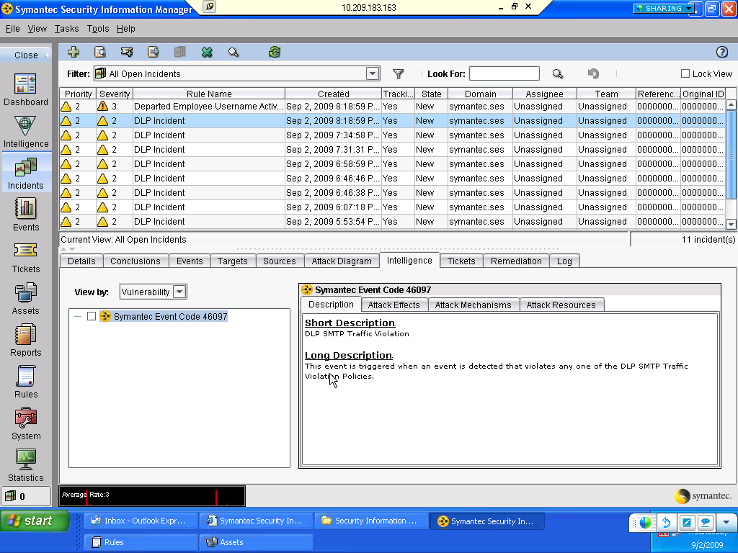
DLP Incidents

Slide 9
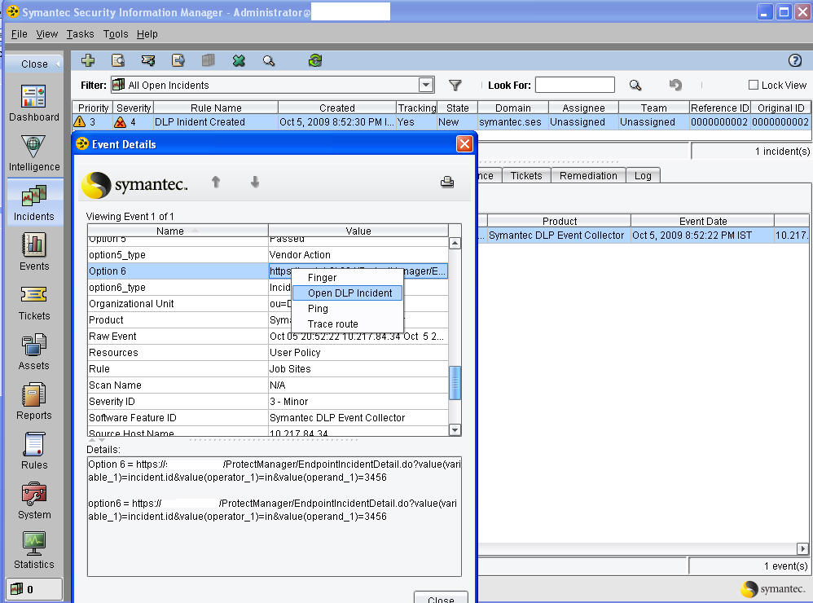
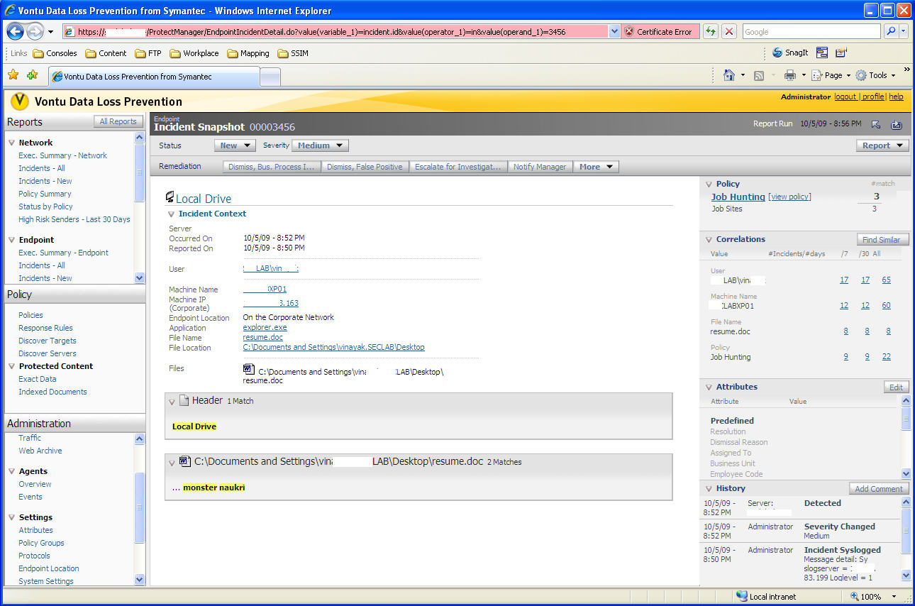
DLP Restricted Workflow
Notes:
A DLP incident is declared in SSIM. If it gets assigned to an incident handler who has access to the DLP information for investigation, with a simple right click on the right field, they can easily pull up the additional information and remediate as necessary.

Slide 10
Questions

Slide 11
Curtis Carroll
Curtis_Carroll@symantec.com
404-435-2758

