Slide 1
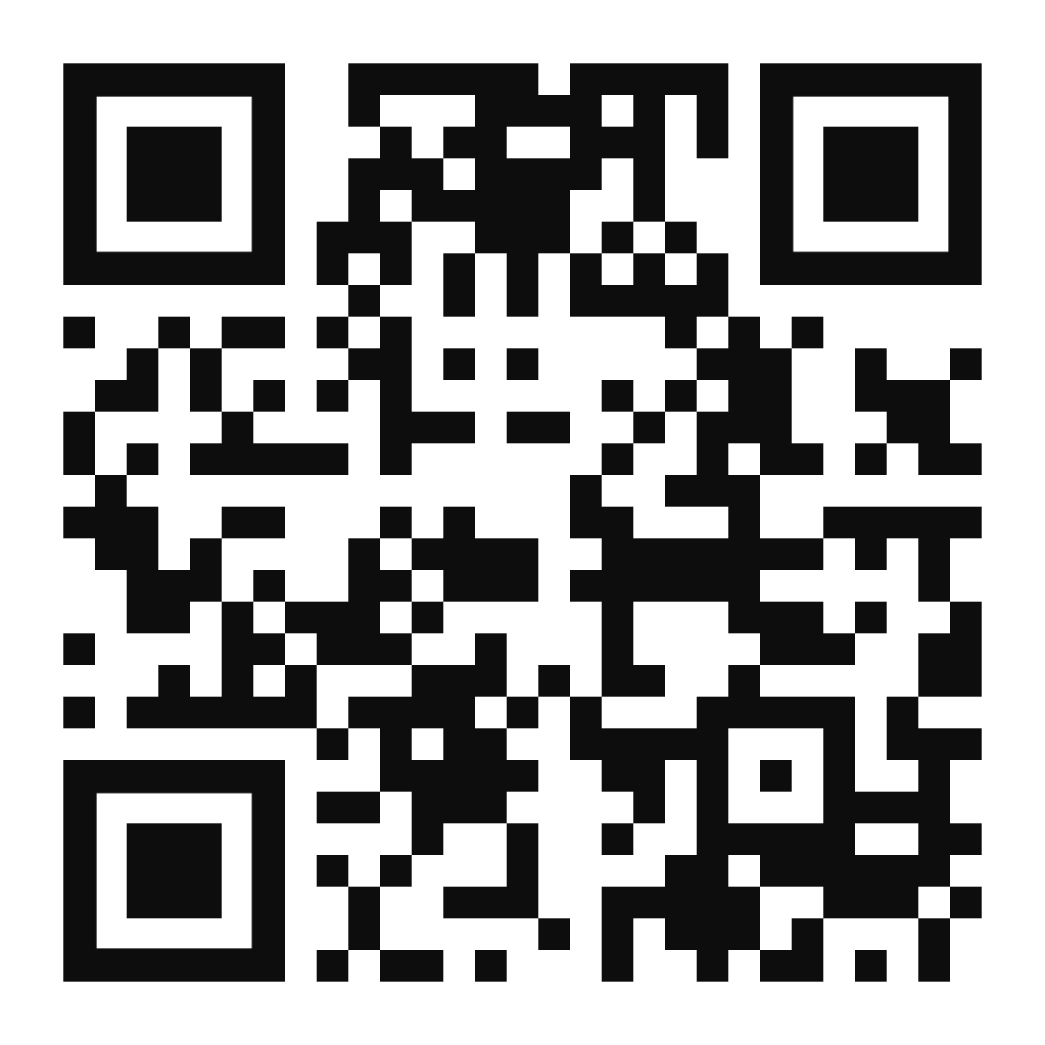
Join Us at SHARE Fort Worth this February!
SHARE Fort Worth is the leading education and networking event for enterprise IT professionals who support the mainframe and applications that run on it.
SHARE features over 300 industry speakers, 500 sessions and 1,400 attendees. This event enables attendees to expand their knowledge, increase efficiencies in their organization and enhance their skills.
Attendees will be able to meet with specialists on products they use, learn about the latest technology solutions and meet face-to-face with product reps.
Register today at event.share.org
SHARE Fort Worth will provide education on key topics:
IBM z15
API Economy
Data Privacy
Analytics, Machine Learning and Cognitive Computing
Cloud Technology in the Enterprise
DevOps
Security
Zowe & Open Source
For information on Broadcom at SHARE
visit
learn.Broadcom.com/SHARE2020

