Slide 1
Server Management Suite: Monitor Solution
Don Platt
Infrastructure Architect

Slide 2
Introduction
Gentiva
Home Health and Hospice
20,000+ Employees
About 2,500 network devices, spread across roughly 350 locations
About 900 servers across 3 locations – 98% Virtualized
Goal of this presentation
Agenda
Platform support
Current “Out of Box” Monitor Policies; Current “Community’ based policies
Agent-Based vs. AgentLess monitoring
Monitor Solution and Monitor Agent architecture
RMS Agent (Monitor Service architecture)
Various views and consoles
Advanced Monitoring

Slide 3
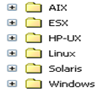
AIX 5.2 | AIX 5.3 | AIX 6.1 |  | HP-UX 11i (PA-RISC) | HP-UX 11i v2 (IA-64) | HP-UX 11i v2 (PA-RISC) | HP-UX 11i v3 (PA-RISC) | HP-UX 11i v3 (IA-64)
Red Hat Enterprise Linux AS 4 | Red Hat Enterprise Linux AS 4 (x84_64) | Red Hat Enterprise Linux ES 4 | Red Hat Enterprise Linux ES 4 (x84_64) | Red Hat Enterprise Linux Server 5 | Red Hat Enterprise Linux Server 5 (x84_64) | Red Hat Enterprise Linux Server 6 | Red Hat Enterprise Linux Server 6 (x84_64) | Red Hat Enterprise Linux 6.1 x86/x64
Solaris 9 (SPARC) | Solaris 10 (SPARC) | Solaris 10 (x86_32) | Solaris 10 (x86_64) | Solaris 10 Update 7
SUSE Linux Enterprise Server 9 | SUSE Linux Enterprise Server 9 (x86_64) | SUSE Linux Enterprise Server 11 SP1 x86/x64 | SUSE Linux Enterprise Server 10 | SUSE Linux Enterprise Server 10 (x86_64) | SUSE Linux Enterprise Server 11 | SUSE Linux Enterprise Server 11 (x86_64)
Vmware ESX Server 3.0 | Vmware ESX Server 3.5
Windows Server 2003 SP2 X86 | Windows Server 2003 SP2 X64 | Windows Server 2003R2SP2 x86/x64 | Windows Server 2008 x86/x64 | Windows Server 2008 R2 x86/x64 | Windows Server 2008 Core x86/x64 | Windows Server 2008 R2 | Windows Server 2008 R2 sp1 | Windows Server 2008 R2 Core

Slide 4
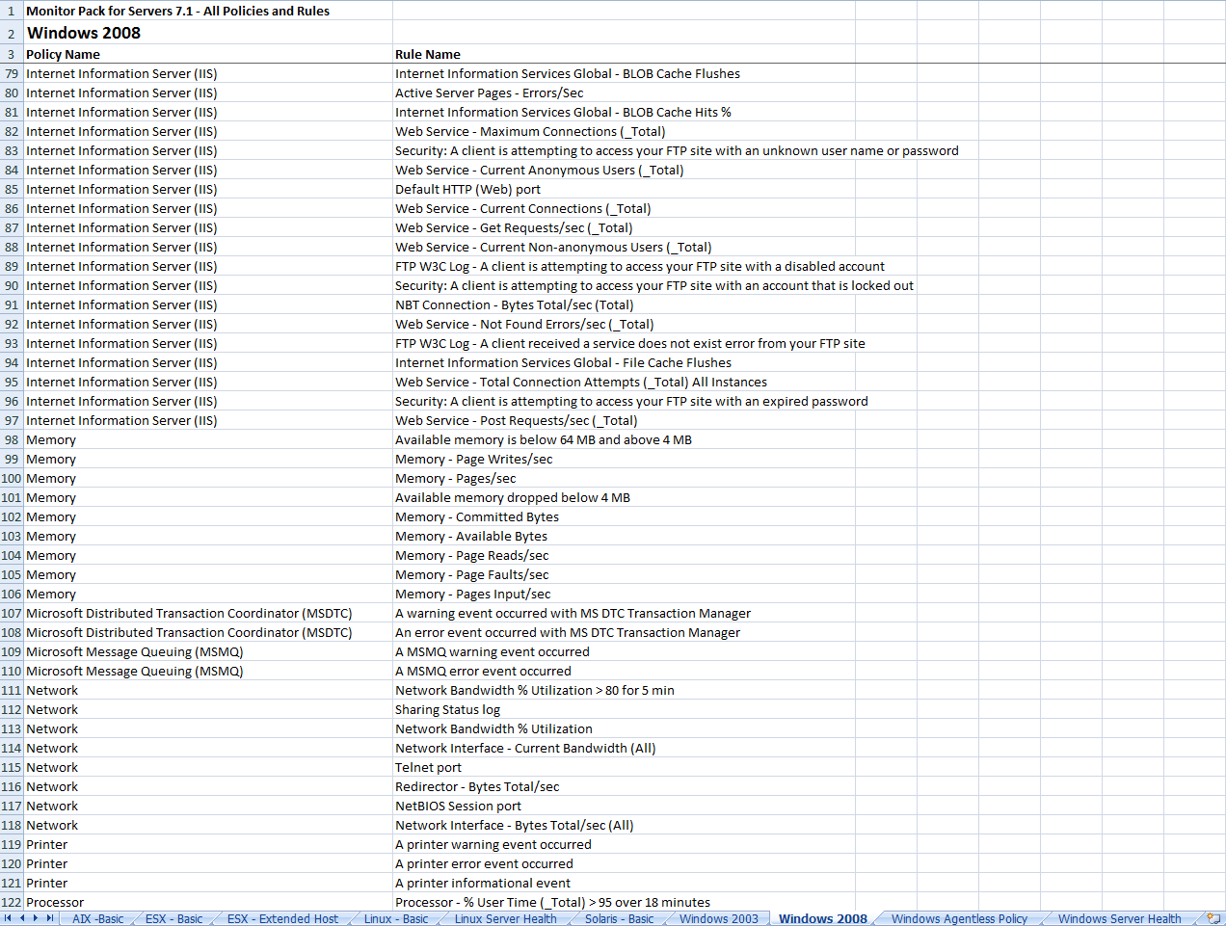
Current “out of box” Monitor Pack Availability

Slide 5
Current “Community” Monitor Pack Availability
http://www.symantec.com/connect/groups/monitor-pack-factor-challenge-altiris-server-management-suite-70
Active Directory additional rules Pack
Altiris Deployment Server Monitor Pack (MS6)
Altiris Server 7 Monitor Pack
Altiris Server 7 Monitor Pack - Basic - Updated July 2009
Altiris XP/Vista Monitor Pack Agentless - Basic
Basic Altiris 7 Package Server Monitor Pack
Basic Symantec Endpoint Protection Monitor Pack
BlackBerry Basic Monitoring Pack
BMC Entuity Monitor Pack
CiscoWorks Monitor Pack
DNS additional rules Pack
EMC Monitor Pack
HDD Monitor Pack - Harddisk Predictive Failure Status using Win32_DiskDrive and S.M.A.R.T. - Windows Only
HP Management Monitor Pack
HP Proliant Windows Agents and Events
Latest Task Status Report
Monitor Pack - Windows Servers Monitor Pack Baseline
Monitor Pack (MS6) - Windows - General System Monitoring
Monitor Pack (MS6) - Windows - Monitor Audit Policy
Monitor Pack (MS6) - Windows - Monitor Computer Account Management
Monitor Pack (MS6) - Windows - Monitor Security Group Account Management
Monitor Pack (MS6) - Windows - Monitor System Crashes
Monitor Pack (MS6) - Windows - Monitor Use of User Rights
Monitor Pack (MS6) - Windows - Monitor User Account Management
Monitor Pack (MS6) - Windows - Monitoring System Proccesses
Monitor Pack (MS7) - Windows - General System Monitoring
Monitor Pack (MS7) - Windows - Monitor Account Management
Monitor Pack (MS7) - Windows - Monitor Audit Policy
Monitor Pack (MS7) - Windows - Monitor Use of User Rights
Monitor Pack (MS7) - Windows - Monitoring System Proccesses
Monitor Pack for Altiris Agent Service Status (Agentless)
Monitor Pack for Biztalk
Monitor Pack for Domino - Basic Services
Monitor Pack for HP-UX Basic
Monitor Pack for Meridio DM Web Service
Monitor Pack for SEP Agent Windows Service Status (Agentless)
Monitor Pack for ZetaFax
Monitor Pack SAV for NAS
Monitor Packs (MS6) - Windows - Monitor Uptime and Reboots
Monitor Solution data not reported within 'N' hours Report
MS 7 - Monitor Pack for SQL - Updated June 2009
MS 7 - Monitor Pack for SQL (2005/2008) - Updated July 2009
MS Exchange Monitor Pack Basic
MS Exchange Monitor Pack Updated Sept 2009
MS SharePoint Monitor Pack
MS7 - Monitor Pack for SQL - Basic
MS7 - Monitor Pack for SQL - Basic
Oracle Pack for Oracle 10G on Windows
Recovery Solution Monitor Pack
SEP Client on Server Monitor Pack (MS6)
Site Server Monitor Pack - Task Services
Symantec Monitor Pack for Enterprise Vault
Symantec NetbackUp Monitor Pack
Symantec pcAnywhere Monitor Pack
Windows Monitor Pack - Memory (MS6)
Windows Workstation Monitor Pack (Agent-based) Fault Alerts Only includes SEP Client and PCA Monitor Pack

Slide 6
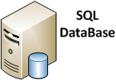
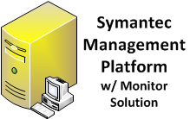
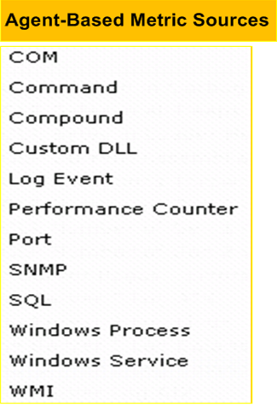
Agent-Based monitoring

Slide 7
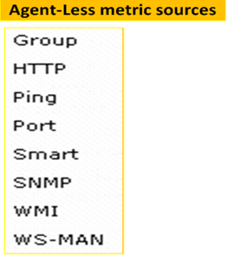
Agent-Less monitoring
Boston
RMS Agent
at Site Boston
Notes:
Group – Aggregates metrics from multiple target hosts.

Slide 8
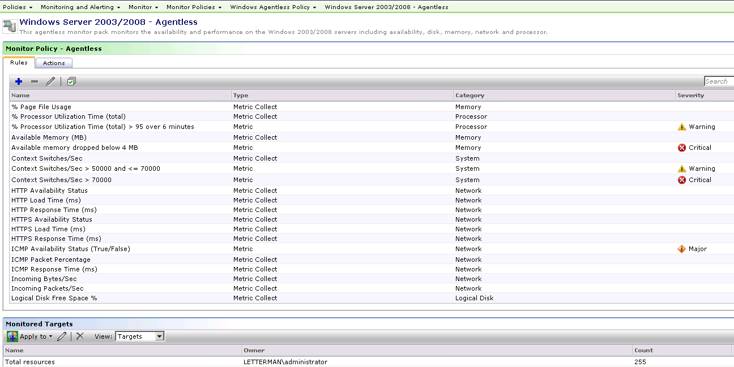
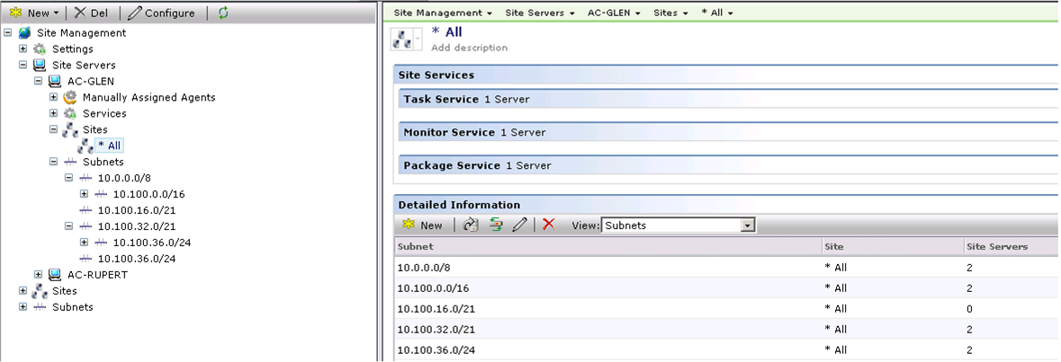
Which resources will each RMS Agent monitor?
Installation of the RMS Agent (Monitor Service) on a system will qualify that system as a Site Server. The resources that RMS Agent will actively monitor are based on 2 mutually inclusive items: 1) The Resources defined in the Target associated with an Agentless Policy. The Target definition computer membership should represent ALL resources monitored collectively by all RMS Agent systems. 2) The resources assigned to that Site Server via the Subnet >Site >Site Server association.
***The commonality of resources between any Target definition associated with an Agentless policy and the assigned resources to a Site Service running the RMS Agent (Monitor Service) defines the resources that will be polled by that RMS Agent.***

Slide 9
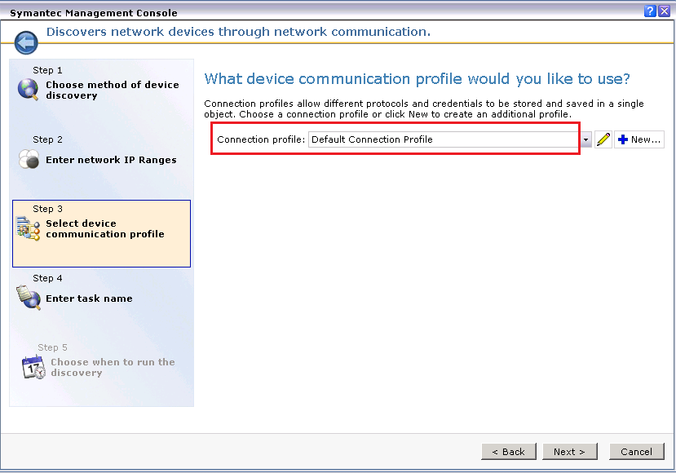
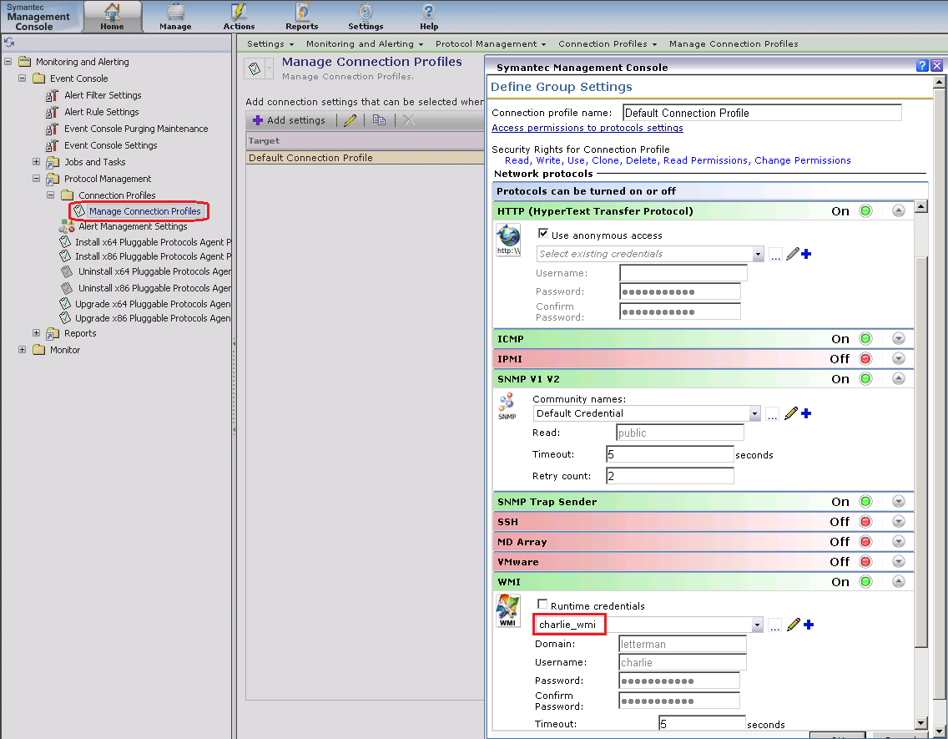
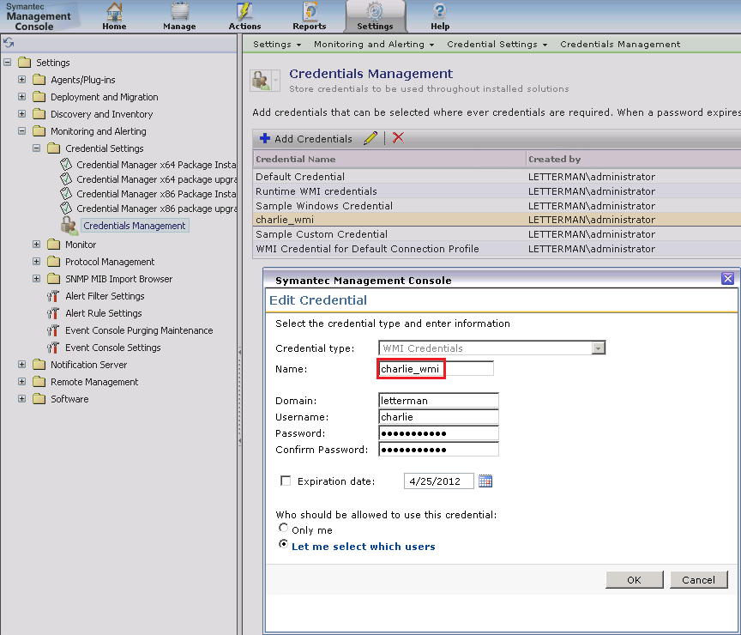
RMS Agent architecture and Dependencies
Network Discovery
Connection Profile
Credential Manager

Slide 10
Maintaining Connection Profile Assignments
update Inv_Altris_Common_ProtocolMask
Set ConnectionProfileGuid = '2B0710CA-4154-4229-9BE9-2A8A9F56386A'
WHERE _ResourceGuid IN (
SELECT distinct id._ResourceGuid [Guid]
FROM Inv_Altris_Common_ProtocolMask p
JOIN Inv_AeX_AC_Identification id
ON p.[_ResourceGuid] = id.[_ResourceGuid]
JOIN Item i
ON p.[ConnectionProfileGuid] = i.[Guid]
JOIN vComputer vc
ON p.[_ResourceGuid] = vc.guid
WHERE
vc.[OS Name] LIKE '%Windows%'
AND (vc.domain = 'OHC' or vc.domain = 'GENTIVA' or vc.domain = 'FHCC' or vc.domain = 'OLSTENHS' or vc.domain = 'ODSYHEALTH' or vc.domain = 'OLSTEN'
or vc.domain = 'gentiva.ghsnet.com' or vc.domain = 'HEALTHFIELD' or vc.domain = 'GHSNET'))

Slide 11
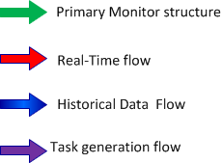
Monitor Agent architectural flow
Monitor Pack
Port 1011
Policy
Reports
Rule
SQL
Historical Performance Viewer
METRIC aexmetricprov.exe
Task Handler
SMP w\Monitor
Solution
Config.xml
Task
NS Event Handler
BLOB Event Handler
NSE
NSE
BLOB
NSE

Slide 12
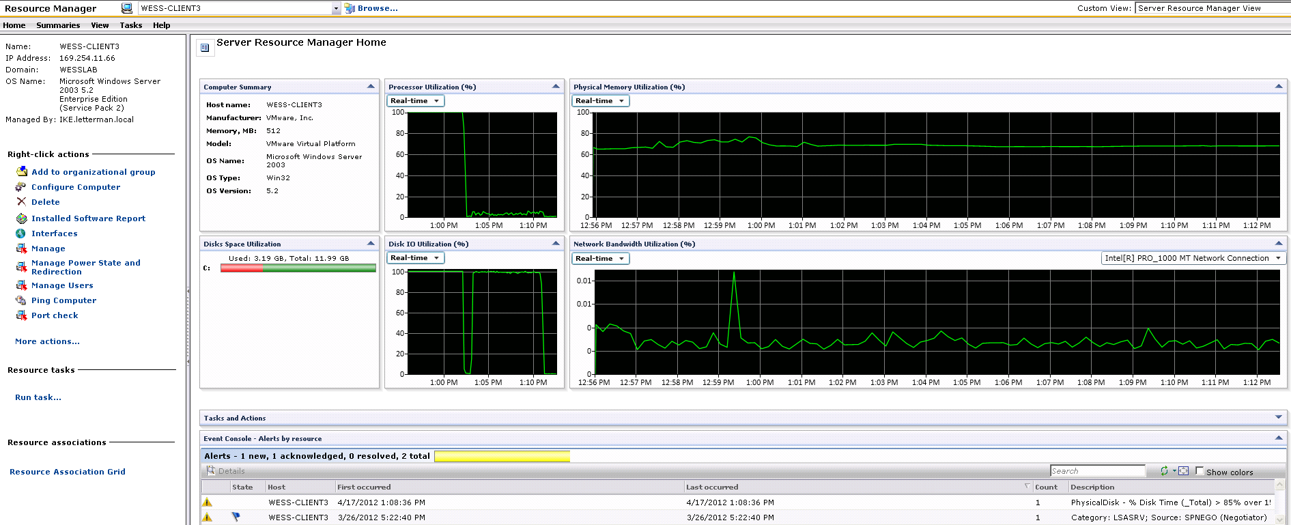
Monitor Solution and Server Management Suite
Server Object Resource Home View

Slide 13
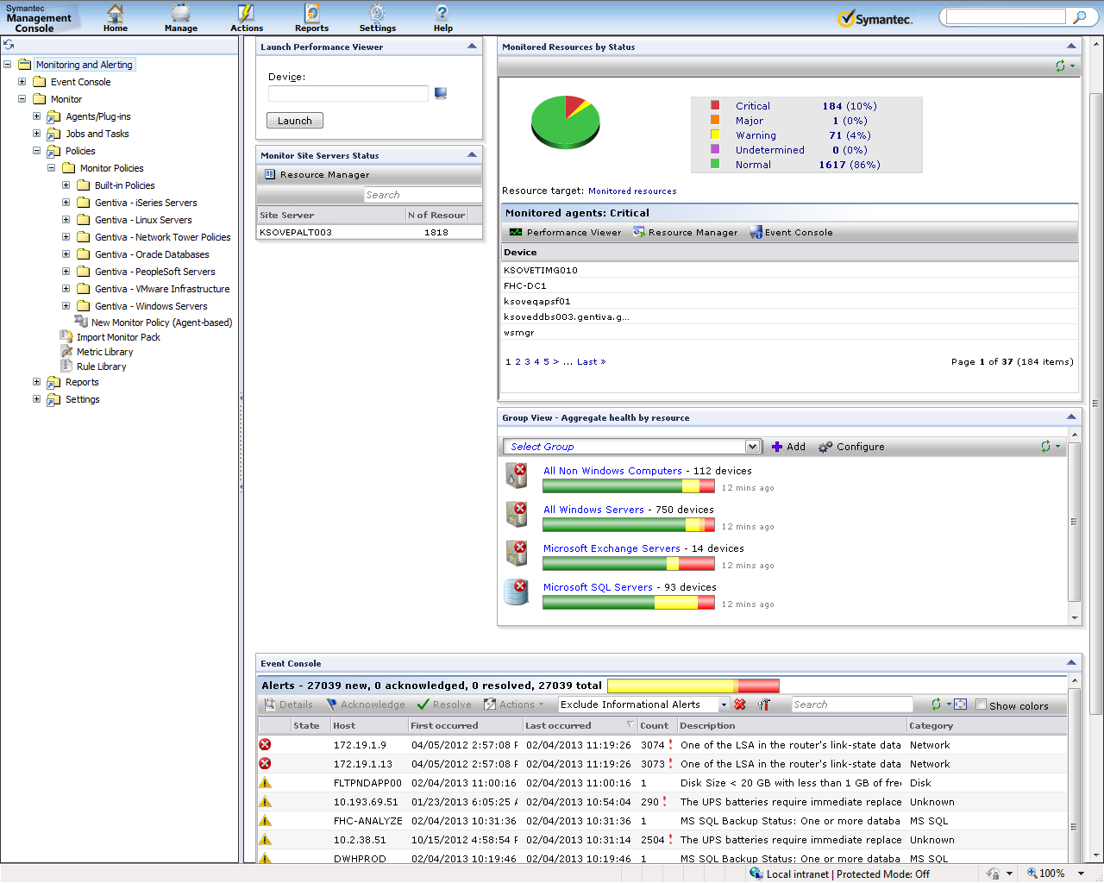

Slide 14
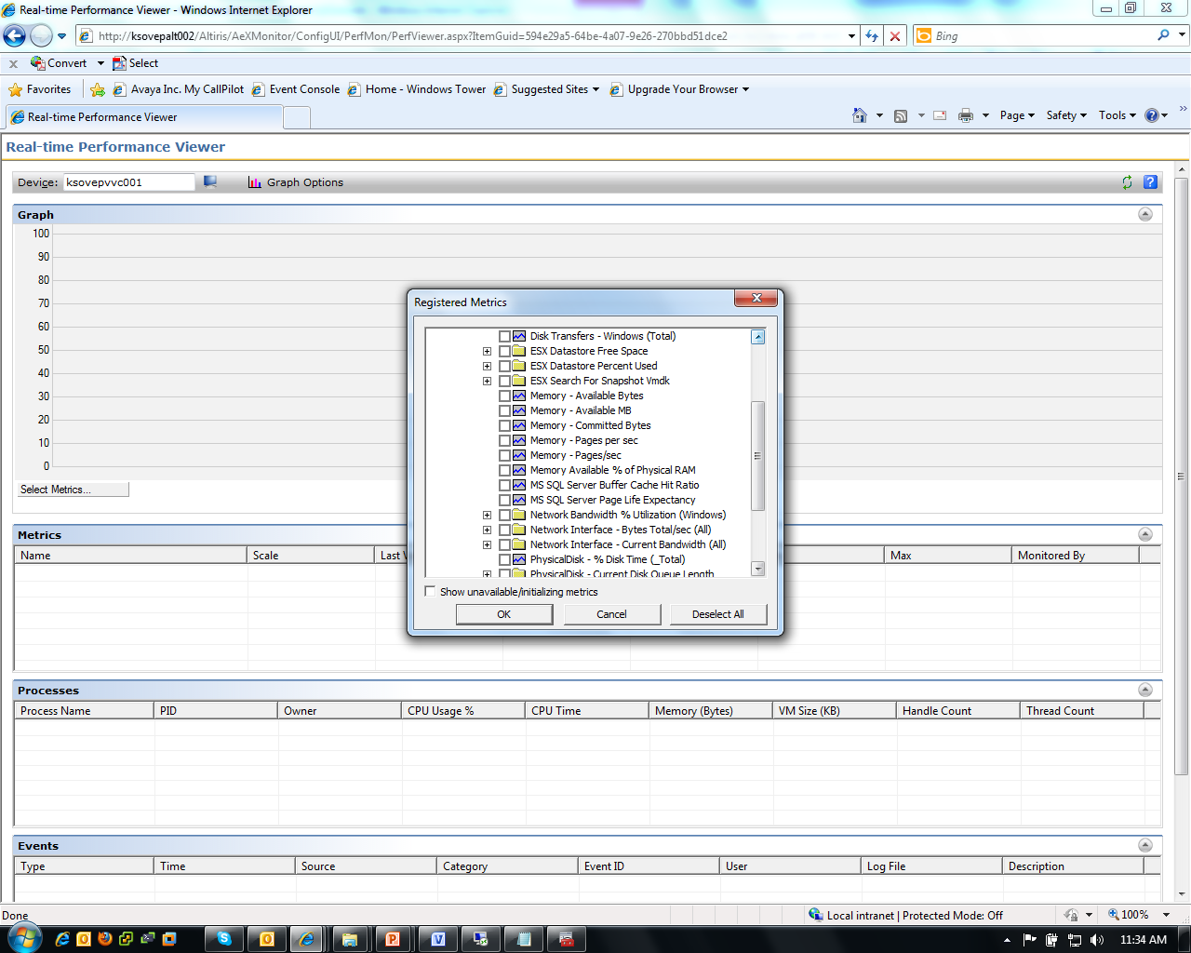

Slide 15
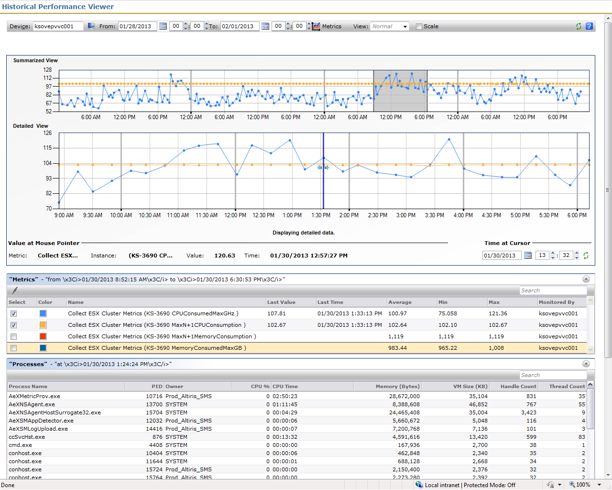

Slide 16
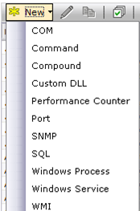
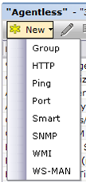
Construction of a Policy
Apply to hosts
Policy
Rule – i.e. CPU > 95% over the past 30 minutes
Metric – i.e. Processor - % Processor Time (_Total)

Slide 17
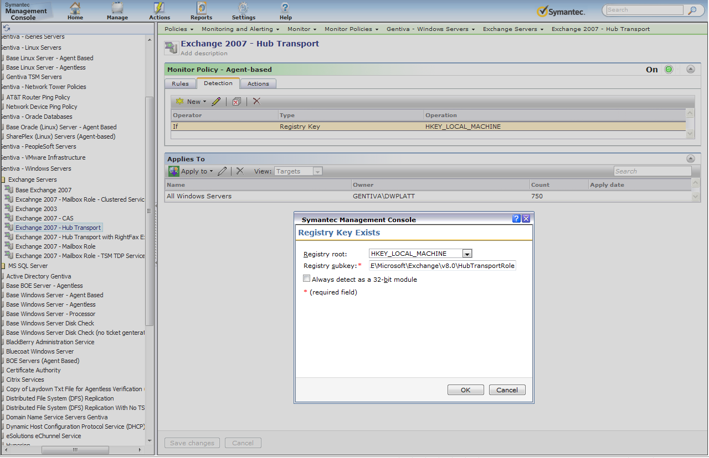

Slide 18
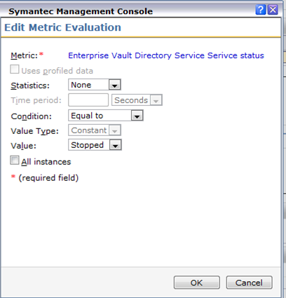
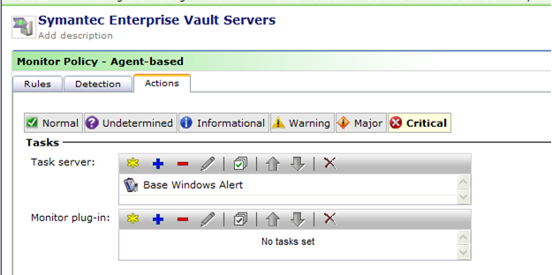

Slide 19
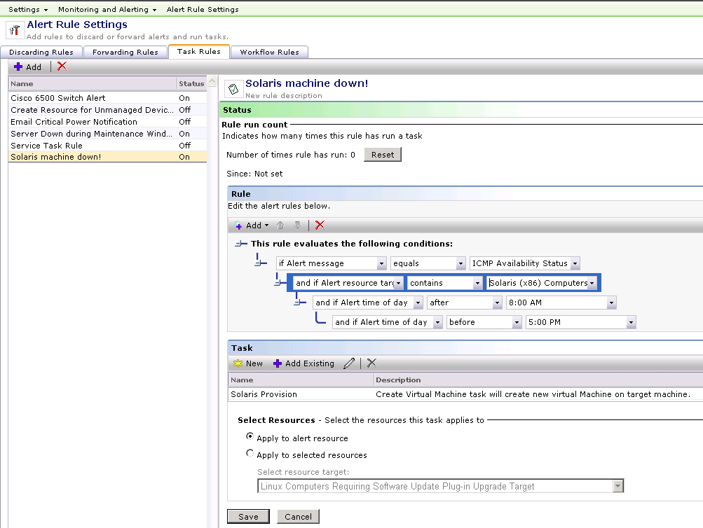
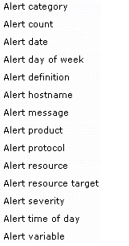
Management of Alerts using the Event Console
Discard Rule – defines (based on Event Console Alert Rule) what alerts should be “filtered out’ or prevented from appearing in the Event Console
Forwarding Rule – defines which alerts will be formatted into an SNMP Trap and sent to a defined upstream SNMP Management station.
Task Rule – defines task association based on a specific alert criteria (Event Console Alert Rule)
Workflow Rule – defines workflow association based on a specific alert criteria (Event Console Alert Rule)

Slide 20
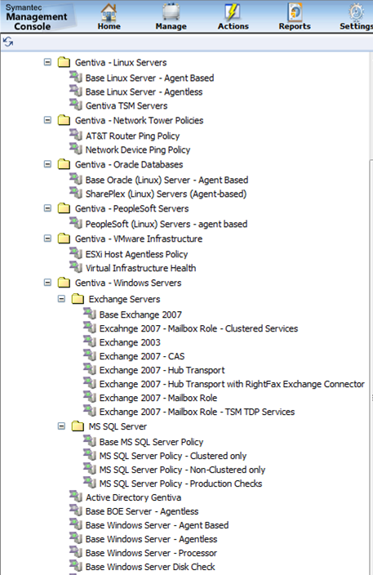

Slide 21
Notable Items
Network Device Policy
Asset Management
Event Correlation
VMware
Datastores – Percent provisioned, actual provisioned, orphaned snapshots
Cluster metrics for N+1 status
Host connection status
DFS Backlogs
Journal Mailbox
Ticket generation
RightFax Queues
Agentless verification
Disk info in tickets

Slide 22
Thank you!
Don Platt
Infrastructure Architect

